Slide 1
Team hungary
Our town and school

Slide 2
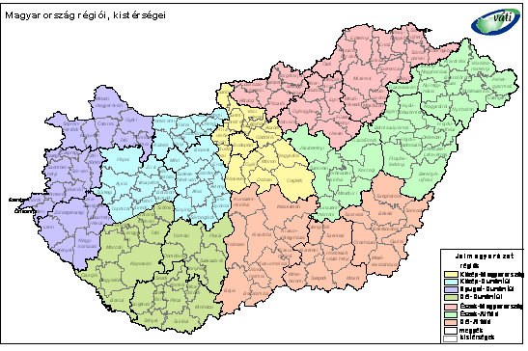
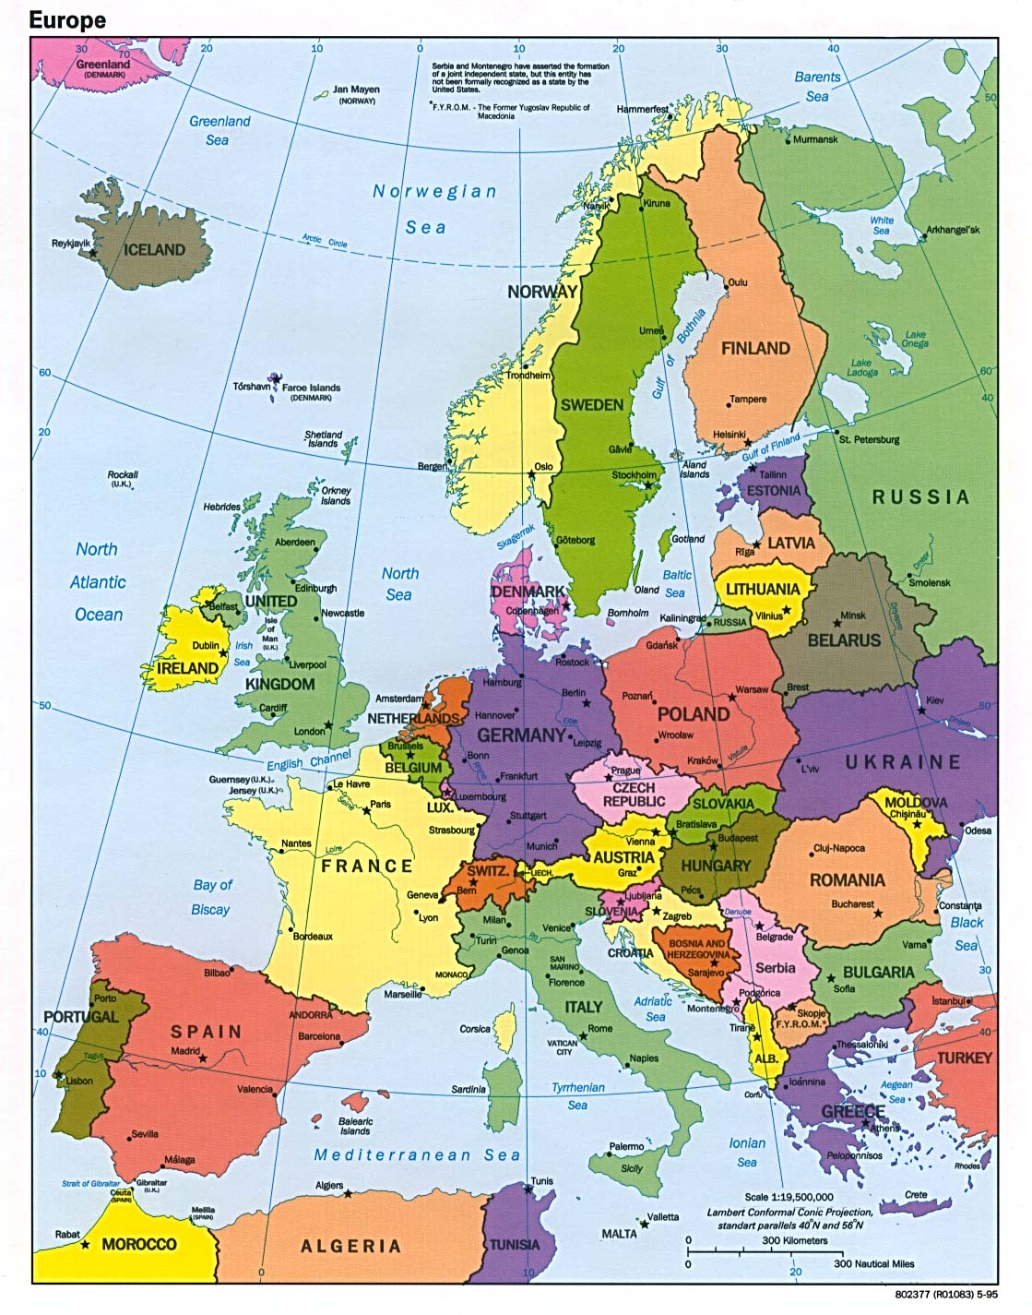

Slide 3
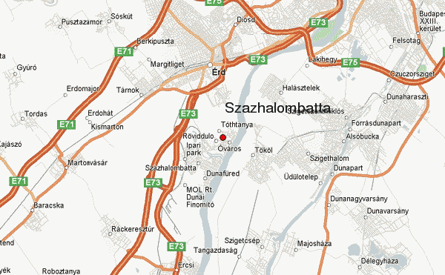
Hungary’s area: 93 030 km²
Population: almost 10 million
Százhalombatta’s area: 28,06 km²
Population: 18 226

Slide 4
Some interesting fact
The area was inhabited since the Bronze age
It is 27 kms away from Budapest
It is a sport town with several swimming pools , a Sport Centre and many different sport clubs
We have churhes from different religions
Two big festival each year: Summerfest and Battai Napok
Industrial town -> MOL Nyrt. , oil refinary and a power station
On the main square we have a statue of our first king, Stephen the First
The town is next to the Danube, Hungary’s longest river, we also have an artificial lake

Slide 5
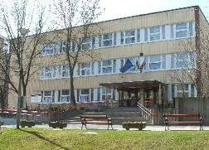
Schools
6 schools in the town
3 primary, 1 secondary and vocational school, 1 primary and secondary school
Arany János Primary and Secondary school százhalombatta
Around 870 students and 80 teachers
Children can study in primary school from age 6 to 14 (8 years), later in the secondary school
Two secondary classes:
Biology and Mathematics/IT classes: Here students have more lessons in these subjects
Language classes: in the first year (9th grade) they have 18 English lessons, dance and drama lessons; they concentrate on English and the second foreign language

Slide 6
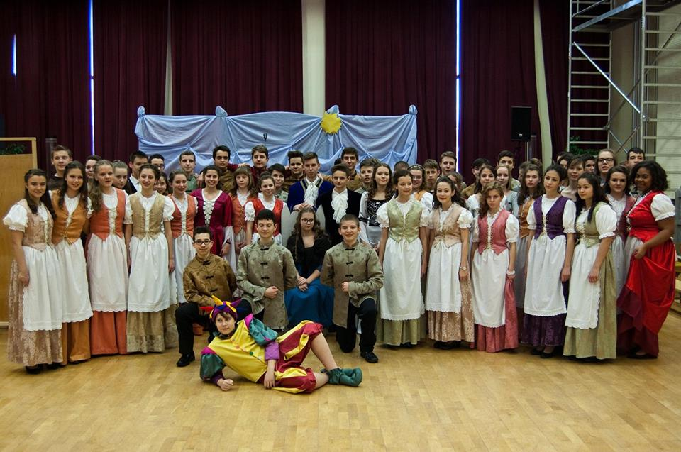
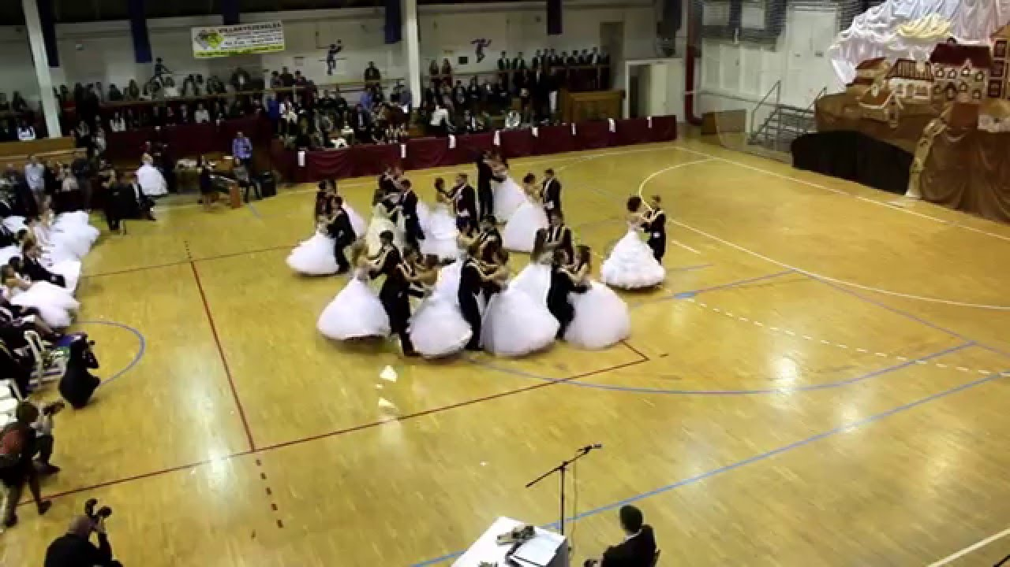
Our schools teaches English from 1st grade, in secondary school students have to study a second language, that can be: German, Italian or French
The schools is an eco-friendly and bird friendly school
Students with special needs also study here, like kids with autism
Some schools event:
The Carnival in February, where the students dress up in costumes
The prom: senior students dance waltz
We celebrate the eponymous of our school with a week full of competitions and fun

Slide 7
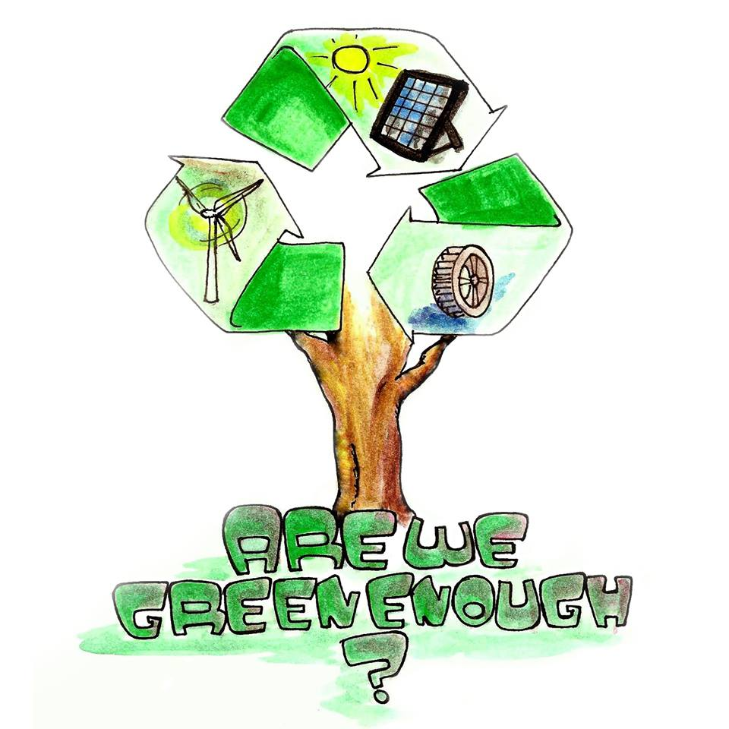
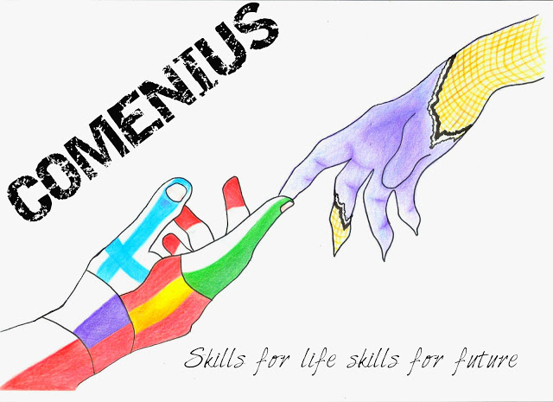
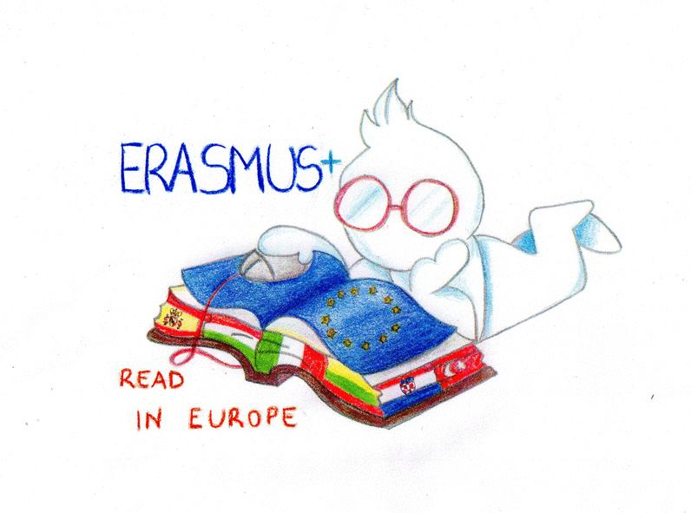
international projects
Comenius projects
Are we green enough? (finished)
Skills for life, skills for future (finished)
Erasmus projects
Y.E.S for Future, Your Entreprenurial Skills (ongoing)
READ in Europe (ongoing)

Slide 8
Thank you for your attention!
#teamhungary

