Slide 1
Spanish Day 2019

Slide 2
Quiz

Slide 3
What is the Spanish name for Spain?
España
Spain
Spanola

Slide 4
What is the name of this famous Spanish football player?

Slide 5
Fernando Torres
Fernando Alonso
Kylian Mbappe

Slide 6
What is the capital of Spain?
Barcelona
Madrid
Paris

Slide 7
Complete this phrase from Terminator “Hasta la -----, baby”
Siesta
Mister
Vista

Slide 8
What is the name of this Famous Spaniad?

Slide 9
Pablo Picasso
Rafael Nadal
Roger Federer

Slide 10
What is the name of the Spanish meal which is made of rice, fish, meat and seafood?
Fajitas
Lasagne
Paella

Slide 11
In the list of the most widely spoken languages in the world, where does Spanish rank?
5th
3rd
1st

Slide 12
What is a ‘siesta’?
A dance
A festival
An afternoon nap

Slide 13
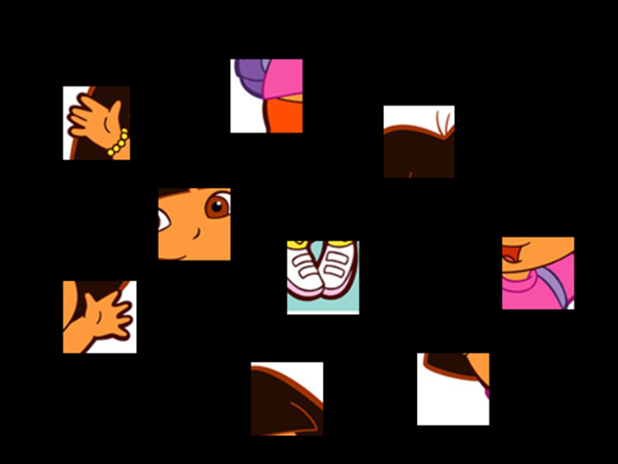
What is the name of this famous Spanish speaking character?

Slide 14
Dora
Velma
Lilo

Slide 15
How many people live in Spain?
9 million
26 million
46 million

Slide 16
What is the name of the Spanish King?
King Juan Carlos I
King Alfonso
King George V

Slide 17
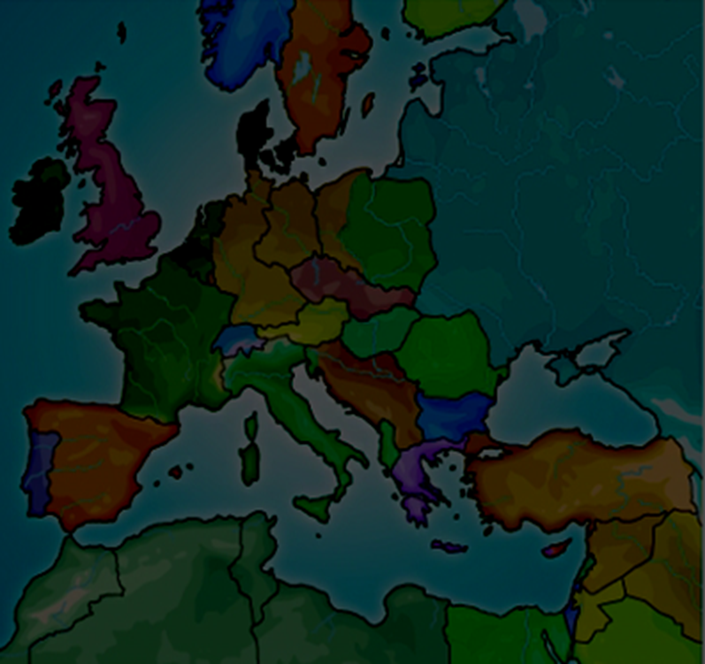
Which two countries border Spain?
Portugal and France
Great Britain and Italy
Italy and France

Slide 18
How many official languages are spoken in Spain?
1
3
4

Slide 19
How do you say hello in spanish?
Muchas gracias
bonjour
hola

Slide 20
Which male star sang the Spanish language song ‘Despacito’?
Chris Brown
Justin Bieber
Justin Timberlake

Slide 21
The End

Slide 22
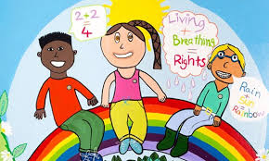
Why are we having a Spanish day?

Slide 23
“One Class-Total Inclusion”

Slide 24
The project seeks to:
1. share good practice, with focus on additional learning needs and inclusion
2. provide cultural experiences for pupils
3. promote new experiences, regardless of social background or learning ability
4. forge new links with European schools
5. develop better understanding of responding to well-being needs

Slide 25
Lots of you have already done some great work with Mrs Sanders on this topic and the activities you will do today are also part of it.
But 18 lucky Pupils will get even more involved with the project!

Slide 26
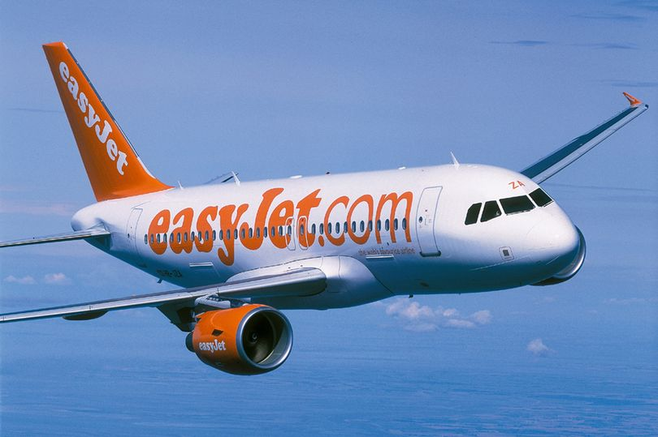

Slide 30
How to be one of the lucky 18!
Write a letter of interest
Or
2) Create a recorded presentation
Closing date - 25th Nov

Slide 31
Make sure you say:
- why you want to be involved in the project
- what would make you a good person to go on the project

Slide 32
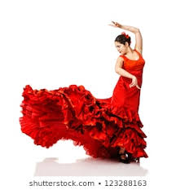
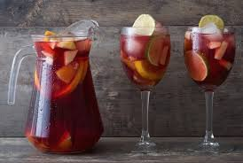
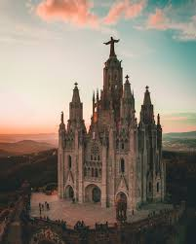
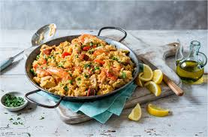
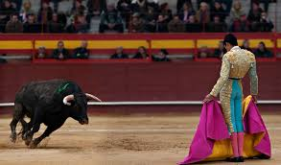
Have a great day and good luck!

