Slide 1
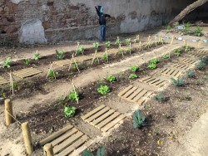
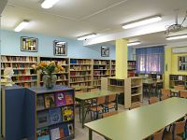
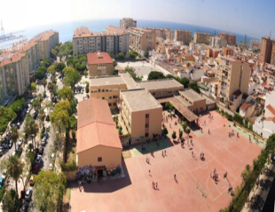
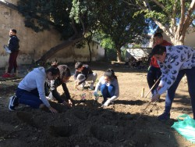
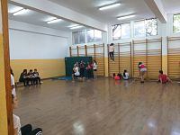
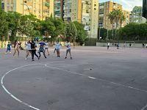
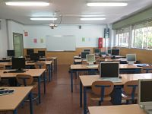
School Garden
Library
Welcome to I.E.S Huelin
Tomás Echeverría 2, Málaga 29004 951298494 http://ieshuelin.com/huelinwp/
29011539.edu@juntadeandalucia.es
Gym
Playground
TIC Room

Slide 2
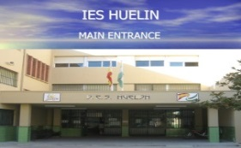
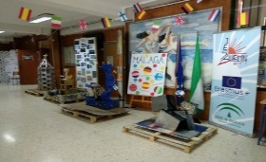
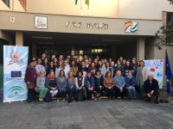
Our School
European projects
School day
Monday-Friday 08:30-15:00
6 lessons of 60 min per day +30 min break
Subjects
. Maths
. Spanish
· English
· Biology and Geology
· Music
· French
· Geography and History
· Technology
· ICT
· Physical Education
· Art
· Religion
· Philosophy
· Physics and Chemistry
Number of teachers: approx. 67
Number of students: approx. 830 with more than 30 nationalities
We have been doing European projects for many years with countries such as:
. Finland . Italy . Spain . Germany . Poland . Croatia . United Kingdom . Greece
Other projects
. English CLIL . ICT . Fit Youth
. Space of Peace School . Entrepreneurship
School Hall

