Slide 1
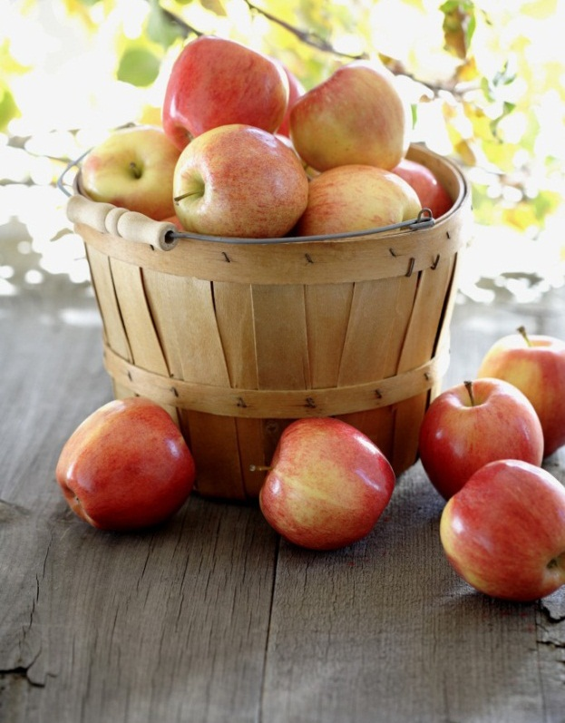
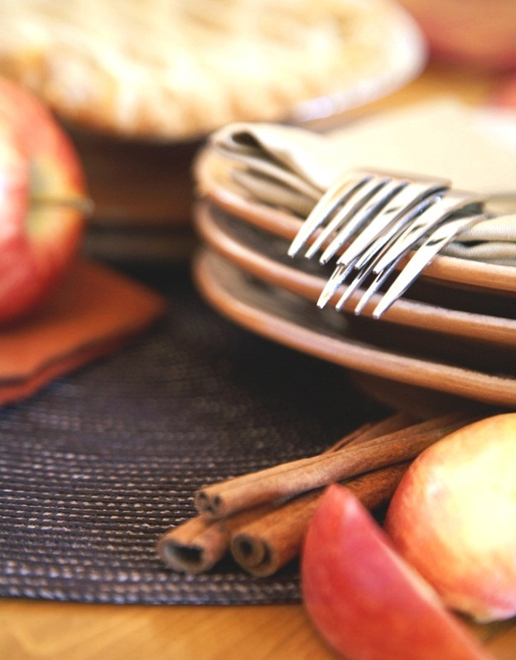
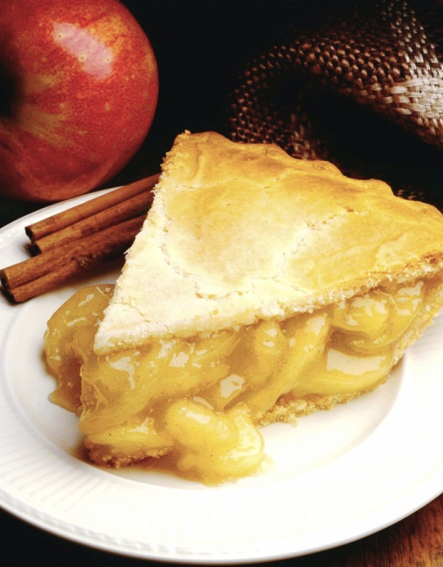
A quiz about food and drink
From class 5d
Ochtrup
Germany
Notes:
HINWEIS: Wenn Sie ein Bild ersetzen möchten, wählen Sie es einfach aus und löschen es dann. Verwenden Sie dann das Symbol "Bild einfügen", um es durch ein eigenes Bild zu ersetzen.

Slide 2
It's a hot and alcoholic drink. It is drunk in winter on Christmas market. The colour is red.
A) Glühwein
B) Rotwein
C) Weißwein
D) Bier

Slide 3
It's a dessert. It's made with vanilla pudding, chocolate chips and rum. It's typical for the Westphalian region.
A) Schokopudding
B) Wackelpudding
C) Herrencreme
D) Zitronenpudding

Slide 4
It's a green vegetable. It's often eaten in winter. It's served with potatoes and smoked sausages.
A) Spinat
B) Salat
C) Rotkohl
D) Grünkohl

Slide 5
It's a special cake in Germany. In this cake are cherries. It's starts with a German region.
A) Apfelkuchen
B) Sachertorte
C) Schwarzwälder Kirschtorte
D) Schokokuchen

Slide 6
It's a popular, alcoholic drink in Germany. The coulor is golden. On the top of the drink is white foam.
A) Apfelsaft
B) Wein
C) Bier
D) Tee

Slide 7
It's a classic dish of fried veal or pork. It' covered with a mushroom cream sauce. The name starts with the German word for hunter.
A) Schweinebraten
B) Jägerschnitzel
C) Kassler
D) Lamm

Slide 8
It's with curry. The name starts with curry. It's a special sausage.
A) Bratwurst
B) Currywurst
C) Hotdog
D) Hamburger

