Slide 1
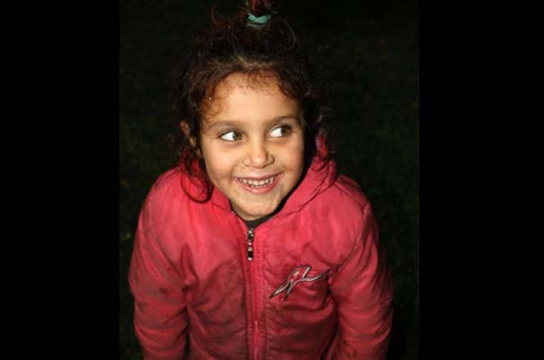
THE STORY OF THE GIRL IN RED COAT

Slide 2
I think everybody knows the tale of the red riding hood. But this time, unlike a tale I will tell a real story.

Slide 3
Her name is Suad. And she is only 5 years old. She escaped from Gallopi to Istanbul in 2014.

Slide 4
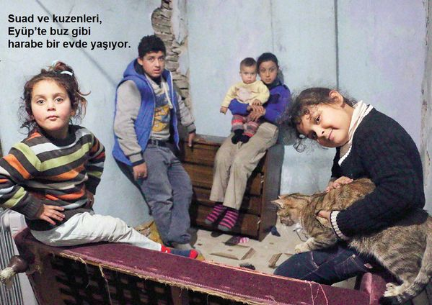
Her father was killed in Syria. Now she lives with her mother, one-year old brother and her cousins.

Slide 5
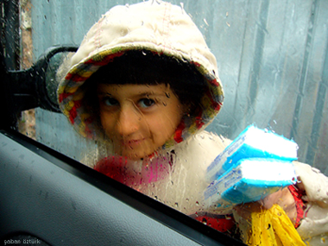
She knows a few Turkish. Unlike the other five-year old children, she have to work and earn money. She sells tissue on the street.

Slide 6
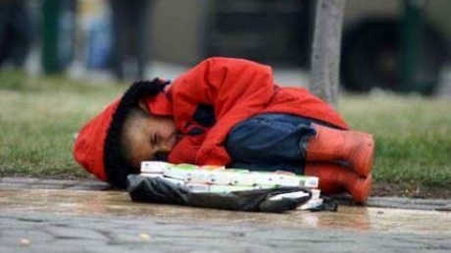
I asked how much money can she earn? She answered; ‘ I must wake up at 4 a.m. o’clock. And I go out to sell them. I could sell 7 or 9 in a day. So I only earn 9 Liras. Is it enough for you? ‘ No. But we must work to pay the renting. Otherwise where can 14 people stay?’

Slide 7
When she doesn’t work, she plays with her brother. She says; ‘ I am happy. Beacuse my brother didn’t see the war. And my father’s murder.’

Slide 8
Everybody recognized her firstly with this Photo.

Slide 9
What were you doing there? I was only sleeping. Beacuse ı woke up very early. Don’t you sleep? ( Smiling) I answered: Yes, I do when I need. ( not on the street, in a bed) I whispered myself.

Slide 10
Do you want to go to school? ‘Yes, I want. I am going to be a lawyer. Maybe ı could help other children like me. Actually I go to refugee school once a week. I like painting. I draw old days, old friends. Would you like to see it?

Slide 11
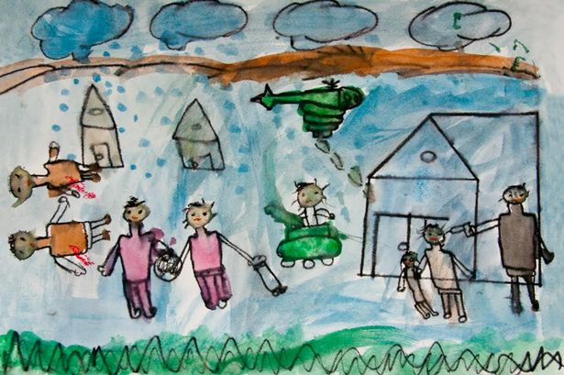

Slide 12
‘They were my friends. While playing in the park, a plane came and bombed everywhere. I lost all of them.’ she explained. I hope future will be better for her. But after that everbody must answer this question.

Slide 13
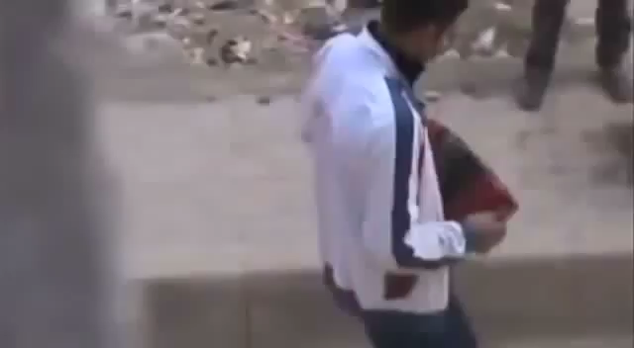
WHO İS QUİLTY?

