Slide 1
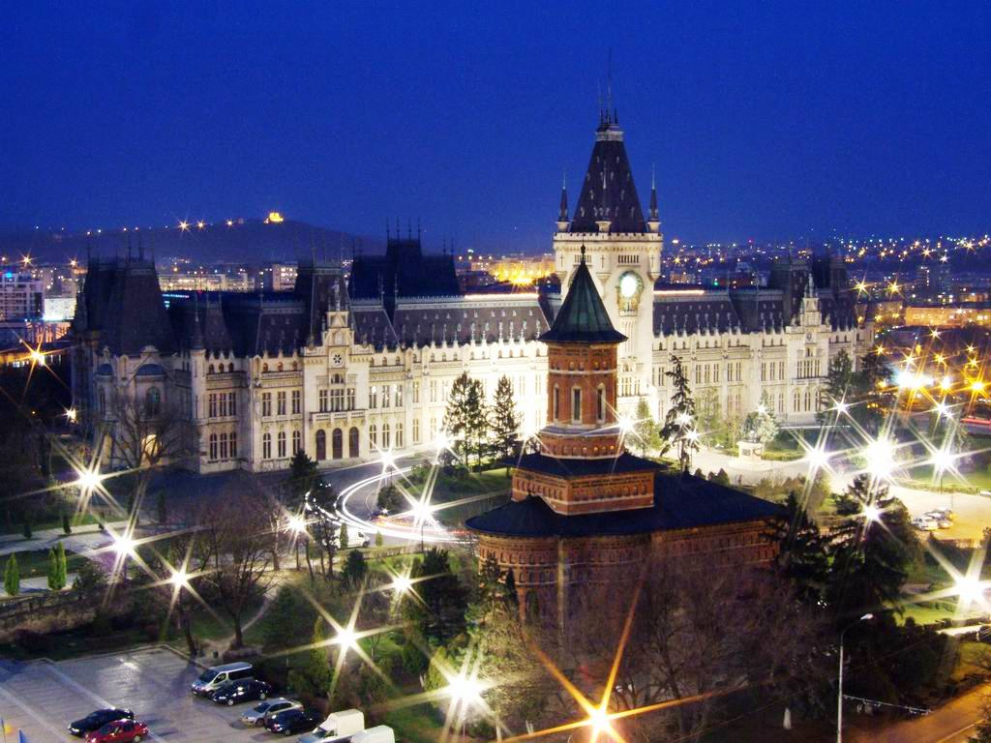
Romania

Slide 2
Location and surface
The value for Surface area (sq. km) in Romania was 238,400 as of 2018.
Romania is situated in the southeastern part of Central Europe and shares borders with Hungary to the northwest, Serbia to the southwest, Bulgaria to the south, the Black Sea to the southeast, Ukraine to the east and to the north and the Republic of Moldova to the east. Roughly the size of Oregon, Romania is the second largest country in the area, after Poland.

Slide 3
Geographical and population
Located halfway between the Equator and the North Pole, Romania is the 12th largest country in Europe.
Romania's terrain is almost evenly divided between mountains, hills and plains.
he current population of Romania is 19,294,465 as of Saturday, January 18, 2020, based on Worldometer elaboration of the latest United Nations data.
Romania 2020 population is estimated at 19,237,691 people at mid year according to UN data.
Romania population is equivalent to 0.25% of the total world population.

Slide 4
The climate
Owing to its distance from open sea and position on the southeastern portion of the European continent, Romania has a climate that is temperate and continental, with four distinct seasons. The average annual temperature is 11 °C (52 °F) in the south and 8 °C (46 °F) in the north. In summer, average maximum temperatures in Bucharest rise to 28 °C (82 °F), and temperatures over 35 °C (95 °F) are fairly common in the lower-lying areas of the country. In winter, the average maximum temperature is below 2 °C (36 °F).Precipitation is average, with over 750 mm (30 in) per year only on the highest western mountains, while around Bucharest it drops to approximately 570 mm (22 in).:29 There are some regional differences: in western sections, such as Banat, the climate is milder and has some Mediterranean influences.

Slide 5
Language
The official language is Romanian, a Romance language (the most widely spoken of the Eastern Romance branch), which presents a consistent degree of similarity to Aromanian, Megleno-Romanian, and Istro-Romanian, but equally shares many features with the rest of the Western Romance languages, specifically Italian, French, Spanish, Portuguese, and Catalan. The Romanian alphabet contains the same 26 letters of the standard Latin alphabet, as well as five additional ones (namely 'ă','â','î','ț', and 'ș'), totaling 31.

Slide 6
and religion Currency
The leu is the money that is used in Romania. The smaller kind of money used is the ban, or bani(plural). 100 bani make up a leu.
Romania is a secular state, and it has no state religion. Romania is one of the most religious countries in the European Union and a majority of the country's citizens are Christian.

Slide 7
Ancient Romania
The earliest inhabitants of Romania were stone age hunters who lived about 8,000 BC. In time the people of Romania learned to farm and then they learned to make bronze tools. Eventually they learned to use iron. From about 600 BC the ancient Greeks traded with the people they called Getae. They founded settlements on the coast of Romania.

Slide 8
The monuments
The National Register of Historic Monuments In Romania, these include sites, buildings, structures, and objects considered worthy of preservation due to the importance of their Romanian cultural heritage. The list, created in 2004, contains places that have been designated by the Ministry of Culture and National Patrimony of Romania and are maintained by the Romanian National Institute of Historical Monuments, as being of national historic significance.

Slide 9
National Museum of Art of Romania
The National Museum of Art of Romania (Romanian: Muzeul Național de Artă al României) is located in the Royal Palace in Revolution Square, central Bucharest. It features collections of medieval and modern Romanian art, as well as the international collection assembled by the Romanian royal family.
The exhibition "Shadows and Light" ran from 15 July to 2 October 2005. With four centuries of French art, it was the largest exhibition of French painting in Central and Eastern Europe since 1945. 77 works were exhibited, including masterpieces by painters such as Poussin, Chardin, Ingres, David, Delacroix, Corot, Cézanne, Matisse, Picasso, and Braque

Slide 10
Romanian dress
Romanian dress refers to the traditional clothing worn by Romanians, who live primarily in Romania and Moldova, with smaller communities in Ukraine and Serbia. Today, the vast majority of Romanians wear modern style dress on most occasions, and the garments described here largely fell out of use during the 20th century. However, they can still be seen in more remote areas, on special occasions, and at ethnographic and folk events. Each historical region has its own specific variety of costume.

Slide 11
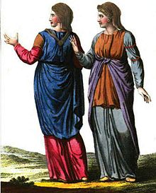
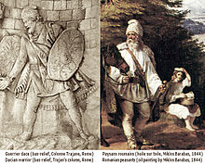
Romanian dress

Slide 12
Traditional music
Traditional Romanian music reflects a confluence of sounds similar to Central European (especially Hungarian) as well as Balkan traditional music. In Romanian folk music, emphasis is on melody rather than percussion, with frequent use of the violin for melody and often only the cimbalom for percussion. The melody itself and especially the melodic embellishments are reminiscent of music from further south in the Balkans and of a distant Turkish influence.

Slide 13
The most popular food in Romania
Traditional Romanian dishes heavily feature meat but also usually include vegetables or fruits. Cabbage rolls (called sarmale), stuffed with spiced pork and rice, are so traditional they are regarded as the national dish of Romania and are a favorite main dish.

Slide 14
The celebrities
Angela Gheorghiu. ...
George Enescu (1881-1955) ...
Radu Lupu. ...
Gheorghe Zamfir. ...
Constantin Brancusi (1876-1956) ...
Alexandra Nechita. ...
Nadia Comaneci. ...
Simona Halep.

Slide 15
source
Food and Agriculture Organization, electronic files and web site.
Worldometer (www.Worldometers.info)Elaboration of data by United Nations, Department of Economic and Social Affairs, Population Division. World Population Prospects: The 2019 Revision. (Medium-fertility variant).
Wikipedia.

