Slide 1
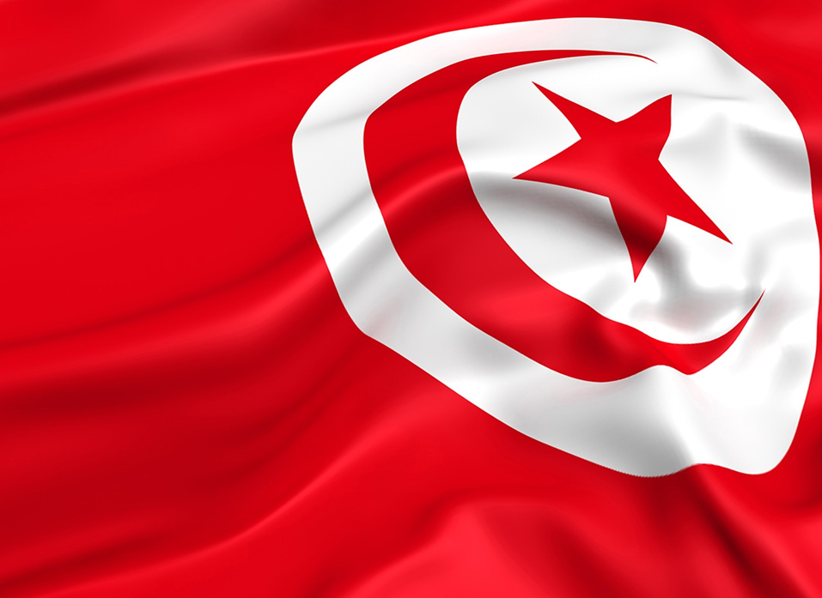
Presentation made by Romanian Students (Tudor Delia, Radu Robert, Strulia Alexandra, Balea Andrei, Mihalache Denis, Dinca Gabriel)
TUNISIA

Slide 2
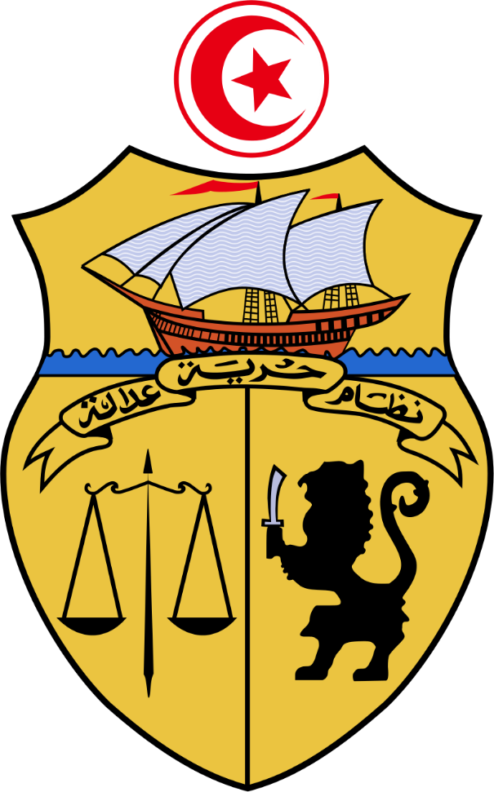
Tunisia, officially the Republic of Tunisia, is a country in the of North Africa, covering 163,610 square kilometres . Cape Angela, the highest point in all the country, is also the highest point on the African continent. Tunisia is bordered by Algeria to the west and southwest, Libya to the southeast, and the Mediterranean Sea to the north and east. Tunisia's population was 11.5 million in 2017. Tunisia's name is derived from its capital city, Tunis, which is located on its northeast coast.

Slide 3
Population of Tunisia
In Tunisia, the Arab people are predominant : Arab 98%, European 1%, Jewish and other 1%.
According to the 1956 Tunisian census, Tunisia had a population at the time of 3,783,000 residents, of which mainly Berbers and Arabs. The proportion of speakers of Berber dialects was at 2% of the population . According to another source the population of Arabs is estimated to be <40% to 98%, and that of Berbers at 1% to over 60%.

Slide 4
Brief History
Modern Tunisians are the descendants of indigenous Berbers and of people from numerous civilizations that have invaded, migrated to, and been assimilated into the population over the millennia. Recorded history in Tunisia begins with the arrival of Phoenicians, who founded Carthage and other North African settlements in the 8th century B.C. Carthage became a major sea power, clashing with Rome for control of the Mediterranean until it was defeated and captured by the Romans in 146 B.C.
Muslim Conquest
The Romans ruled and settled in North Africa until the 5th century, when the Roman Empire fell and Tunisia was invaded by European tribes, including the Vandals. The Muslim conquest in the 7th century transformed Tunisia and the make-up of its population, with subsequent waves of migration from around the Arab and Ottoman world, including significant numbers of Spanish Muslims and Jews at the end of the 15th century.
From Arab Center to French Protectorate
Tunisia became a center of Arab culture and learning and was assimilated into the Turkish Ottoman Empire in the 16th century. It was a French protectorate from 1881 until independence in 1956 and retains close political, economic, and cultural ties with France.

Slide 5
Brief History
Independence for Tunisia
Tunisia's independence from France in 1956 ended the protectorate established in 1881. President Habib Ali Bourguiba, who had been the leader of the independence movement, declared Tunisia a republic in 1957, ending the nominal rule of the Ottoman Beys. In June 1959, Tunisia adopted a constitution modeled on the French system, which established the basic outline of the highly centralized presidential system that continues today.
A Strong and Healthy Beginning
Starting from independence, President Bourguiba placed a strong emphasis on economic and social development, especially education, the status of women, and the creation of jobs, policies that continued under Zine El Abidine Ben Ali's administration. The result was strong social progress and generally steady economic growth. These pragmatic policies have contributed to social and political stability.

Slide 6
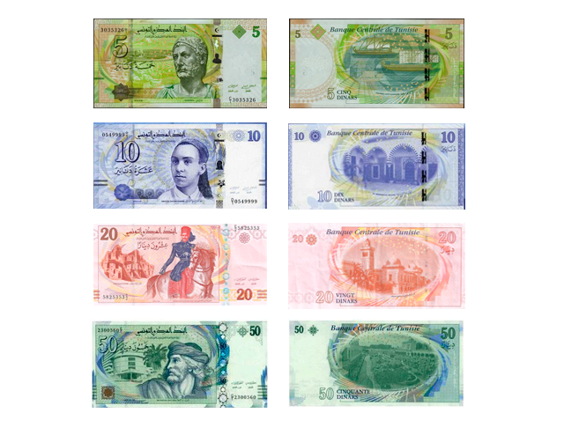
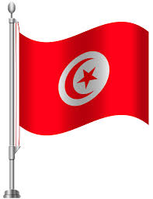
Flag and Currency
The flag is red and has a white circle in the middle which contains a red moon and star.
An interpretation is that the "red Beylical flag spread light throughout the Muslim world". The white symbolizes peace, the disk symbolizes the radiance of the nation as the sun, while the crescent and five-pointed star represent unity of all Muslims and the Five Pillars of Islam
Tunisian Dinar is the official currency.
1 DT = 0.32 EURO

Slide 7
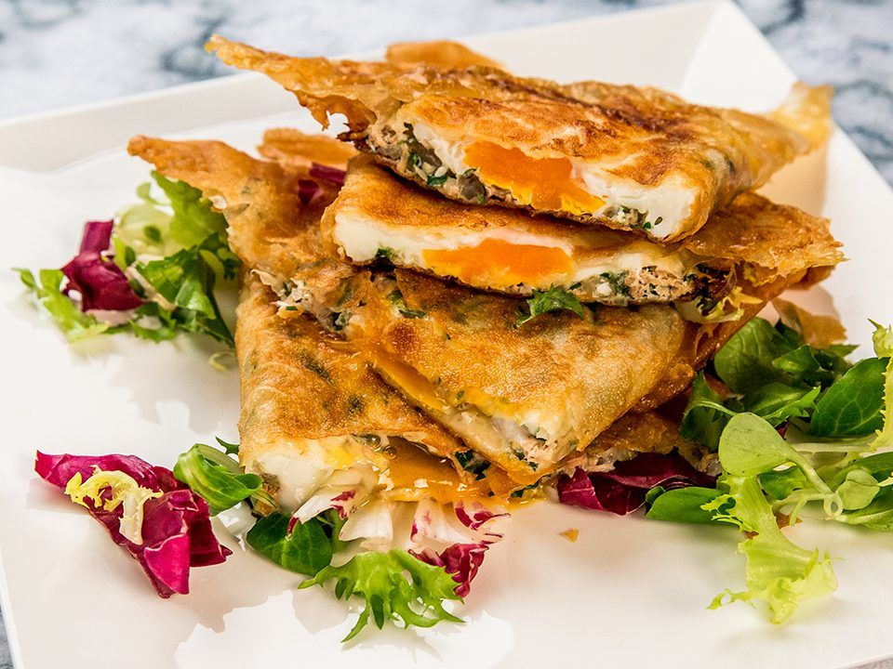
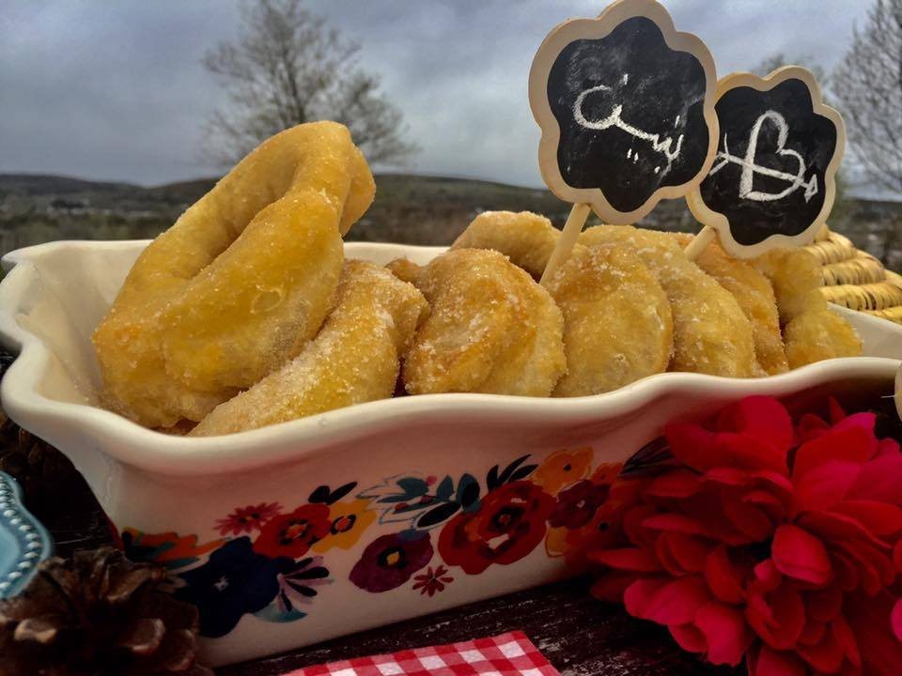
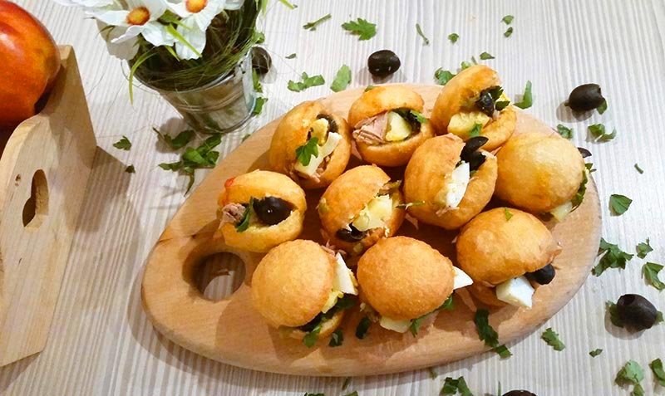
Typical Dishes
Brik = It is a delicate pastry dough called Malsouka, which is fried and stuffed with egg, parsley and tuna. It is served with lemon
Bambalouni = It is a round-shaped flour dough fried in oil and sprinkled with sugar or honey.
Fricassé = It is a savoury fried doughnut filled with tuna, boiled egg, olives, harissa, and boiled potato.

Slide 8
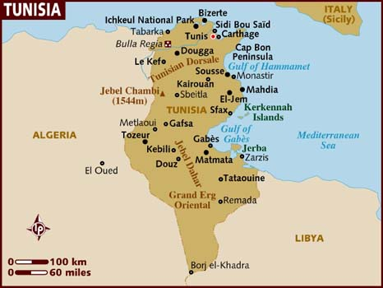
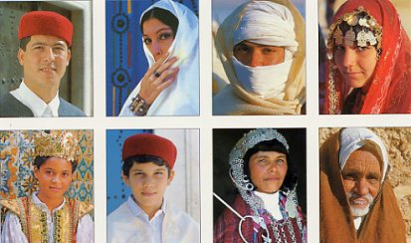
Culture of Tunisia
Tunisian culture is a product of more than three thousand years of history and an important multi-ethnic influx. Ancient Tunisia was a major civilization crossing through history, different cultures, civilizations and multiple successive dynasties contributed to the culture of the country over centuries with a varying degrees of influence. Among these cultures were the Carthaginian – their native civilization, Roman, Vandal, Jewish, Christian, Arab, Islamic, Turkish, and French, in addition to native Amazigh. This unique mixture of cultures made Tunisia, with its strategic geographical location in the Mediterranean, the core of some great civilizations of Mare Nostrum.

Slide 9
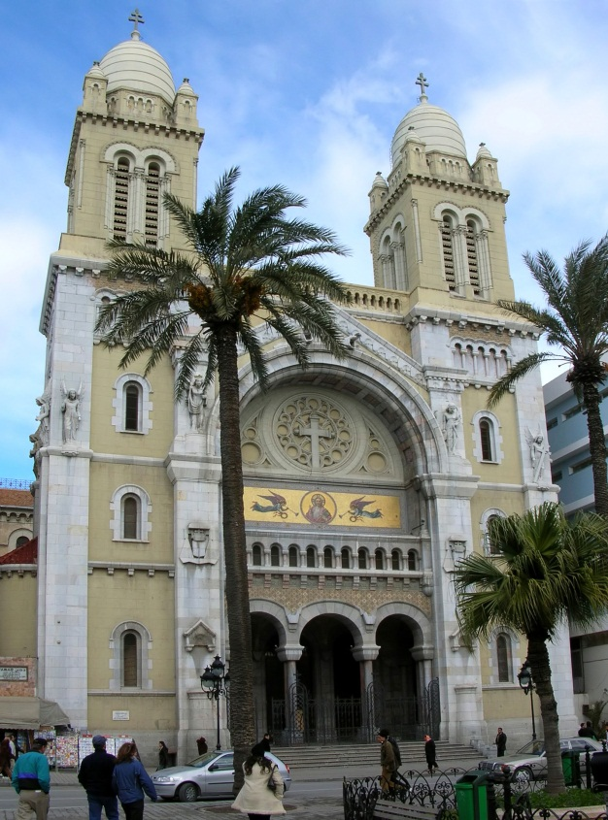
Religion
The Tunisian Constitution provides freedom of thoughts and beliefs, as well as the free exercise of religion, as long as it does not affect public order.
The government generally respects this right but do not allow the establishment of political parties based on religion.
Islam is the main official religion of Tunisia with a rate of around 70% of the population. 99% of Tunisians are Sunni Muslims of the Maliki rite, the rest being attached to the Hanafi cult.
There is also a small community of Muslim Sufis but there are no statistics regarding its size. The country is also dotted with small white mausoleums scattered in rural and urban areas and called marabouts. These tombs of saints, often male, are usually housed in places such as caves, hills, springs or points on the coast.

Slide 10
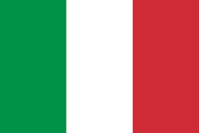
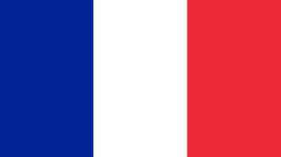
Language
Tunisia is homogeneous in terms of language, since nearly all of the population masters French and Arabic (the state Official language) and speaks Tunisian Arabic which is the mother-tongue of almost all Tunisians. Tunisian Arabic is actually a dialect – or more accurately a set of dialects, for which there is no official body of standards. It is established on a berber and punic substratum, influenced by the languages of the people that lived or administered the region, during the course of history, including: Arabic, Turkish, Italian, Spanish and French. Tunisian Arabic is not understood by most Arab speaking countries as it does derive from a mixture of a few languages.
Tunisian is spoken mostly in the context of a daily dialogue between Tunisians and within the family

Slide 11
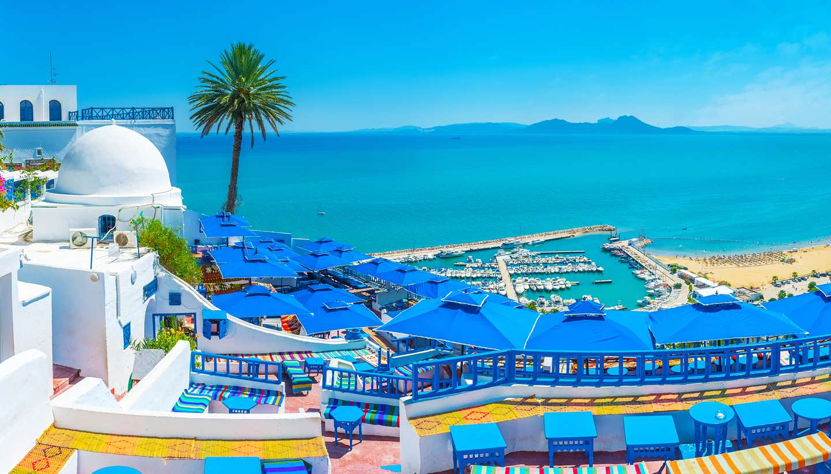
Monuments, museums, ruins
Some might visit Tunisia for its beach and general culture, but there is no doubt that history plays a massive part in the country’s tourism industry

Slide 12
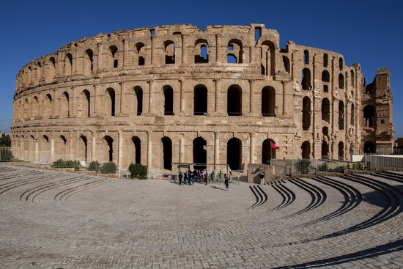
EL Jem Amphitheatre
The amphitheatre was constructed by Emperor Gordian at same point between 230 and 238 AD.
It could have held up to 60,000 people, it is 162m long by 118 m wide.

Slide 13
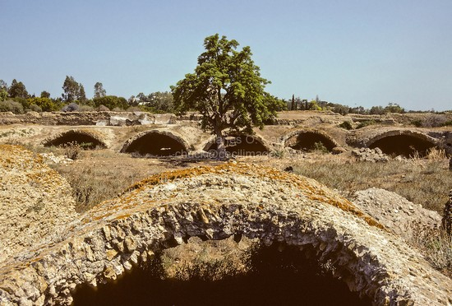
La Malga Cisterns
While La Malga Cisterns don’t hold anything like the reputation that the amphitheatre has, they are still a very interesting attraction for anyone who visits Carthage.
In short, they can be described as ancient water storage tanks that were once used to supply water to the city.
The aqueduct system around the area, which runs for over 100km, brought water to these systems.

Slide 14
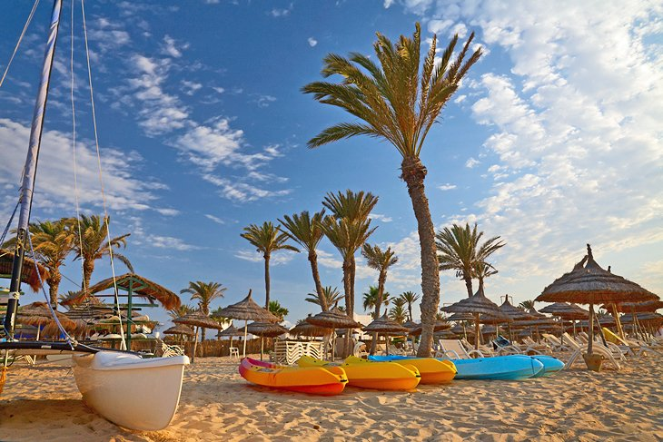
Djerba
Important places for tourism
A perfect looking beach
The island town of Houmt Souk is the main point of interest off the beach, with an old town district that is a muddle of whitewashed houses.

Slide 15
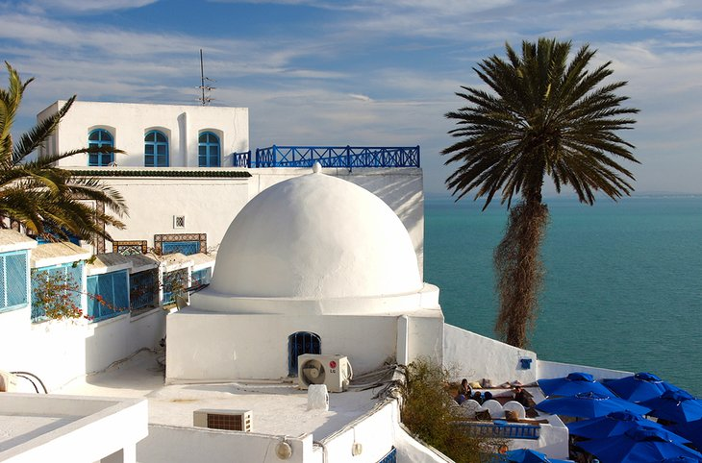
Sidi Bou Said
Sidi Bou Said is a clifftop village of petite dimensions that seem to have fallen off an artist's canvas. Unsurprisingly, artists have feted this little hamlet for decades. The whitewashed alleyways, wrought-iron window frames, and colorful blue doors are Tunisian village architecture at their finest, while the Mediterranean backdrop is the cherry on top.

Slide 16
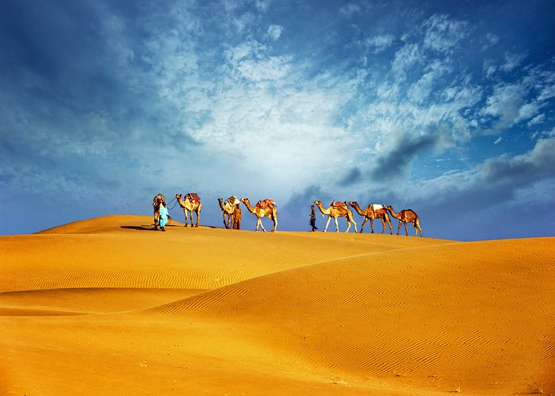
Grand Erg Oriental
Tunisia's vast Sahara covers much of the country's interior, and the most beautiful corner of the desert is the field of sand dunes known as the Grand Erg Oriental. These poetically beautiful dunes are a surreal and gorgeous landscape of huge waves, shaped by the ever-shifting desert sands. For many visitors, this is an adventure playground for riding dune buggies and camel treks, but nothing tops the simple pleasure of sitting atop one of these mammoth sand mountains and watching the sun set over the Sahara.

Slide 17
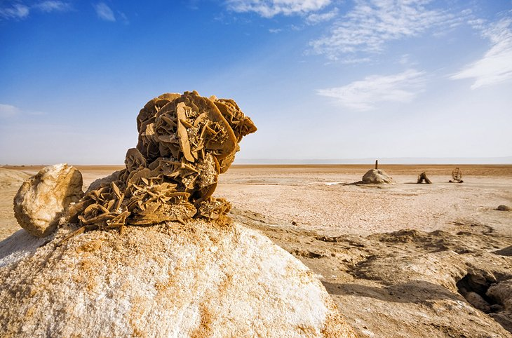
Chott el Djerid
The moonscape surroundings of the Chott el Djerid are a storybook panorama brought to life; filled with shimmering mirages on the horizon and jigsaw puzzle pieces of blindingly white cracked land under foot. This sprawling salt pan (most easily reached on a day trip from the desert town of Tozeur) is a desolate and otherworldly scene that wows all who visit with its stark and brutal beauty.

Slide 18
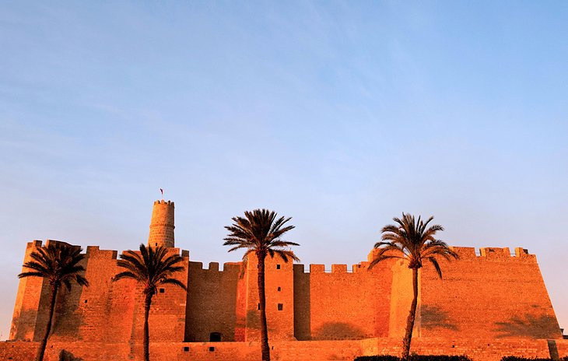
Monastir Ribat
One of Tunisia's most photographed buildings and a film star to boot, the Ribat in Monastir is a bulky walled and exceptionally well-preserved fort. Its defensive purposes may have long since faded, but this golden-stoned relic is now one of Tunisia's most recognizable landmarks, and today, tourists scramble up into its bastion tower, rather than soldiers.

Slide 19
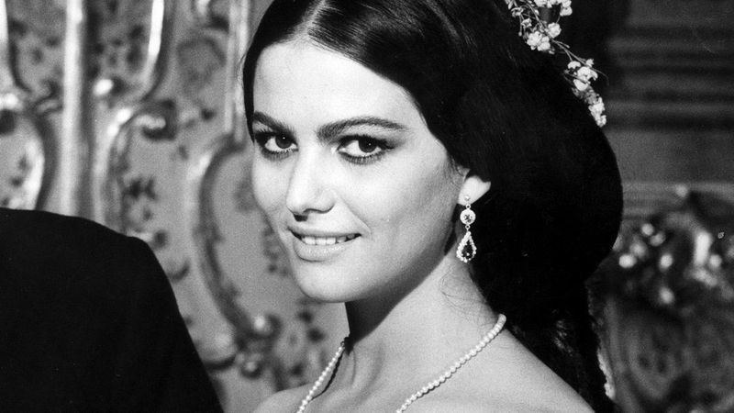
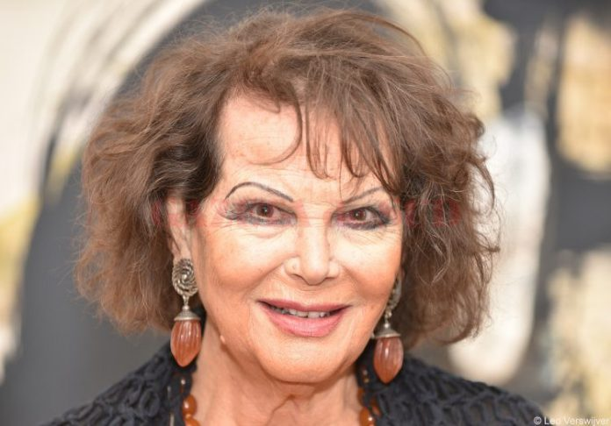
Claudia Cardinale
Celebrities
Claudia Cardinale (born 15 April 1938) is an Italian Tunisian film actress who appeared in some of the most acclaimed European films of the 1960s and 1970s, mainly Italian or French, but also in several English films.

Slide 20
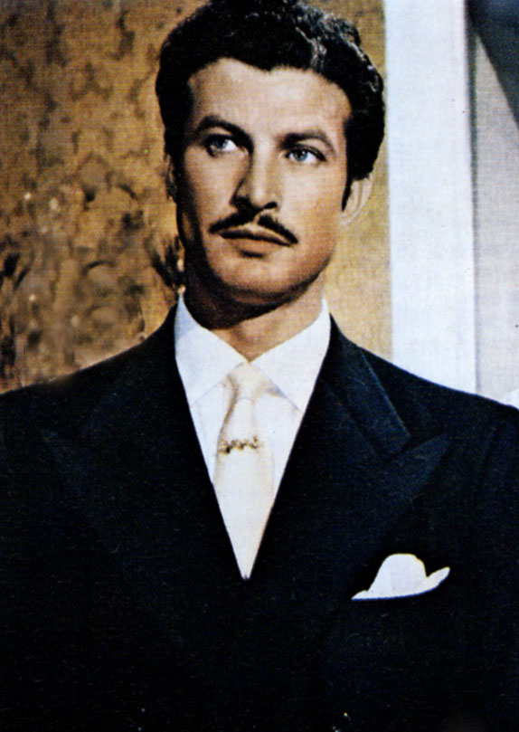
Erno Crisa
Erno Crisa (10 March 1924 – 5 April 1968) was an Italian film actor. He appeared in 52 films between 1944 and 1968. His last film was the spaghetti western Sugar Colt.

Slide 21
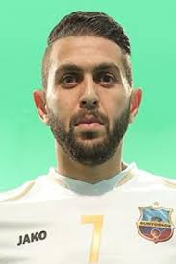
Chaker Zouaghi
Chaker Zouaghi (born 10 January 1985 in Béja) is a retired Tunisian footballer, who played as a defensive midfielder .

Slide 22
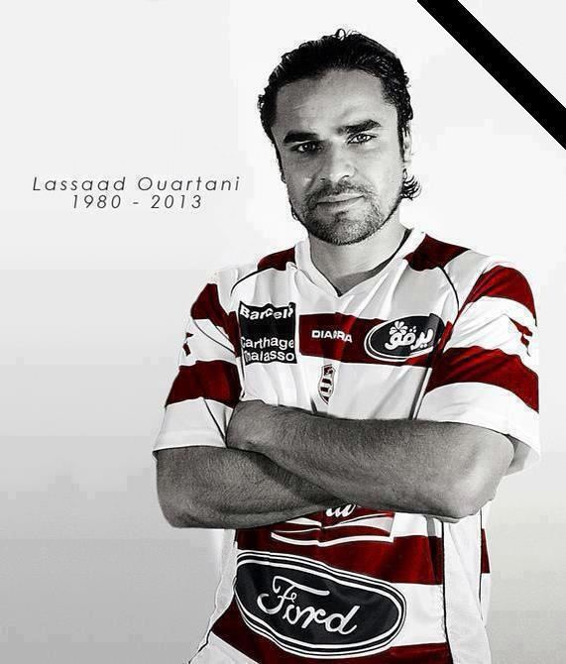
Lassaâd Ouertani
Lassaâd Ouertani aka "Zgaw" (2 May 1980 – 4 January 2013) was a Tunisian football player who played for Jeunesse Sportive Kairouanaise, Stade Tunisien, Club Africain, ES Zarzis before returning to Jeunesse Sportive Kairouanaise. He died in a traffic accident.

Slide 23
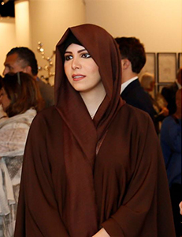
Latifa
Latifa Bint Alaya El Arfaoui better known as Latifa is a Tunisian pop singer and former actress.
International releases:
Les Plus Belles Chansons De Latifa
Inchallah (God willing)
Ma Wahashtaksh? (Did you miss me?)
Wa Akheeran (At last)

Slide 27
Sources
Wikipedia
www.everyculture.com
www.discovertunisia.com
Pinterest
A Brief History of the World (by Peter N. Stearns)
www.ranker.com
www.worldatlas.com
Tunisian Traditional Lookbook

Slide 28
THANKS FOR YOUR ATTENTION!

