Slide 1
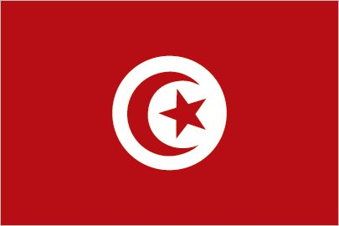
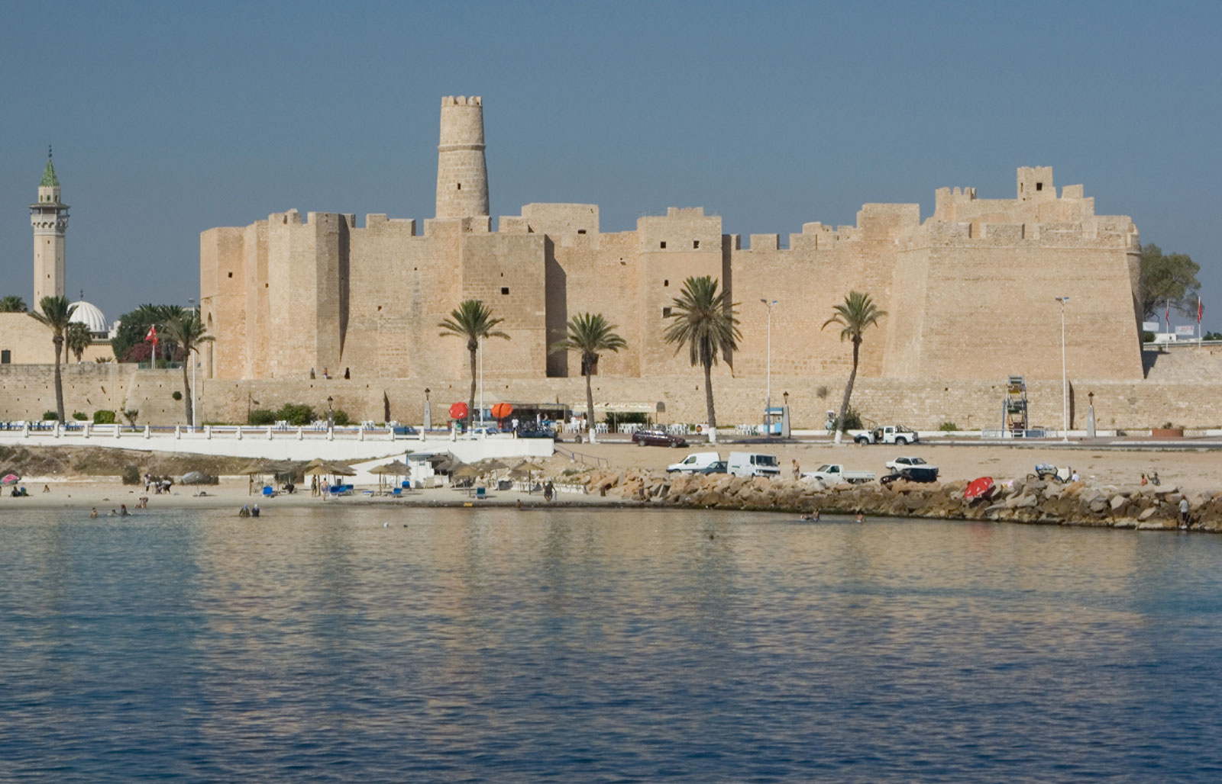
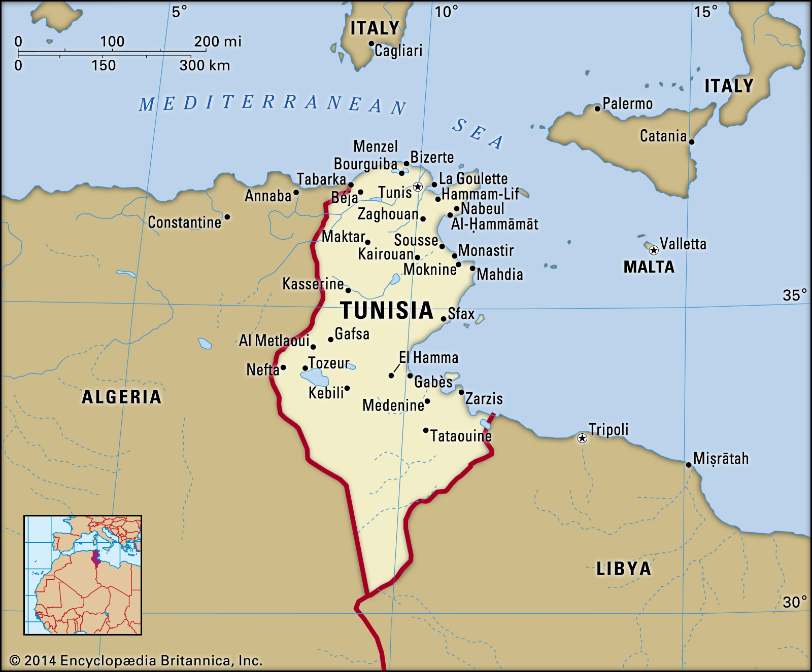
Tunisia
Tunisia is a country of North Africa.
It’s a republic, the president is Kais Saied.
The official religion is Islam, and the monetary unit is Dinar.
4 A PCU – Sraffa Crema Italy

Slide 2
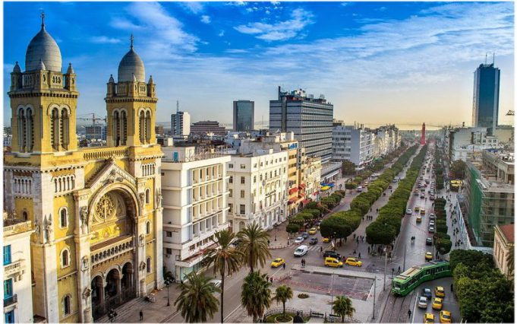
Population of Tunisia
The population in Tunisia is made up of different types of peoples that are from Algeria, Amazigh (population that lives between Morocco, Algeria, Tunisia and Libya), and the Bedouins; only the 62% are Tunisians.
They speak Arabic, but also French after the 1900.
They live in the North or in the East where the life is better, because in the South of Tunisia there is the Sahara desert, and there is no vegetation or water.

Slide 3
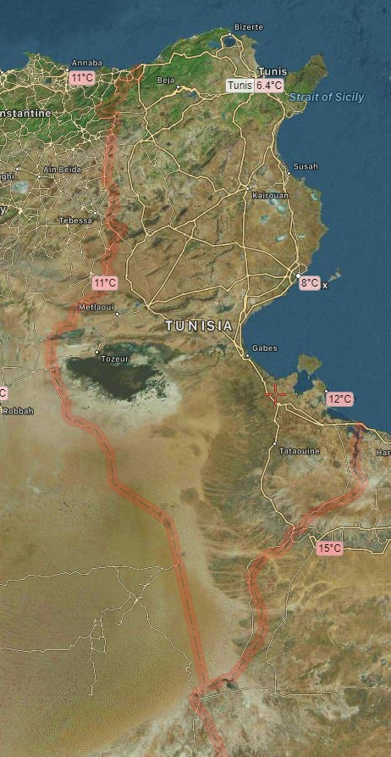
Geography
Tunisia is located along the Mediterranean Sea. It is a small African nation. Tunisia is located between Algeria and Libya and has a varied topography. In the north, Tunisia is mountainous, the southern part of Tunisia is semiarid and becomes arid desert closer to the Sahara Desert. Tunisia also has a fertile coastal plain called the Sahel along its eastern Mediterranean coast. This area is famous for its olives.
The climate of Tunisia varies with location but the north is mainly temperate and it has mild, rainy winters and hot, dry summers. In the south, the climate is hotter. Tunisia's capital, Tunis, is located along the Mediterranean coast. Because of the hot desert climate in southern Tunisia, there are very few large cities in that region of the country.

Slide 4
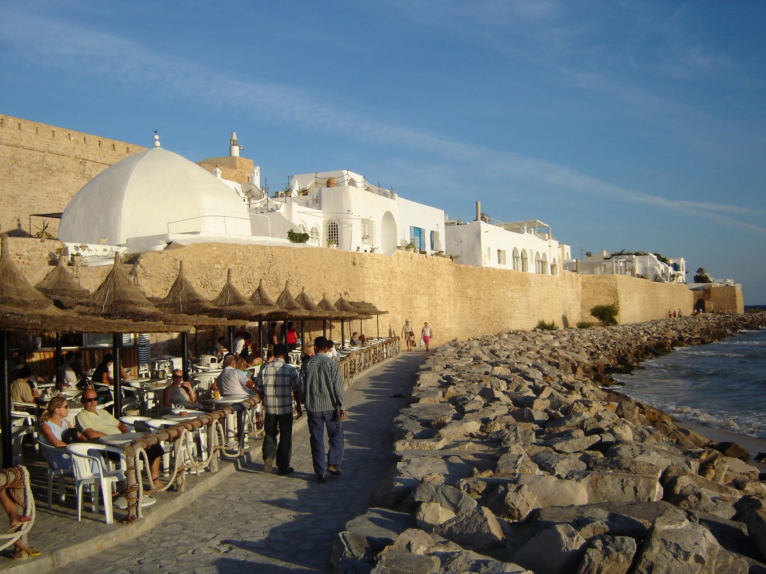
Tunisia economy
Agriculture contributes for 16%, industry for 28.5%, and services for 55.5%. In particular:
The primary sector mainly produces cereals like corn, wheat, oats; fruit like datterini and oranges. The most advanced sector is the fishing industry that produces a lot for export, thanks to the low labor cost: the main industrial sectors are the food, textile and oil industry.
The tourist sector is also growing in importance.
The most popular places are Hammamet, Monastir, Sousse, where there are numerous villages with entertainment; the Sahara desert.

Slide 5
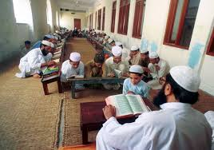
School system
Basic education lasts nine years and is divided into two phases:
Six years of elementary school and
three years of preparatory education
Secondary education is divided into two phases:
The phase of a general academic year and
the three-year specialist education phase
All secondary school graduates they can enter university or enter the labour market.

