Slide 1
Students from Azores Portugal

Slide 2
Reading Group
We are a small workgroup. We do readings and group discussion of various texts.

Slide 3
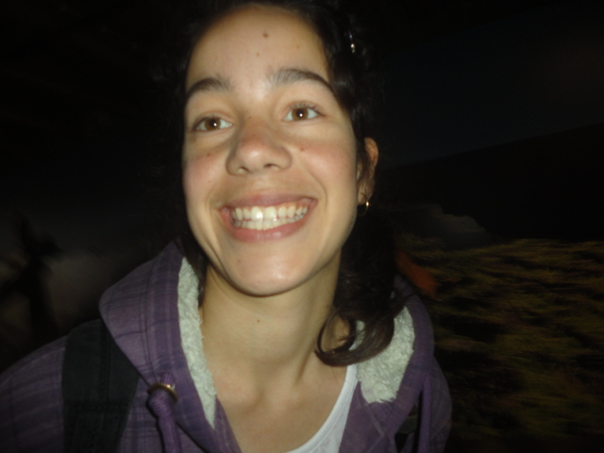
Hello.
My name is Mariana Madruga.
I´m 16th years old. I live in São Jorge, Azores - Portugal. At school I like math, visual and science education.
My favorite hobbies are playing video games, walk my dog and cycling.

Slide 4
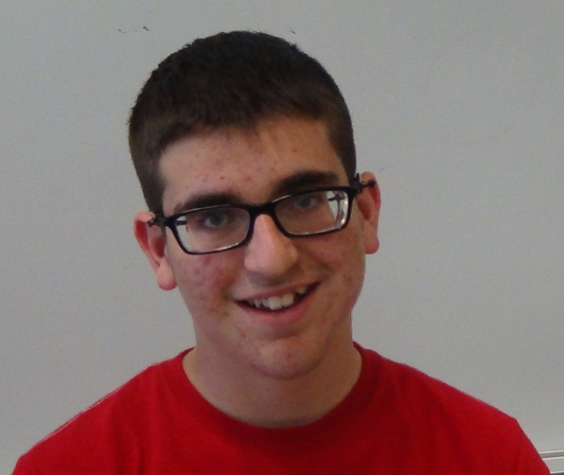
Hi. I´m Rodrigo Sequeira.
I´m 15th years old.
At school I like physical education and math.
My hobbies are play playstation 2, football and cycling.
I also like to feed and care for my animals (dog, cows, pigs, chickens, ...).

Slide 5
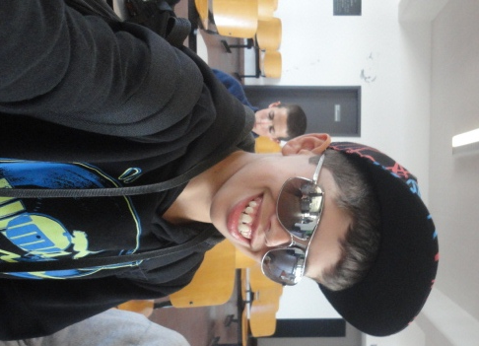
Hi. I´m Rúben.
I´m 14th years old.
At school I like physical education, english and math. For me the colleagues are also very important.
My hobbies are being with friends, playing football, playing video games and playstation3. I also like to being with my family and walk my dog.

