Slide 1
OUR HOBBIES AND INTERESTS class 6a

Slide 2
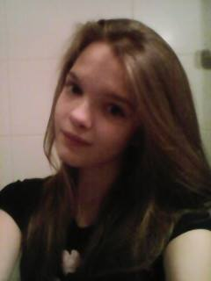
My name is Natalia. I love sports. My hobby is handball.

Slide 3
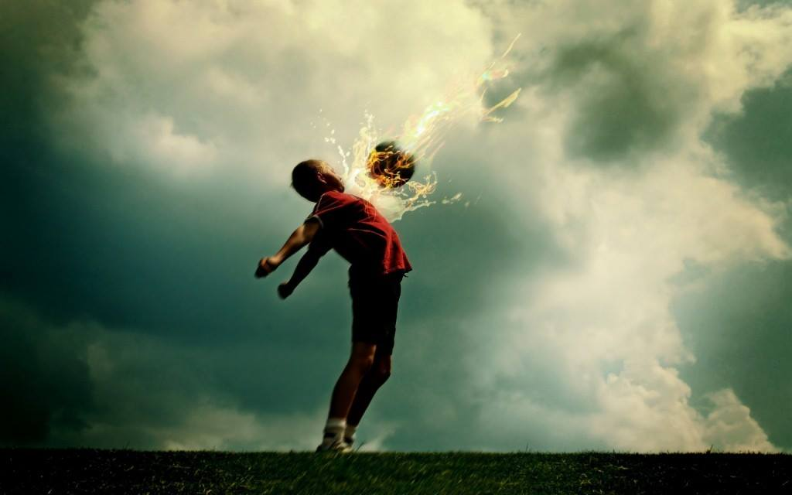
Hi, I'm Peter. I'm twelve years old. I like football. I'm training it on football club Pogoń Siedlce. I like handball too.

Slide 4
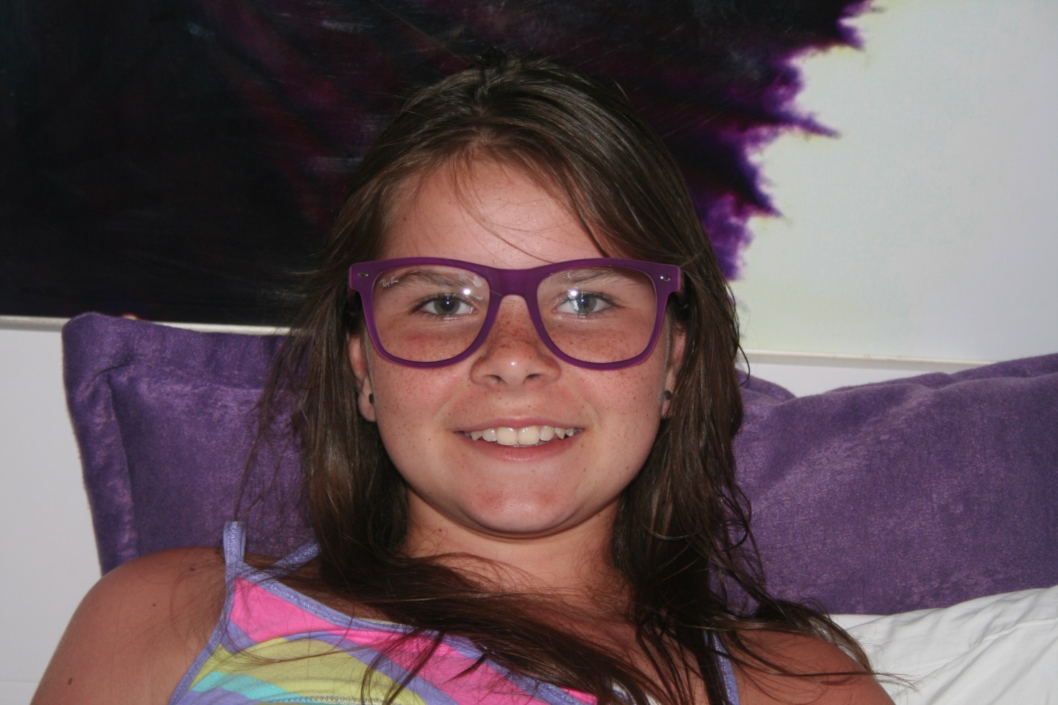
Hello! My name is Madzia. I am 12. I like music and sport. My hobby is riding a bike.

Slide 5
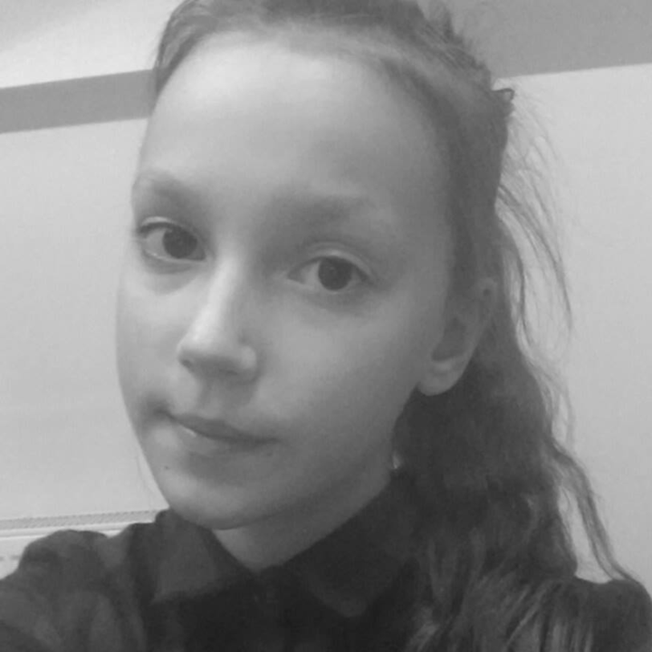
Hello. My name is Gabrysia. I like animals and sports. My hobby is rollerblades.

Slide 6
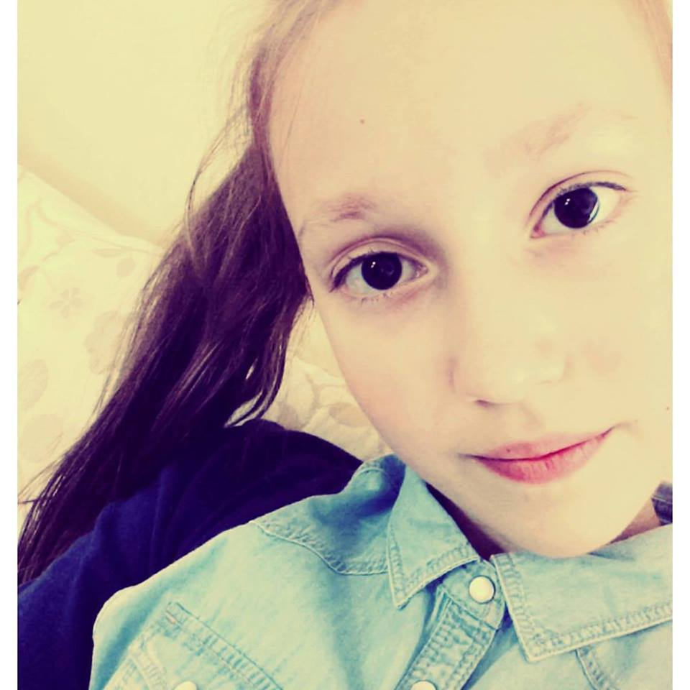
Hello. My name is Zuzia. I love dogs and handball. My hobby is rollerblading.

Slide 7
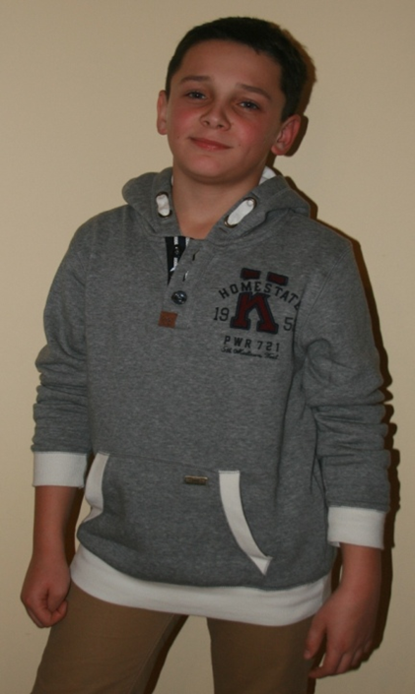
Hello! I'm Michał. I'm 12 years old. I like sports. My favourite sports are football and handball. My favourite football team is FC Barcelona.

Slide 8
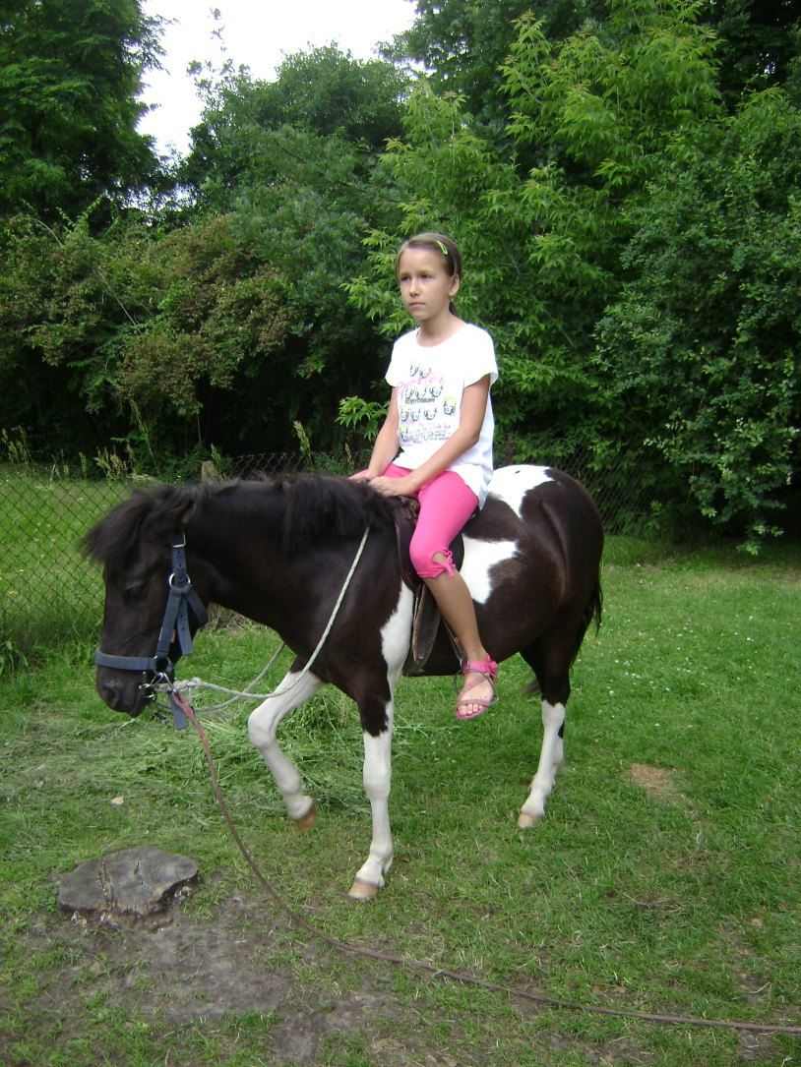
Hello! My name is Karolina. I am 12 years old. I like riding a horse.

Slide 9
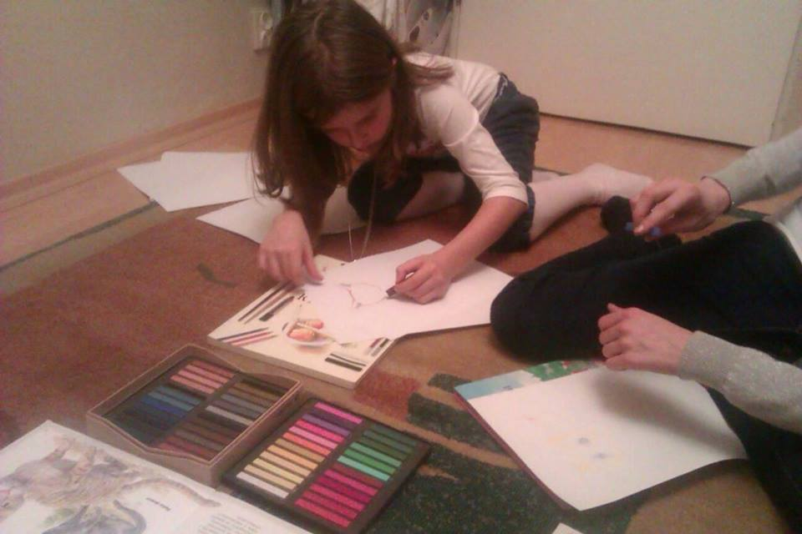
Hi, my name's Elena. I love drawing. In this picture my sister and I are drawing colorful cats.

Slide 10
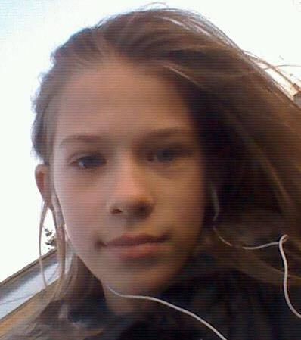
Hello. My name is Ania. I like dancing.

Slide 11
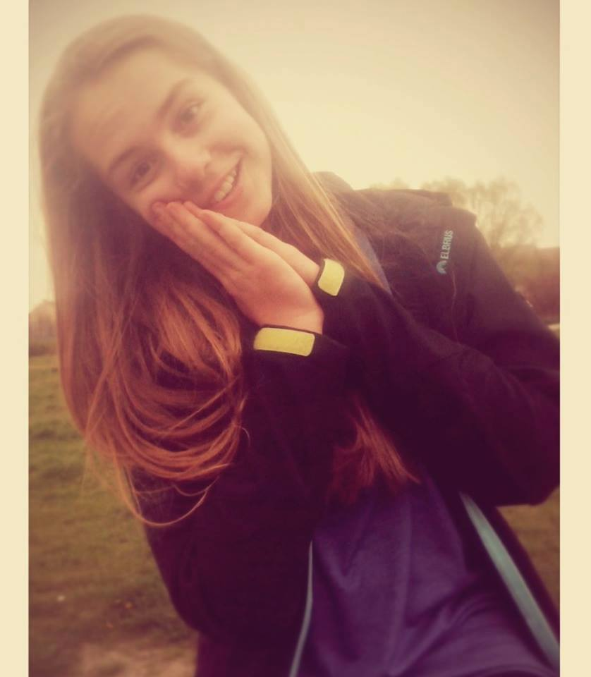
Hello. My name is Marta. I love riding a horse.

Slide 12
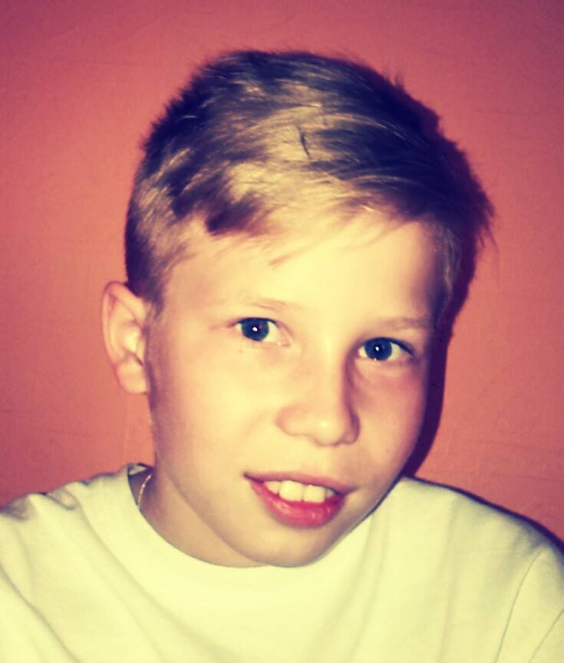
Hi, my name is Mateusz. I love football and I play in a football club Pogoń Siedlce.

Slide 13
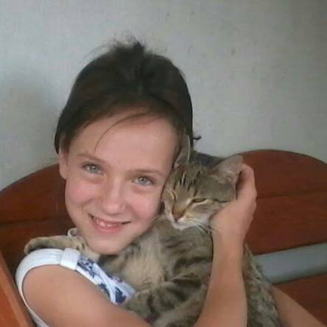
Hi, my name is Magda. I like animals and sport. My hobby is music.

Slide 14
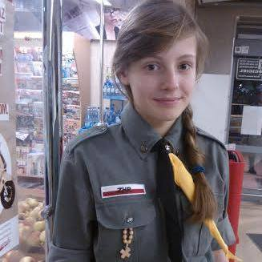
Hi, my name is Emilka. I like swimming and playing footbal. I'm a scout.

Slide 15
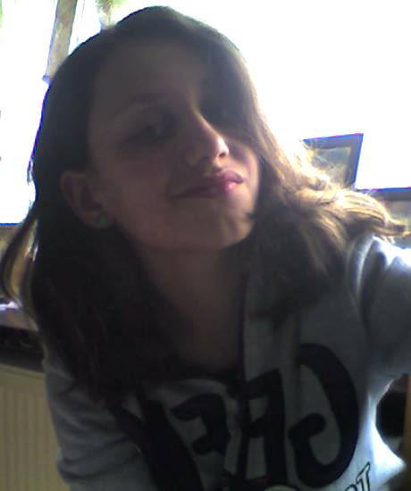
Hello. My name is Kasia. I love riding a horse.

