Slide 1
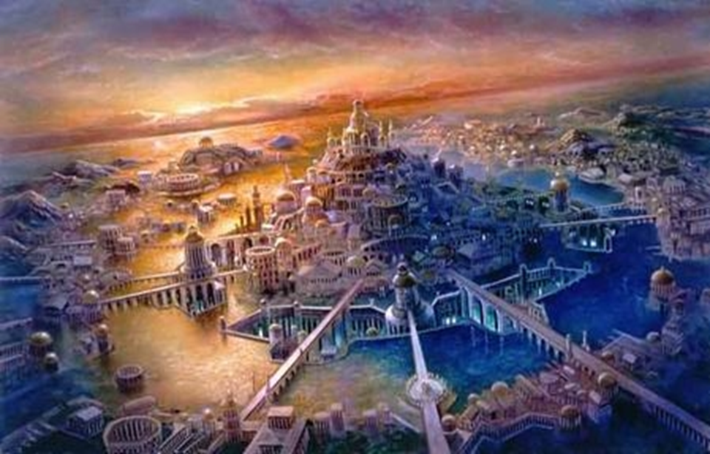
Legend of Atlantis

Slide 2
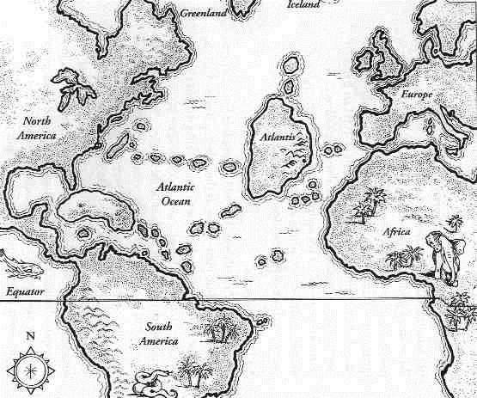
It is said that there was once a huge continent in the middle of the Atlantic Ocean called Atlantis.
There was a time when the king of Atlantis held several islands around, a good part of Europe and part of North Africa.

Slide 3
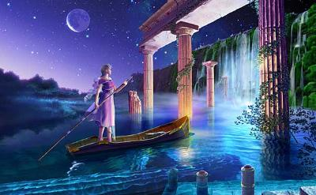
Its habitants were the Atlanteans, who were a huge civilization, even perfect and very rich: the palaces and temples were all covered with gold and other precious metals such as ivory, silver and tin.

Slide 4
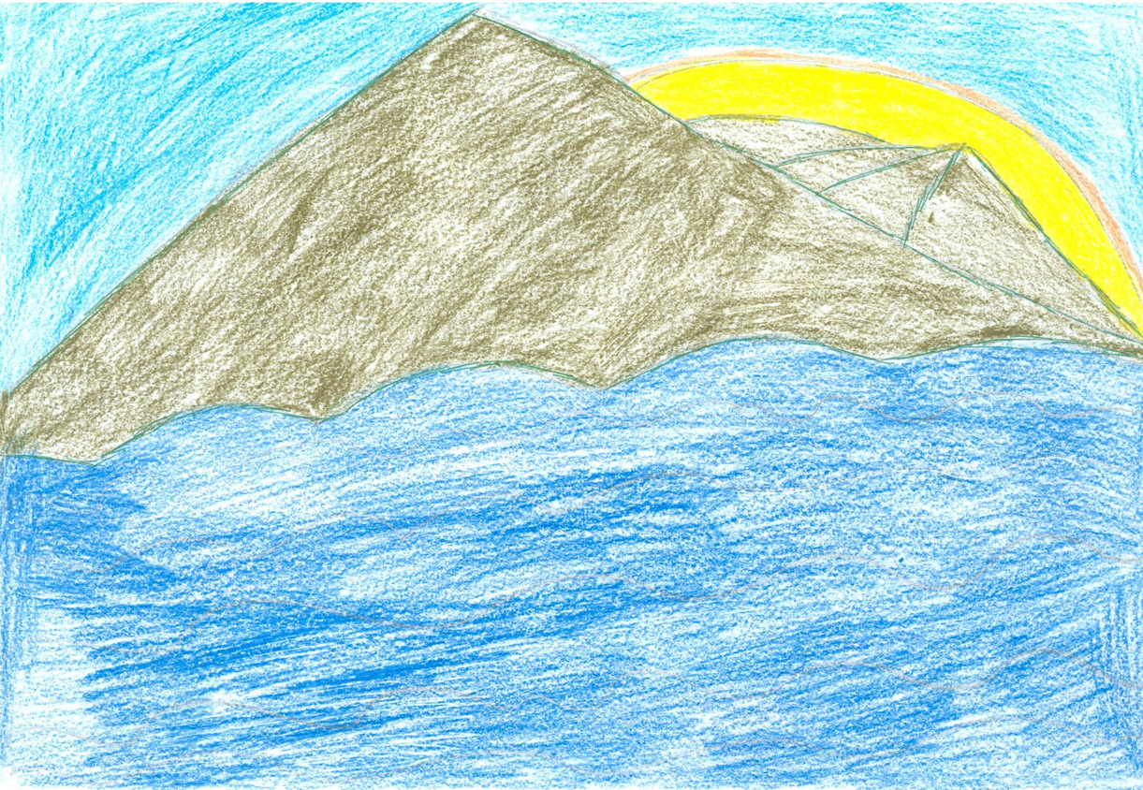
The sunset in Atlantis.
Illustration of Mariana.

Slide 5
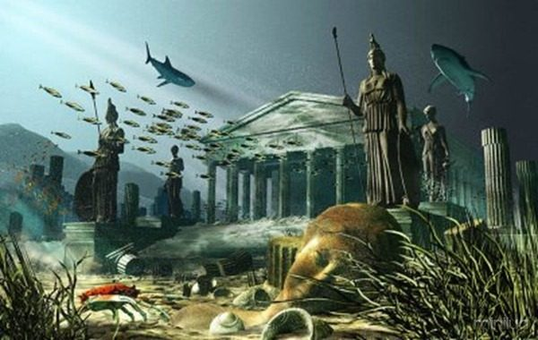
The gods, seeing so much wealth and beauty, were filled with envy and therefore triggered such a violent earthquake that sank the continent in one night.

Slide 6
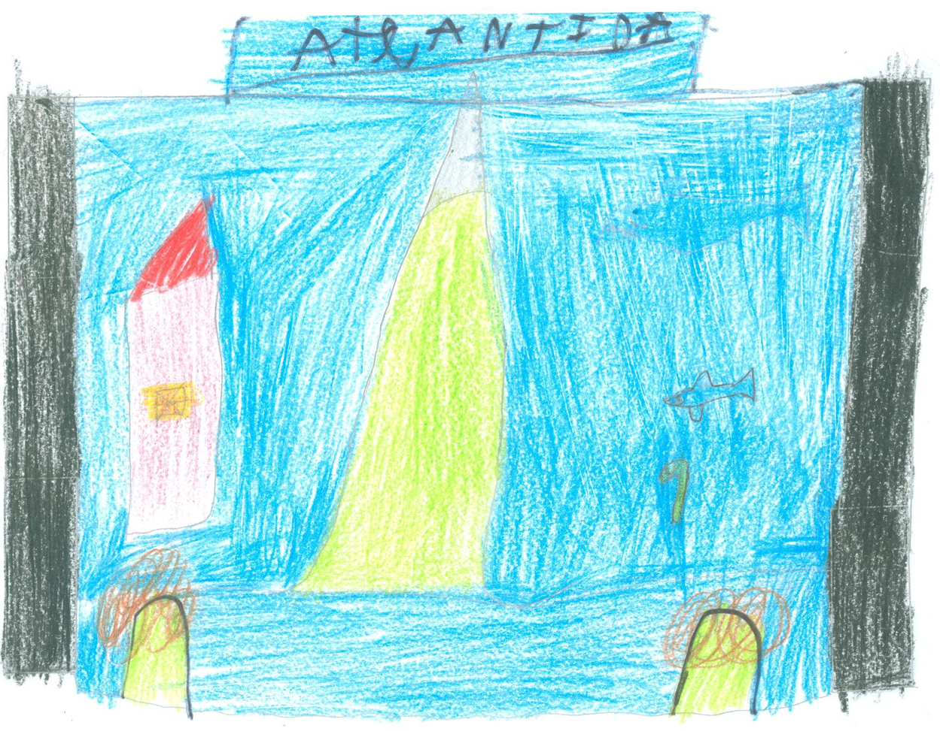
The Atlantis sink.
Illustration of Rúben.

Slide 7
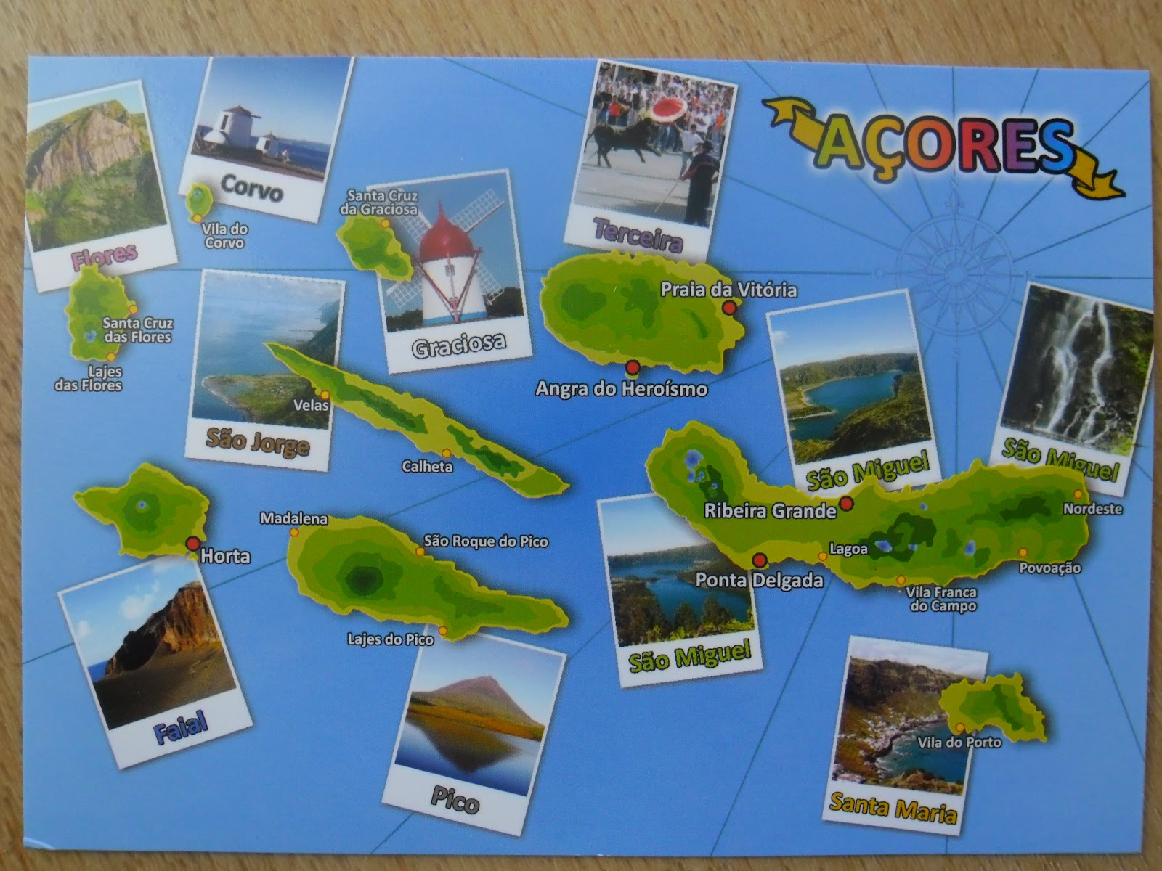
But it seemed that this land was really magical, because it did not sink completely: the tops of the highest mountains were above water forming nine islands, as beautiful as the submerged land - the Azores.

Slide 8
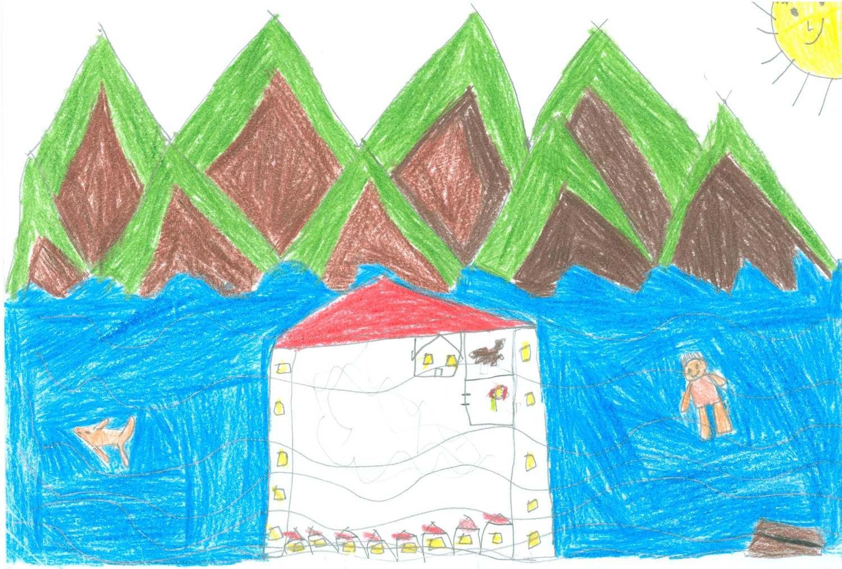
The mountain peaks of Atlantis that did not sink.
Illustration of Rodrigo

Slide 9
It is said that some atlanteans survived the catastrophe, leaving descendants to the four corners of the world.
It is said that this civilization before disappearing had a metal more precious than gold, called orichalcum.
It is also said that atlanteans had discovered the secret of eternal youth, but after the cataclysm, the surviving forgot or did not know it, and this knowledge was trapped on the seabed.
Plato, Greek philosopher, who lived five centuries before Christ, described in some detail this mythical land in the books "Critias" and "Timaeus".ATLÂNTIDA
The end

