Slide 1
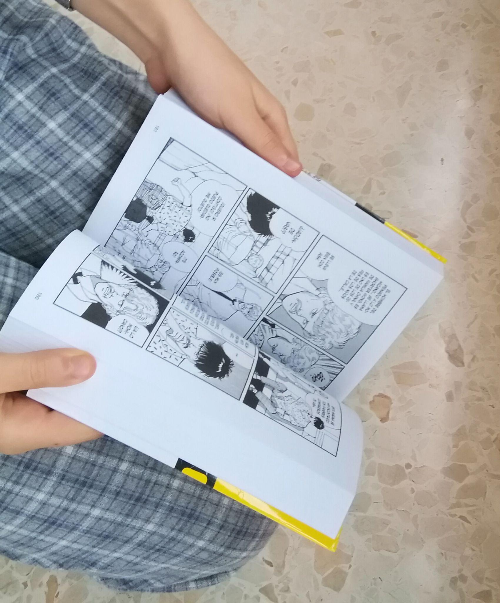
Banana Fish
By Elsa Jiménez Gómez

Slide 2
General information
Title: banana Fish 1
Author: Akimi Yoshida
Editorial:
Panini ( Manga)
copyright’s date: 2018

Slide 3
Resume:
IN 1973, In Vietnam. An American soldier suddenly loses the control after says ``Banana Fish``. after years the soldier’s friends forget the past, as Ash, our protagonist, try to find out the cause of the past trouve using his cunning and his force playing with the death.

Slide 4
Context
Where develop the history?
When?
The history generally develop in New York, where Ash life with her gang of criminals and with his friends, being in care of Papa Dino.
In 1985, fulfilling more years, as we watch our protagonist, Ash, growing and maturing.

Slide 5
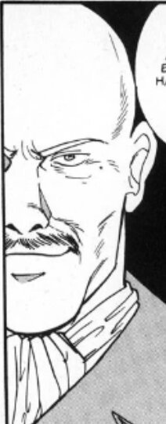
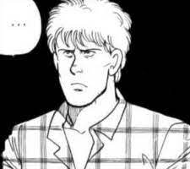
principals characters:
Ash
Papa Dino
Eiji
Max wolf
Our protagonist. More clever and strong than the others. With a problematic childhood.
He become to be the Ash’s father, the strong mafia’s boss.
The Japanese who with his, companion, a photographer, travel to New York where Eiji become to be the Ash’s fiend.
A journalist who was soldier in the Vietnam war and friend of the soldier who loses the control.

Slide 6
Conflict
Ash have a problem with his gang. He loses the leadership when other of the gang want to start a war for her leadership, scape of a persecution, when he meet Eiji. He go to the jail and he meet Max Lobo there who help to socialize with the other people in the jail.

Slide 7
Outcome:
It is not possible to go out to the jail, he get into a fight with others in the jail, he win with the Max’s help, who has an idea to escape of the jail.

Slide 8
It is not the end, I think that it transmit the love of the friends and the family.

Slide 9
Opinion
This manga has a great history, and characters. It has intrigue in the end of capitules. (It is just the first capitule of this serie).

