Slide 1
Tollgate Primary School ( Boleyn Academy Trust)
24th January 2019
By Iclal Lawrence

Slide 2
Overview
Tollgate is a Teaching School that leads an alliance of 30 schools across 7 London Boroughs. This gives us huge strength and capacity in teaching and learning and leadership to support other schools.
Tollgate is also an Initial Teacher Training Centre that trains 45 teachers a year.
From 1st January 2017, Tollgate Primary School became an academy as part of the Boleyn Academy Trust. It aims to have a total of nine local schools within the trust.
The Executive Head teacher Mr. Tom Canning OBE, is also a lead inspector for OFSTED.

Slide 3
Key facts
The school lies at the heart of the community in a disadvantaged area with 500 pupils coming from different religions and cultures. Altogether more than 50 languages spoken by pupils and the school community.
Tollgate is a two form entry school with an autism provision in East London close to Docklands and Stratford Olympic Park. We offer 30 places for children with autism from reception to year 6.
It has been graded as Outstanding by the OFSTED inspectors. It is one of the beacon schools in UK for achieving top results in Year 6 exams.
Tollgate has won many awards and given four International School Award since 2007 by the British Council.
Due to its popularity, there is a waiting list and the trust aims to extend the school from two form to three form entry.

Slide 4
What do we offer to the school community?
Fully staffed, committed teaching and non-teaching staff to offer a range of services from 8 am to 6pm.
Breakfast club from 8 to 8.45 am- Offers breakfast and PE activities
After school club from 3 to 6 pm- Offers food and drink and homework support.
The Family Centre offers a range of courses for parents. For example; mother and toddler classes, ESOL etc.. All free.
1 to 1 tuition and intervention classes after school.
Over 15 after school clubs for children including language, PE, reading, art and craft classes.
Special events organized to invite parents; parents evenings, international evenings and Xmas, Easter and Summer celebrations
Ongoing CPD every week for all teachers and SLT members
External visitors to celebrate key events including, Eid, Diwali, Harvest Festival, Chinese New Year and more..
Regular communication through our website and newsletters

Slide 5
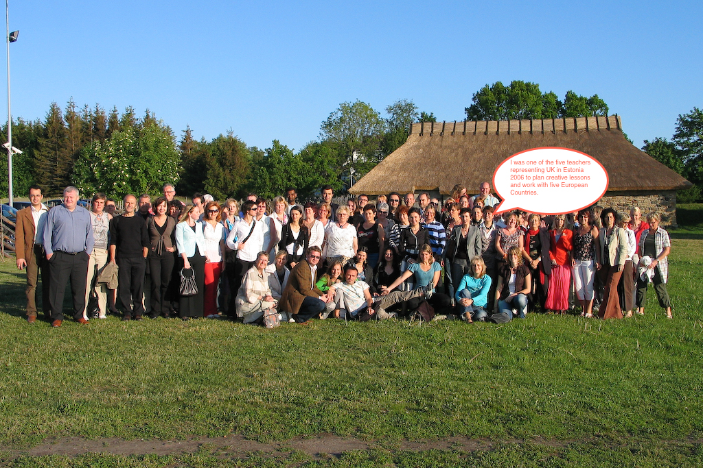
Our Global Links
Turkey
Bangladesh
International Development Summer 2012
Estonia

Slide 6
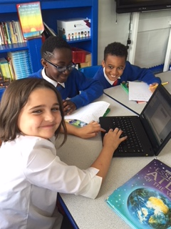
Plastic Pollution Project with Denmark
Year 5 pupils have collaboratively worked
together to research about Denmark and
Issue of plastic pollution. They have created
Power point presentations. Here is one of them.

Slide 7
Global Links- Why is important?
Our aim is to develop global citizens through the curriculum and beyond.
We believe that the global market will be important for our pupils to travel and find job opportunities beyond UK and Europe.
It has created many professional opportunities for the teaching staff and the school leaders.
The British Council has supported our work and invited us to share our experience through national and international events.
It has opened new horizons for those children and families who might be otherwise disadvantaged economically and socially.

Slide 8
School Development Plan 2016/17
Key Priorities
Teaching School SCITT – ITT/CPD/ School to School support.
Assessment – Ensuring that all children’s progress is comprehensively assessed through the use of standardised scores and low, mid and high codes. Also to ensure that all teachers are tracking vulnerable groups of children that fall into the bracket of ‘Diminishing the Difference’
Reading and Inference – Ensuring that the teaching of reading includes inference and deduction.

Slide 9
Role of Pupil Premium to improve standards in schools
Pupil premium has been allocated for pupils whose
families identified to support.
Each child gets over £ 1000 to get additional support which could be trips, tuition or additional help in the class.
Tollgate has high percentages of children with pupil premium but not static as it can change throughout the year.
Our pupil premium children doing as well as non pupil premium pupils as we gathered and analyzed the data.

Slide 10
Role of school leadership
The executive head teacher positively encourages teachers to take a range of responsibilities to develop them as leaders.
Leadership is not exclusive to Senior leaders only.
Every subject leader is a middle leader who produces a detailed report with data with strengths and area for development.
There is a clear progression from being a middle leader to senior leadership team
Most subject leaders offer their expertise to train teachers and mentor NQTs.
SLEs ( Specialist Leaders in Education) offer outreach work to support other schools for example in literacy or numeracy.
All teachers including NQTs use the school’s key priorities in their day to day planning and teaching.
SLT conducts regular monitoring cycle of planning, teaching and evaluation to ensure that standards are high.

Slide 11
Where do we go next?
Developing the academy trust while retaining the core values that we instill everyday.
Extend the numbers gradually every year to meet the local population demand.
Develop middle leaders to senior leaders to carry out more support to other schools.
To ensure that results reflect the outstanding schools standards at the league tables.
To continue to offer globally relevant curriculum and learning opportunities to pupils.
To extend our links to Middle East MENA countries to exchange ideas in teacher training and inclusive education.
To outreach other community of schools through the British Council programmes and share our expertise to show possibilities beyond the classroom.

Slide 12
Questions and answers
Thank you for listening and taking active interest.
Senior Leader/International Links Leader
Iclal Lawrence

