Slide 1
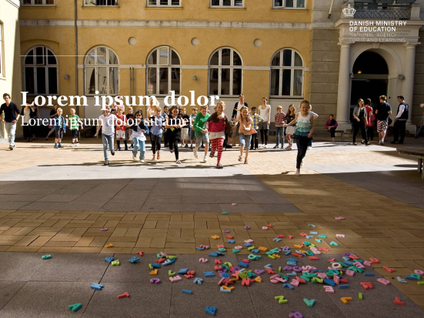
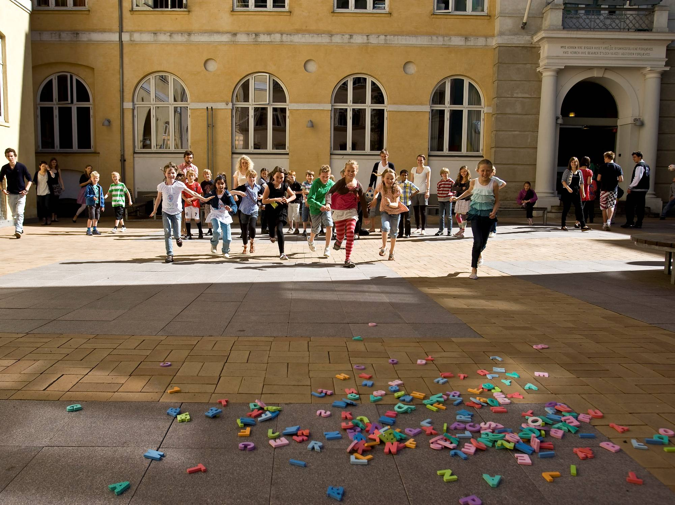
Insights from Denmark – Education – Pedagogy, “CRAFT”, eTwinning
Intro: Claus Berg, Chief Adviser, Pedagogical ICT, Ministry of Education, National Agency for IT & Learning (STIL)
Notes:
During the recent years, the use of ICT in the schools is a still greater priority for the Danish government.
Most recently ICT and digital learning resources have become a substantial part of the political agreement on the reform of the Danish public school.
Central aim in the reform which came into effect summer 2014: The public school must challenge all students to reach their full potential.
We need to develop new ways of organizing the teaching and new ways of learning – but with the same amount of resources. We have to start thinking in a new way.
The use of ICT can help us reach our goals.
There is a big unexploited potential within ICT and digital learning resources.
The use of ICT can provide more variation during the school day and offer integration of play and action in the learning process
Digital learning resources can contribute to new ways of organizing the teaching and new ways of learning – e.g.:
Working with 21st century skills, e.g. teamwork and collaboration, problem solving, creativity and innovation - thus reflecting the work fields that the students will meet in the future
Working with differentiated teaching
Working with authentic learning – solving problems that origin in themes that students meet in life.

Slide 2

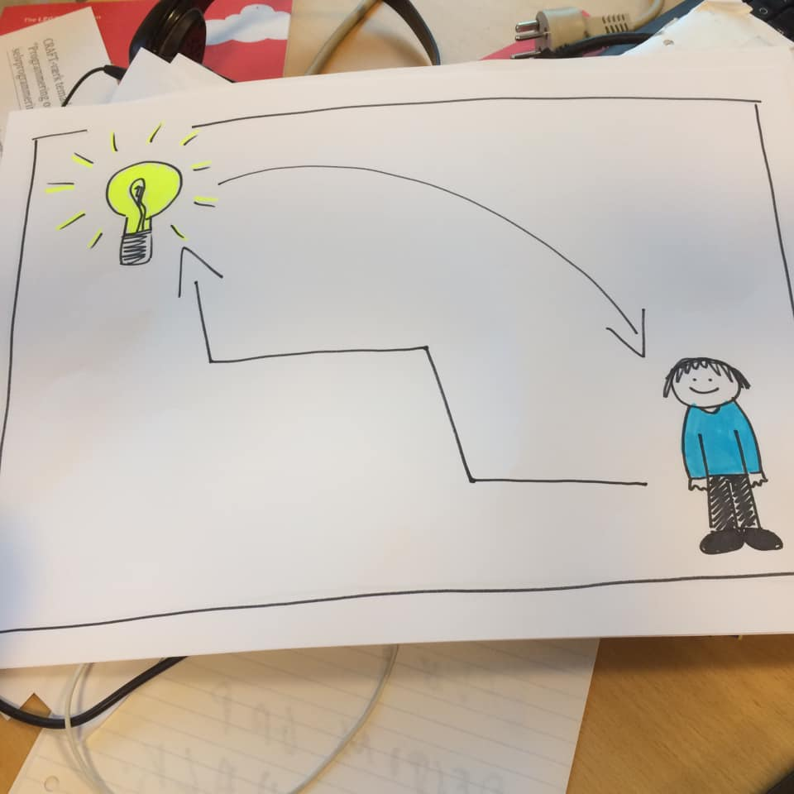

Slide 3
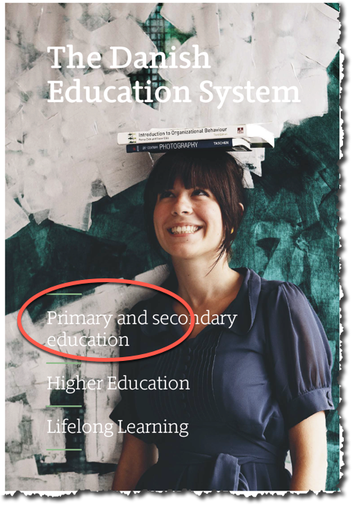
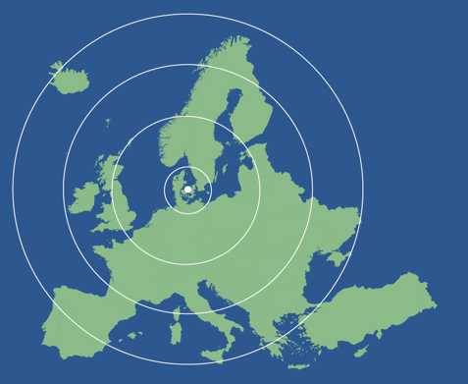
Read more

Slide 4
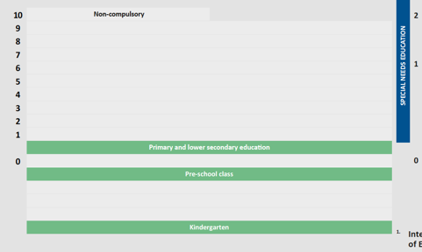

One school: Grade 0-9 (or 10)

Slide 5
Digital learning in Denmark
What is the status on transforming digital opportunities into better learning in the education sector?
On the other hand…
…attention to digitalisation is constantly increasing – especially in education, where the demand for new solutions to the skill needs of the future is constantly increasing
On the one hand…
…we have a good starting point. High digital literacy among young people i.e. 98 % of children from lower socio-economic groups have access to at least one computer at home
Notes:
Denmark has long been at the forefront regarding use of ICT in education. But in recent years many other countries have caught up with us and several have even overtaken us.
- Danish primary school pupils use the computer more often than average, but they are not that advanced in their use of ICT (ICILS, 2013)
- Danish upper secondary school students source critical readiness and abilities to reflect on ethical aspects of digital media are limited (EVA, 2015)
- Danish teachers are in the top regarding integration of ICT in teaching and in student activities, but ICT is used for traditional types of teaching (ICILS, 2013)
- Denmark is below average for OECD countries regarding teachers' ICT skills (OECD, 2016)

Slide 6
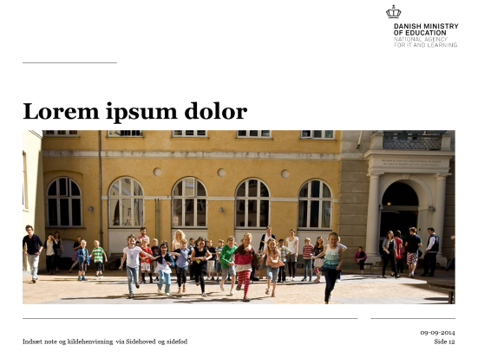
Looking back on the lacks…
Before 2012
Lack of IT-infrastructure
Lack of network, competences and knowledge sharing
Lack of a market for digital learning ressources
Lack of Research and knowledge
Notes:
Focus on ” Development of a market for digital learning ressources”: Application pool (pulje til digitale læremidler) to affect the demand side as well as a (smaller) development pool to affect the supply side
ICT in public schools (500 million DKK = 67 million euro, 2018-values)
Before developing the strategy a number of challenges were identified:
The market for digital learning resources was relatively small – low supply and demand
The ICT infrastructure was generally not good enough for ICT-based teaching
Many small projects on the use of ICT in education, but no comprehensive, interdisciplinary research / knowledge of ICT-based learning = We didn’t know how it affects the students.
Many enthusiasts, some advanced schools - but generally there was a need to support local efforts
Based on these challenges, the strategy contains four main elements to increase and qualify the use of ICT in education:
Develop the market for digital learning resources to increase the supply of high quality products
Gain more knowledge on IT-based learning
Ensure efficient IT infrastructure in schools in order to ensure the basis for action
Support the use of IT and digital learning resources through networking, collaboration and knowledge sharing (focus on implementation)
In recent programs, we have often approached only one of these areas in a certain period of time; this strategy takes on all at the same time.

Slide 7
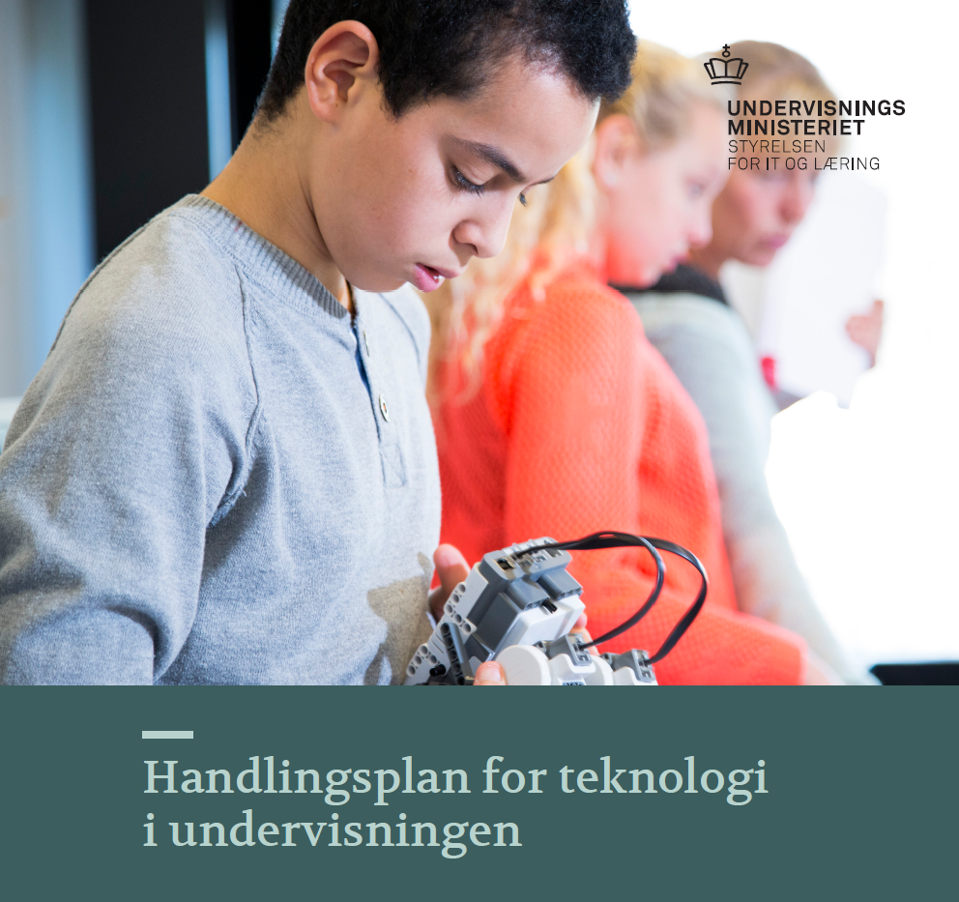
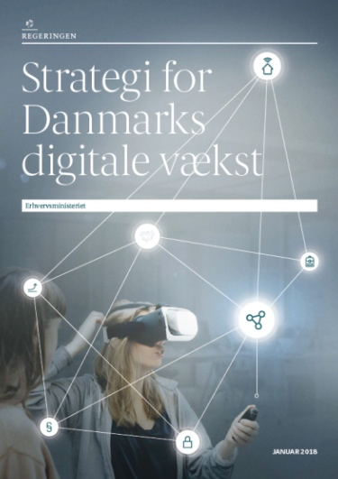
What now and next?
Action plan for technology in education (February 2018)
Technology understanding for all children, young people and adults
Digital skills of teachers, managers and educators
Use of IT in education
User-friendly digital infrastructure and learning resources
Use of data and data ethics
Initiatives in all educational areas
New
New
New
Notes:
Action plan for technology in education
The Ministry of Education’s action plan for technology in education focuses on children, youth, and adults’ technological understanding and aims to improve the use of IT at all levels of educational sector.
Danish children and youths must be able to craft creatively with technology rather than simply being users. As technology develops at a high pace it requires a new focus on strengthening technology at all levels of the educational sector.
In order realise the two goals the action plan includes five focal points:
It is necessary to strengthen the concept of technological understanding in the goals of education as well as the content – making sure that every child, youth and adult learns to be critical of technology and learns to shape it rather than simply use it
It is necessary to strengthen the competencies of teachers, managerial and educational staff in order to better use IT in classroom education as well as teach the subject understanding of technology
It is necessary to improve the pedagogical and didactical use of IT in education
It is necessary to continuously develop user friendly and functioning digital infrastructure
It is necessary to increase awareness of data ethics along with a qualified use of data about the pupils and their learning processes
Strategi for Danmarks digitale vækst
Vigtigste initiativer om kompetencer:
Forsøgsprogram om styrket teknologiforståelse i folkeskolen
Teknologipagt
Center for anvendelse af it på erhvervsuddannelserne

Slide 8

New trial program: Obligatory element of ”Technology comprehension” in primary/lower secondary schools
Program duration: 2018-2021, 68 mio. kr.
Focus on programming (computational thinking), consequences of technology and automation on society, design and innovation, problem solving, digital competencies (i.e. social media)
Development of teacher competencies together with all University Colleges
46 schools participate and starts in January 2019 (1th, 4th and 7th grade first year)
Mandatory subject (two lessons) and technology comprehension integrated into seven subjects.

Slide 9
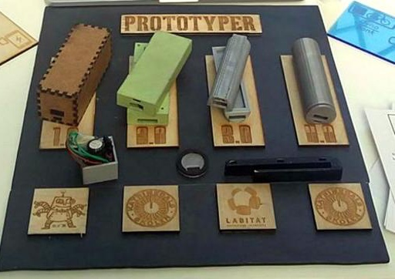
Active Learning
Danish Championship in Digital Skills and Nordic CRAFT 2019
1 Projects in the classroom
2 Municipality competitions
3 Finals at the National Learning Festival (8.000 visitors)
(Student winner project ”Dynobank” -
charges powerbank while you ride your bike)

Slide 10
CRAFT ”Circle”

Slide 11
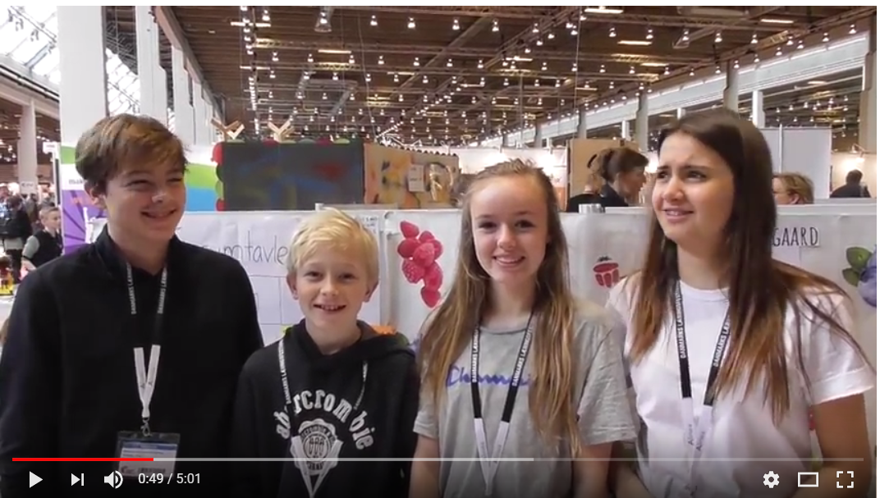
Documentation video produced by a 12 year old student

Slide 12

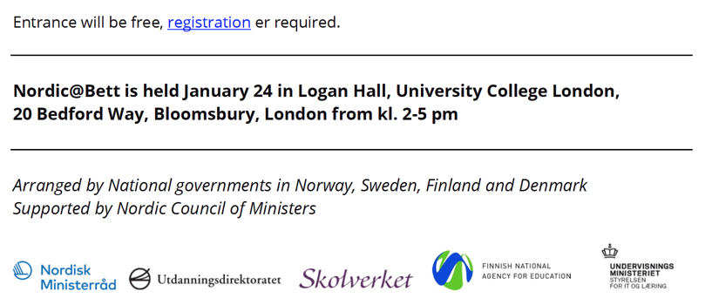
Free conference tomorrow, Logan Hall

Slide 13

Danish Learning Festival
13-14 March 2019 in Bella Center,
Copenhagen, DK

Slide 14
Teacher Tine Lund
Asgård School, Køge
eTwinning.net
TwinSpace ” Danish visit to Tollgate Primary School in London, January 2019”
https://twinspace.etwinning.net/81761
(ShortURL: l.ead.me/bb312o )

Slide 15
Pernille Reenberg
Nyager School, Rødovre
Sway: ”UK & DK Scratch and Marine Pollution”
  https://sway.office.com/ZNlIU3jlNU869CD6?ref=Link

