Slide 1
Movies on at cinemas
Valenta Jacqueline, Zimmerl Victoria

Slide 2
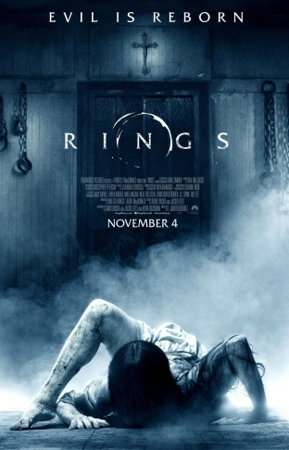
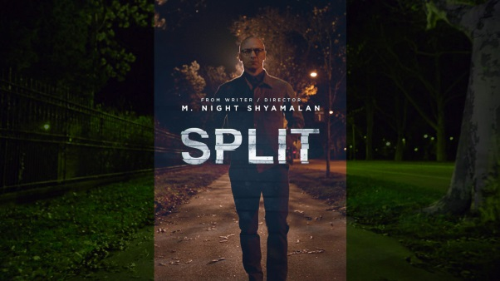
Content
Hello guys! We want to show you which movies are on at our cinemas at the moment. ☺ We compiled a little overview for you . Here are a few pictures of the movies:

Slide 3
Movies In Klagenfurt
Rings → Drama, Thriller
Split → Thriller, Horror
Resident Evil: The Final Chapter → Fantasy, Science-Fiction
Hacksaw Ridge – The Decision → Drama, History
Wendy – The Movie → Adventure
Monster Trucks (3D) → Science Fiction, Action

Slide 4
Vaiana (3D) → Fantasy, Adventure
Sing (3D) → Fantasy, Adventure
Timm Thaler or the laughter sold → Drama, Adventure
Ballerina → Adventure, Music
xXx – The return of the Xander Cage → Action
Why Him? → Love, Comedy

Slide 5
The GreatWall → Fantasy, Mytsery
Live by Night → Crime, Drama
Passengers → Fantasy, Science-Fiction
Suddenly Papa → Comedy
Assassin‘s Creed → Fantasy, Science-Fiction
Rouge One: A Star Wars Story (3D) → Science-Fiction, Fantasy

Slide 6
Movies On in Austria
The movies La La Land, My Blind Date with the Life of Jackie , Hidden Figures – Unkown Heroes are shown all over Austria.
The Hell is shown in some parts of Austria like Vienna. ☺

