Slide 1
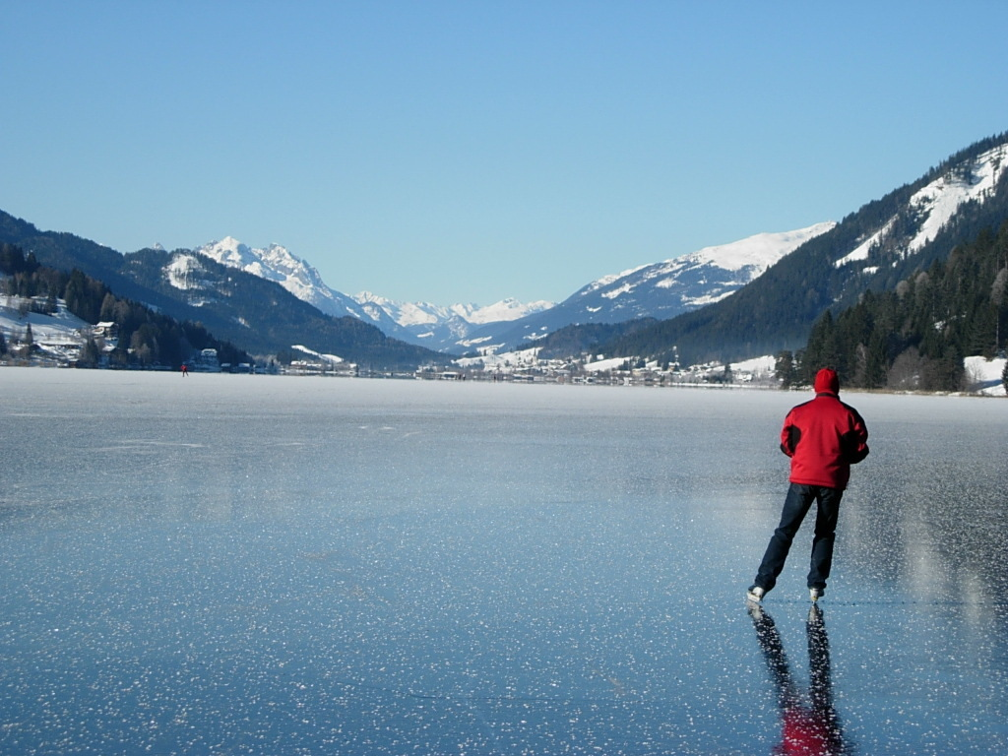
MOVIES SET IN AUSTRIA
Laura Reynaerts, Selina Trapitsch

Slide 2
Movies
Lissi and the wild Emperor
Dead in 3 Days
Released: 2007
Duration: 85 minutes
German: Lissi und der wilde Kaiser
Animated comedy parody
Released: 2006
Duration: 97 minutes
German: In 3 Tagen bist du tot
Sequel: Dead in 3 Days 2

Slide 3
Movies
Permission to Kill
7 Days in Tibet
Released: 1975
aka: The Executioner
Genre: Spy thriller
Shot in Gmunden, Austria
Austrian-British-American co-production
Released: 1997
Duration: 136 minutes
German: 7 Tage in Tibet
Genre: Biographical drama
Based on a book released in 1952

Slide 4
Movies
James Bond and the living daylights
Indiana Jones and the Last Crusade
Sölden, Tirol
James Bond and the living daylights on the Weissensee -> Lake famous because of that movie
Some huts have been replaced to make the set perfect
Released: 1989
Duration: 128 minutes
Genre: Adventure
Official Trailer of James Bond https://www.youtube.com/watch?v=IXAVKJTIM1E

Slide 5
