Slide 1
SISSY
*24th of December 1873
† 10th of September 1898
Katharina, Kerstin, Verena

Slide 2
Who was Sissy?
Her Highness Duchess Elisabeth Amalie Eugenie
Mother: Princess Ludovika of Bavaria
Father: Maximillian Duke in Bavaria
Grew up at Possenhofen Castle on the shore of Lake Starnberg
Childhood: full of happines and freedom

Slide 3
Who was Sissy?
1853 married Emperor Franz Joseph I of Austria
Bad relationship to her mother in law
Loved Hungary
Four Children (two died when they were very young)
Traveled all over Europe (own palace in Corfu, Greece)

Slide 4
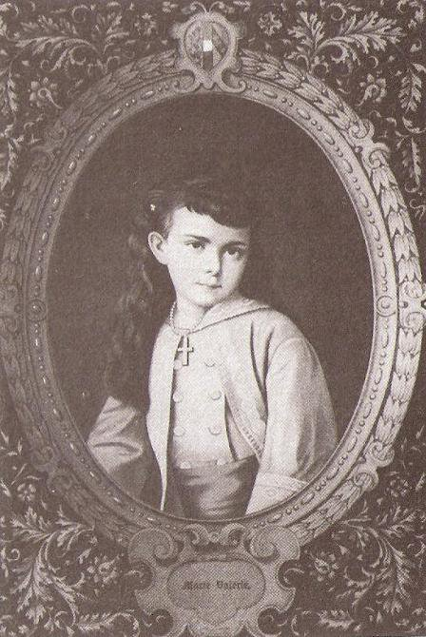
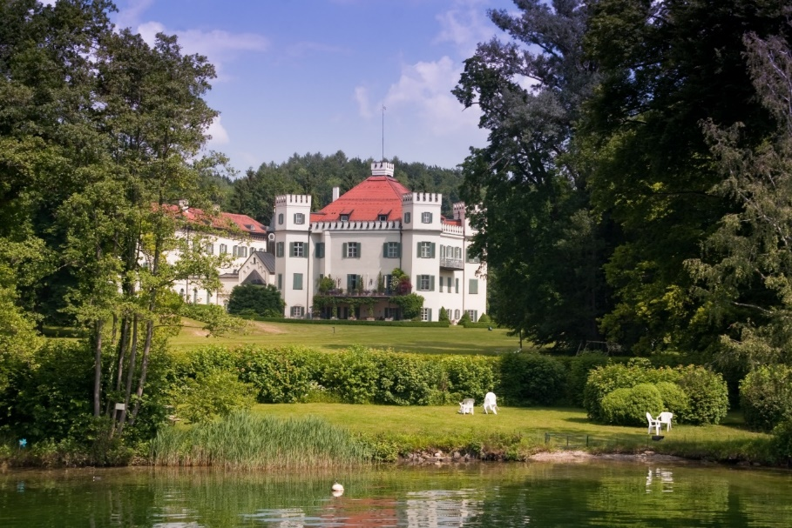
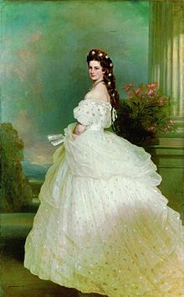
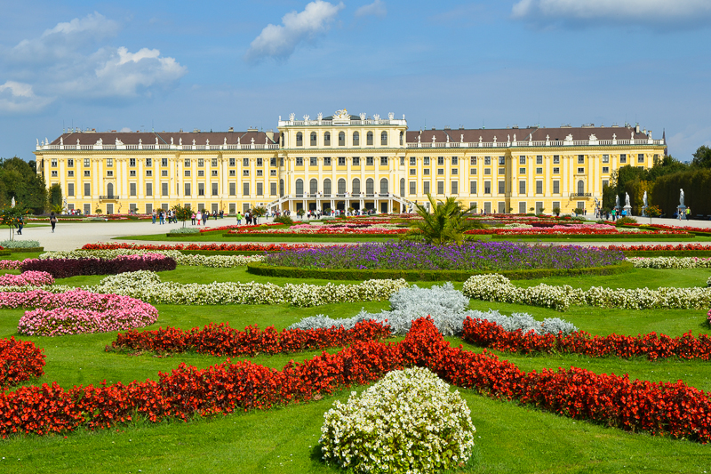
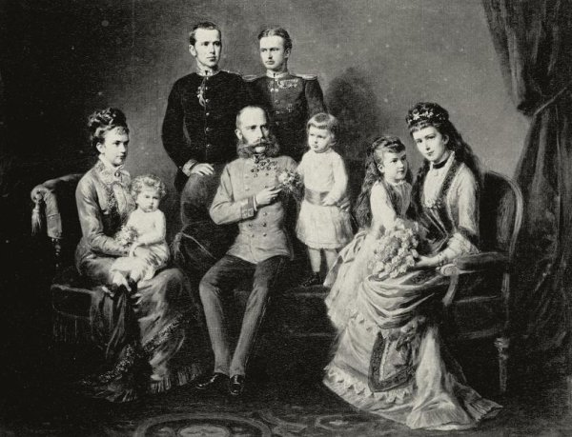
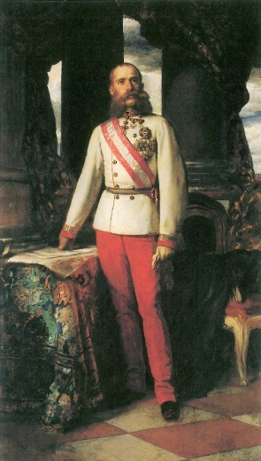
Possenhofen Castle
Sissy as a child
Sissy on her wedding day
Sissy’s family
Schönbrunn Castle
Emperor Franz Joseph I

Slide 5
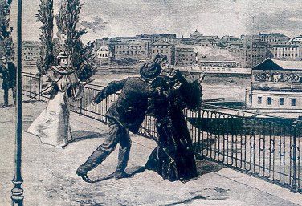
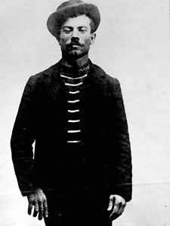
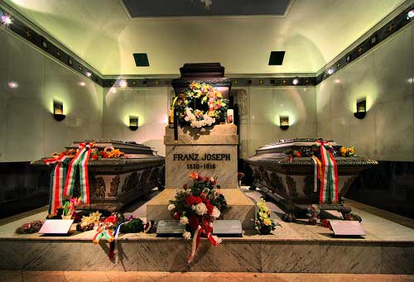
The death of Sissy
Italian Anarchist Lugigi Lucheni
Stabbed
Thought that he bumped into her trying to steal her purse
The attack
Luigi Lucheni
Sissy‘s and her husband‘s grave

Slide 6
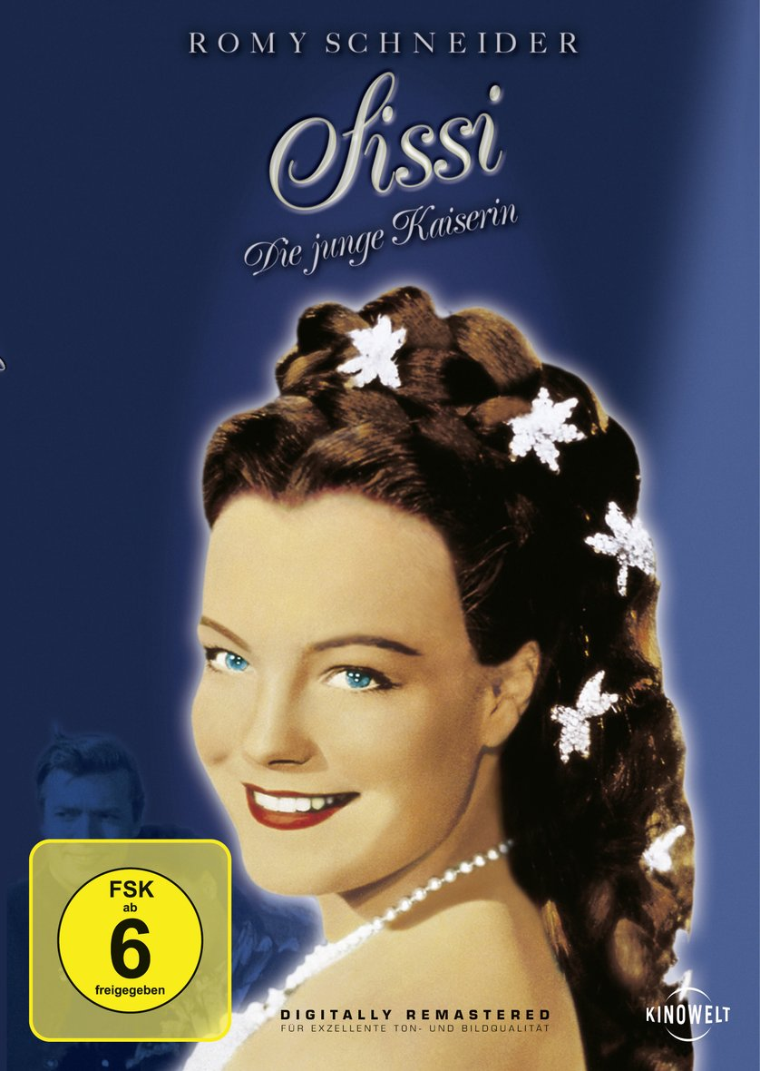
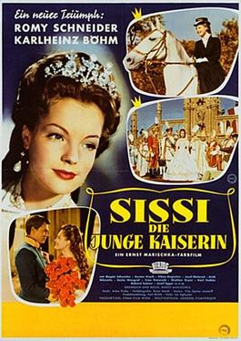
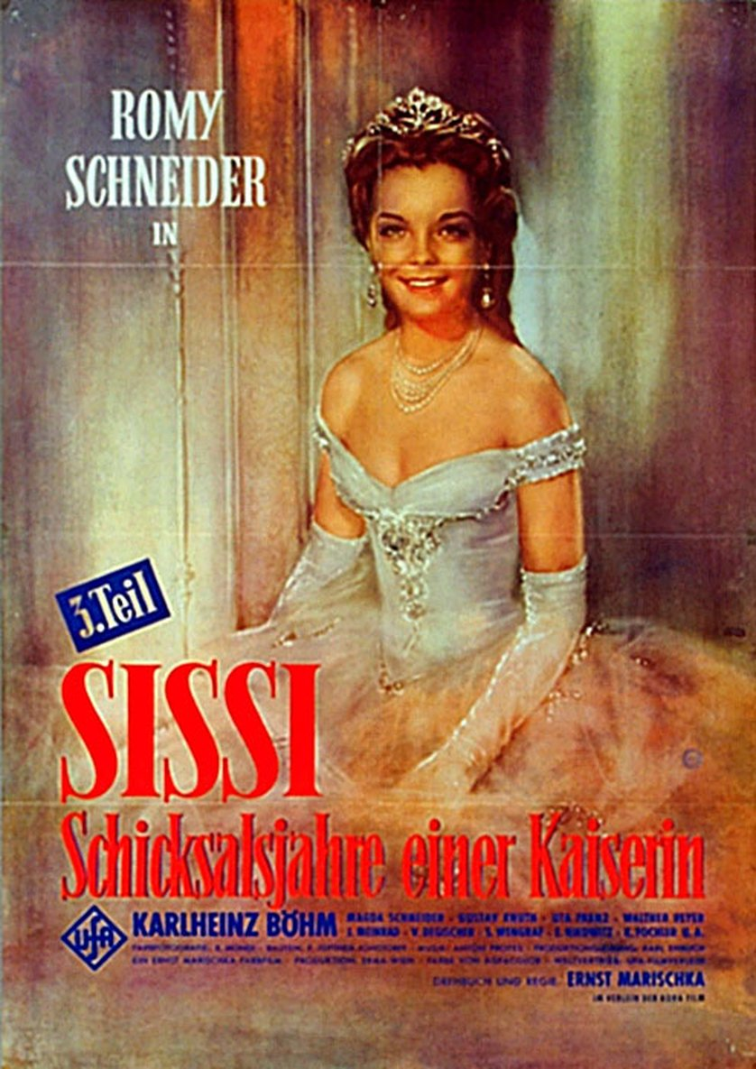
Famous Sissy-Movies

Slide 7
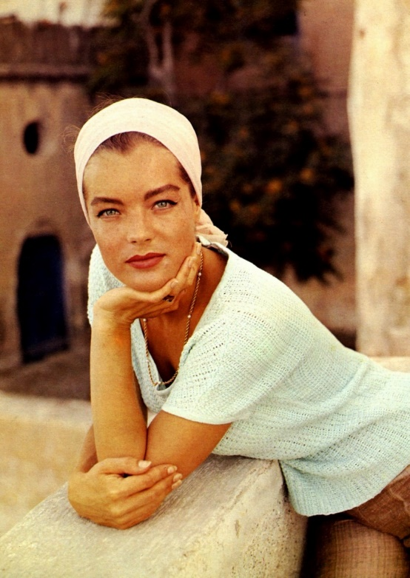
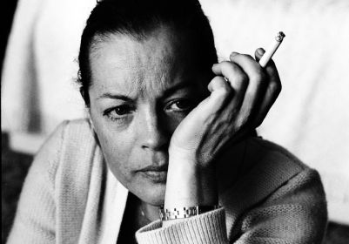
Romy Schneider
* 23th of September 1938 in Vienna
† 29th of May in Paris
Civil name: Rosemarie Magdalena Albach
Beautiful-Famous-Miserable as sin:
The boon and bane of the Sissy-Movies
“Childstar” (16 years)
“La Grande Dame” in France
Married two times
Two children

Slide 8
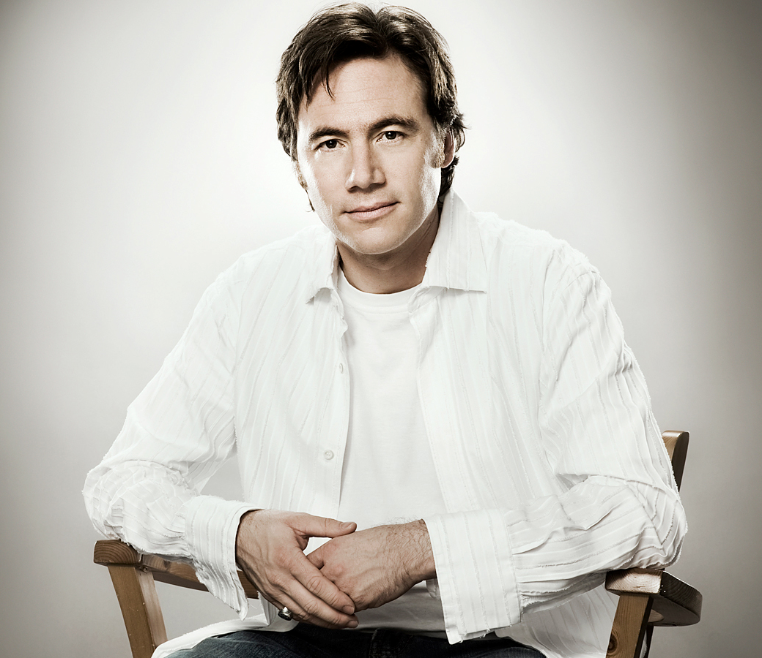
Sissy‘s life as a comedy movie
German actor and director: Michael „Bully“ Herwig

