Slide 1
Austrian actors and actresses
Kristina Niemetz, Lea Ramsauer, Melissa Groinig

Slide 2
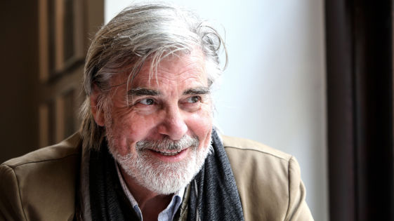
Peter Simonischek
Peter Maria Simonischek was born on 6th August 1946 in Graz.
From 2002 to 2009 he played the part of ,,Jedermann“(EVERYMAN) at the Salzburg Festival.
Since 26th August 1989 he has been married to the Austrian actress Brigitte Karner. Together they have two children.
He is starring in the movie „Toni Erdmann“ which is nominated for the best foreign language film this year.

Slide 3
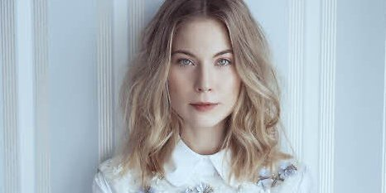
Nora von Waldstätten
Nora von Waldstätten was born on
1 Dezember 1981 in Vienna.
From 2003 to 2007 she studied arts.
In 2007 she graduated at the university of arts in Berlin.
Her real name is Nora Marie-Theres Beatrice Elisabeth Waldstätten.

Slide 4
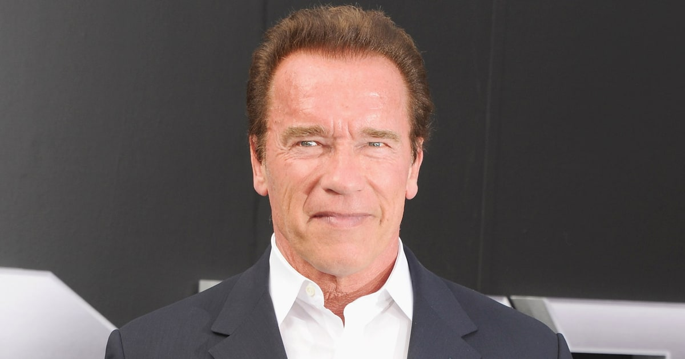
Arnold Schwarzenegger
He was born on 30th of July 1947 in Thal. He´s an Austrian-American actor, producer, politician…
He served in the Austrian Army in 1965. During his service in the Army he won the Junior Mr. Europe contest.
Schwarzenegger gained worldwide fame as a Hollywood action film icon. His breakthrouh film was the sword-andc-sorcery epic Conan the Barbarian in 1982.
He has a star on the Hollywood Walk of Fame.

Slide 5
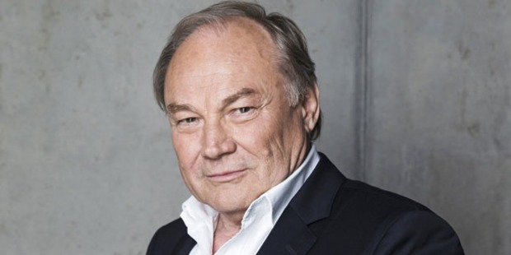
Klaus Maria Brandauer
He was born on 22th June 1943. He´s an Austrian actor, director and professor.
He was born as Klaus Georg Steng in Bad Aussee. He began acting on stage in 1962.
He starred in Out of Africa (1985), opposite Meryl Streep and Robert Redford, for which he was nominated for an Oscar and won a Golden Globe, and Szabó's Oberst Redl (1985).
Brandauer has at least a working knowledge of five languages: German, Italian, Hungarian, English and French and has acted in each.

Slide 6
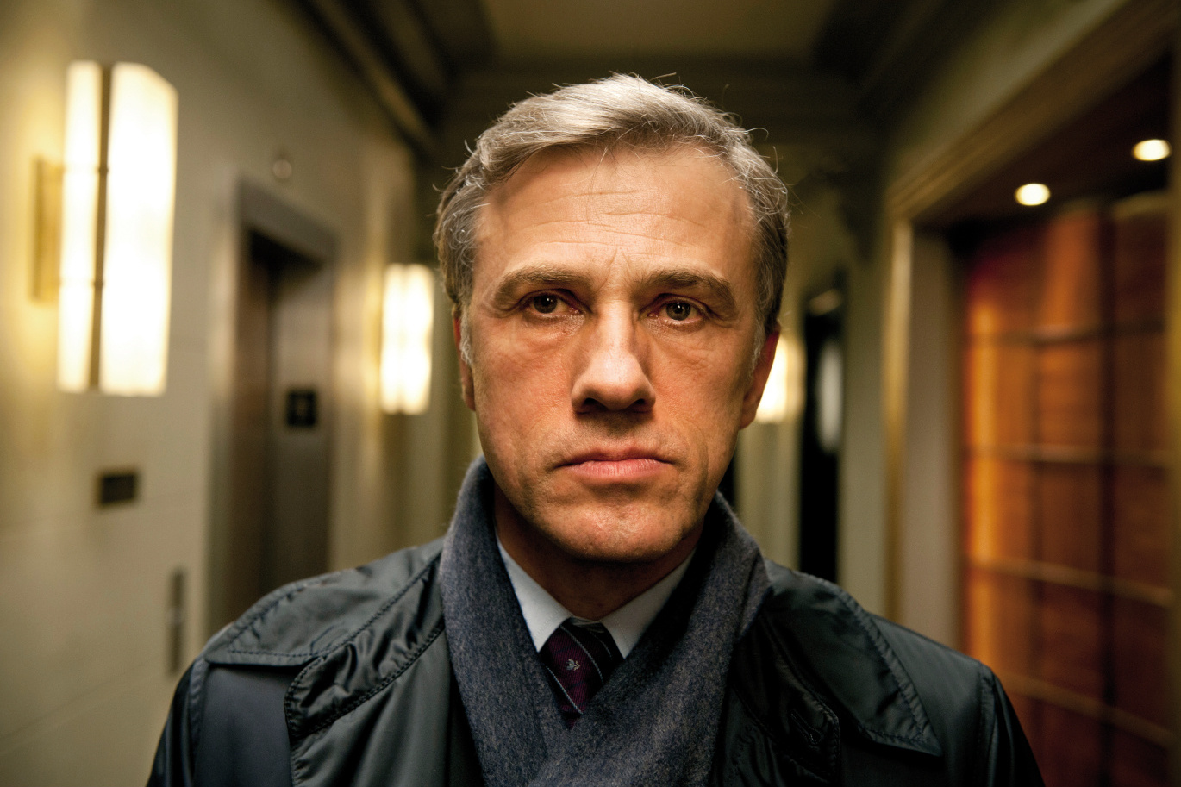
Christoph Waltz
Christoph Waltz was born on 4th October 1956 in Vienna. He’s an actor and a double Oscar winner. He became internationally famous because of the movies Inglourious Basterds (2009) and Django Unchained (2012). For each performance, he won an Academy Award, a BAFTA Award, and a Golden Globe Award for Best Supporting Actor. He also received the Best Actor Award at the Cannes Film Festival and a Screen Actors Guild Award for his portrayal of Landa.
Waltz studied acting at the Max Reinhardt Seminar in Vienna. In the late 1970s, Waltz spent some time in New York City where he studied method acting. He started as a stage actor, performing at venues such as Zurich's Schauspielhaus Zürich, Vienna's Burgtheater, and the Salzburg Festival. He became a television actor in the years 1980 to 2000. In 2000, he made his directorial debut, with the German television production “Wenn man sich traut”. Before coming to the attention of a larger audience in Tarantino's Inglourious Basterds he had played Dr. Hans-Joachim Dorfmann in the British TV series “The Gravy Train” in 1990.
Now he lives in Los Angeles and Berlin with his wife and his child. He is also father of three other children of his last marriage.

Slide 7
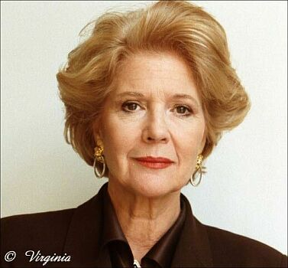
Christiane Hörbiger
Christiane Hörbiger was born on 13th October 1938 in Vienna and is an Austrian television and film actress. She has played roles in various German and Austrian TV movies and TV series. For example, from 1998 until 2002 she played the eponymous role in the Austrian TV series Julia—eine ungewöhnliche Frau (Julia—An Extraordinary Woman).
When she was 17 years old she played in her first movie Der Major und die Stiere. At the beginning of her career Hörbiger also played at many theaters.
She got awards like the Bambi and the Romy as the most popular actress.
She was married two times but now she lives with her boyfriend in Vienna and Zurich. Her son Sascha Bigler lives in Los Angeles and works as a director.

