Slide 1
Energy
Class IV 4
Teacher: Lidija Fox
Jovan Jovanovic Zmaj Primary School
Sremska Mitrovica
2020.

Slide 2
We investigated how we use energy at home, school and in our town.
We tried to learn how does this affect our environment.
This is what we learned. Maybe this will help you too.

Slide 3
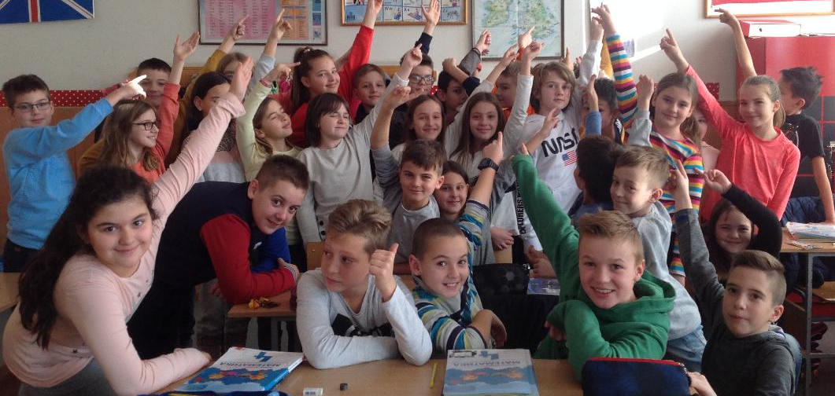
In our class there are 32 pupils. We made graphs to show how we use energy for lighting, cooking, heating and for transport.

Slide 4
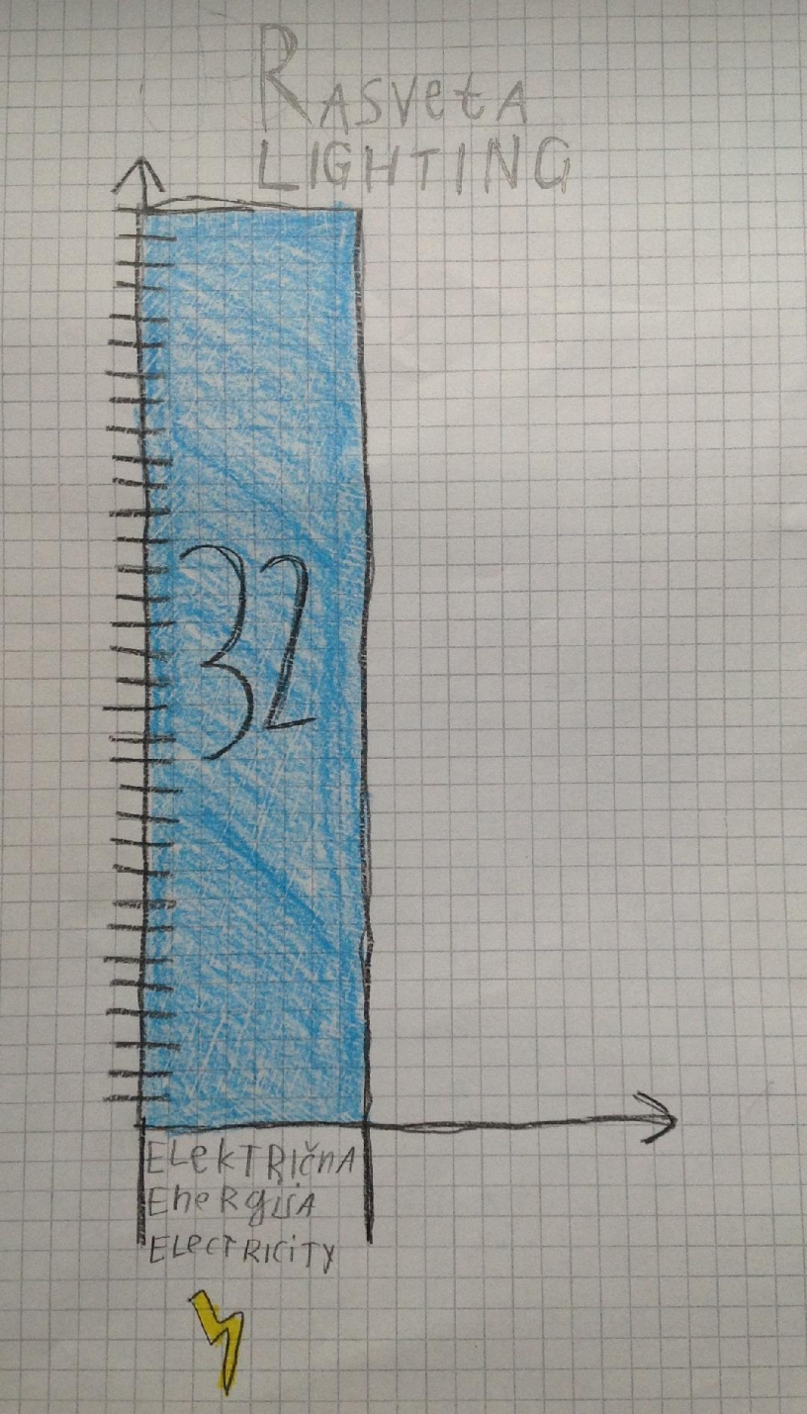
Lighting
All pupils in our class use electricity for lighting.Most of us use energy saving light bulbs at home.

Slide 5
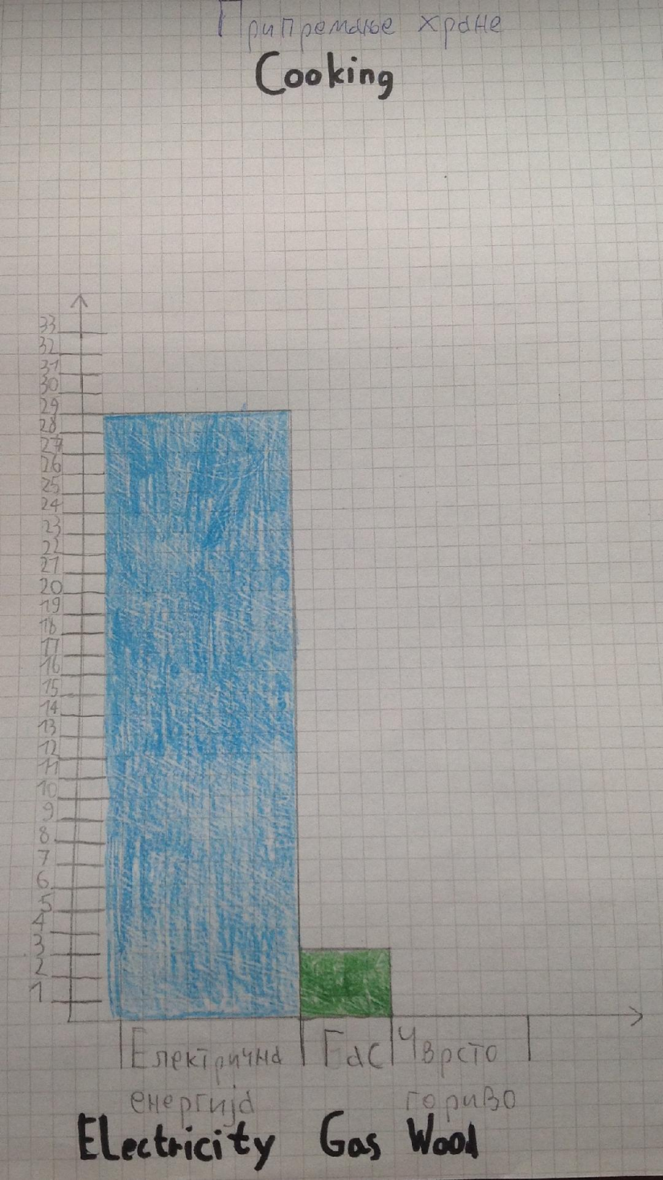
Cooking
Most of us use electricity for cooking. Some of us use gas.

Slide 6
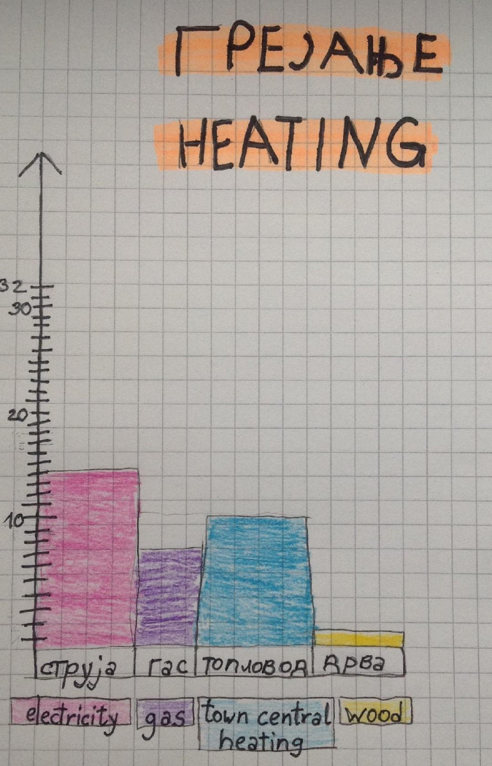
Heating
For heating we use most electricity, then town central heating, then gas.

Slide 7
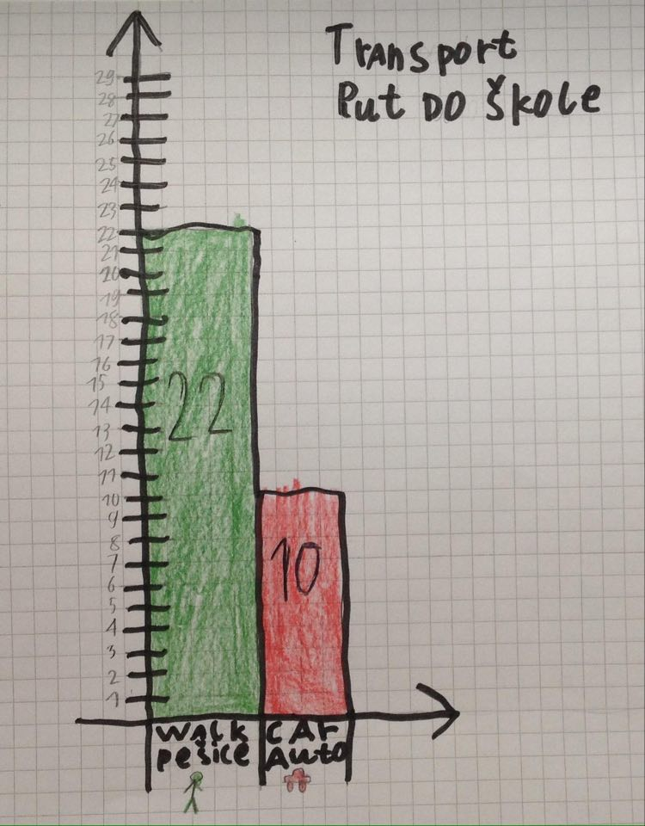
Transport
Most of us walk to school. Some use cars.

Slide 8
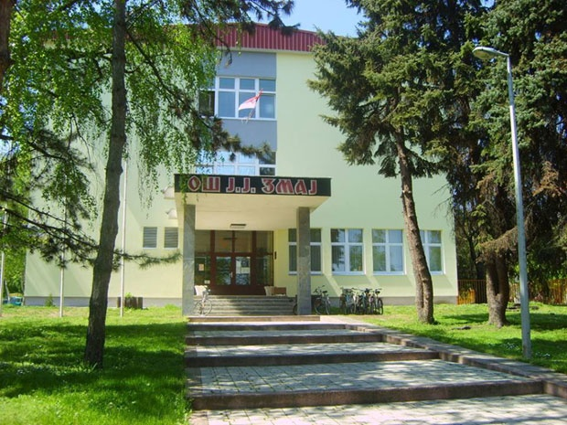
We learned that we use town central heating in our school.
Тоwn central heating uses mostly gas, аnd sometimes they use biomass plant waste.

Slide 9
Our school is insulated from outside and we have double glazing.This is how we save energy for heating. The heat stays inside the building, instead coming out through windows and walls.

Slide 10
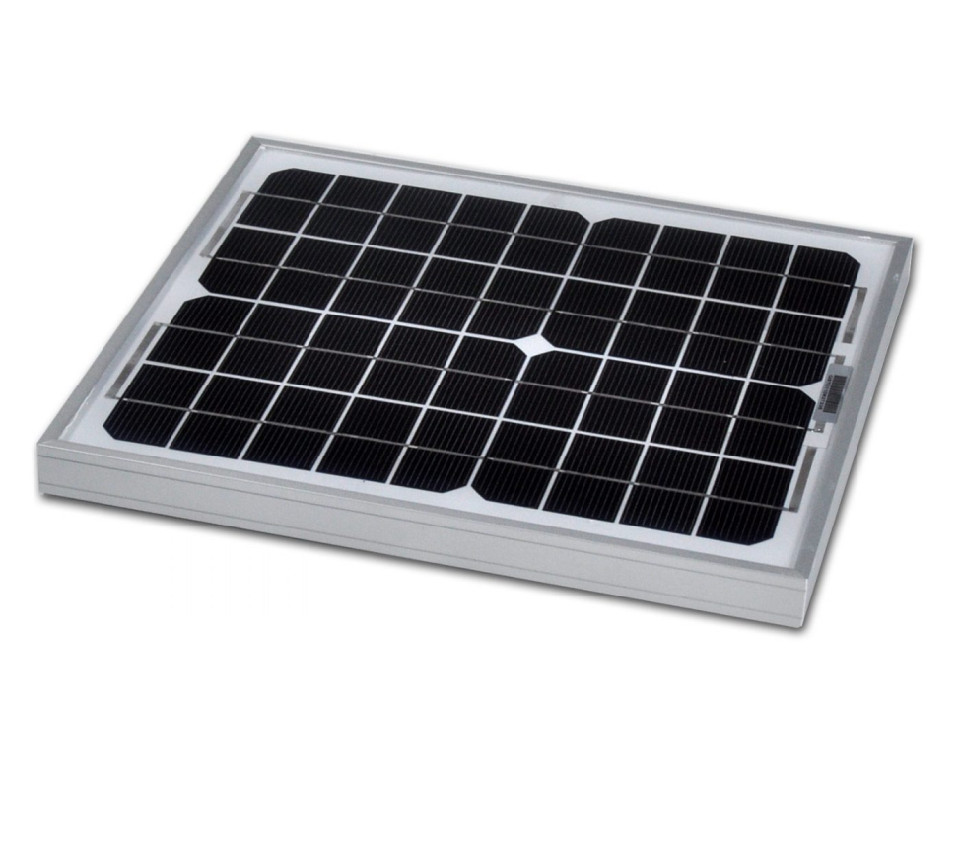
In school we have solar panels which we use for heating some water.

Slide 11
ELECTRICITY
We learned that out town sometimes gets electricity from coal. This is bad because it causes pollution.
Sometimes we get electricity fro hydroelectric power plant. This is great because it does not cause pollution.

Slide 12
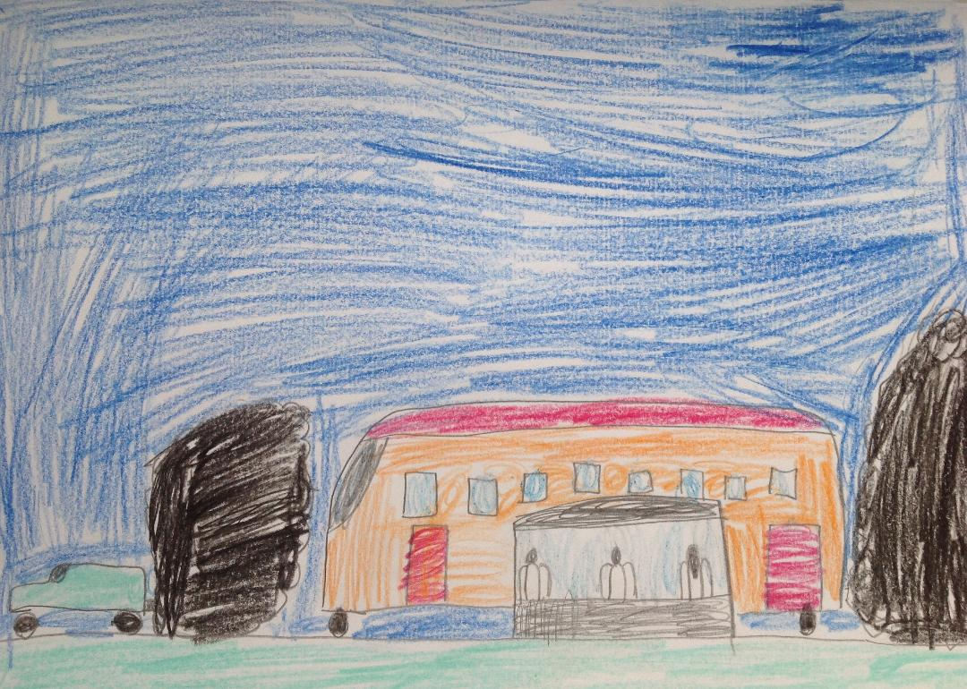
In our town most people travel in cars. There is public transport-busses.
Cars and busses use petrol and diesel. They cause lots of air pollution.

Slide 13
Earlier we learned about renewable sources of energy and about fossil fuels.

Slide 14
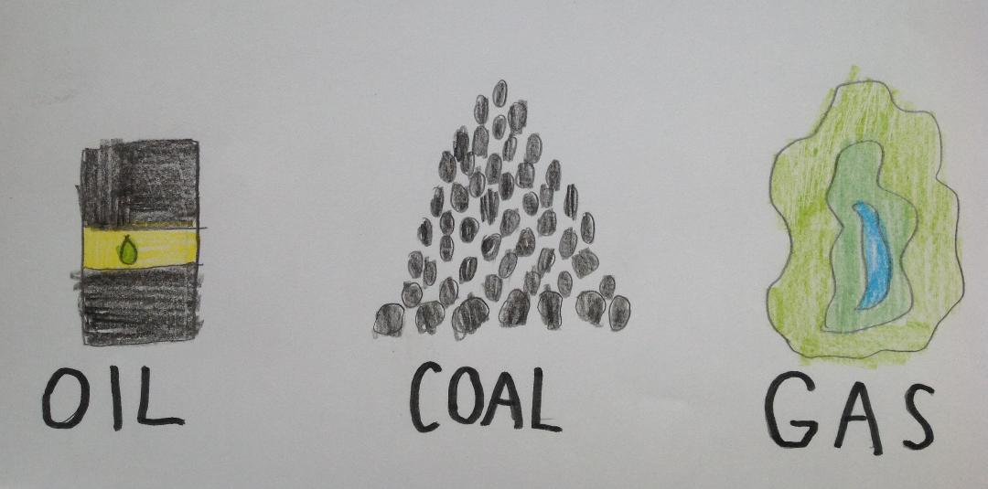
Fossil fuels are oil, coal and gas. When we use them up, there will be no more left. Except gas, all of them cause pollution.

Slide 15
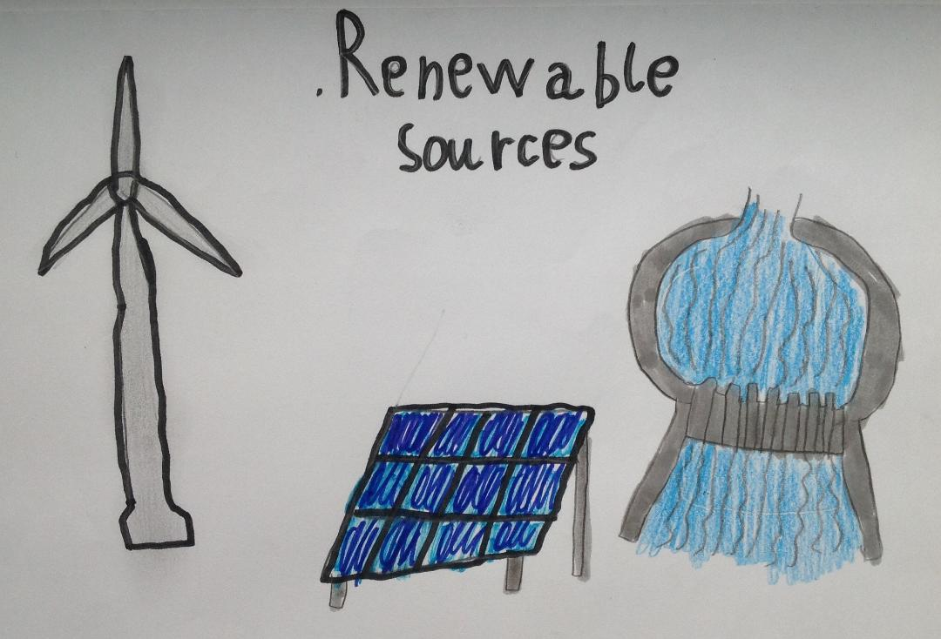
Most important renewable sources are water, wind, sun. We use them to make energy. They do not cause pollution and we will not use them up.

Slide 16
We should to more save energy and make energy from renewable sources.

Slide 17
How to save
Here is some advice how to save energy.

Slide 18
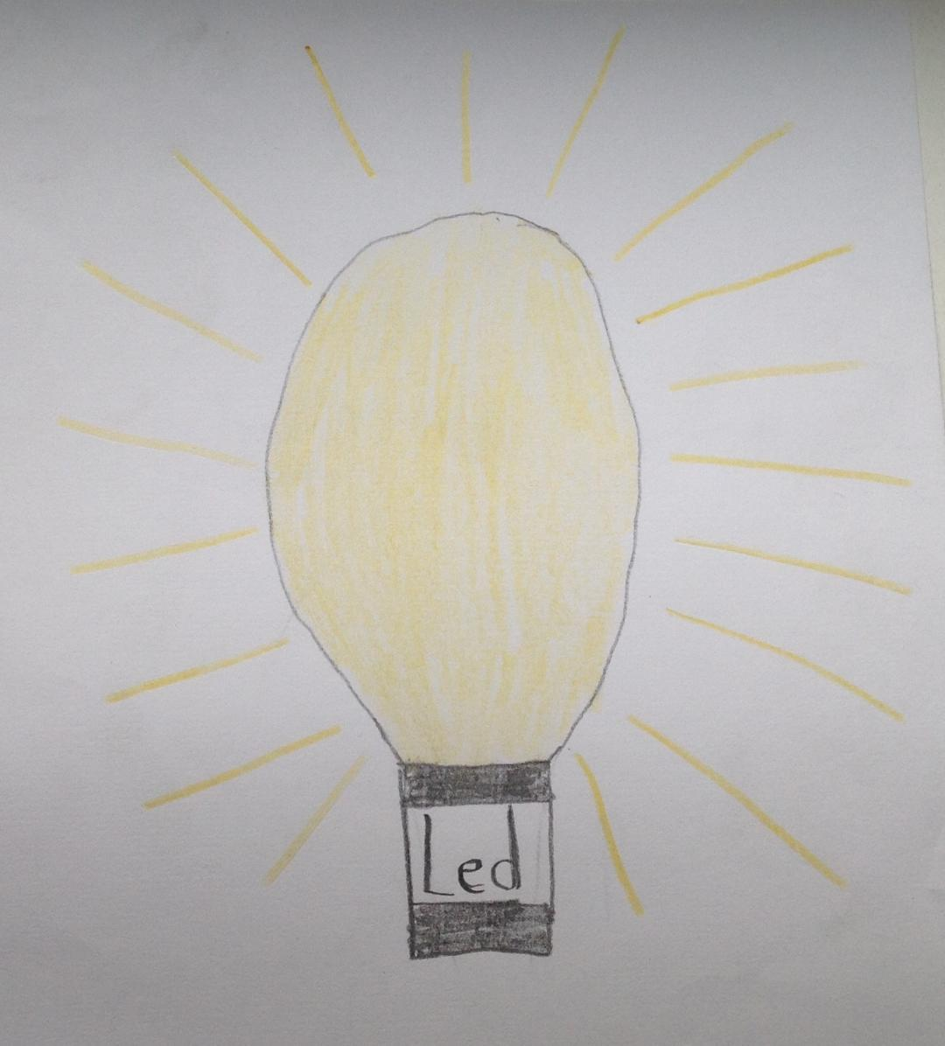
In house
Use energy saving light bulbs.
Turn off light when you leave the room.

Slide 19
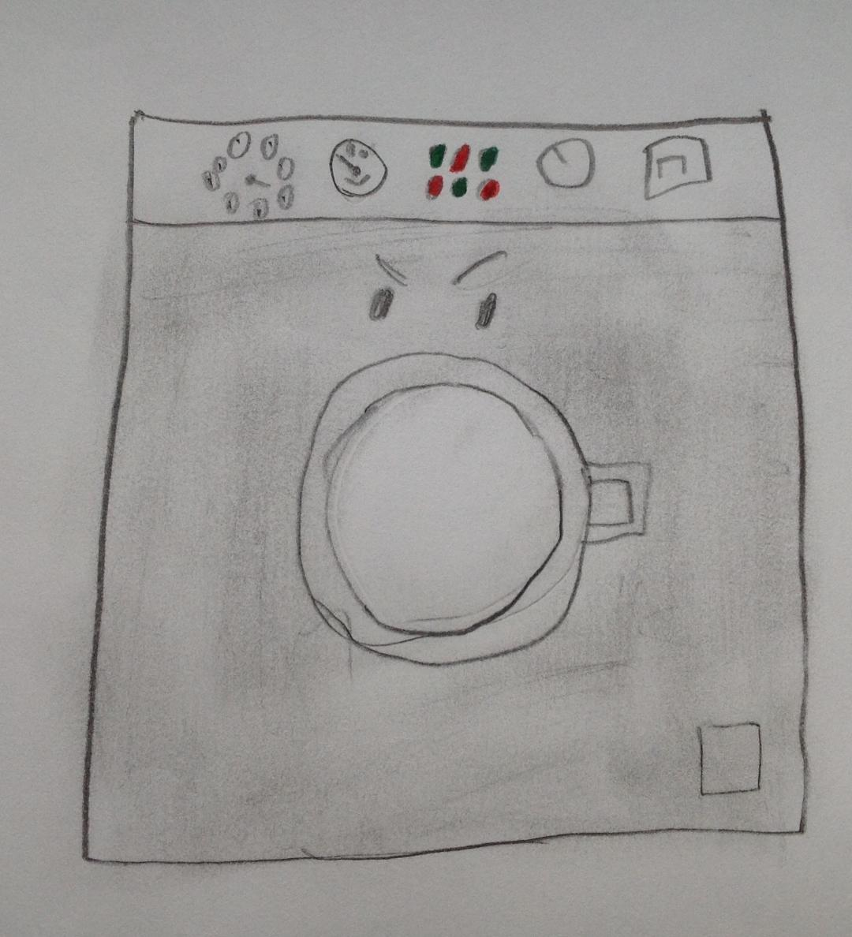
Instead of taking a bath,use shower.That uses less energy for heating water.
Wash laundry when washing mashine full and lower temperature.

Slide 20
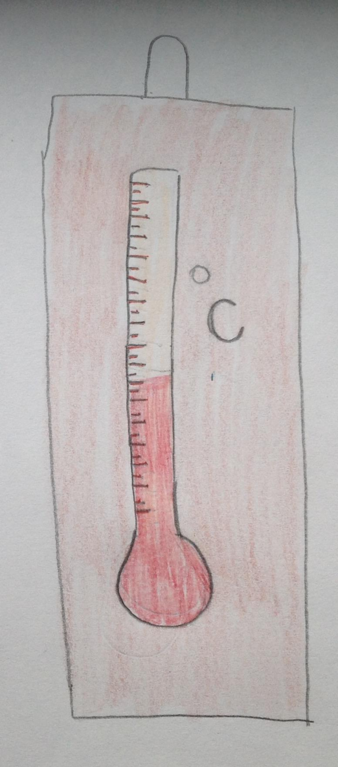
Don’t hold open the fridge for too long. You will save energy.
If you can, lower the teperature in the house for one or two deggres. You will save a lot of energy.

Slide 21
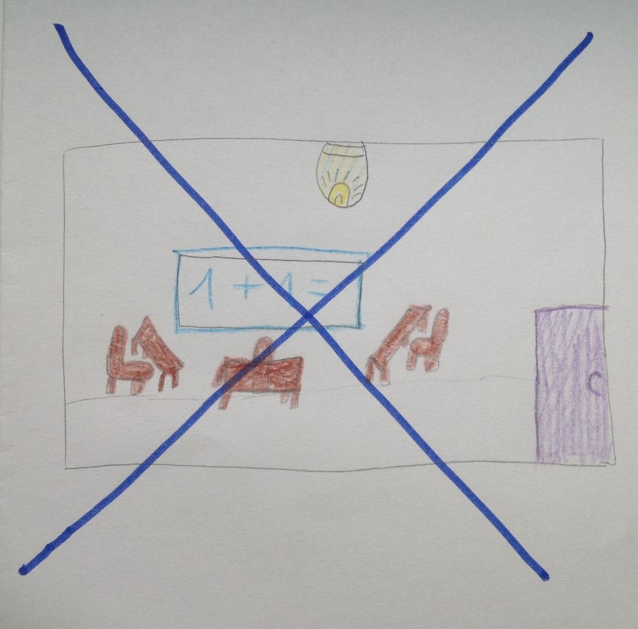
In sch00l
If not necessary don’t turn on light in classroom.
Turn off the lights when to the gym to have PE.

Slide 22
If you have air conditioning in your classroom, use it only when it is too hot. If it is not too hot, open windows.

Slide 23
Talk to your teachers about other ways to save energy.

Slide 24
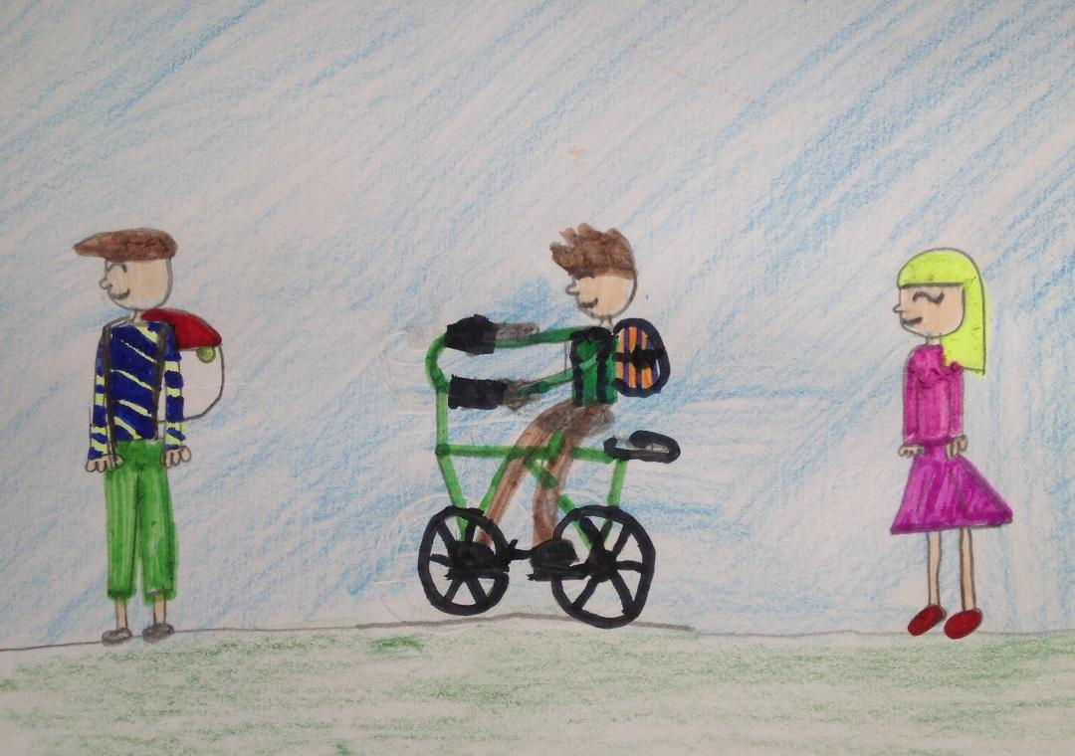
In town
When you can, walk or use bike instead of driving in cars.

Slide 25
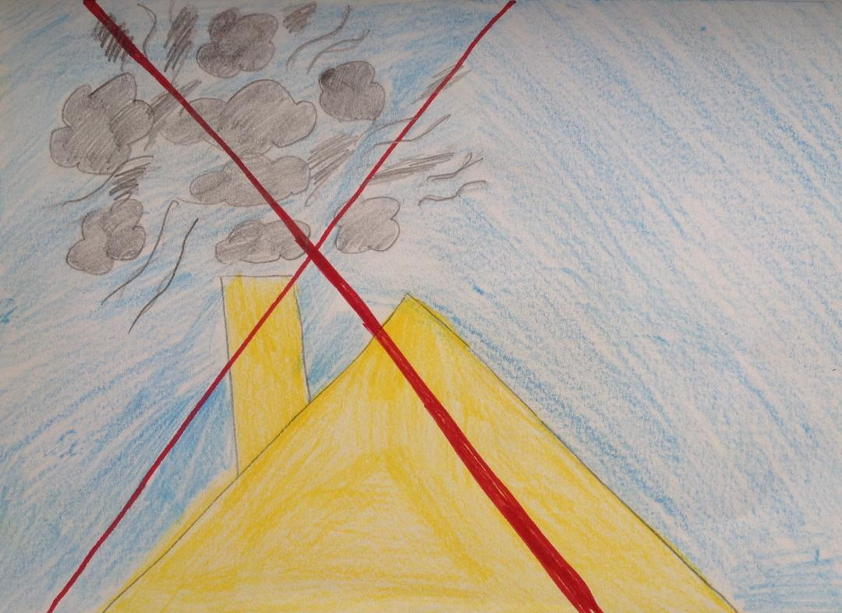
If you can, do not use coal of wood for heating. It pollutes air very much!

Slide 26
ENERGY IS PRECIOUS. LOOK AFTER OUR PLANET.

