Slide 1
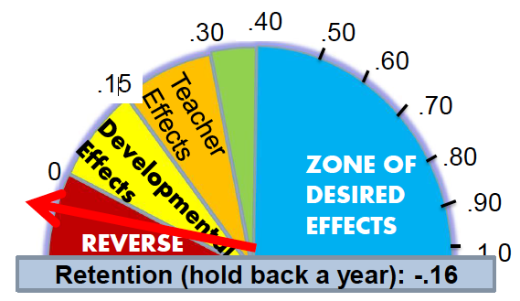
Visible Learning - John Hattie´s Research -
Detlev Lindau-Bank
VT4P
Visible teaching for Performance

Slide 2
VT4P - Hattie-Study
Agenda
Introduction
Preliminary Estimate
Presentation of the results
discussion
perspectives
discussion
Conclusions

Slide 3
Discussion
Kriticritical review

Slide 4
Beware of the leaderboards! The first impression can be fooled !!
The effect size does not say anything about the quality of the investigated measures.
The effect size averages the results of the meta-studies - some are very disparate.
Anglo-Saxon education and school culture differs from many other european countries.
Academic (school) learning is only part of the educational mandate.
Only the interplay of variables makes school and teaching quality.
Notes:
Vorsicht mit den Ranglisten! Der erste Eindruck kann täuschen!!
Die Effektstärke sagt nichts über die Qualität der untersuchten Maßnahmen aus.
Die Effektstärke mittelt die Ergebnisse der Metastudien, manche sind sehr disparat.
Angelsächsisch geprägte Unterrichts- und Schulkultur unterscheidet sich von deutscher.
Akademischer Lernerfolg ist nur ein Teil des Bildungsauftrags.
Erst das Zusammenspiel von Variablen macht Schul- und Unterrichtsqualität aus.

Slide 5
Example 1. Multi grade/age classes - Effec size .04 = no impact
Question: Why does not it work?
Answer: Because there are almost only results from studies in which the teaching is not adapted to the particular learning situation !!
"It is likely that teachers teach in a similar way to the distribution of age range in the class, and the multi-grade classes are often split by age for grouping"! (Hattie study, p. 93)
If cooperative learning methods are used, the effect size increases by more than 10 times !!
Notes:
Frage: Warum wirkt es nicht?
Antwort: Weil es fast nur Ergebnisse aus Studien gibt, in denen der Unterricht nicht an die besondere Lernsituation angepasst ist!!
„.. it is likely that teachers teach in a similar way regardless of the distribution of age range in the class, and the multi-grade classes are often split by age for grouping”! (Hattie Studie, S. 93)
Werden kooperative Lernsituationen genutzt, steigt die Effektstärke um mehr als das 10-fache!!

Slide 6
Example 2. open vs. Traditional lectures - Effect size .01 = no impact!
Question: Why does not it work?
Answers:
Because the data is too small (four meta-studies),
the studies are outdated (1980 and 1982),
because there is a problem of definition.
It is also correct: Methods of open teaching achieve high effect sizes:
reciprocal teaching (pupils as teachers) .74
Self-questioning .64
Learning skills (study skills) .59
Notes:
Frage: Warum wirkt es nicht?
Antworten: Weil die Datenlage zu klein ist (vier Metastudien), die Studien veraltet sind (1980 bzw. 1982), weil es ein Definitionsproblem gibt.
Denn es gilt auch: Methoden des offenen Unterrichts erzielen hohe Effektstärken:
reziprokes Unterrichten (pupils as teachers) .74
Selbstbefragungen (self-questioning) .64
Lerntechniken (study skills) .59

Slide 7
Example! 3. Direkte Instruktion – effect size .59 – desired effect
Question: Why does it work?
Antwort: Because it is demanding integrated frontal lessons!
„.. the teacher decides the learning intentions and success criteria, makes them transparent to the students, demonstrates them by modeling, evaluates if they understand what they have been told by checking the understanding, and re-telling them what they have told by tying it all together with closure”! (Hattie Studie, S. 206)

Slide 8
Hatties conclusion
Don´t blame the students!
„when teachers see learning through the eyes of the student“
The teacher matters!
What teachers do matters!
Notes:
„Schülerorientierung“: Don´t blame the students!
Mit den Augen der Lernenden – Die Lehrperson als Lernende.
(„when teachers see learning through the eyes of the student“; S. 238)
Auf den Lehrer kommt es an: The teacher matters!
What teachers do matters!
What teachers do matters!
What some teachers do matters!

Slide 10
4 key topics
Dual education system in TVET - Duales Lernen
Full time/All-Day schooling - Ganztägiges Lernen
Individualisation of learning - Individualisierung des Lernens
Differentiation - Differenzierung

Slide 11
4 key topics
Dual educational system
There are no comparable system in anglo-american countries
All-day learning
In anglo-american countries taken for grantedness

Slide 12
4 key topics
Individualisation - Individualisierung des Lernens
reciprocal teaching (0.88) – Schüler als Lehrer
feedback (0.74) - Rückmeldungen an Schüler/Lehrer
reading/creativity/comprehension programms (0.67)
self-verbalization (0.64) – Schülerselbstkontrolle

Slide 13
4 key topics
Differentiation - Differenzierung
teacher clarity (0.75) – Klarheit der Lehrkraft
problem-solving teaching (0.61) – problemlösendes Lernen/Lehren
cooperative learning (0.57) – kooperatives Lernen
peer tutoring (0.55) – Schüler als Lerncoaches
classroom management (0.52) - Klassenführung

Slide 15
What do you think? Active or facilitating Teacher
An active teacher,
passionate for their subject and for learning,
a change agent
OR
A facilitative, inquiry or discovery based provider
of engaging activities

Slide 16
Activator or Facilitator?
An activator
Reciprocal teaching
Feedback
Teaching students self-verbalization
Meta-cognition strategies
Direct instruction
Mastery learning
Goals –challenging
Frequent / effects of testing
Behavorial organizers
A facilitator
Simulations and gaming
Inquiry base teaching
Smaller class sizes
Individualised instruction
Problem-based learning
Different teaching for boys and girls
Web-based learning
Whole Language Reading
Inductive Teaching

Slide 17
Activator or Facilitator?
ES
.74 .72 .67 .67 .59 .57 .56 .46 .41
ES
.32 .31 .21 .20 .15 .12 .09 .06 .06
An activator
Reciprocal teaching
Feedback
Teaching students self-verbalization
Meta-cognition strategies
Direct instruction
Mastery learning
Goals –challenging
Frequent / effects of testing
Behavorial organizers
A facilitator
Simulations and gaming
Inquiry base teaching
Smaller class sizes
Individualised instruction
Problem-based learning
Different teaching for boys and girls
Web-based learning
Whole Language Reading
Inductive Teaching
.60
.17
Notes:
17

Slide 18
Activist teaching
Didactic
Facilitator
The extremes of teaching
Stand and deliver
Organises resources
Teacher centred/ student centred
Sage on the stage
Meddler in the middle
Guide on the side
Notes:
Sage – wise man
Meddler - Wichtigtuer

Slide 19
Teaching associated with student learning
Having specific learning intentions and success criteria
Setting challenging tasks
Providing multiple opportunities for deliberative practice
Knowing when one (teacher and student) is successful in attaining goals
Understanding the critical role of teaching appropriate learning strategies
Planning and talking about teaching
Constantly seeking feedback as to the success of the teaching on the students
Notes:
19

Slide 20
Teacher contributions to student learning:
The quality of teaching – as perceived by the students
Teacher expectations
Teachers conceptions of teaching, leaning, assessment and the students – this relates to views of whether all students can progress, whether achievement for all is believed in and whether progress is understood and articulated
Teacher openness – whether teachers are prepared to be surprised
Classroom climate having a warm socio-emotional climate in the classroom where errors are not only tolerated but welcome
A focus on teacher clarity in articulating success criteria and achievements
A fostering of effort
The engagement of all students
Notes:
20

Slide 21
Can be enabled when
Teachers can critically reflect on their own teaching using classroom-based evidence
Can be maximised when
Teachers are in a safe and caring environment among colleagues and talking about their teaching
Notes:
21

Slide 22
Activist teaching
Didactic
Facilitator
The extremes of teaching
Stand and deliver
Organises resources
Teaching as intervention
Sage on the stage
Guide on the side

Slide 24
MINDFRAME 1 of 8 Teachers/leaders as evaluators
A disposition to asking …
How do I know this is working?
How can I compare ‘this’ with ‘that’?
What is the merit and worth of this influence on learning?
What is the magnitude of the effect?
What evidence would convince you that you are wrong?
Where have you seen this practice installed so that it produces effective results?

Slide 25
Do not blame students
MINDFRAME 2 of 8 - it’s about the teacher’s /leader’s mindset, not the kids
All students can be challenged
Strategies not styles
Develop high student expectations
Enhance help seeking
Develop assessment capable students
The power of developing peer interactions
The power of critique/error/feedback
Self-regulations and seeing students as teachers

Slide 26
MINDFRAME 3 of 8 teachers/leaders as CHANGE AGENTS
Achievement is changeable and enhanceable vs. immutable and fixed
Teaching as an enabler not a barrier
Engage in the total learning and
not break into steps and chunks
The Power of learning intentions
The Power of success criteria

Slide 27
MINDFRAME 4 of 8
Teachers/leaders gaining feedback about themselves
Feedback is
information provided by an agent (e.g., teacher, peer, book, parent, self/experience)
regarding aspects of one’s performance or understanding.

Slide 28
MINDFRAME 5 of 8
AFT = Assessment as feedback to teachers
Who did you teach well, who not so well?
What did you teach well, not so well?
Where are the gaps, strengths, achieved, to be achieved?
Levels and Progress
Developing a common conception of progress
Use assessment info not to make judgements about your efficacy as a person but what you need to work on as a teacher!!

Slide 29
MINDFRAME 7 of 8
Dialogue not Monologue
What can I say – we talk too much!
80% of classroom time is estimated
as being teacher-talking – needs to be reversed

Slide 30
MINDFRAME 8 of 8
It’s about “not knowing”/error: relationships in classrooms
The importance of error and not knowing …
Build trust and rapport
Student more than teacher questioning
Teacher clarity, support, and What’s next
Peer teaching, assessment, learning
It’s more about the learning than the teaching
We don’t have to be the experts!!

Slide 31
What some teachers/leaders do!
Clear learning intentions
Challenging success criteria
Range of learning strategies
Know when students are not progressing
Providing feedback
Visibly learns themselves

Slide 32
Such that students …
Understand learning intentions
Are challenged by success criteria
Develop a range of learning strategies
Know when they are not progressing
Seek feedback
Visibly teach themselves

Slide 33
Students need to learn to ask of themselves
Where am I going?
How am I going (progress)?
Where to next?
The students can’t ask the questions unless we
teach them how to ask them, that means we need to frame the way we structure our lessons
around that sort of immediate feedback

Slide 34
Bildungspolitische Forderungen

Slide 35
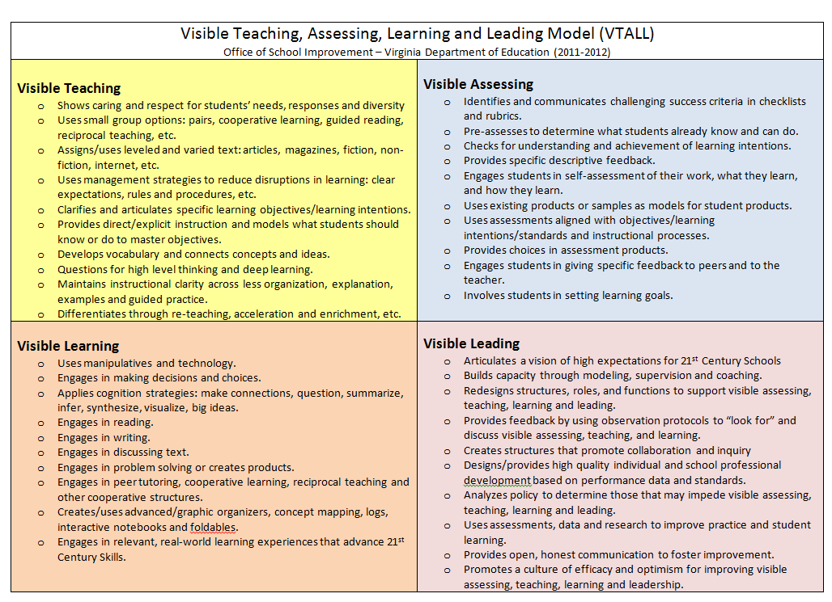

Slide 36
Critical review - revisited
Results are outdated and therefore no longer relevant
No, although studies that are used are older, more recent research findings (for example on self-directed learning, for example Dignath, Büttner & Langfeldt, 2008) validate the findings of the Hattie study
Notes:
Ergebnisse sind veraltet und deshalb nicht mehr relevant
nein, Studien, die herangezogen werden, sind zwar älter, aber auch neuere Forschungsbefunde (z.B. zum selbstgesteuerten Lernen, z.B. Dignath, Büttner & Langfeldt, 2008) lassen sich durchaus in den Befundrahmen der Hattie- Studie einordnen

Slide 37
Critical review - revisited
Cognitive achievements are in the foreground
yes, but we also know that the cognitive and the affective-motivational development correspond with each other
for example,
achievement and self-concept,
achievement and competence experience
Achievement and motivation)
Notes:
kognitive Leistungen stehen im Vordergrund
ja, aber wir wissen auch, dass die kognitive und die affektiv-motivationale Entwicklung miteinander korrespondieren (z.B. Leistung Selbstkonzept, Leistung Kompetenzerleben Motivation)

Slide 38
Results cement the image of directive, teacher-led teaching and are incompatible with constructivist ideas and theories
directive: no, teacher-led: yes,
Hattie's results do not paint the picture of a boring frontal lesson, but the image of a lesson in which
the teachers profess their responsibility for student´s learning
a fearless teaching climate prevails and mistakes are understood as learning causes
students are challenged
students are systematically guided to self-control learning
students are cognitively activated
Notes:
Ergebnisse zementieren das Bild eines direktiven, lehrergelenkten Unterrichts und vertragen sich nicht mit konstruktivistischen Ideen und Theorienansätzen
direktiv: nein, lehrergelenkt: ja,
Hatties Ergebnisse zeichnen nicht das Bild eines langweiligen Frontalunterrichts, sondern das Bild eines Unterrichts, in dem
sich die LPS zu ihrer Verantwortung für das Lernen der SuS bekennt
ein angstfreies Unterrichtsklima herrscht und Fehler als Lernanlässe begriffen werden
den SuS etwas zugetraut aber auch zugemutet wird
die SuS systematisch zur Selbststeuerung angeleitet werden
die SuS kognitiv aktiviert werden

Slide 40
Bildungspolitische Herausforderungen
Welche empirische Evidenz gibt es für eine Maßnahme?
Legitimationsaspekt
Wie ist die Maßnahme gedacht? Wie funktioniert sie? Worauf kommt es dabei an?
Verständnisaspekt
Können das erfahrene Lehrpersonen demonstrieren? Funktioniert das in der Praxis?
Realisierungsaspekt:

Slide 41
Wo und wie kann das – im Hattieschen Dreischritt (surface knowledge, deeper understanding, construct knowledge) – gelernt werden? Q
Qualifizierungsaspekt
Wie stellt die Schulverwaltung sicher, dass die Maßnahme wirkt und Regelpraxis wird
Kontrollaspekt, Qualitätssicherung

Slide 42
Bildungspolitische Perspektiven
Ziel- und Wirkungsorientierung (empirische Evidenz; Wende?)
Einfachstruktur, Konzentration auf die Haupt- bzw. Basiskomponenten; Begrenzung von Maßnahmen
Praxisorientierung (Machbarkeit, Anschlussfähigkeit)
Finanzierbarkeit (langfristige Sicherung)
Langfristigkeit

Slide 43
Bildungspolitische Perspektiven
‚Konzepttreue‘ und Verbindlichkeit
Beständigkeit (Kontinuität, Konsistenz, Kohäsion)
Abgestimmtheit (auch Anschlussfähigkeit) der Maßnahmen
Abgestimmtheit der Aufgabenrollen und Handlungsebenen
Information und Dialog (Partizipation)

Slide 45
Fazit – Schule ist für die Zukunft
Schule ist Lernort und Lebenswelt
Schule ist vielfältiger
Die Welt der Kinder nicht kolonialisieren
Schule ist eine Gesellschaft im Kleinen
Bildung ist auch Arbeit an Haltungen, die weder gemessen noch bewertet werden können
nicht ausschließlich funktionalisieren
Nicht Alles, was gut zu messen ist, ist auch gut
Hattie-Studie misst Lernerfolg fachbezogen, aber Wissenschaft wird zunehmend inter- und transdisziplinär
Kompetenzerwerb, -erweiterung, und -aufbau sind weitaus komplexer

Slide 46
Fazit – Schule ist mehr als ein Lernort
Schule bedeutet auch Zeit für Kinder
nicht ausschließlich ökonomisieren
Es ist nicht immer schlimm, wenn Kinder nur so schnell lernen, wie sie es auch ohne Unterricht tun würden
Schulentwicklung unterstützen durch Evidenz–
Schulentwicklern sollten gut aufbereitete Forschungsdaten zur Verfügung stehen
Schule entwickeln, Schule leiten heißt Entscheidungen treffen – empirische Studien sind hier Entscheidungshilfen (nicht Zwänge)

