Slide 1
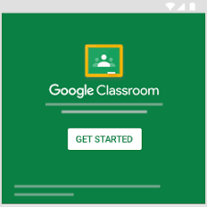
Google Classroom is a free web service developed by Google for schools.
That aims to simplify creating and grading assignments. The primary purpose of Google Classroom is to streamline the process of sharing files between teachers and students.^{[1]}

Slide 2
Sign in to Gmail with your google account

Slide 6
Students can be invited to join a class through a private code, or automatically imported from a school domain.

Slide 7
Teachers can create, distribute and mark assignments all within the google ecosystem.

Slide 8
Each class creates a separate folder in the respective user's drive, where the student can submit work to be graded by a teacher. Assignments and due dates are added to google calendar, each assignment can belong to a category (or topic

Slide 10
Teachers can monitor the progress for each student by reviewing revision history of a document, and after being graded, teachers can return work along with comments

