Slide 1
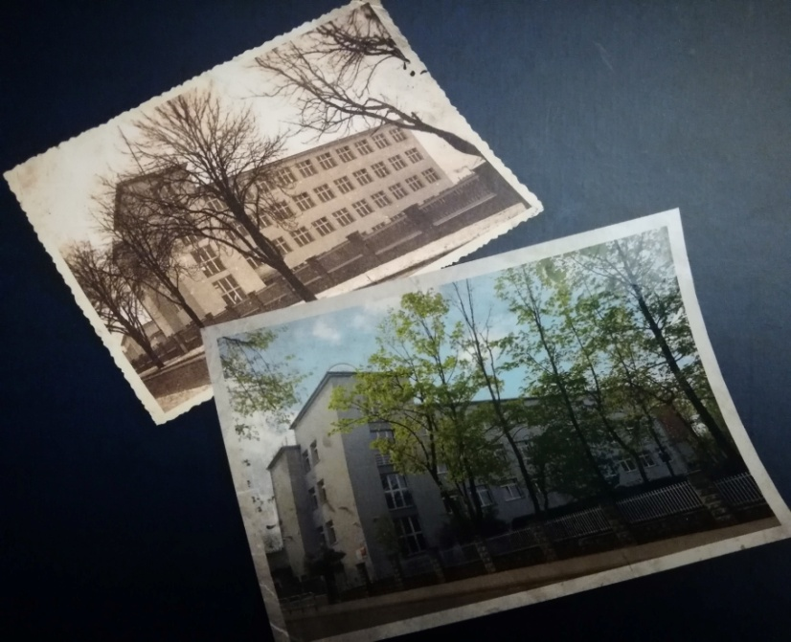
OUR SCHOOL
Andrzej Frycz Modrzewski High School
with bilingual departments
in Rybnik

Slide 2
A BIT OF OUR SCHOOL’S HISTORY
1935 – MARSHAL JÓZEF PIŁSUDSKI PUBLIC SCHOOL
1939-1941 - GERMAN SCHOOL
1941 - GERMAN WAR HOSPITAL
1945 – REOPENING OF POLISH SCHOOL
1948 – PRIMARY SCHOOL AND HIGH SCHOOL FOR WOMEN
1961 – SCHOOL IS BEING NAMED AFTER HANKA SAWICKA
1999 – SCHOOL IS BEING NAMED AFTER ANDRZEJ FRYCZ MODRZEWSKI
Notes:
2

Slide 3
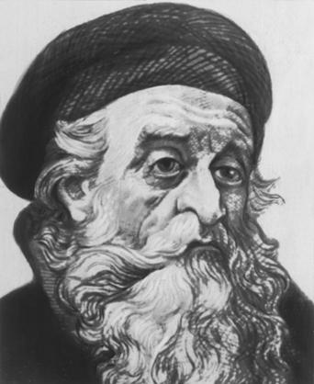
OUR PATRON – ANDRZEJ FRYCZ MODRZEWSKI
POLISH RENAISSANCE SCHOLAR, HUMANIST AND THEOLOGIAN,
CALLED "THE FATHER OF POLISH DEMOCRACY”
HE WAS CHOSEN AS OUR PATRON IN SCHOOL VOTING IN 1999
PORTRAIT OF OUR PATRON

Slide 4
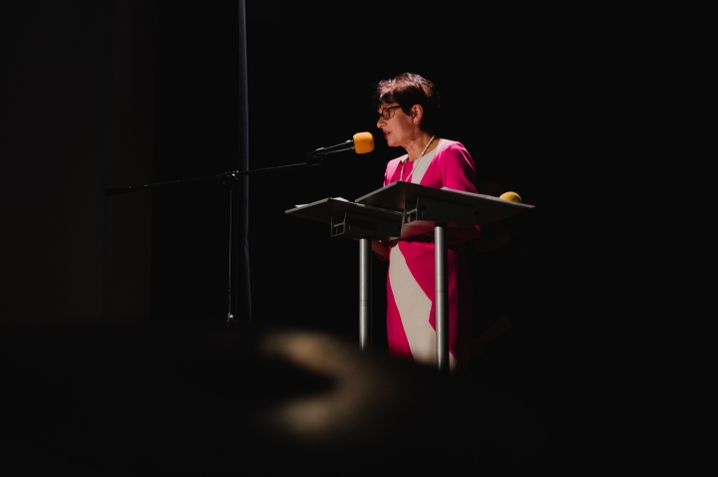
OUR TEACHERS
The School Principal: Maria Malinowska
(since 2002)
MRS MALINOWSKA DURING SCHOOL JUBILEE

Slide 5
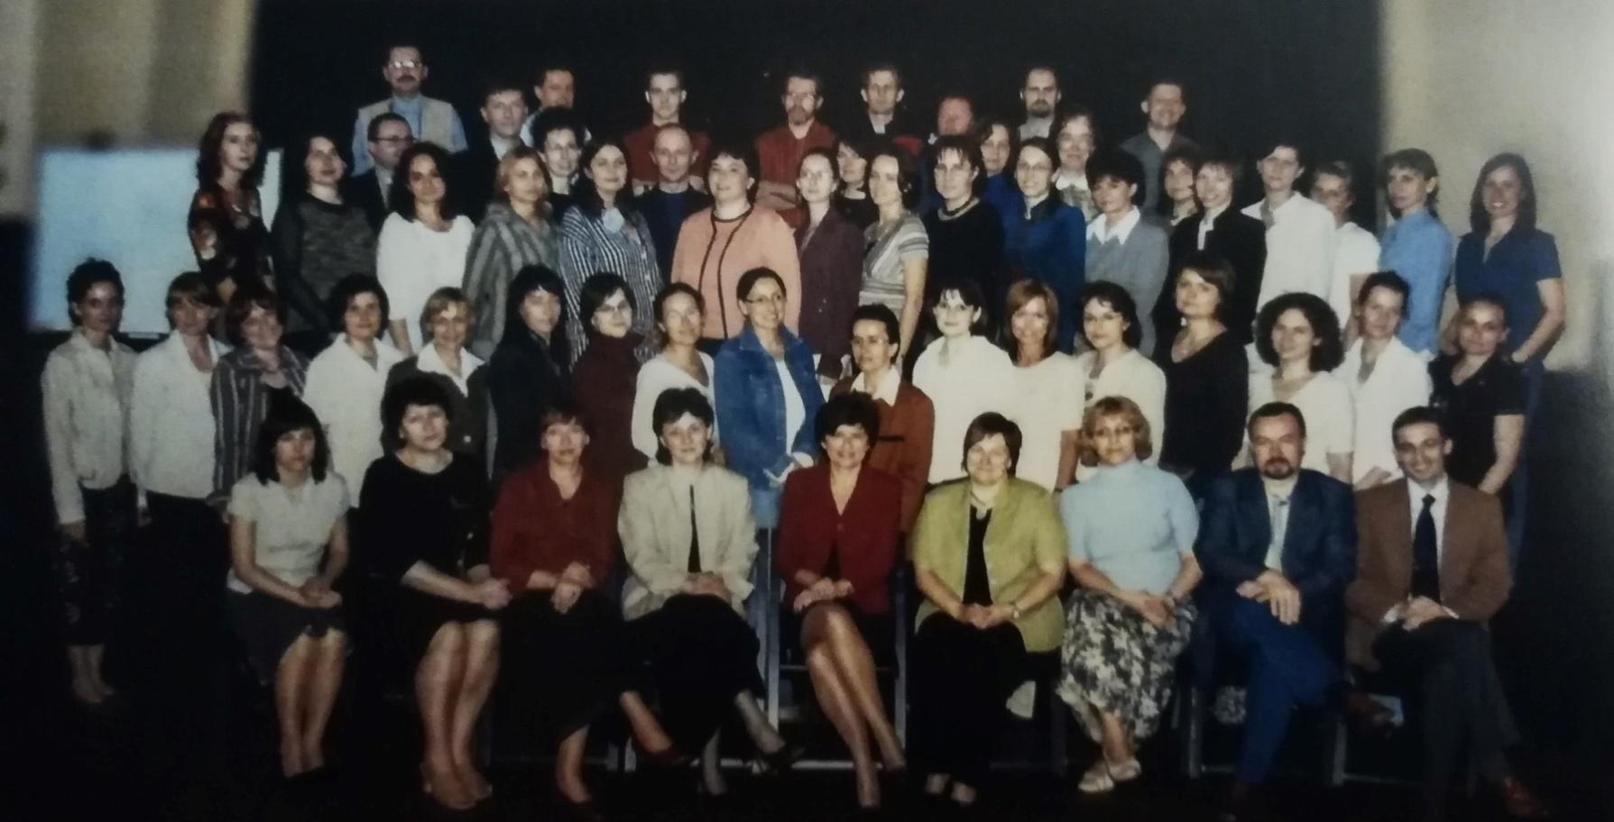
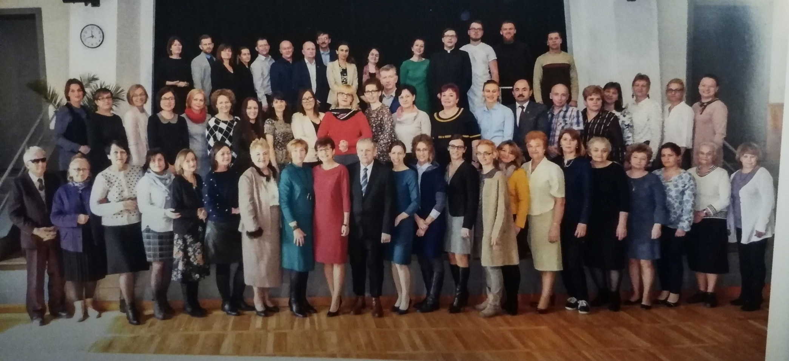
2005/2006
March 2018

Slide 6
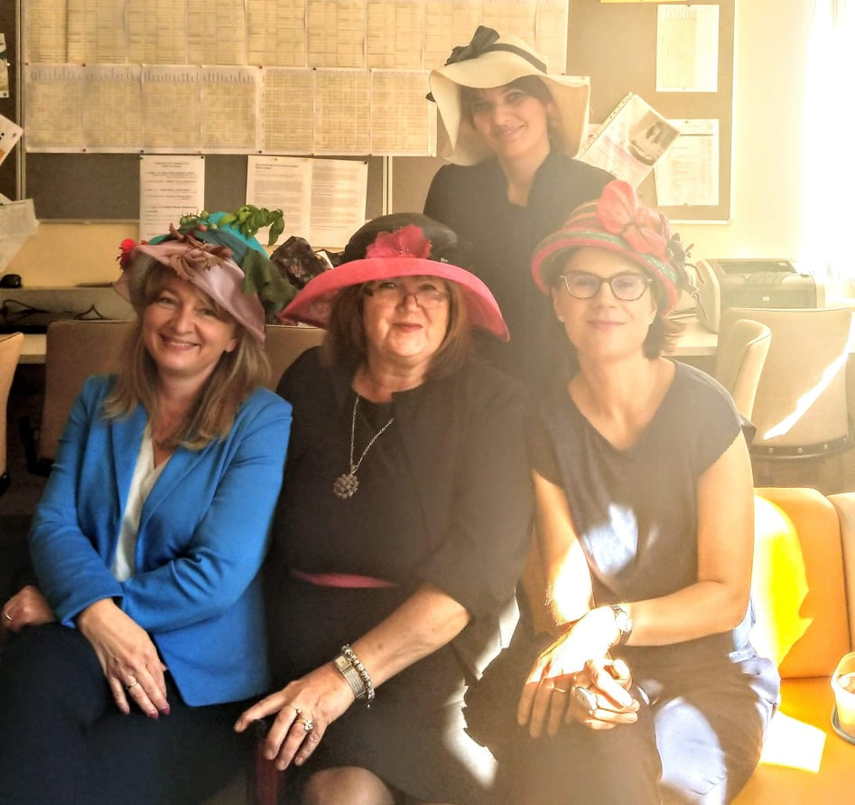
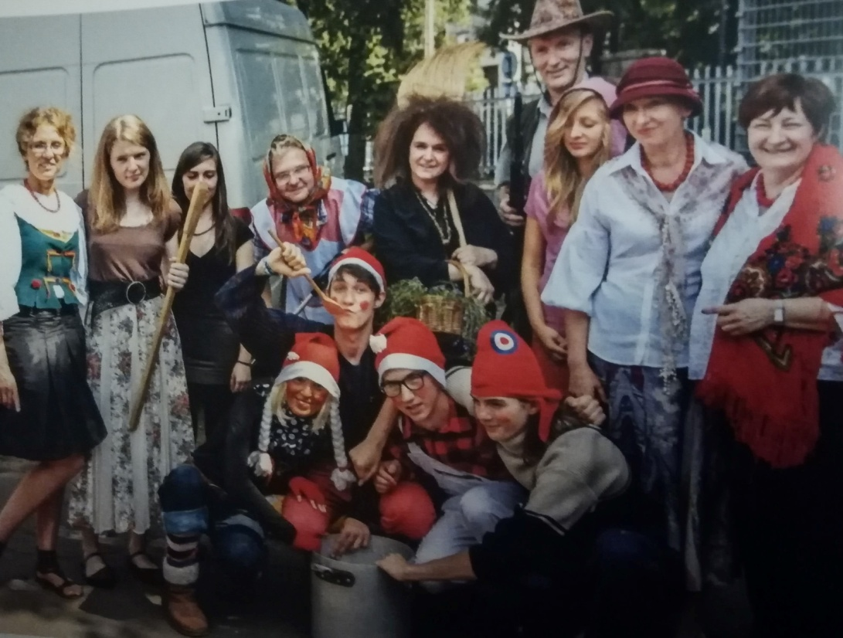
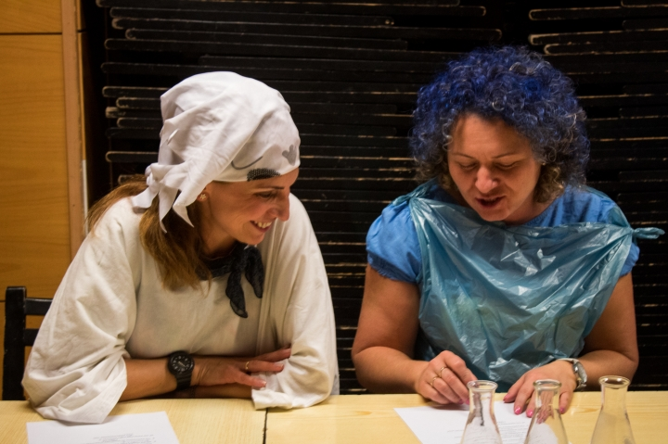
But they are not always that serious...

Slide 7
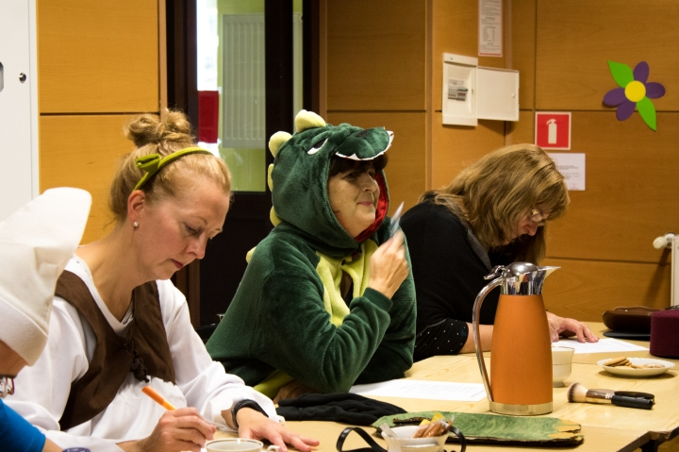
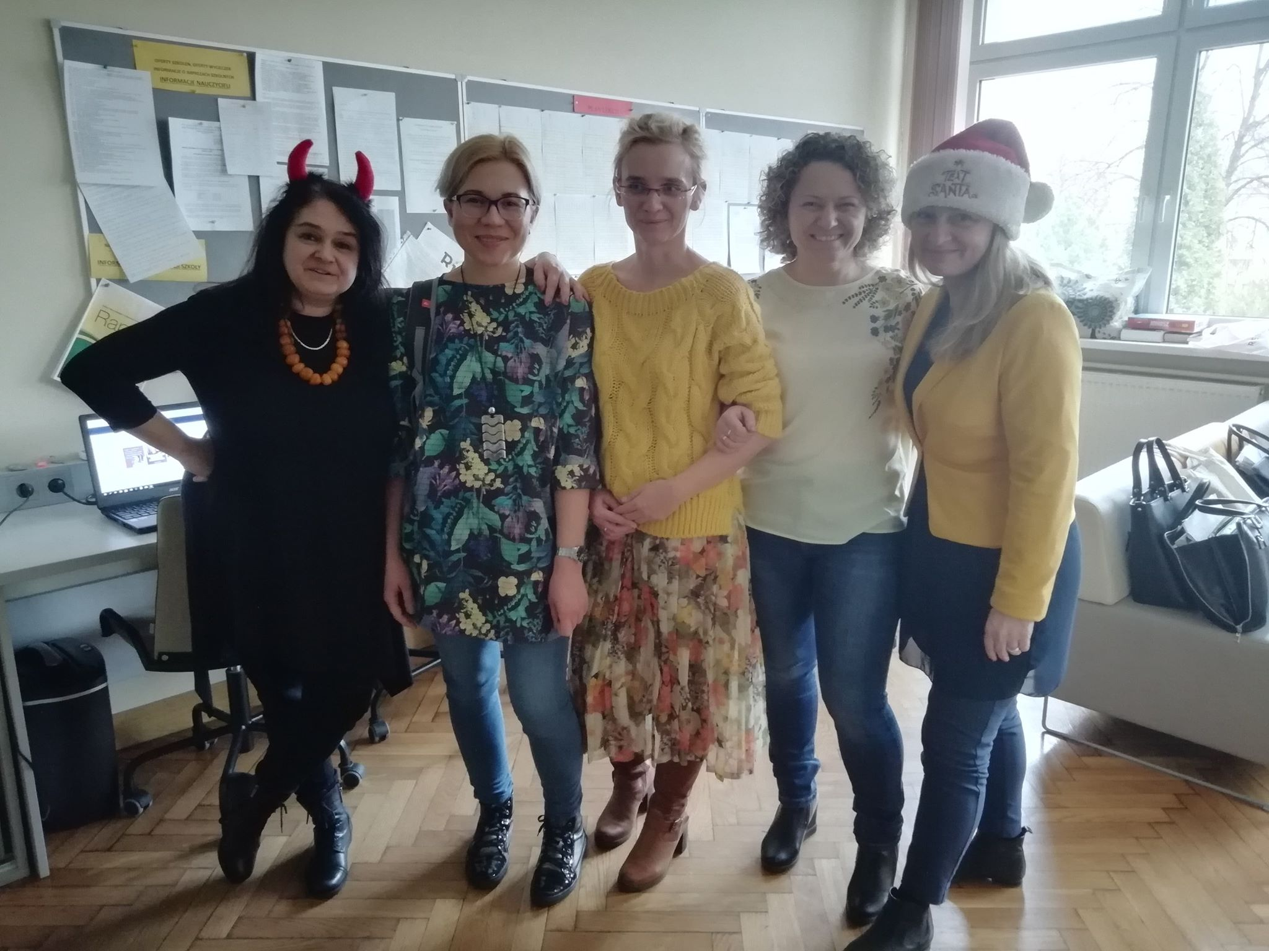

Slide 8
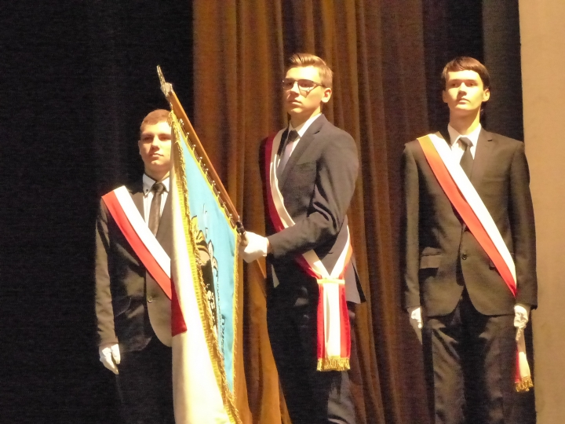
SCHOOL COMMUNITY
Every year we welcome younger students who choose one of the six extended profiles
There are around 530 pupils
STUDENTS DURING THE INAUGURATION OF THE SCHOOL YEAR

Slide 9
ACHIEVEMENTS OF THE SCHOOL
80th PLACE IN POLAND AND 4th IN SILESIAN VOIVODESHIP IN „PERSPEKTYWY” RANKING
NUMEROUS TITLES OF LAUREATES AND FINALISTS IN NATIONAL OLIMPIADS OBTAINED BY OUR STUDENTS

Slide 10
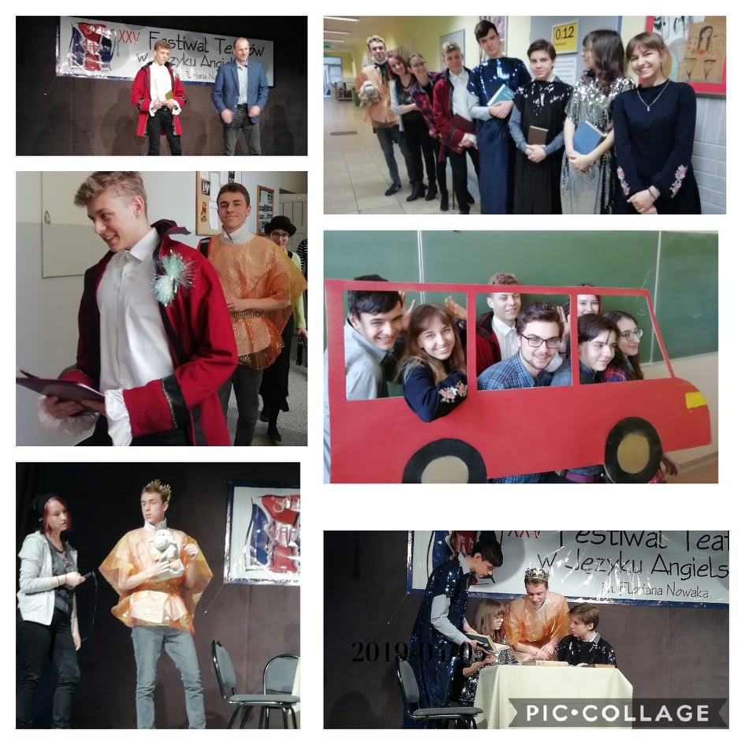
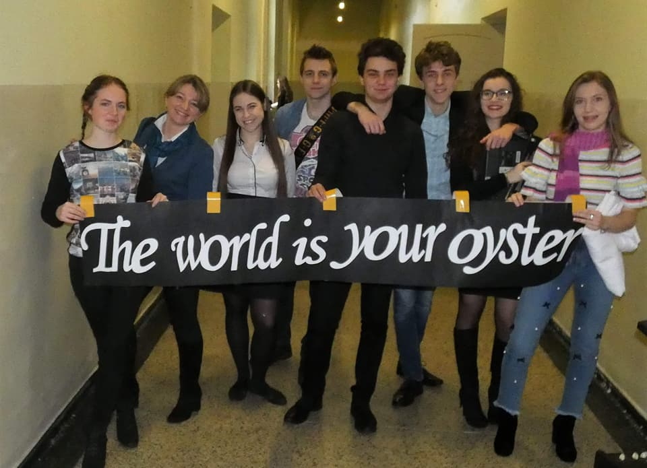
Theatre Festival
2019
Zosia and Dawid
Best actors of the festival
Theatre Festival in English 1st Prize Winners 2018

Slide 11
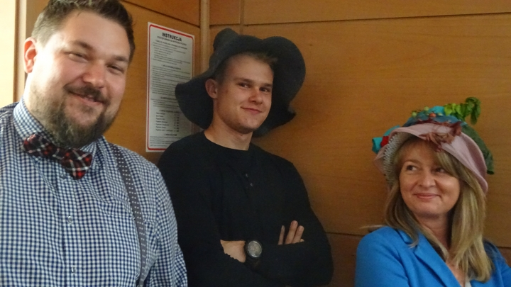
INTERESTING EVENTS ORGANIZED IN SCHOOL
Day of foreign languages
Everyone who was wearing a hat was “safe” from being questioned by teachers
British Desserts competition
Numerous quizzes and competitions about foreign languages and countries
MRS SKOWROŃSKA, MR ADAMCZYK AND ONE OF STUDENTS

Slide 12
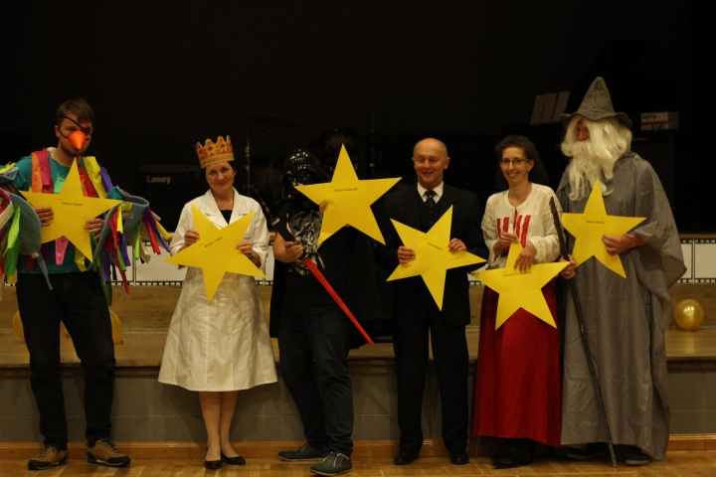
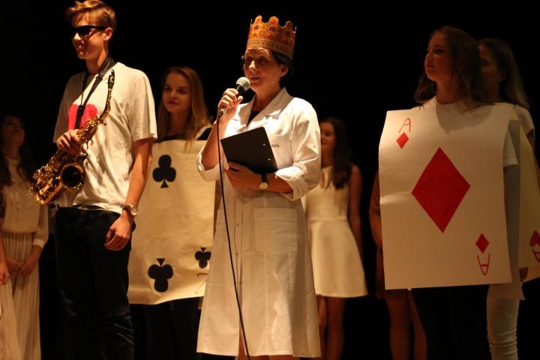
“Otrzęsiny”
Organized for first-year students
It’s all about integration
They consist of many competitions
Each class has a different theme

Slide 13
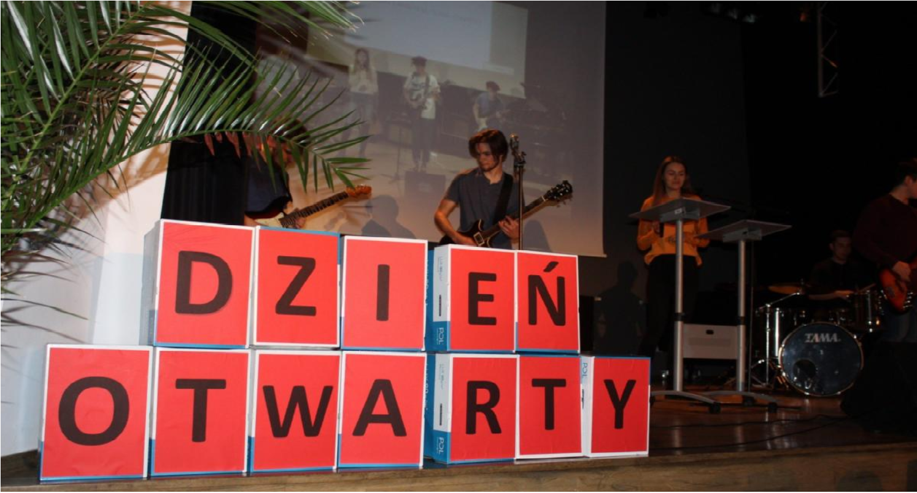
Organised every year for prospective students to show how great our school is!
OPEN HOUSE DAY

Slide 14
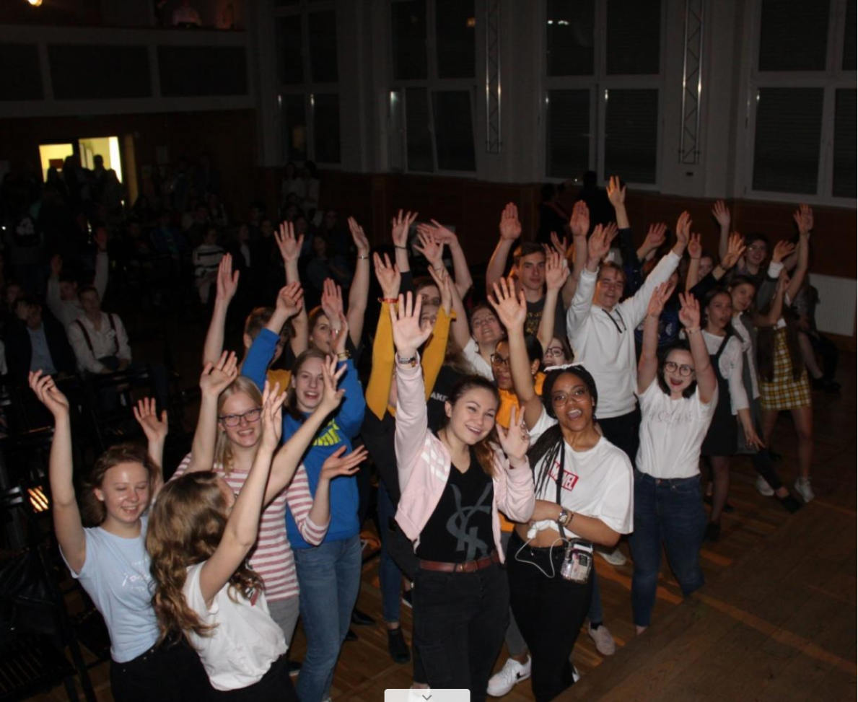
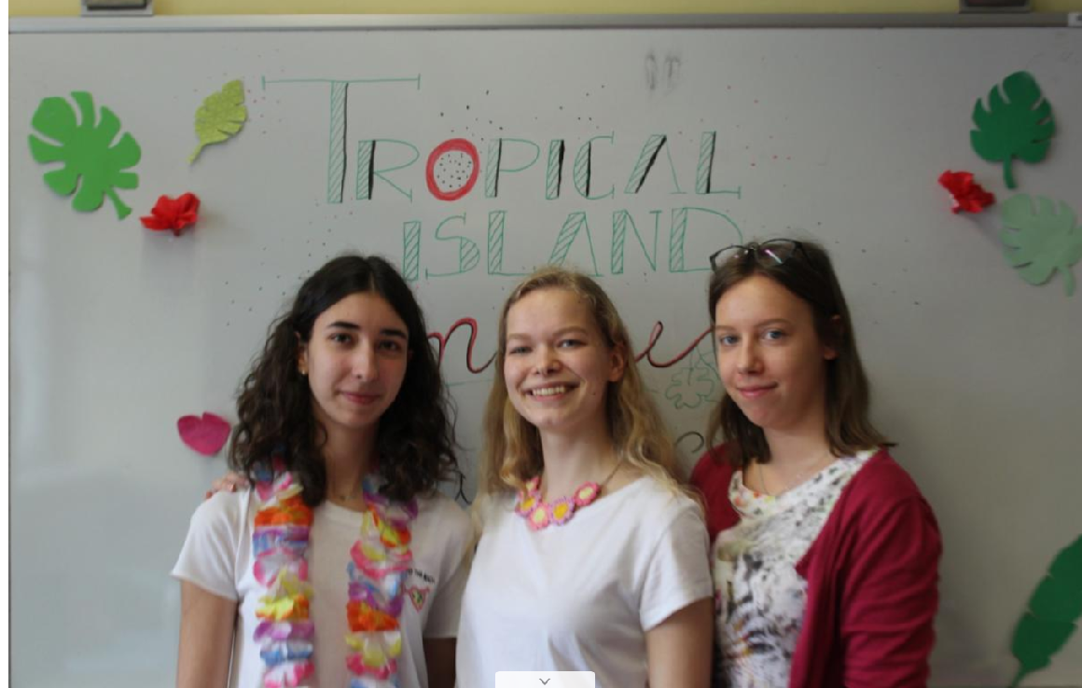

Slide 15
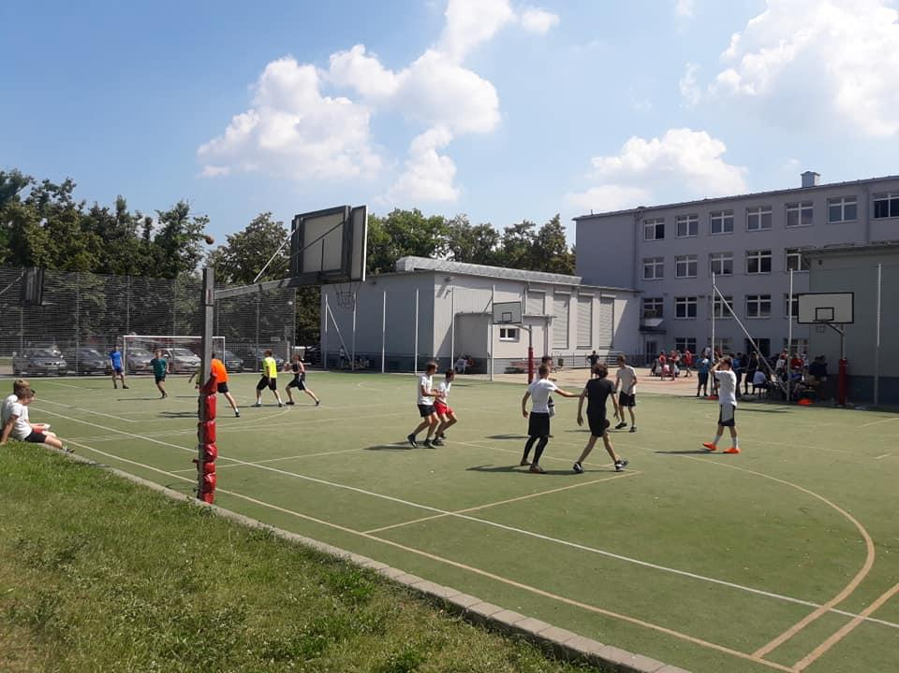
SPORTS DAY

Slide 16
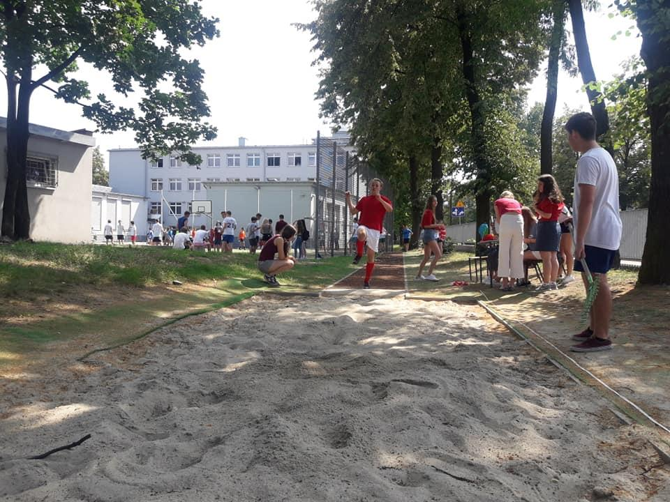
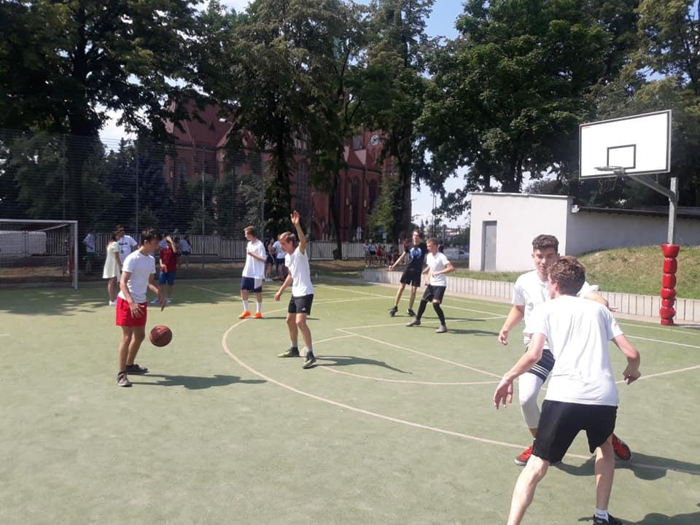
SPORTS DAY

Slide 17
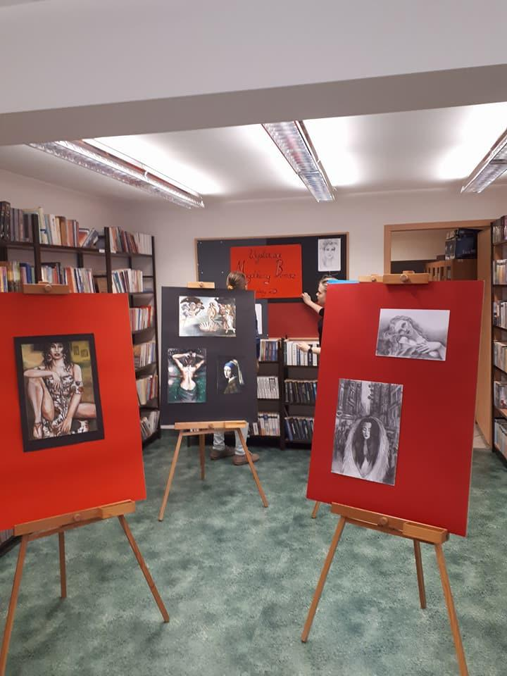
SCHOOL LIBRARY

Slide 18
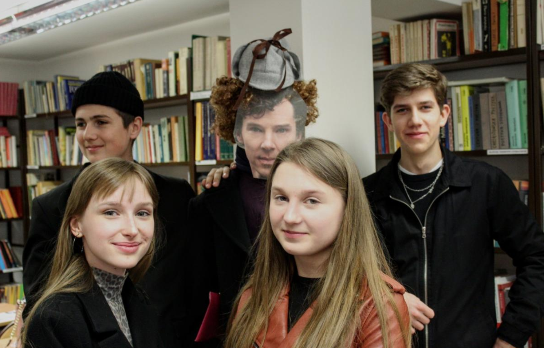

Slide 19
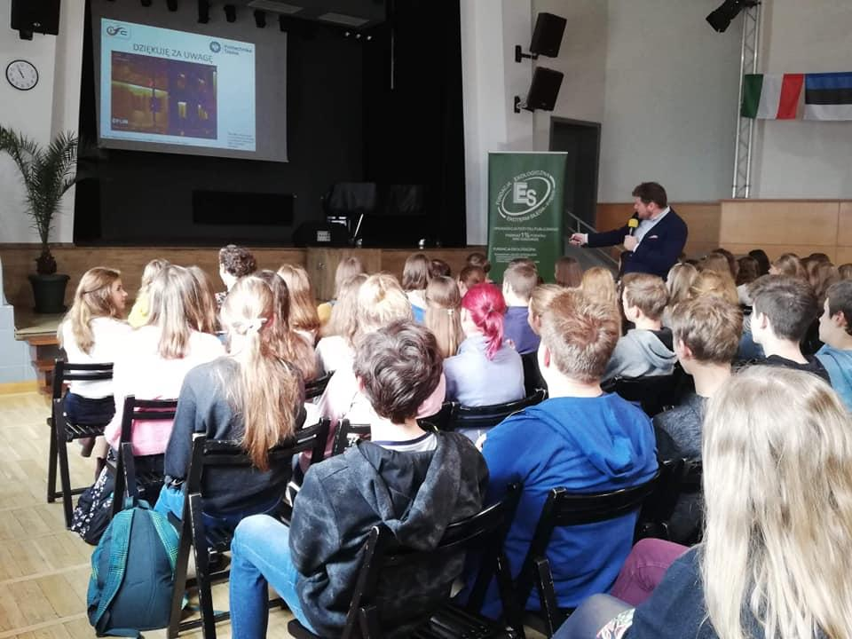
Assembly hall

Slide 20
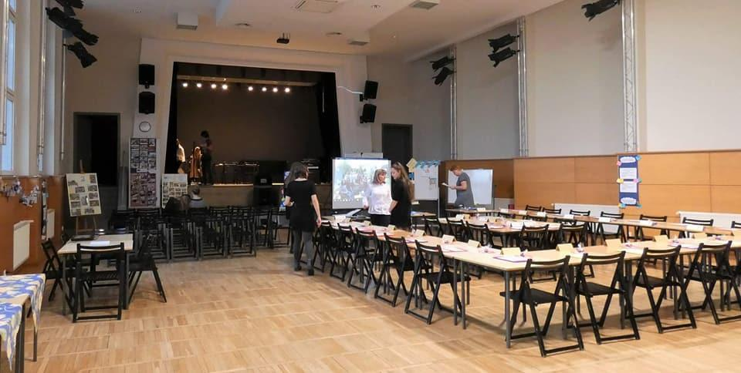
ERASMUS+ in our school in 2017

Slide 21
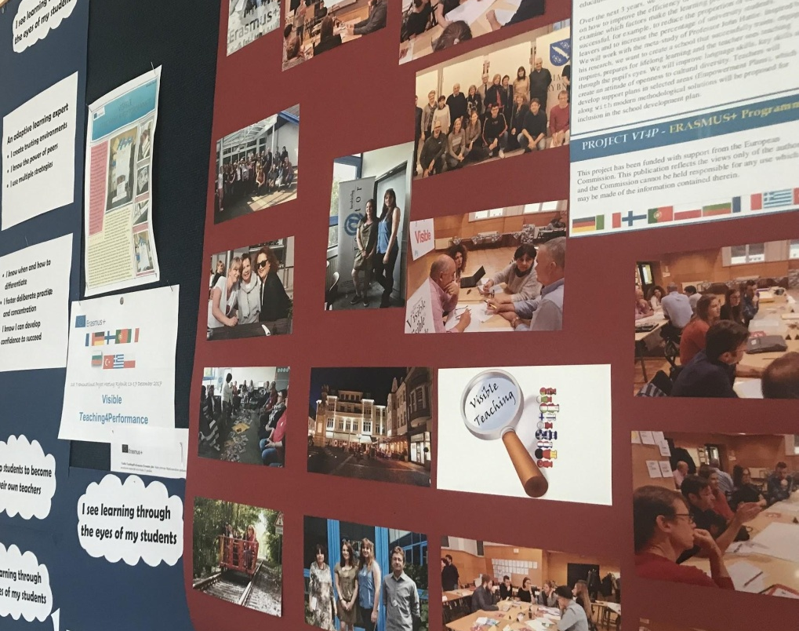
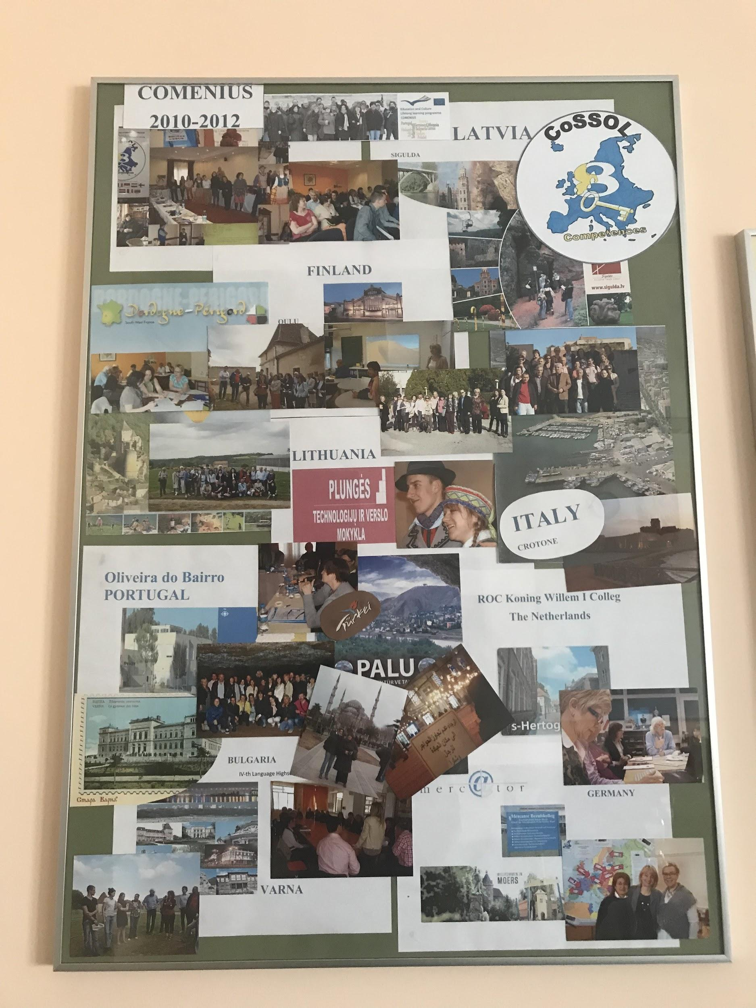
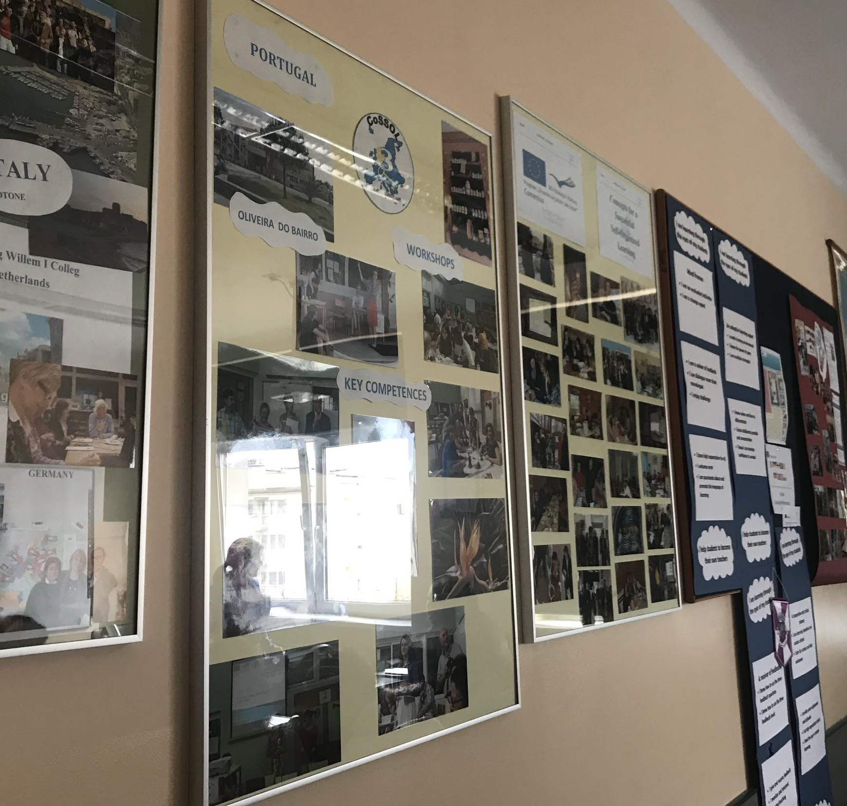
ERASMUS+ PHOTO GALLERY IN OUR SCHOOL

Slide 22
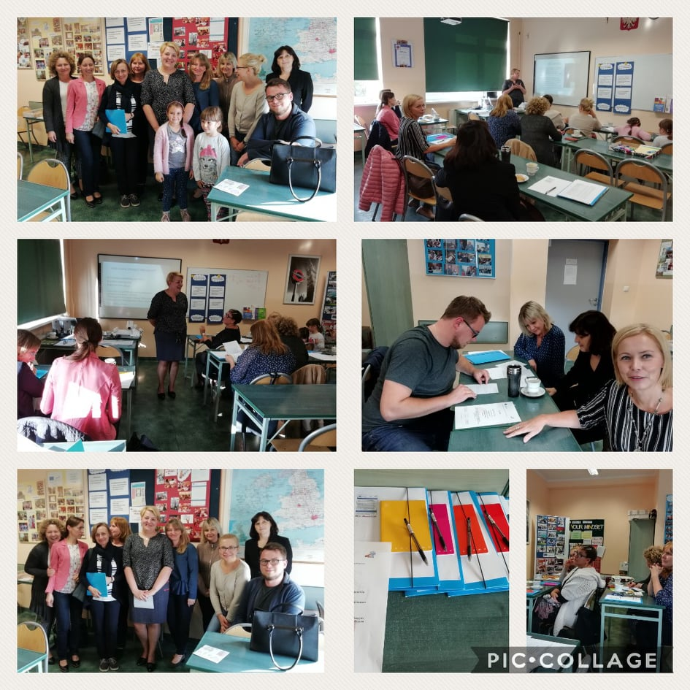

Slide 23
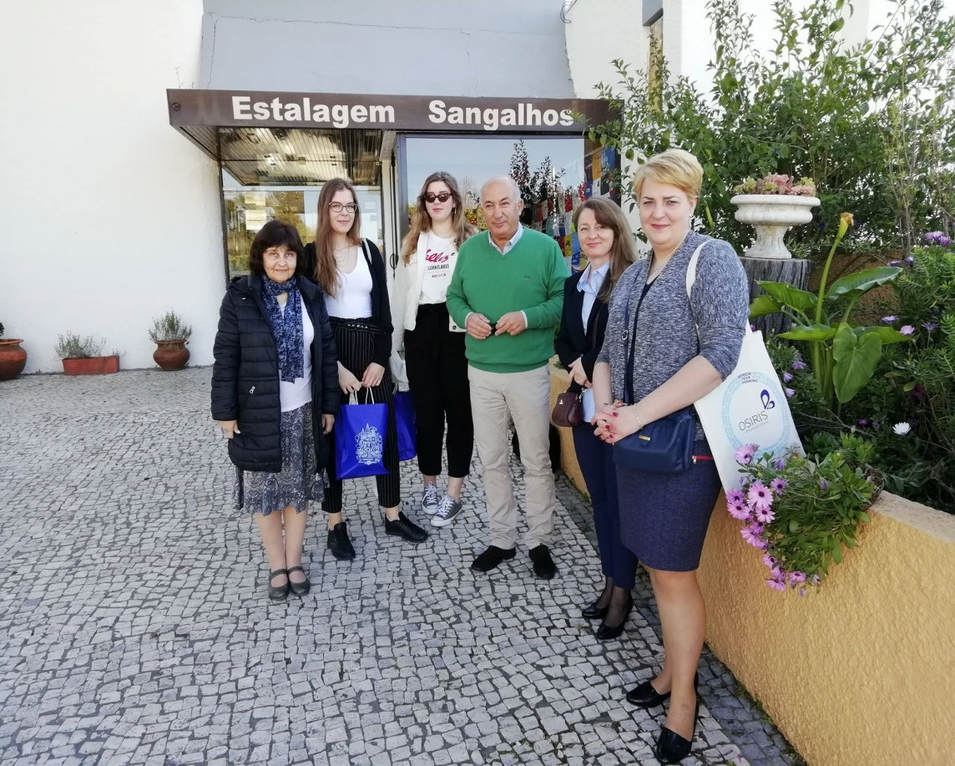
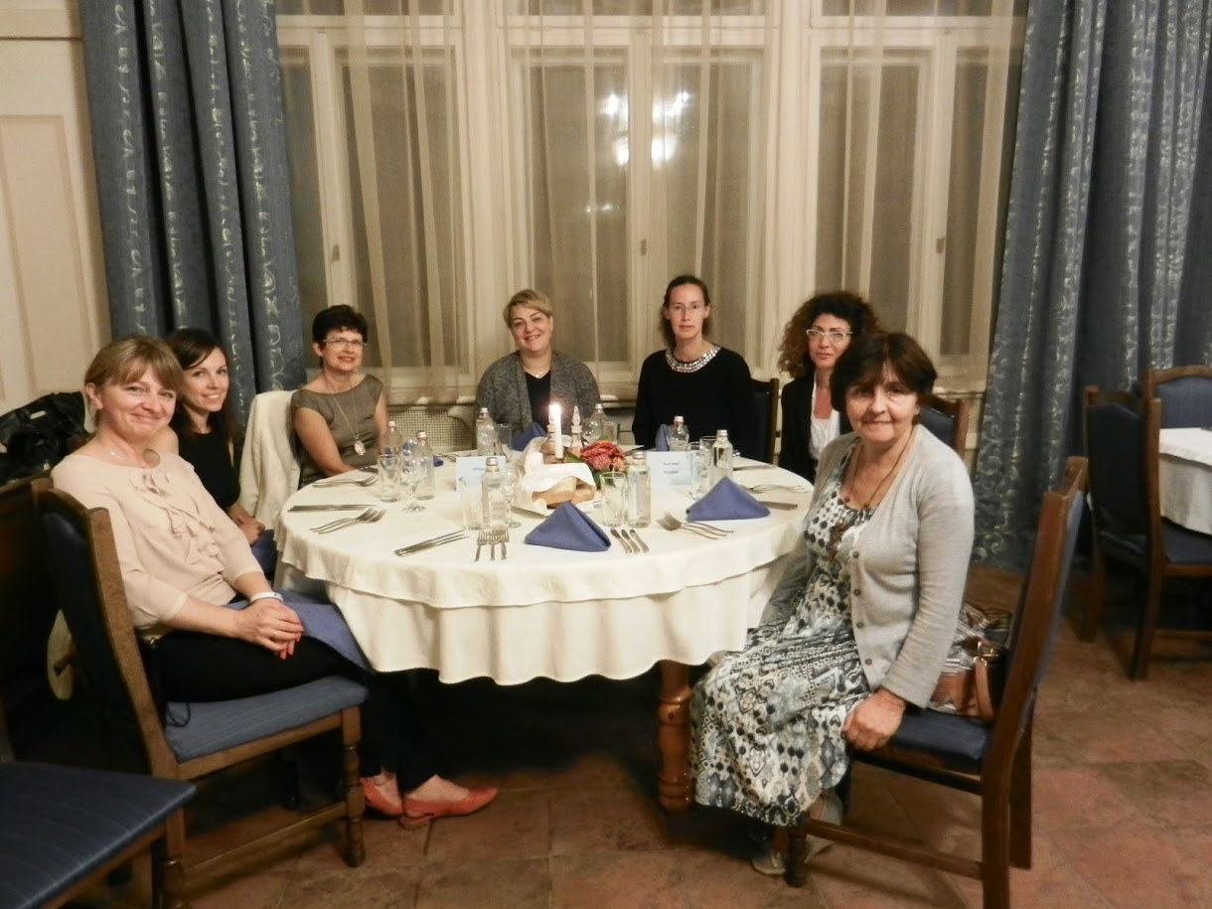
We love travelling!

Slide 24
Thank you for your attention
Prepared by Pola Karczmarek and Małgorzata Nosiadek ( adapted)
photos were taken from II High School’s facebook profile and web page,
Album wspomnień II LO and Erasmus plus photo gallery
https://www.facebook.com/pg/2lo.rybnik/photos/?ref=page_internal
https://starastrona.frycz.rybnik.pl/component/option,com_ponygallery/func,viewcategory/catid,231/Itemid,29/
https://www.frycz.rybnik.pl/

