Slide 1
Luovi Vocational College
Providing VET – supporting individual

Slide 2
Luovi in figures
The largest special needs VET provider in Finland
Spread across over 20 sites
Staff around 700
About 1 500 students in initial VET (IVET)
About 300 participants in continuing VET (CVET)
Turnover 55,9 million euro (2016)

Slide 3
Organisation of Luovi Vocational College
Luovi Vocational College
Director*
VET Services
Director of Education*
Sites and Units
Unit Directors
Communication and Information Services
Director of Communications and Information Services*
Development
Director of Development *
Alavus
Kokkola
Reisjärvi Seinäjoki Vaasa Ylivieska
Helsinki
Liperi Imatra Kuopio Joensuu Lappeen-ranta
Muhos
Kajaani Kempele Liminka Lumijoki Raahe Suomus- salmi
Oulu
Kemi
Rovaniemi
Tampere
Pori
Finance and Administration
Director of Financial and Administration*
Student Services
Human Resources
Director of Human Resources*
Study Services
* = Luovi’s executive group

Slide 4
Units and Sites
- Administration based in Oulu
Units: Alavus, Helsinki, Liperi, Muhos, Oulu and Tampere
Sites in 18 locations
Rovaniemi
Kemi
Kempele
Oulu
Suomussalmi
Lumijoki
Muhos
Raahe
Liminka
Kajaani
Kokkola
Ylivieska
Reisjärvi
Vaasa
Kuopio
Seinäjoki
Alavus
Joensuu
Liperi
Tampere
Pori
Imatra
Helsinki
Lappeenranta

Slide 5
Our mission
To provide our students routes to employment and good life.

Slide 6
Our vision
To be the best place in the world of diverse people and competence.

Slide 7
Our values
Luovuus / Creativity
Uudistajuus / Innovation
Osaaminen / Competence
Välittäminen / Caring
Ilo / Joy

Slide 8
Luovi’s financing
Turnover 55,9 m€ (2016)
Financing comes mainly as a state subsidy from the Ministry of Education and Training
Financing of initial vocational education and training is based on the number of study places and student classification IVET
Financing of continuing vocational education and training CVET

Slide 9
Luovi’s staff
Luovi employs around 700 experts
82 % of staff work within teaching and student services
Female 68 %
Male 32 %

Slide 10
The Education System in Finland

Slide 11
Initial VET in Luovi

Slide 12
Students at Luovi
All students have need for special support
Support is based on the Finnish legislation
Student selection is done by a multidisciplinary team
Luovi offers guidance to IVET and Training-try-outs before applying
Reasons for special support may include mental health and social problems, minor developmental delays, reading and writing difficulties and developmental disorders

Slide 13
Students at Luovi Reasons for special needs education and training 20.1.2016
Difficulties in conceptualization, attentiveness and concentration 13 %
Verbal difficulties 10 %
Interaction and behavioral problems 3 %
Delayed development 29 %
Long-term mental illnesses 16 %
Long-term physical illnesses 12 %
Learning difficulties due to autism and Asperger syndrome 8 %
Mobility and motor difficulties 1 %
Hearing impaired students 1 %
Visually impaired students 0 %
Other grounds for special needs education 1 %

Slide 14
Studying at Luovi
Learning by doing
Versatile learning and learning environments
e.g. cafes, green houses, practice firms, restaurants and shops
Extensive student services through IVET-process
Preparatory and rehabilitative training and guidance
Vocational qualifications, which give general eligibility for higher education
Individual study plan for each student

Slide 15
Preparatory training
Pre-vocational preparatory instruction and guidance (60 competence points)
Basic skills for VET
Vocationally oriented
For work and independent life (60 competence points)
For example cookery, building maintenance, metalwork, storage work

Slide 16
Vocational qualifications
Scope of studies 180 competence points
135 competence points vocational studies, including minimum 30 competence points on-the-job learning
10 competence points free-choice studies
35 competence points core subjects: languages, maths, arts, workplace studies, physical and health education

Slide 17
Initial VET study fields
Culture
Audio visual communication
Natural resources and Environment
Horticulture, agriculture
Natural sciences
IT
Social sciences, business and administration
Technology and Transportation
Metal, woodwork, electronics, logistics
Tourism, catering and Home economics
17 Vocational Qualifications

Slide 18
Student welfare services
Student welfare services has a focus on preventive measures supporting the whole vocational college
In addition, the student has the right to individual student welfare services
Based on VET legislation and Curricula, Student Welfare legislation and action-plans
Together with the student, carers, Luovi’s staff and external service providers, e.g. municipalities
Supporting and developing
Well-being
Participation
Sense of community
Student welfare services
Success in studies
Placement after studies
Student

Slide 19
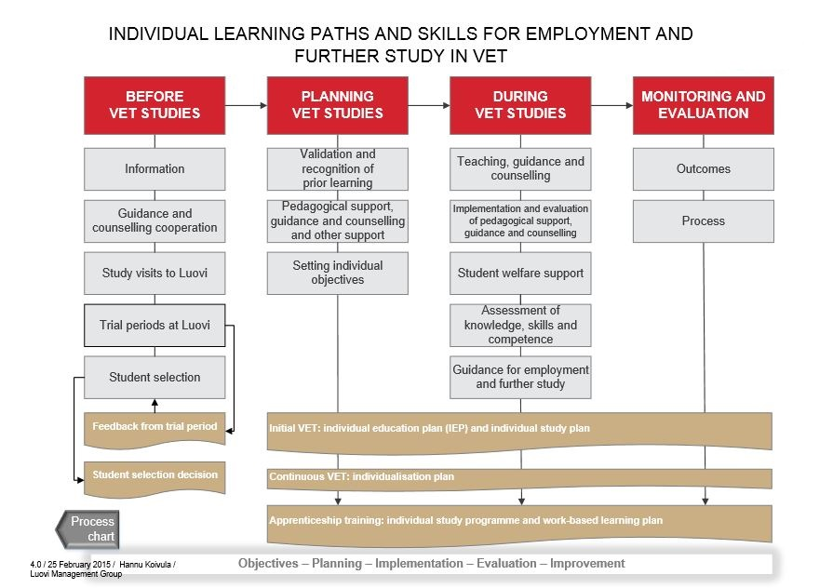

Slide 20
Placement after completing studies (September – October 2015)

Slide 21
Continuing VET in Luovi

Slide 22
Continuing VET in Luovi
Main target is to improve the professional skills and employability of adults with special needs
Preparatory training for competence-based qualifications
Competence-based qualifications
Further vocational qualifications
Specialist vocational qualifications
In-house training for firms
Apprenticeship training
Funded mainly by the Ministry of Education and Culture

Slide 23
Students in Continuing VET
Adults changing career or field of studies
Unemployed adults
Adults with mental health problems
Adults with learning and social problems
Focused on:
adults with special needs
persons working with young people and adults with special needs

Slide 24
Luovi’s Expert Services

Slide 25
Luovi as a Special needs VET expertise provider
Luovi’s task as a developer of special VET is based on the authorization by the Ministry of Education and Culture
Expert services to mainstream VET and other partners include
training, consultation and supervision of work
publications, research reports and teaching materials
The aims of the services are
supporting the professional development of teachers and counselling staff who work with SEN students
producing new knowledge and materials in the field of special VET
increasing awareness of special VET by making the work with SEN students visible
promoting educational and social inclusion of students

Slide 26
Training, consultation and supervision of work
Examples of topic areas
Encountering and counselling SEN students
Guidelines for the individual education plan process: how to design and evaluate the individual learning and placement pathways
Evaluation and outcome measurement of special needs VET services, e.g. Peer Review and QOLIS
Tailor-made services in cooperation with the customer
Funded by project funding or by the customer
Services provided by Luovi’s recognized professionals
About 5700 participants in the training and consultation services in 2014

Slide 27
Research reports and teaching materials
Contents are related to the current issues of special VET, focus on the topics with limited information available, such as
teaching, guidance and empowerment of SEN students
encountering and supporting depressed young people
cooperation with families
The need for special support is taken into account in teaching materials
plain language / using clear language
images supporting the text

Slide 28
International cooperation

Slide 29
International cooperation
Internationalisation at home
Tutoring and hosting visitors
International events
Foreign trainees
Competitive actions (Abilympics)
Projects
e.g. Erasmus + strategic partnerships, Nordplus and projects funded by Finnish National Board of Education
Training
Language and culture
Development of activities as network cooperation

Slide 30
International cooperation
Luovi works in an active and goal-oriented manner in international networks:
European Forum for Vocational and Technical Education (EFVET)
International Vocational Education Training Association (IVETA)
Action for Families and Youth (AFFY)

Slide 31
Luovi quality

Slide 32
Quality in VET in Finland
Quality Framework for VET in Finland
VET legislation: act and degree
Education and Research in Finland, Development Plan (2011-2016)
National Core Curricula for VET study fields
Quality Management Recommendation for VET
Quality management strategy 2012-2020
National education evaluations with special topics by the Finnish Education and Evaluation Council

Slide 33
Luovi quality
Luovi’s quality-work
Promotes and verifies homogenous and high ‘Luovi quality’
Implements quality to daily work and for the work of all staff and students
Quality work is based on EQAVET framework, EFQM Excellence model and EQUASS approach
Quality guidelines in Luovi are
Quality-work in Luovi 2016 - 2020 (road map)
Luovi’s process map
Objectives and indicators (Luovi compass)
Evaluation and feedback system and annual plan

Slide 34
Outcome measurement in Luovi
The key measures for the impact of special needs VET are
Quality of Life (QOLIS)
Placement after studies
These indicators are developed with Finnish Special Needs VET providers’ network and QOLIS also with European Platform for Rehabilitation (EPR)

Slide 35
www.luovi.fi

