Slide 1
Learning strategies
PRESENTED BY EMILIA KUCZERA

Slide 2
During our lives we learn all the time not only at school. But it is preparation for exams that often gives students sleepless nights and causes nervousness. Fortunately, there are multiple ways to manage with strenuous learning by heart which enable us getting dreamy grades and being proud of ourselves.

Slide 3
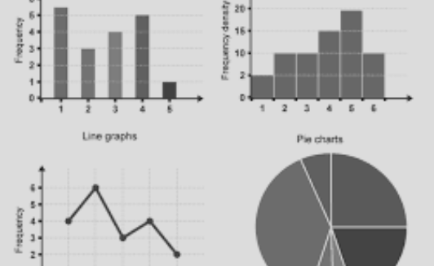
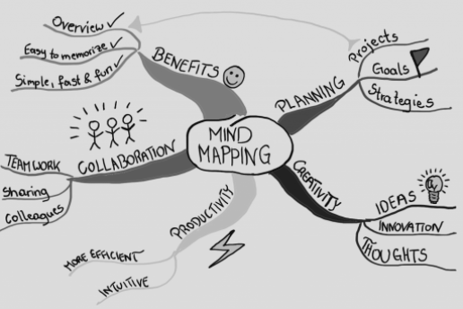
DRAW SOME SCHEMATIC PICTURES WHICH SHOW MAIN IDEAS.
1. MAKE INFORMATION VISUAL
CREATE DIAGRAMS TO REMEMBER STATISTICAL DATA.
USE MIND MAP TO GROUP INFORMATION.

Slide 4
2. Straighten your workplace
Sort out all papers into separate files.
Buy few devices like penners which will help you to keep order.
Get rid of unnecessary things from your desk which distract you.

Slide 5
3.Use specific examples to understand abstract ideas.

Slide 6
4. Devide learning in time, take regular breaks and repeat new knowledge constantly.

Slide 7
5. Explain and describe ideas with many details.
from general to specific

Slide 8
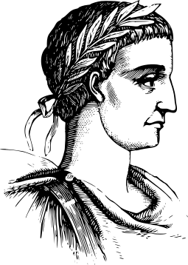
6. Switch topics and subjects repeatedly while learning.
Maths
Art
Biology
History

Slide 9
As we see there are many strategies which make learning easier and more effective.

Slide 10
THANK YOU FOR ATTENTION
Sources:
https://teaching.berkeley.edu/active-learning-strategies
https://www.cultofpedagogy.com/learning-strategies/

