Slide 1
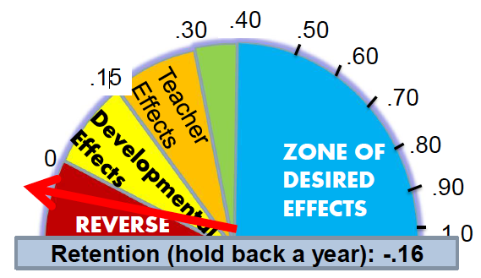
Visible Learning - John Hattie´s Research -
Detlev Lindau-Bank
VT4P
Visible teaching for Performance

Slide 2
Time table - Tuesday
Time
9.00 | Introduction workshop – What works best? – Interconnection of influencing factors | 6 Groups Chairs: Ch. Graack D. Lindau-Bank Method Know-How-computer
Incl. | Coffee Break
11.30 | Plenary session | Chairs: Ch. Graack D. Lindau-Bank
12.30 | Lunch

Slide 3
Time table - Tuesday
Time
13.30 | Plenary session Presentation of the student´s survey 8 Mindframes (Hattie´s conclusions) | Presenters: Ch. Graack D. Lindau-Bank
15.00 | Coffee break
15.30 | Discussion and wrap up
16.30 | End

Slide 5
Notes:
2 minutes (11:00-11:02)
As John Hattie discussed in the previous videoclip, we will experience greater student growth if we focus on using instructional strategies that are the average effect size or higher (0.40).
If you look at the back cover of your binder, you will see the instructional strategies and practices (as well as effect size) that we will highlight in the next three days.

Slide 7
Interconnecting Variables „Vester´scher Papiercomputer“
Group-Rating-Method
Goals:
Reduction of complex interactions
Visibility of complex interactions
Notes:
Solving problems or performing a task can always be understood as an intervention in complex systems, which requires systems thinking.
Lack of knowledge of the system properties or wrong assumptions often lead to interventions in action situations whose unforeseeable effects were not considered and then break down as surprising developments about the actors.
Problem situations are characterized by many variables, input factors that are interlinked and interdependent. This is their complexity and causes their intransparency.
You do not see everything you want to see.

Slide 8
Briefing
Aim:
This method is a simple tool that allows us to analyze the estimated impact intensities within a complex network of factors.
The results of this analysis can be used very well to help witk making decisions on intervention possibilities and strategies for systematic change processes.
Notes:
Ziel:
Mit dem Papiercomputer liegt ein einfaches Hilfsmittel vor, mit dem wir die geschätzter Wirkungsintensitäten innerhalb eines komplexen Netzwerkes von Faktoren analysieren können. Die Ergebnisse dieser Analyse lassen sich sehr gut nutzen zur Entscheidungshilfe über Eingriffsmöglichkeiten und -strategien für systematische Veränderungsprozesse.
Hilfsmittel:
Papier, Stift, bei Gruppenarbeit Flipchart
Zeit:
abhängig von der Anzahl der zu analysierenden Faktoren, der Größe der Arbeitsgruppe und dem Maß an Beteiligung der Systemmitglieder zwischen
1 Stunde (ich alleine mit relativ wenigen Faktoren [<20])
2-3 Stunden (kleine Gruppe mit relativ wenigen Faktoren)
mehrere Wochen (komplexe Veränderung und Beteiligung der Systemmitglieder)

Slide 9
Briefing
Required equipment:
Paper, pen, in group work flipchart
Time: Today 2,5 hours
depending on the number of factors to be analyzed, the size of the workgroup and the level of involvement of system members
1 hour (me alone with relatively few factors [<20])
2-3 hours (small group with relatively few factors)
several weeks (complex change and involvement of system members)

Slide 10
Briefing
To model a change, we determine the factors that should change according to our objectives in a particular direction (outcomes or target factors).
This can be a single factor, but it can also be a bunch of factors.
From different perspectives, all possible influencing factors (influencing factors) are collected.
This refers to the factors that play a role in the "problem situation".
All elements of the situation analysis (target factors and influencing factors) are listed in a two-dimensional matrix, which contains all elements in both dimensions
Notes:
Für die Modellierung einer Veränderung legen wir die Faktoren fest, die sich unserer Zielsetzung entsprechend in einer bestimmten Richtung verändern sollen (Zielgrößen oder Zielfaktoren). Hierbei kann es sich um einen einzigen Faktor handeln, es kann aber auch ein Bündel von Faktoren sein.
Aus unterschiedlichen Perspektiven werden alle möglichen Einflussgrößen (Einflussfaktoren) gesammelt. Damit sind die Faktoren gemeint, die in der „Problemsituation“ eine Rolle spielen.
Alle Elemente der Situationsanalyse (Zielfaktoren und Einflussfaktoren) werden in einer zweidimensionalen Matrix aufgelistet, die in beiden Dimensionen jeweils alle Elemente enthält (vgl. Entfernungstabelle zwischen Städten).

Slide 11
Briefing
For the intensity of effect, a scale is set.
0 = no effect
1 = little effect
2 = strong effect
3 = very strong effect
The intensity of the effect between two factors ("What is the influence of ..... on .....?") Is - line by line - estimated and entered with the appropriate number in the matrix.
Each line thus contains the effects that emanate from the "goal element" on all other elements, each column the measure of influenceability.
Notes:
Für die Wirkungsintensitäten wird ein Maßstab festgelegt. Bewährt hat sich:
0 = keine Wirkung – 1 = geringe Wirkung –
2 = starke Wirkung – 3 = sehr starke Wirkung
Die Intensität der Wirkung zwischen jeweils zwei Faktoren („Wie groß ist der Einfluss von ..... auf .....?“) wird – Zeile für Zeile – geschätzt und mit der entsprechenden Zahl in die Matrix eingetragen. Jede Zeile enthält somit die Wirkungen, die von dem „Zielelement“ auf alle anderen Elemente ausgehen, jede Spalte das Maß der Beeinflussbarkeit.
Jeder Faktor wird mit seinen zwei Werten (Einfluss und Beeinflussbarkeit) in ein Diagramm eingetragen und in aktive Faktoren (Einfluss hoch/Beeinflussbarkeit niedrig), reaktive Faktoren (Einfluss niedrig/Beeinflussbarkeit hoch), kritische Faktoren (Einfluss hoch/ Beeinflussbarkeit hoch) und träge Faktoren (Einfluss niedrig/Beeinflussbarkeit niedrig) unterteilt.
Der Fokus für weitere Planungen liegt auf den aktiven Faktoren: Wenn es gelingt, sie zu verändern, erzeugen wir Veränderungen im gesamten System.

Slide 12
Connecting influence factors
 | Influence of on | A | B | C | D | E | Effect
A | Collective teacher efficacy |  | 0 | 3 | 0 | 3 | 6
B | Self-reported grades | 3 |  | 3 | 0 | 3 | 9
C | Teacher estimates of achievement | 0 | 0 |  | 0 | 3 | 3
D | Cognitive task analysis | 0 | 0 | 1 |  | 3 | 4
E | Response to intervention | 0 | 0 | 3 | 1 |  | 4
Influenceability |  | 3 | 0 | 10 | 1 | 12
⇧
Influenced by the other factors
0 = no impact
1 = poor impact
2 = average impact
3 = high impact
⇧
Influence on the other factors

Slide 13
Briefing
From the row and column sums, the median is formed.
Each factor is entered into a diagram with its two values (influence and influenceability)
active factors (influence high / low influence),
reactive factors (influence low / influenceability high),
critical factors (influence high / influenceability high) and
slow/dull factors (Influence low / suggestibility low).
The focus for further planning is on the active factors: if we manage to change them, we will create changes throughout the system.

Slide 14
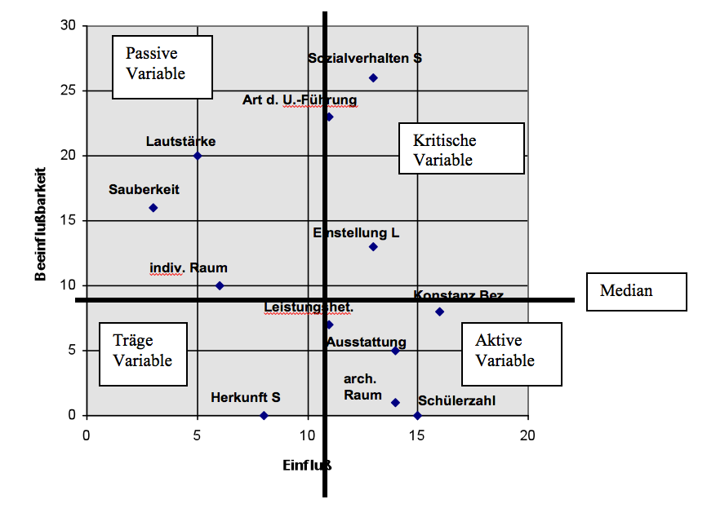
Active Variable =Influences other factors strongly, low influenceabiltiy | Critical variable =Influences other factors strongly, influenced by other factors strongly as well
Reactive Variable = Low influence on other factors, influenced by other factors strongly | Slow/dull variable = low Influence on other factors, low influenceabiltiy
Reactive Variable
Critical variable
Influenceability
Slow
variable
Active
Variable
Influence
Notes:
Aktives Element => rel. stärkster Einfluß auf alle anderen
Reaktives Element => wird selbst rel. am stärksten beeinflußt
Kritisches Element => stärkste Involviertheit (aktiv+reaktiv)
Pufferndes Element => schwächste Involviertheit (dito)

Slide 15
How to interprete the results
Active element offers best intervention possibilities – go for it!
Reactive element is least suitable for influencing – forget it!
Critical element acts as an "accelerator“ – be careful!
Slow element dampens self-reinforcing processes – have an eye on it!

Slide 17
MINDFRAME 1 of 8 Teachers/leaders as evaluators
A disposition to asking …
How do I know this is working?
How can I compare ‘this’ with ‘that’?
What is the merit and worth of this influence on learning?
What is the magnitude of the effect?
What evidence would convince you that you are wrong?
Where have you seen this practice installed so that it produces effective results?

Slide 18
Do not blame students
MINDFRAME 2 of 8 - it’s about the teacher’s /leader’s mindset, not the kids
All students can be challenged
Strategies not styles
Develop high student expectations
Enhance help seeking
Develop assessment capable students
The power of developing peer interactions
The power of critique/error/feedback
Self-regulations and seeing students as teachers

Slide 19
MINDFRAME 3 of 8 teachers/leaders as CHANGE AGENTS
Achievement is changeable and enhanceable vs. immutable and fixed
Teaching as an enabler not a barrier
Engage in the total learning and
not break into steps and chunks
The Power of learning intentions
The Power of success criteria

Slide 20
MINDFRAME 4 of 8
Teachers/leaders gaining feedback about themselves
Feedback is
information provided by an agent (e.g., teacher, peer, book, parent, self/experience)
regarding aspects of one’s performance or understanding.

Slide 21
MINDFRAME 5 of 8
AFT = Assessment as feedback to teachers
Who did you teach well, who not so well?
What did you teach well, not so well?
Where are the gaps, strengths, achieved, to be achieved?
Levels and Progress
Developing a common conception of progress
Use assessment info not to make judgements about your efficacy as a person but what you need to work on as a teacher!!

Slide 22
MINDFRAME 7 of 8
Dialogue not Monologue
What can I say – we talk too much!
80% of classroom time is estimated
as being teacher-talking – needs to be reversed

Slide 23
MINDFRAME 8 of 8
It’s about “not knowing”/error: relationships in classrooms
The importance of error and not knowing …
Build trust and rapport
Student more than teacher questioning
Teacher clarity, support, and What’s next
Peer teaching, assessment, learning
It’s more about the learning than the teaching
We don’t have to be the experts!!

Slide 24
The three major messages for teachers
Transparent goals
the more transparent the teacher makes the learning goals, then the more likely the student is to engage in the work needed to meet the goal.
Success criteria
the more the student is aware of the criteria of success, then the more the student can see the specific actions that are needed to attain these criteria
Rapid formative feedback
the more there is feedback about progress from prior to desired outcomes the more positive attributes to learning are developed

Slide 25
What some teachers/leaders do!
Clear learning intentions
Challenging success criteria
Range of learning strategies
Know when students are not progressing
Providing feedback
Visibly learns themselves

Slide 26
Such that students …
Understand learning intentions
Are challenged by success criteria
Develop a range of learning strategies
Know when they are not progressing
Seek feedback
Visibly teach themselves

Slide 27
Students need to learn to ask of themselves
Where am I going?
How am I going (progress)?
Where to next?
The students can’t ask the questions unless we
teach them how to ask them, that means we need to frame the way we structure our lessons
around that sort of immediate feedback

Slide 29
Where to start this change process?
Do not start by lecturing staff.
invite teachers to evaluate their own mind frames to see whether they are shared by other teachers.
asking teachers about their ideas about feedback.
look at the effect sizes of practices at your school.
examining the mind frames of the school leaders.
Notes:
School leaders will need to be learning leaders in order to support teachers as they begin to discuss their beliefs and consider moving in a direction where they will begin to examine the impact they have on student learning.

Slide 30
Helpful questions
What does Hattie mean by “visible” learning and teaching?
In what ways is your teaching visible to students?
In what ways are you able to make student learning visible?
What are some ways teachers can make their teaching more visible to students?

Slide 31
Guiding lines for change
The more the student becomes the teacher and the more the teacher becomes the learner, then the more successful are the outcomes.” (p.17)
Schools and teachers must evaluate the impact of their effect on student learning, become “evaluators of your effect.”

Slide 33
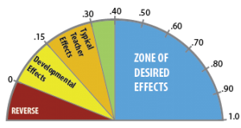
Teachers shared belief that through collective action, they can positively influence student outcomes, including impacting those who are disengaged and/or disadvantaged.
1.57 effect size
Collective Teacher Efficacy
Notes:
Marzano

Slide 34
Students knowing about their chance of success
Awareness of what they know about a subject
1.33 effect size
Self-Reported Grades
Notes:
Marzano

Slide 35
Teachers ability to identify essential representations of subject
Guiding learning through classroom interactions
Monitoring learning and providing feedback
Influence student outcomes
1.00 effect size
Instructional Quality
Notes:
Marzano

Slide 36
You had the child for a year, and you failed, now you’re going to give him the same kind of curriculum, the same kind of strategies…
What that kid needs is not more, he needs different.
- John Hattie
-0.17 effect size
Retention
Notes:
https://www.youtube.com/watch?v=sng4p3Vsu7Y

Slide 37
The problem with tracking is the expectations it sets for kids.
It says to them very clearly, this is where you perform...
Quite often teachers only teach material that is relative to that tracking. -John Hattie
0.12 effect size
Ability Grouping
Notes:
https://www.youtube.com/watch?v=m6czhy6kPpc

Slide 38
If you are going to reduce class size, the first thing we have to do is change how we teach. - John Hattie
.21 effect size
Class Size
Notes:
http://thelearningexchange.ca/videos/john-hattie-class-size/

Slide 40
Student Achievement
Components of
Effective Implementation
Leadership
Competency
Organization
Vision  Mission  Beliefs
Notes:
As you move into developing your plan for implementing the strategies that have been identified, it is important to understand the research around effective implementation. This slide visually represents the components/drivers of effective implementation. The components are based in an organization’s vision, mission, and beliefs. It is important to very purposefully consider each pillar/component in any implementation. The components include Leadership, Competency, and Organization. In the next stage you will see how each component/driver links to the School Improvement Framework.

Slide 41
Continuous School Improvement Process
Gather
Get Ready
Collect School Data
Build School Profile
Do
Implement Plan Monitor Plan
Evaluate Plan
Student
Achievement
Study
Analyze Data
Set Goals
Set Measurable Objectives
Research Best Practice
Plan
Develop School Improvement Plan
Notes:
This brings us to the end of the Plan stage.

