Slide 1



Teacher training activities carried out at local schools
Project 2017-1-PL01-KA219-038284_5
IV EG “Frederic Joliot-Curie”, Varna
26.08.2020, online pedagogical meeting

Slide 2
Teacher training activities carried out at local schools
On 26.08.20 (within the online pedagogical council) the Bulgarian team of the VT4P project held an event for dissemination and training on the topic of “Teacher Empowerment Plan”. The plan, which is the final product of the project, was presented by Mr. Ivaylo Stamatov. Teachers and management showed interest. Additions to the presentation were made by the newly appointed psychologist Mr. Martin Stoyanov and the coordinator for IV EG, Varna - Mrs. Donka Geprgieva.

Slide 3
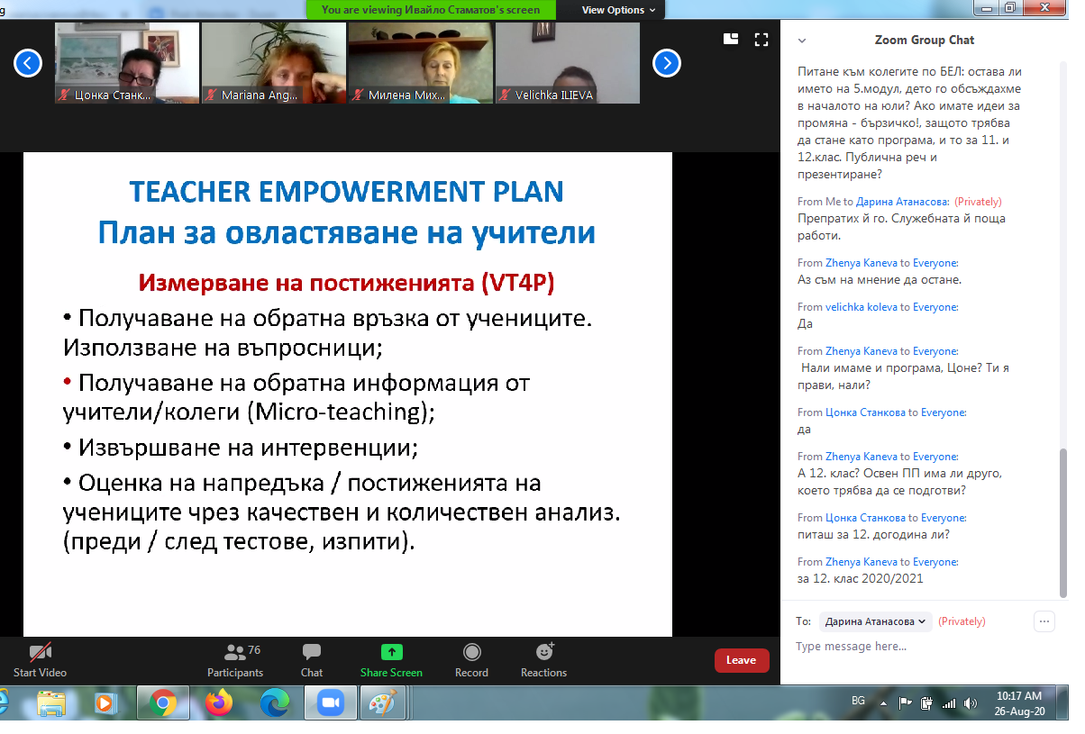
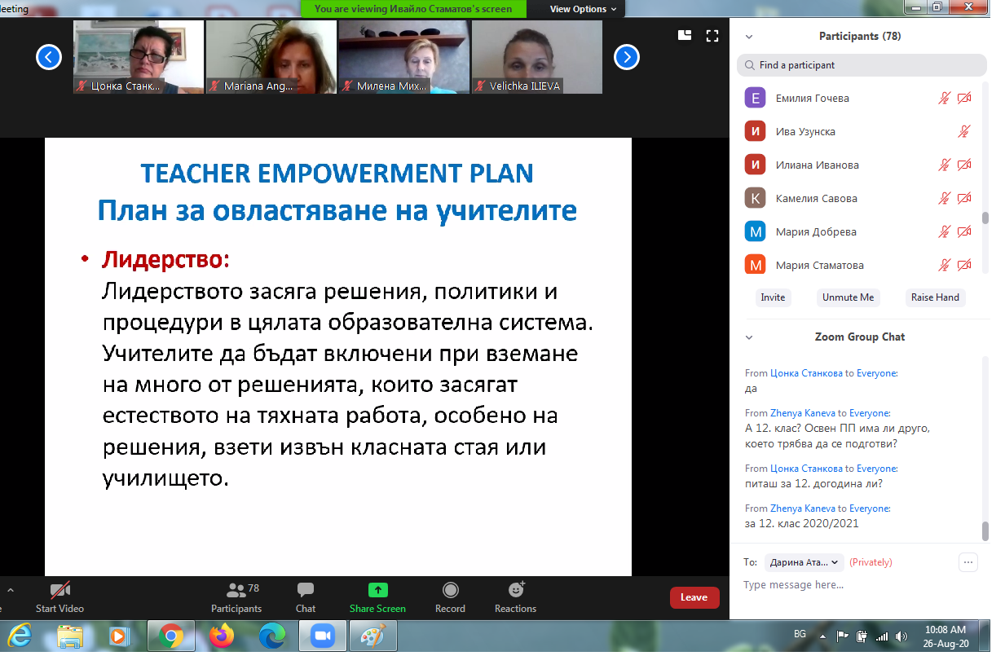
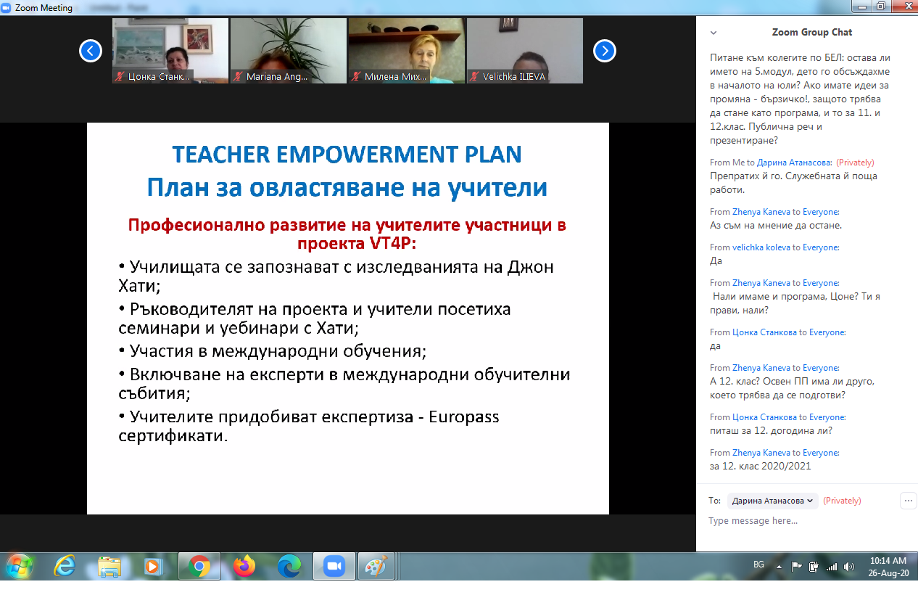
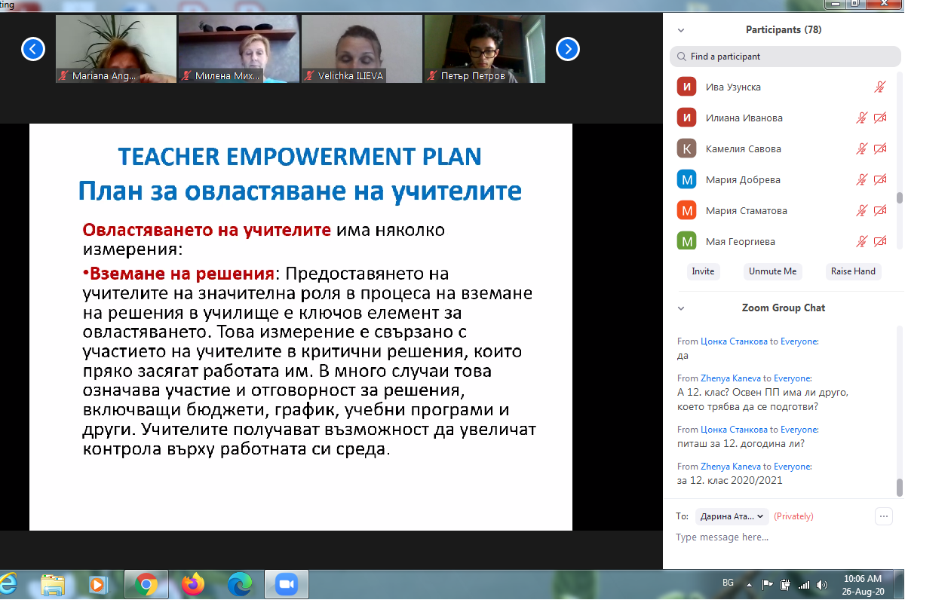
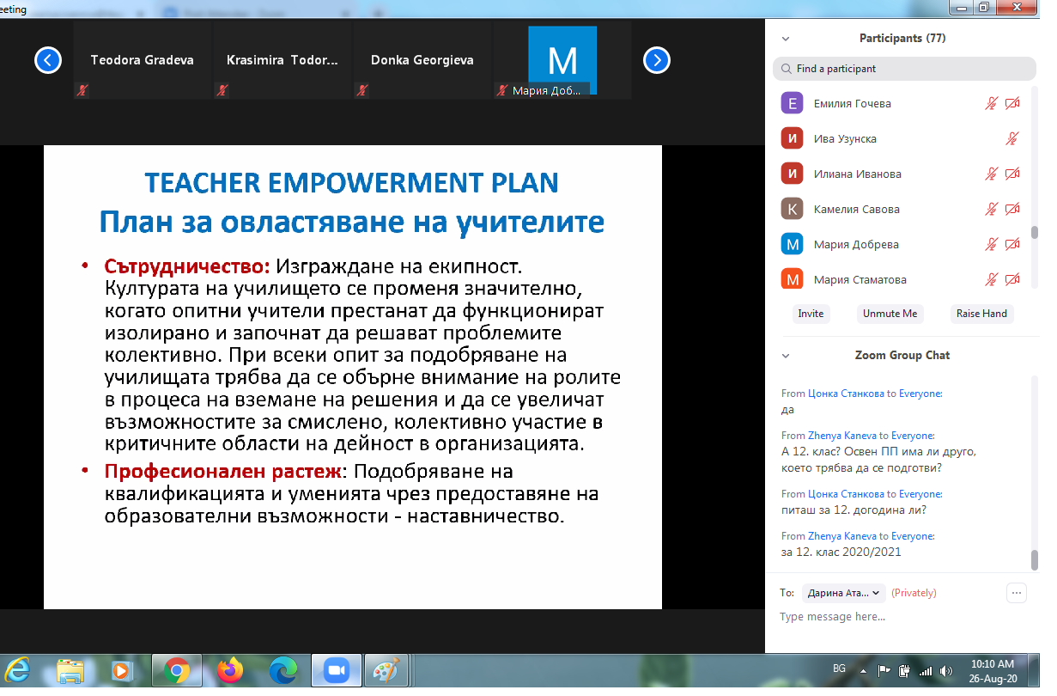
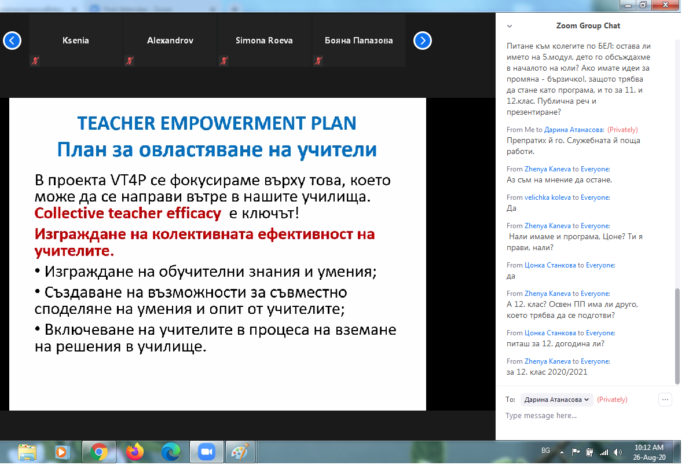

Slide 4
VT4P project team
IV EG “Frederic Joliot-Curie”, Varna
26.08.2020, Varna

