Slide 1
2017-1-PL01-KA219-038284_3 “VISIBLE TEACHING4PERFORMANCE”(VT4P) Cooperation for innovation and the exchange of good practices
1° TRANSNATIONAL PROJECT MEETING
RYBNIK (POLAND) 13 -17 DECEMBER 2017
DROPOUT RATE IN ITALY, CALABRIA REGION AND I.I.S. PERTINI-SANTONI
MEASURES TO PREVENT AND REDUCE EARLY SCHOOL LEAVING

Slide 2
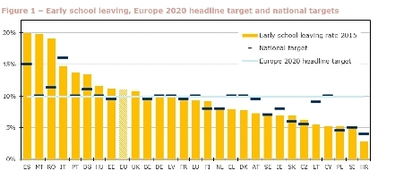
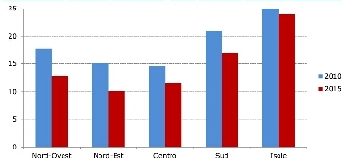
Early school leaving in Italy
Regional differences
Early school leaving in Europe

Slide 3
Early school leaving at I.I.S.PERTINI-SANTONI
ISTITUTO DI ISTRUZIONE SUPERIORE “PERTINI – SANTONI.
DROP-OUT RATE: 24,5%
Girls 492
Boys 438
Girls 492

Slide 5
LEARNING OUTCOMES IN THE THREE DEPARTMENTS
PASS

Slide 6
Our school, within the NATIONAL OPERATIONAL PROGRAMME 2014-2020, in the current school year, is implementing A SOCIAL INCLUSION extracurricular project : «SCHOOL@LAB», consisting of 6 Modules, in order to prevent and reduce school dropout from an average of recently 24.5% to 15% in the future.
The topics are:
BEACH VOLLEY AT SCHOOL
FIVE-A-SIDE FOOTBALL
MODULE FOR PARENTS: PARENTS, FAMILIES, SCHOOL.
MUSIC AND ENGLISH
THE COMPANY THEATRE and EDUCATION LAW
Early school leaving at I.I.S.PERTINI-SANTONI

Slide 7
DROP-OUT RATE
IIS Pertini -Santoni 24,5
Calabria 16.9%,
Italy 15%
Europe 11%

