Slide 1
My Peda path
John Smith
15.10.2019
Creativity
I use and create innovative pedagogical solutions and leanrning environments I utilize multiple possibilities of working life in learning I search for possibilities, I brainstorm new individual paths to both working life and a good life together with representatives from business’s and stakeholders.
Innovation
I educate and guide future subject matter experts for the future needs of working life I try and develop new ways to teach, mentor and guide I take actively part in development of Luovi and working life
Competence
I recognize the future needs of working life in my own vocational field. I act as an example according to the rules of working life I make sure with different kind of pedagogical methods that my students reach their goals I’m an expert in cooperation both inside Luovi and among our networks of business’s, partnerships and cooperations
Caring
I believe in students strenghts and in progression of competence I promote equality and parity I don’t tolerate bullying
Joy
I point out successes I respect my own work and the work of the others – I’m present and listen I create and promote supportive athmosphere, in which learning is a joy

Slide 2
Pedagogical anchors, 360° -feedback as a support of my own work
Person: self evaluation
Colleague 1
Student 1
Boss
Colleague 2
Colleaque 3
Student 2
Student 3
Compare your feedback to your self evalution
Think how others see your activity/work? Do others see your work as you yourself want them to see it? Is there anything surprising in your feedback? Which individual matters stand out especially? Who (which group) gave you this feedback? How these matters relate to the goals of your work or influence reaching your goals in your work? What kind of concrete situations relate to these?

Slide 3
Analyse your feedback
My strengths | Meaning of those for myself and others
Strength 1
Strength 2
Strength 3
What makes me wonder in my feedback | Meaning of those for myself and others
Matter 1
Matter 2
Matter 3
How do you want to deepen and progress your way of working?
Which strengths you use and how? Which concrete matters your do first? What happens to the matters you have to develop? How do you know you are progressing? How do the others notice your progress? Which matters you would like to be more aware of? What do you do more, less, stop doing completely or do differently?

Slide 4
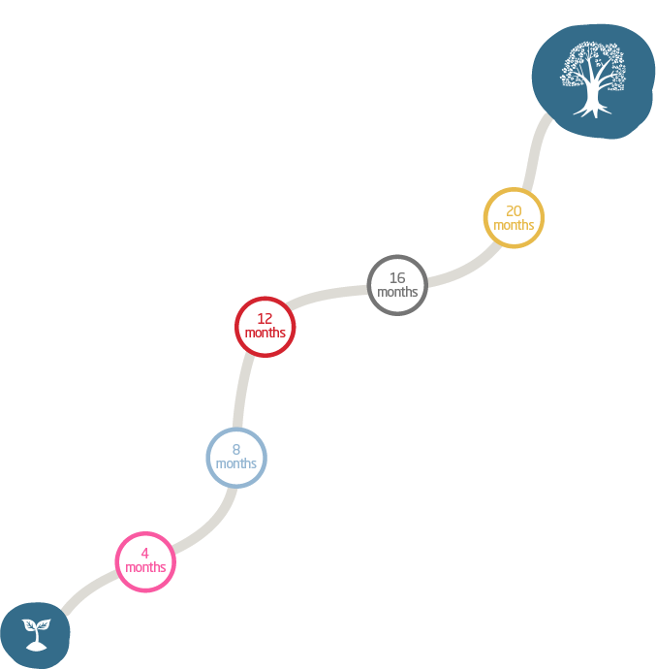
My peda path
Think, write down and discuss
Write three of your goals next to the tree Write or draw at least three things which you believe will bring you closer to your goals to the timeline. Try to be as concrete as possible, for example I try new ideas in guiding students Write down your successes during the way. Discuss with your boss about your Peda path progress yearly at your development discussions
Goal 1:
Goal 2:
Goal 3:
Enjoy your progress and success!

