Slide 1
Historical beauties of the Black Sea Region

Slide 2
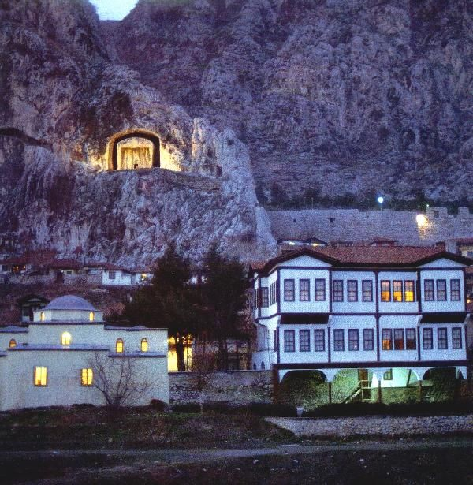
Amasya City
Amasya is one of our cities rich in history. The first settlement in Amasya goes back to 8500 years ago. Features Its name is mentioned during the Hittite civilization. During the Ottoman period, Amasya raised a prince for 183 years. For example, Fatih Sultan Mehmet and Yavuz Sultan Selim served as a prince here. It is also important for the history of the Republic of Turkey Amasya. Amasya Circular was published on 22 June 1919.
Amasya is known for its king rock tombs, historical buildings and structures, and legends. To give another example, the historian Strabon is from Amasya. Yeşilırmak divides Amasya into two from the beginning. Amasya Yalıboyu houses on the edge of Yeşilırmak, tombs from the Seljuk and Ottoman periods, Amasya Archeology Museum and Amasya Castle are important structures that should be seen in the city.

Slide 3
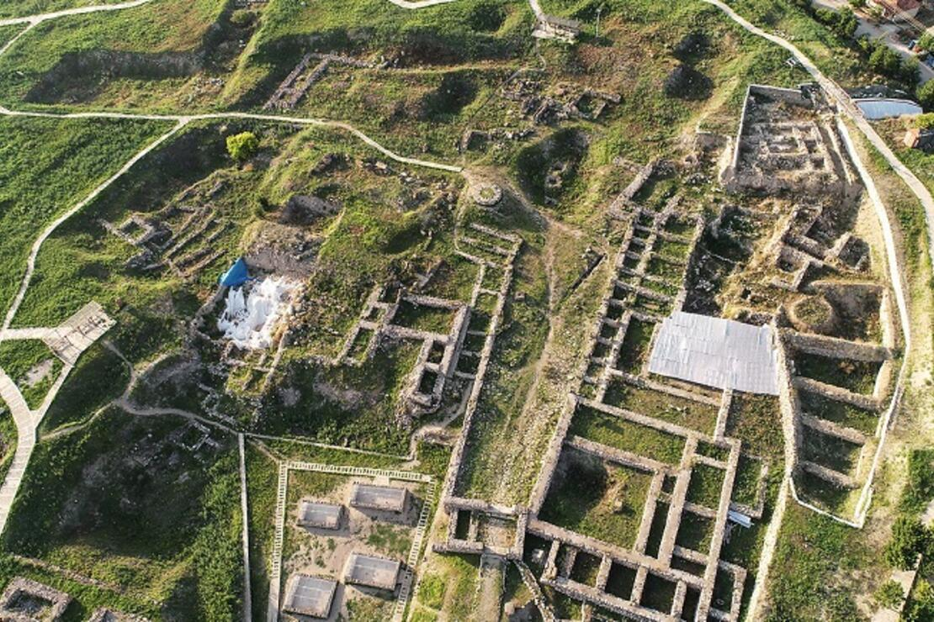
Alaca Höyük Ancient City
Inside the Alacahöyük ancient city or archaeological site, there is also a museum with artifacts unearthed from the region and royal tombs. The royal tombs are exhibited under protection in the open air.
As a result of the excavations carried out in Alacahöyük, four cultural layers and fifteen building layers were identified. The oldest one is the Chalcolithic Age layer. Others are the Early Bronze Age, Hittite Age and Phrygian Period, respectively. Building layers are also among them.
The ancient settlement discovered in 1835 was named as İmat Höyük in 1842. In 1872, the connection of the mound with the Hittite was announced for the first time. In 1907, Theodor Makridi Bey excavated and in 1910 the stone ax found in excavations was published. All of this information can be viewed on the Alacahöyük page in the relevant resources below.

Slide 4
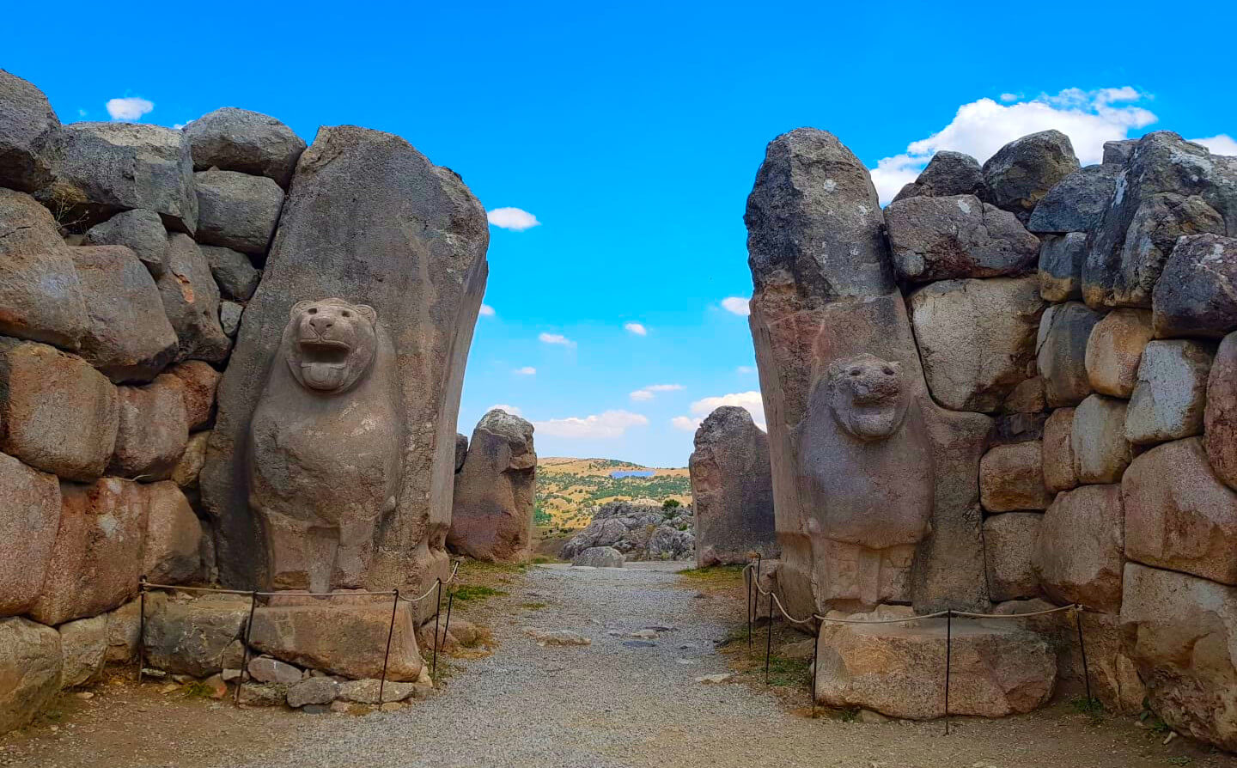
Hattusha
Hittite Cuneiform writings and Hittite hieroglyphs are also described on the page where Hattusa, the capital of Hittite Civilization, and Hittite history are located. It also has information about the Hattusa Ancient City gates, the Hittite Great Temple, and Poternli city walls.
Similarities with Luwian language and hieroglyphs, Hittite legends, Hittite art details, Hittite traditions and Turkish traditions are also on the same page.

Slide 5
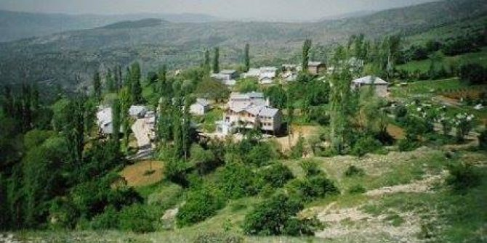
Kayacik Village
Kayacık village is a village of Çamoluk district of Giresun province.
Çamoluk district is located on the valley formed by the Kelkit River in the Black Sea Region. Camoluk has been conquered by the Hittite Kingdom, Kimers, Metler, Persians, Parthians, and Pontus Kingdom in order throughout history. The district, which was in the hands of the Roman Empire in the post-Christ periods, passed into the hands of the Seljuks in 1054. Yavuz Sultan Selim included it within the borders of the Ottoman Empire after the war of the stole in 1514.
The village is one of the hundreds of villages that were established in 1925 with the instructions and orders of Atatürk to move the Armenian and Greek villages that were willing to move to the Armenian and Greek villages, which were emptied (by immigration) due to the land deficiency in the Kırıntı village of Şiran. Çamoluk Kayacık Village was a Greek village from the Greek Pontus until the 1925's. The leader of our national liberation war, Mustafa Kemal, to the selfless Anatolian people who protected the National Pact's borders and cleansed Anatolia from the occupation forces, Anatolia's Greeks, Armenians, Jews, etc. as a reward the villages abandoned by One of these villages is Kayacık Village. The name of the village in the Greek period is known as HINZIRI.ektedir.

Slide 6
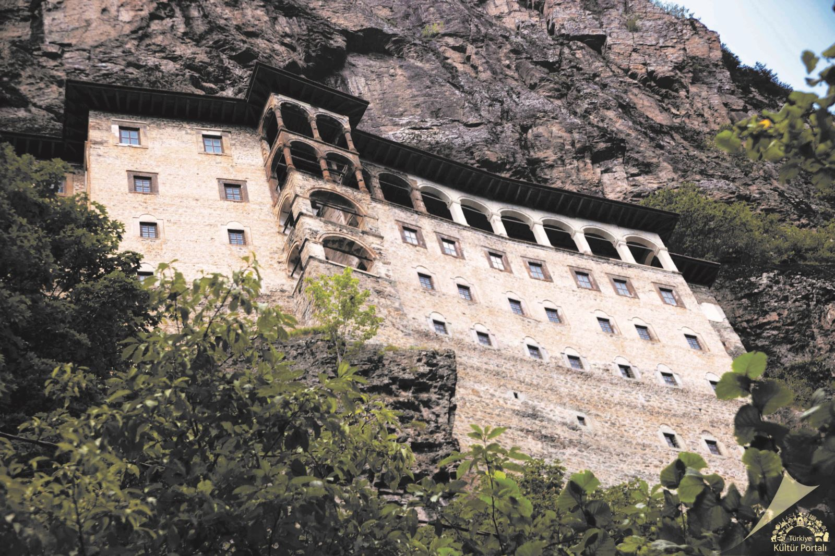
The Sümela Monastery
The Sümela Monastery, built on a steep cliff in the foothills of Montenegro, which dominates the Altındere valley, within the borders of Altındere Village of Maçka District of Trabzon, is known as "Virgin Mary" among the people. The structure, which is about 300 meters above the valley, has continued the tradition of establishing monasteries outside the city, in forests, caves and waterfront. It is said that the monastery founded in the name of the Virgin Mary took its name "Sumela" from the word "molasses" which means "black". Although this name is thought to come from the dark-colored Montenegro, where the monastery was established, the word Sumela can be attributed to the black color of the depiction of Mary here.

Slide 7
THANKS FOR WATCHING MY SLİDE
RAMAZAN TAHA KÖROĞLU
9/E
196

