Slide 1
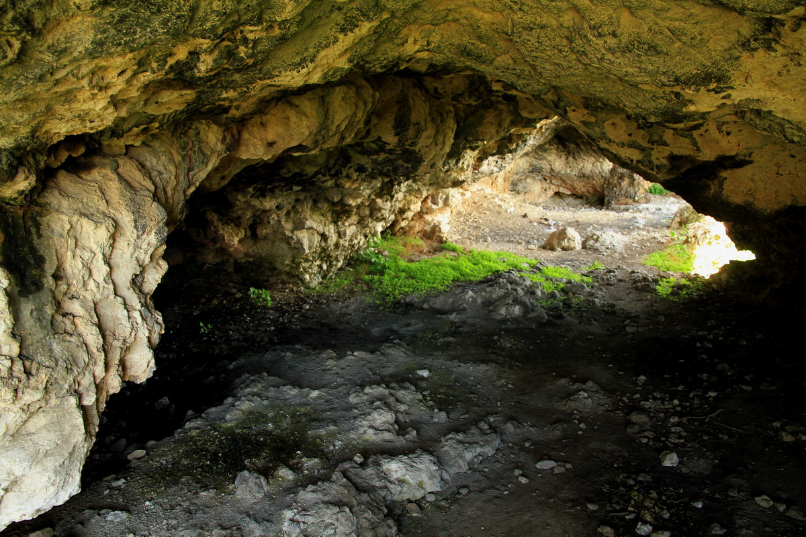
The symbol of The cave in literature
Made by:Gasanov Firuza
Neopolitical caves in northern Moldova

Slide 2
SUMMARY:
“The reader in the cave”, Rui Zink
“Mircea's shadow-At Cozia”, Grigore Alexandrescu
“Caesara”, Mihai Eminescu
“the singing of Romania”,Alecu Russo
“

Slide 3
“The reader in the cave”,Rui Zink
The Cave Reader is a micro-novel written by Rui Zink, published in 2006, on the occasion of World Reading Day. The story is told with humor and without moralizing ostentation. A second edition of the book, added, was published in Lisbon in 2010 and is the subject of a translation of the 2006 edition. At the center of the action is a drifting teenager, who, fleeing the "royal guard", goes on a journey in search of a mythical and fabulous animal, Anibalector. The novel is structured in 3 chapters: "The Journey", "The Island" and "The Return".

Slide 4
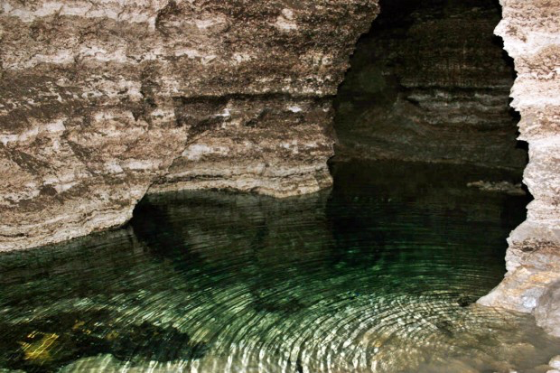
“The reader in the cave”,Rui Zink
In this work, the cave is represented as the refuge of Anibalector.
He, being passionate about reading, stimulates and motivates the boy to read as much as possible. Finally, they both read and discuss the books they read.

Slide 5
“Caesara”,Mihai Eminescu
“My world is a valley, surrounded by all parts of impenetrable rocks that stand like a wall from the sea, so that the human soul can not know this earthly heaven where I live. There is only one entrance - a moving rock that masterfully covers the mouth of a cave that leads to the inside of the island. Otherwise, those who do not enter that cave believe that this island is a pile of barren rocks raised in the sea, without vegetation and without life.”

Slide 6
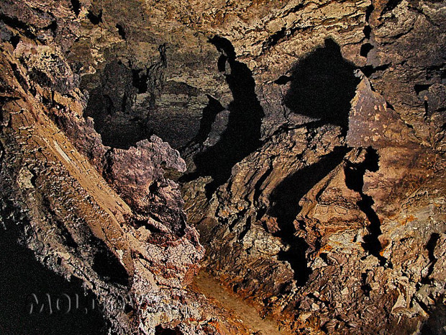
“The singing of Romania”
“Praise be to you, our country, blessed and speaking by God ... the sons of the Huns dared to submit to you ... and you were the cave of their wolves ... the flood of Asia wanted to swallow the world ... and you you were the dam of the world ... a race of heroes coveted your flocks and the golden grains of your holdings ...”

Slide 7
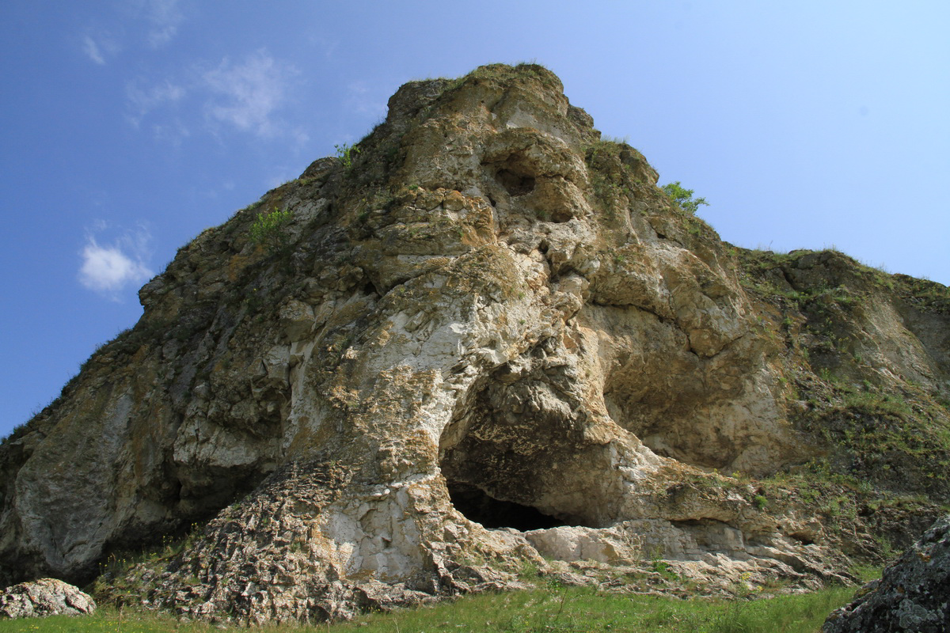
“Mircea’s shadow-At Cozia”
Out of a cave, out of the ravine, night comes out, it envelops me:
From the flies, from the rock, black faces descend;
The muscle of the wall moves… through the grass to slip
A breath that passes like a shiver.

Slide 8
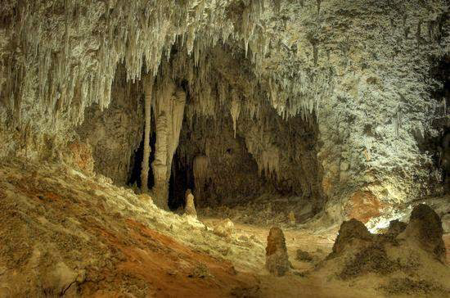
“Mother of Stephen the Great"

Slide 9
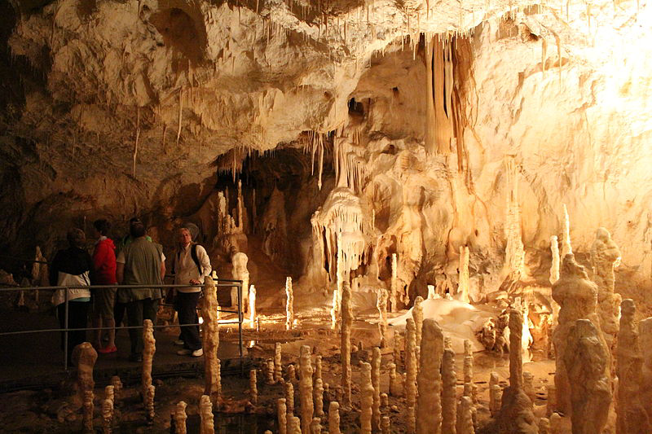
Conclusion :
For romantic poets, entering a cave has the meaning of a journey into the depths of the inner "self," making contact with the soothing, and calm intimacy of substance.

