Slide 1
DISCOVER EUROPE
ITALIAN MOUNTAINS FACTS AnD Legends

Slide 2
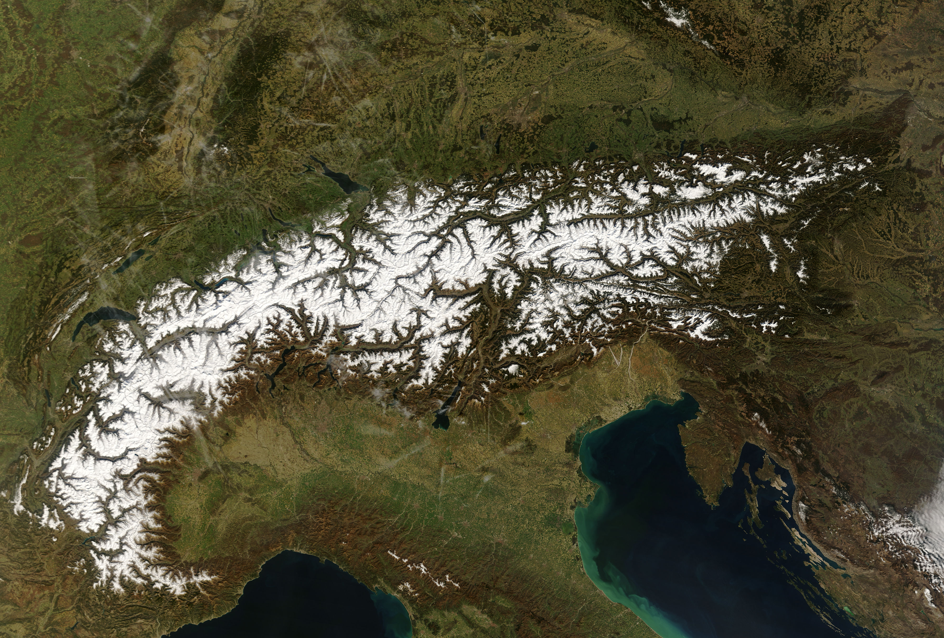
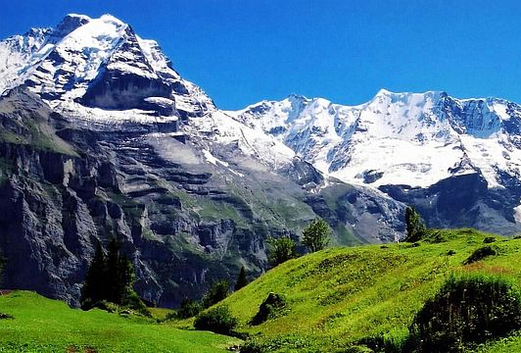
The Alps are the highest and most extensive mountain range system that lies entirely in Europe.

Slide 3
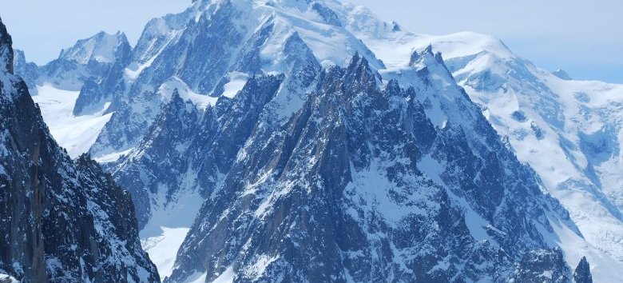
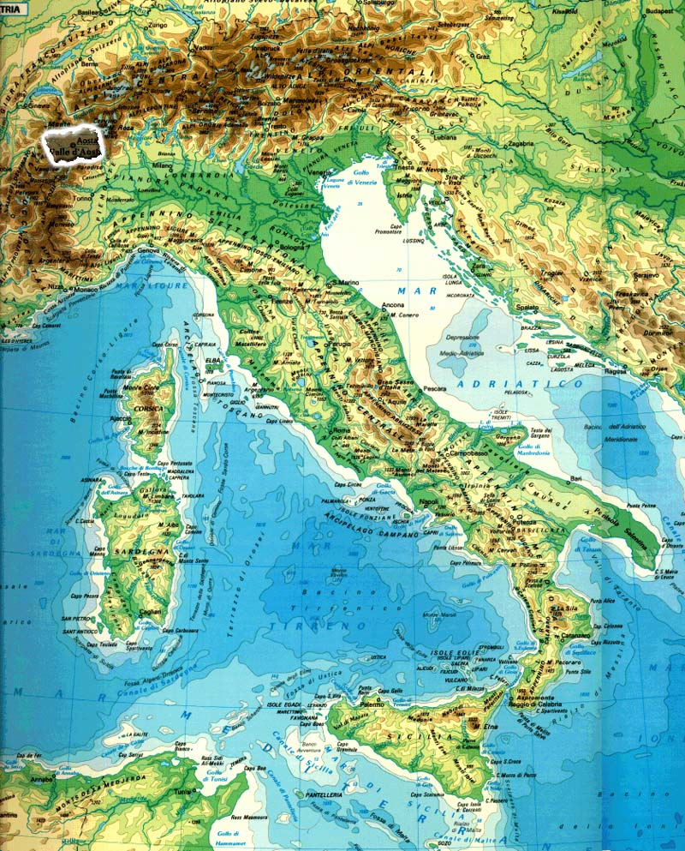
MONTE BIANCO/ The white mountain
Rising 4808 mt, the mountain stands between the regions of Aosta Valley, Italy, and Savoie and Haute-Savoie, France.

Slide 4
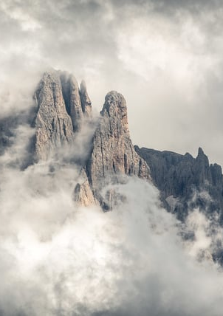
LEGEND OF The pale mountain: the dolomites
Once upon a time, in the south of the Alps, there was a rich and fortunate kingdom. the king’s son had a tormented desire: he wanted to go to the moon. The prince succeded in going to the Moon, and he immediately felt in love with the king’s daughter. He took the beautiful Princess of the Moon with him to the earth as his wife, but she felt ill because she missed the moon light.
But the dwarves caught the moonlight ray by ray and the Princess became happy again.
Today they are the only pale mountains.

Slide 5
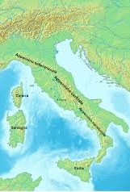
Appennine Mountains
The appenninis
They are a mountain range consisting of parallel smaller chains extendind about 1.200 km along the length of peninsula Italy.

Slide 6
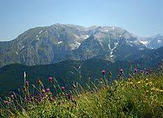
The Apennines conserve
some intact ecosystems
that have survived human intervention

Slide 7
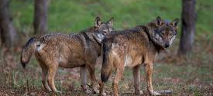
Fauna in the appennins
These mountains are one of the last refuges of the big European predators such as the Italian wolf and the marsican brown bear, now extinct in the rest of Central Europe.

Slide 8
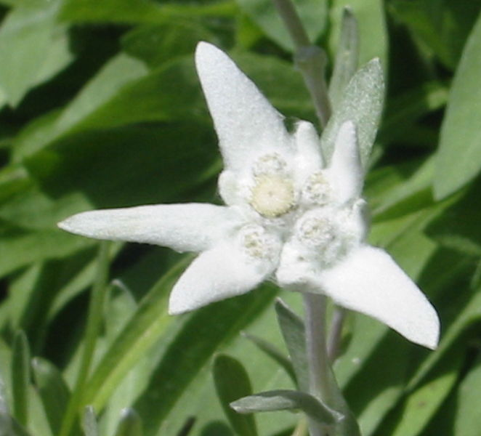
The legend of edelweiss
A young man went to the mountains to look for herbs. Her wife was worried because he was so late ..she went to look for him and when she found him he was dead. She spent there all night crying all the time. In the morning all her drops of cries became little white flowers…
Goodbye
from the Italian Mountains

