Slide 1
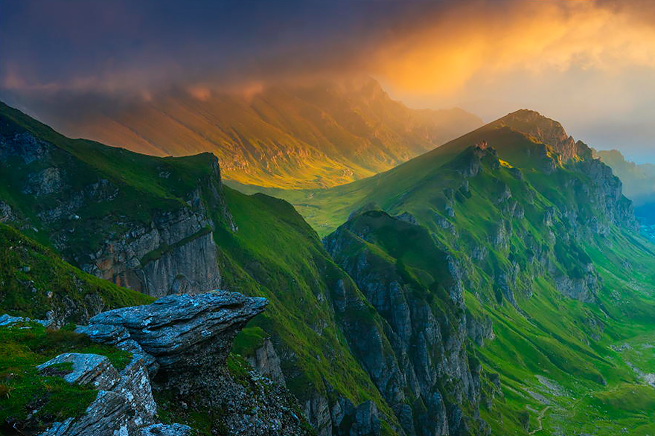
The symbol of MONTAIN in Romanian literature
Made by :Gasanov Firuza
Teacher:mÂțU Inga

Slide 2
Summary:
Symbol of mountain in general;
“ The mountain “ , Alecu Donici;
“The mountain and the valley “, Bogdan Petriceicu-Hasdeu;
“The song of Romania”, Mihai Eminescu;
Personal impressions;

Slide 3
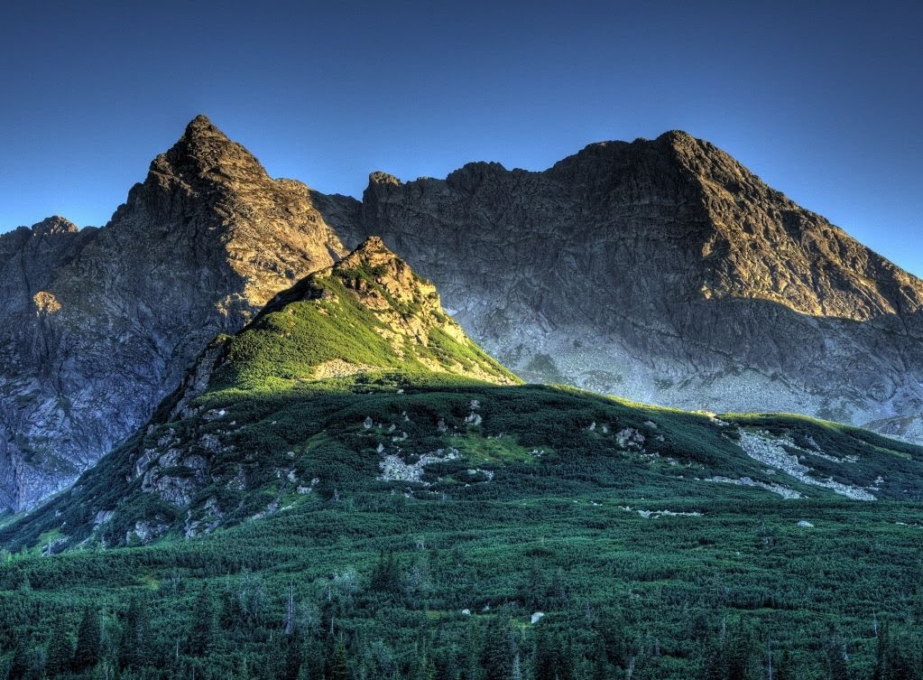
Symbol of mountain in general
MOUNTAIN It is considered as earth, the latter being the feminine principle, the motherland, the mother and nourisher of all living things, always correlated with the forest, especially with the fir, masculine principle, because it shakes its seed on the ground, which it protects from the weather. , being simultaneously son, husband and father
Carpathian Mountains

Slide 4
“The mountain “ ,Alecu Donici
In this work, the mountain is associated with people. Being a fable, we find the moral directly in the text "There are people you expect / see wonders from" they make a big fuss, and in the end their end product is as small as a "mouse." the author cites as an example his creation "and after much, much work / I make a short fable"

Slide 5
“The mountain and the valley “, Bogdan Petriceicu- Hasdeu
this work reflects the beauty of the mother earth, the valley signifying the lowest land point and the highest mountain
Bogdan Petriceicu Hasdeu was a Romanian writer and philologist from the Hâjdău family, a pioneer in various branches of Romanian philology and history. Academician, encyclopedist, jurist, linguist, folklorist, publicist, historian and politician, Hasdeu was one of the greatest personalities of Romanian culture of all time.
the top of the Carpathian mountain

Slide 6
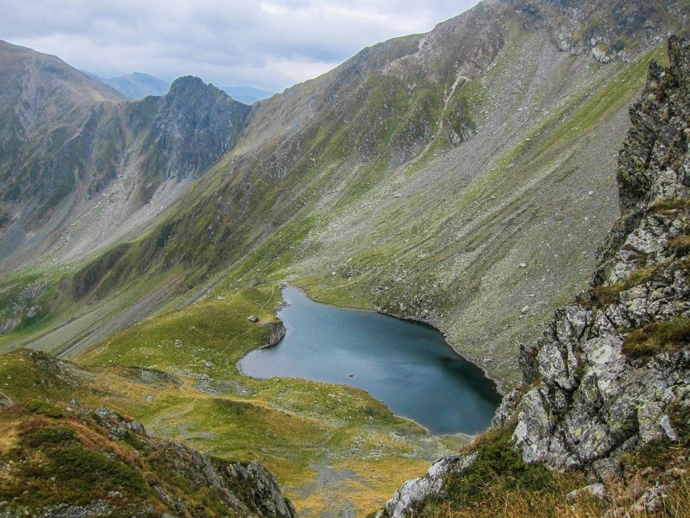
“The song of Romania” ,Alecu Russo
“the mountains rise proudly in the air”
“the beautiful plains, surrounded by green mountains, stretch more than the eye could see”
“Beneath the foot of a mountain lay a great plain, and a bright sun shone on that plain”
Hasdeu described the mountains of his homeland as a wealth of nature.

Slide 7
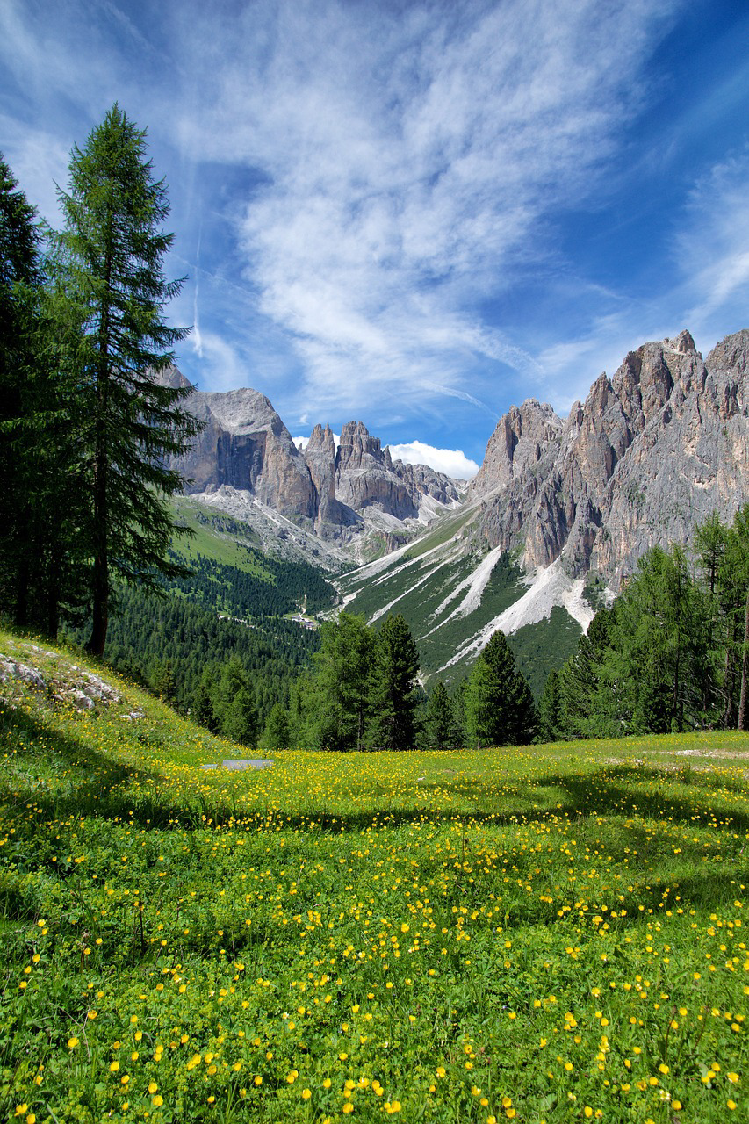
Personal impressions about mountains in Romanian works
In my opinion, the mountains have an important role in the works of the great Romanian writers. They represent a natural wealth of Romanians. As a thank to them, the authors glorify them in their works

