Slide 1
HIstorIcal BeautIes of Istanbul, Thrace and Marmara RegIon

Slide 2
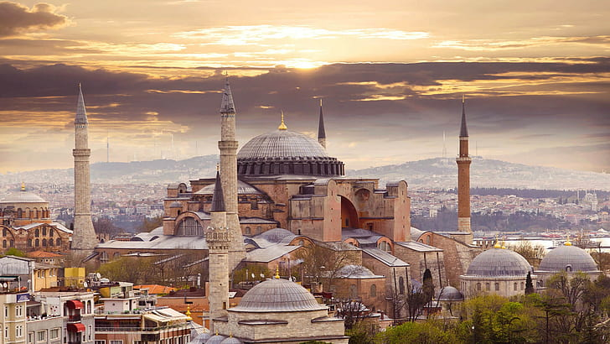
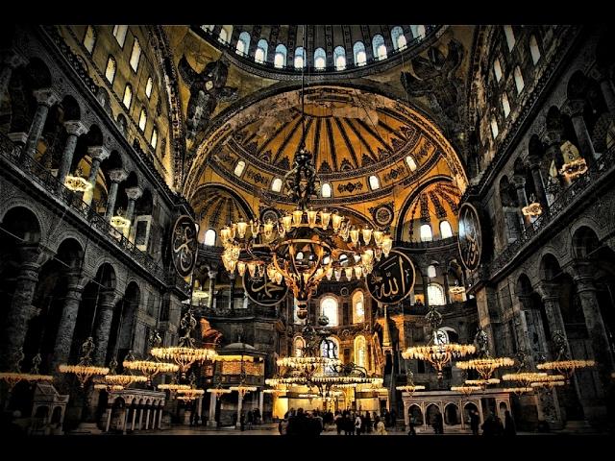
HAGIA SOPHIA
Hagia Sophia: Hagia Sophia is the largest church built by the Eastern Roman Empire in Istanbul. It was built three times in the same place. After the 5th century, when it was first built, it was named as Megale Ekklesia (Great Church). Hagia Sophia means holy wisdom

Slide 3
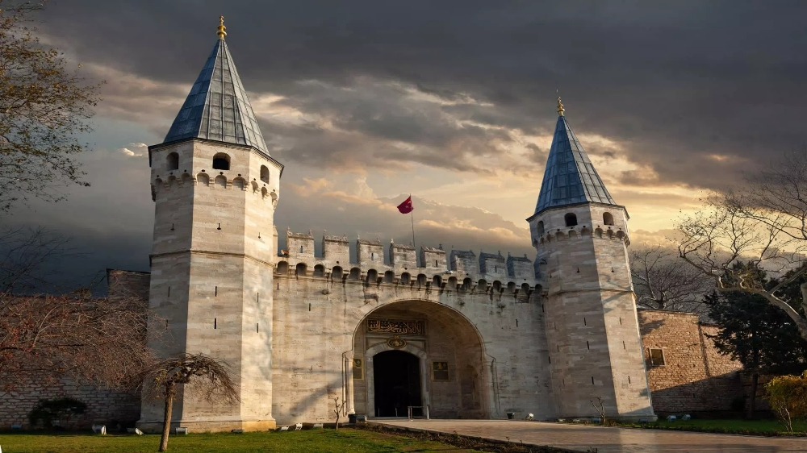
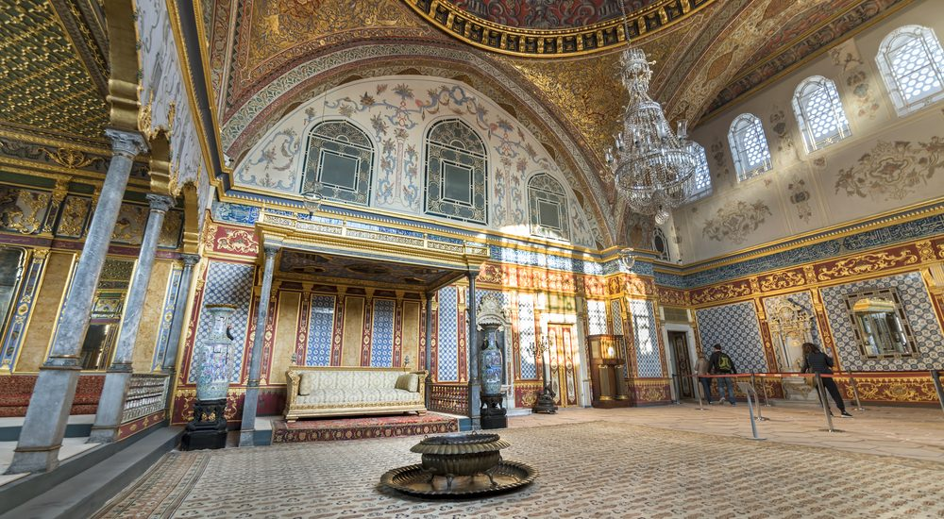
TOPKAPI PALACE
Topkapı Palace is the oldest and largest palace in the world that has survived until today. The palace that was the administrative center of the Ottoman Empire for about 400 years on the ridges of Sarayburnu in Istanbul. It covers the shores of the Golden Horn and the Bosphorus with Sultanahmed.

Slide 4
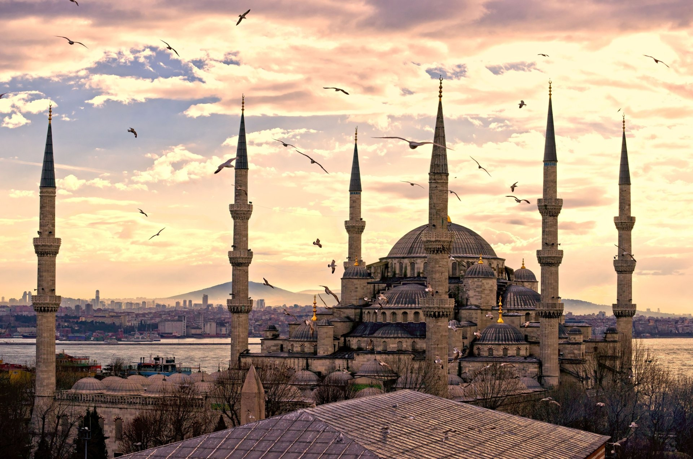
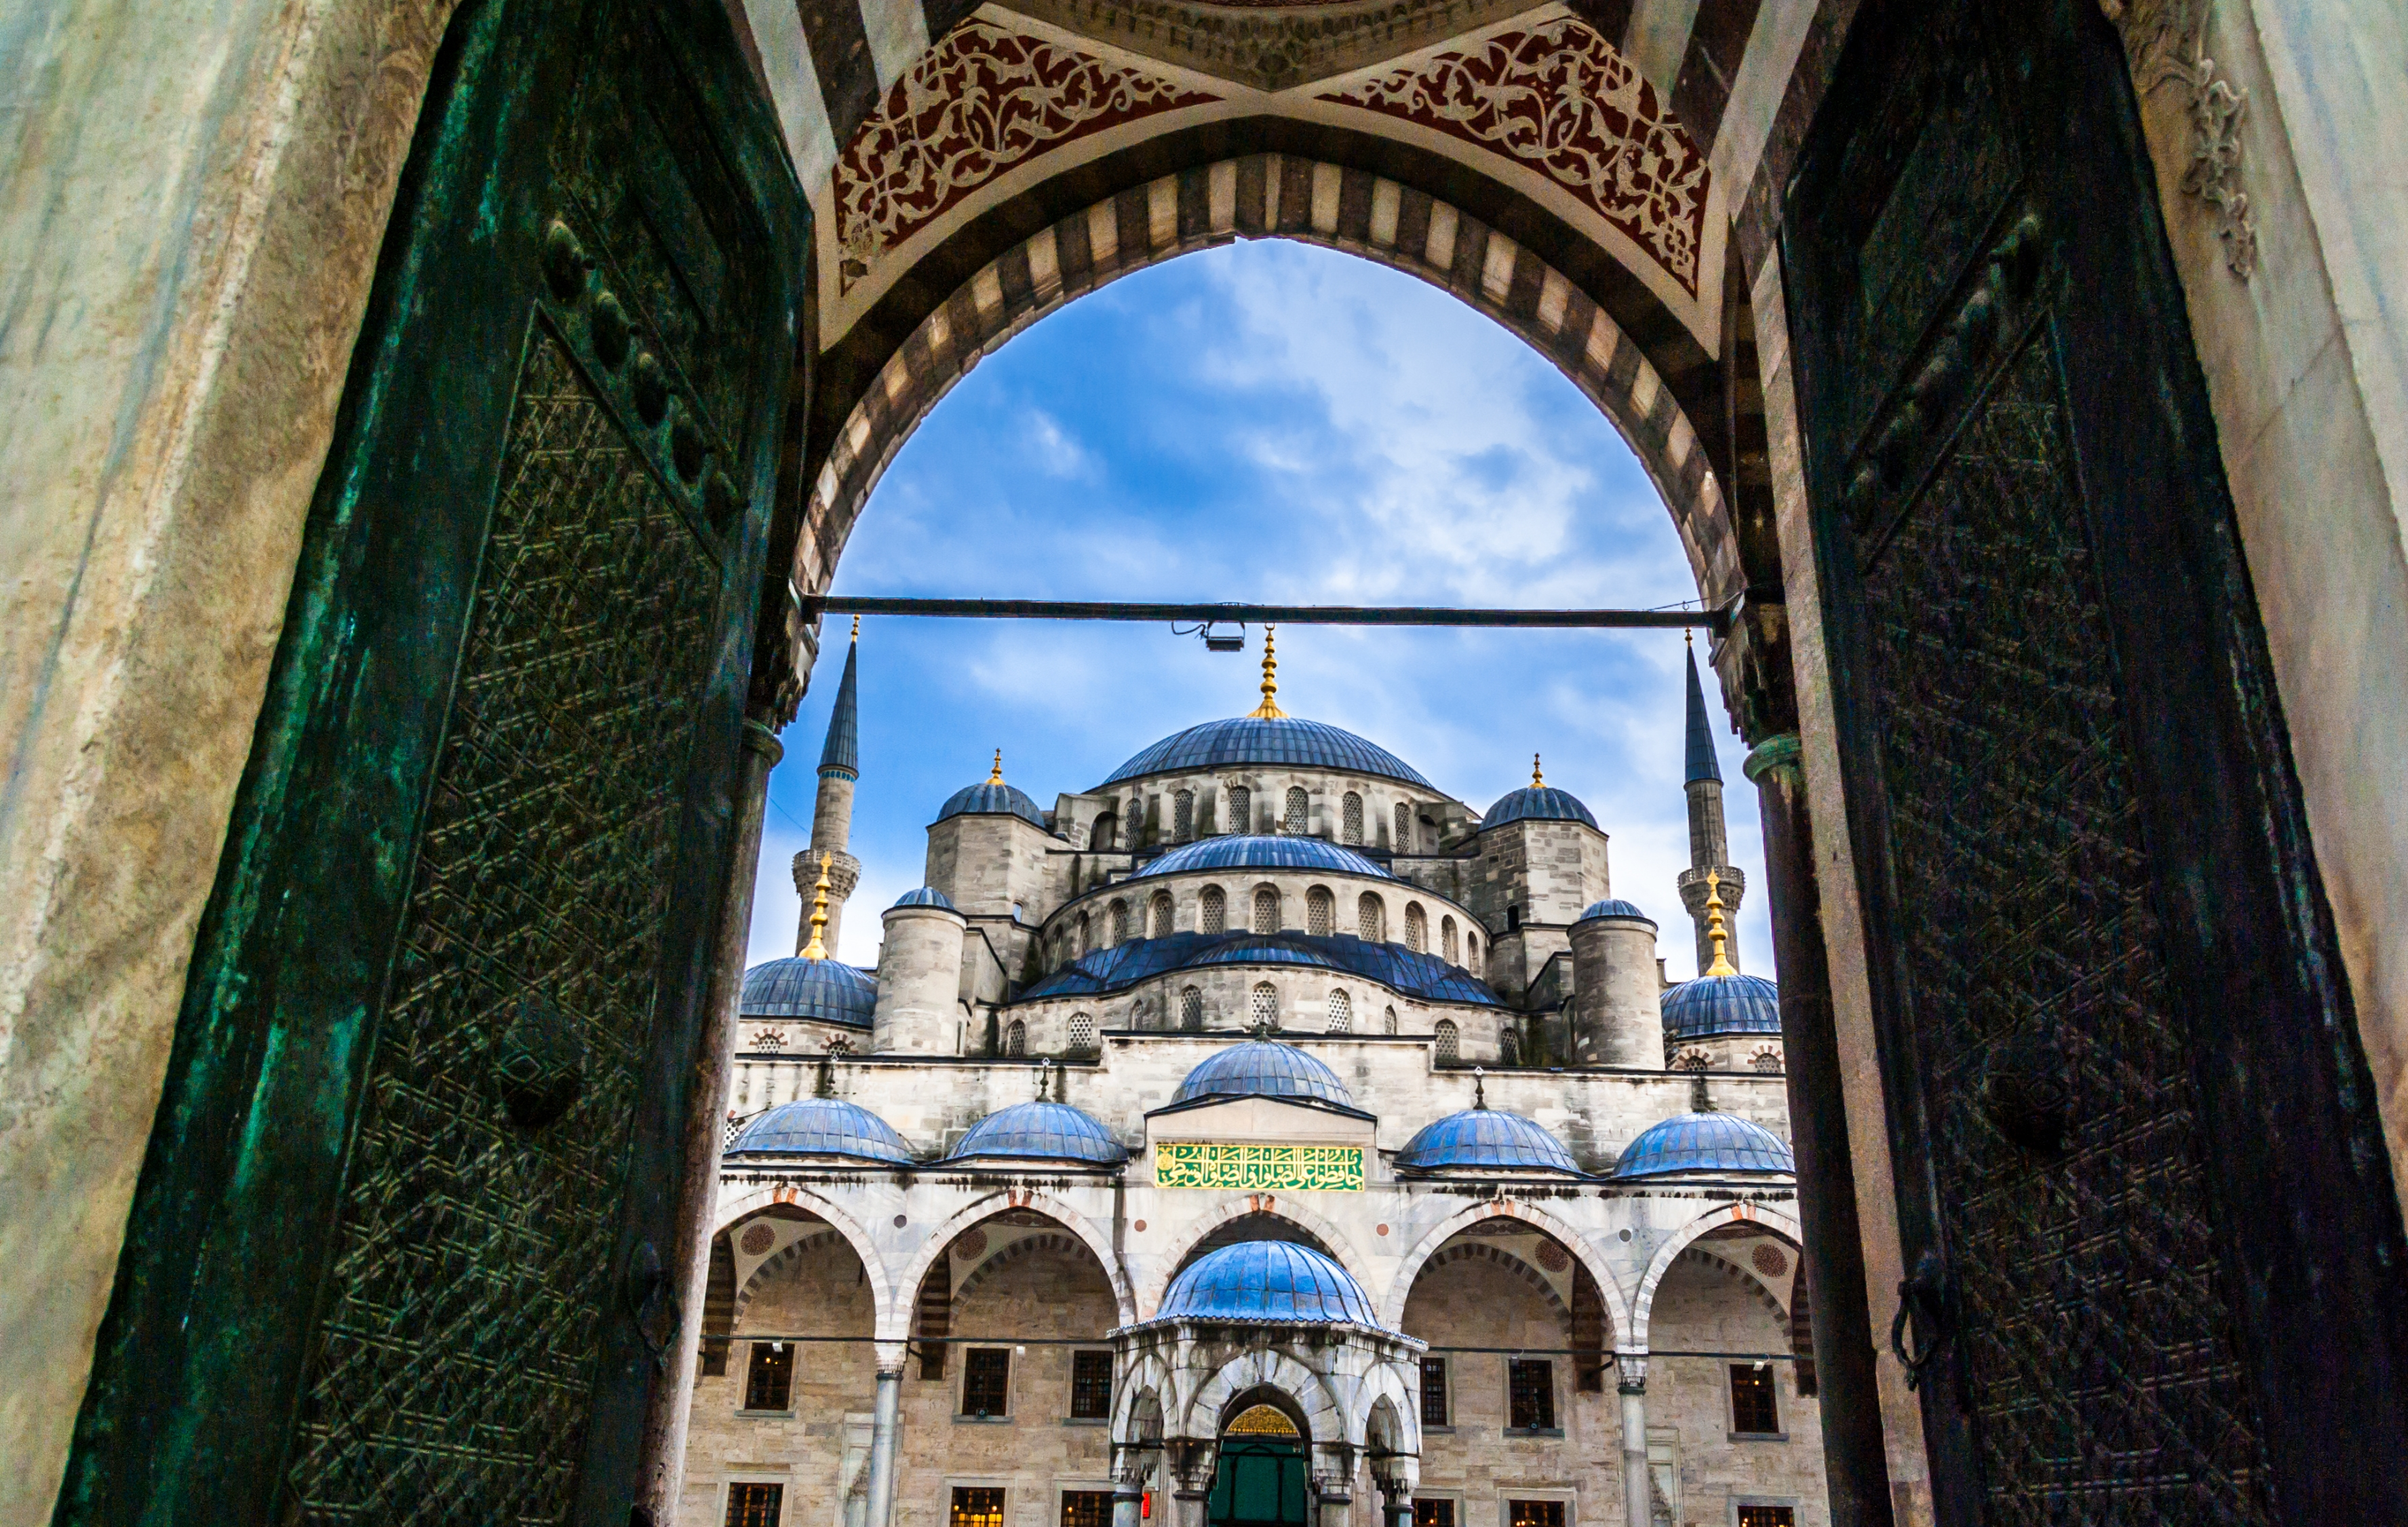
SULTANAHMET MOSQUE
The architect of the mosque is not Mimar Sinan, but one of his best students, Sedefkar Mehmet Ağa. The mosque has 16 balconies and a main dome with a diameter of 23.5 meters. The mosque is the first mosque with 6 minarets in the Ottoman Empire.

Slide 5
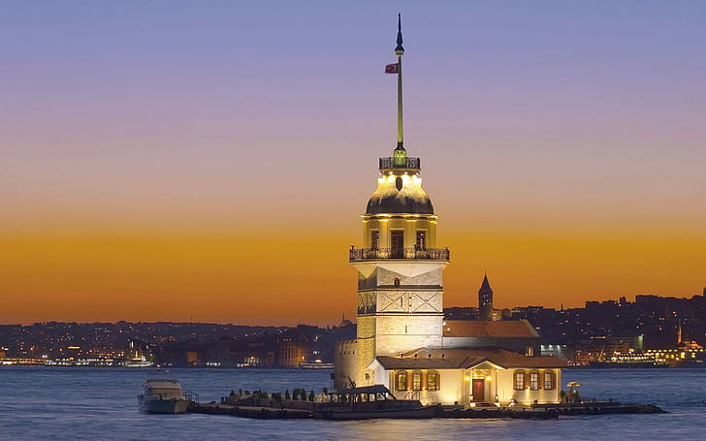
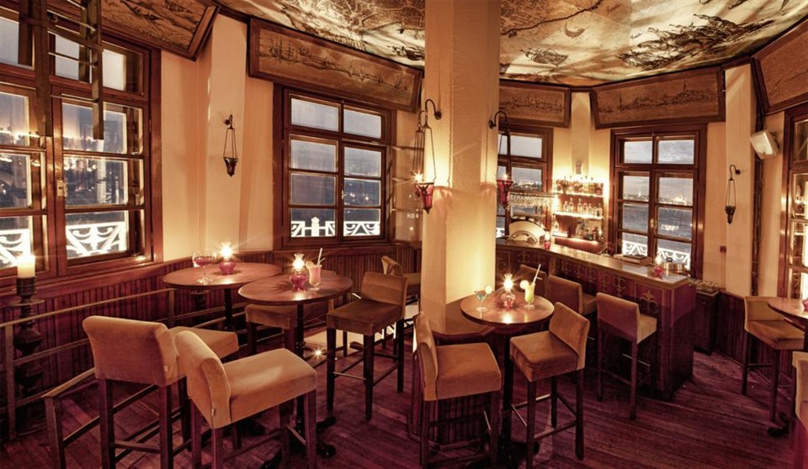
MAİDENS TOWER
The Maiden's Tower was established by the Greeks in the 5th century BC at a point close to the Üsküdar Salacak coast of the Bosphorus. It is the only architectural work from the Roman Empire in Üsküdar. It has been used for different purposes throughout history and many rumors have been produced about it.

Slide 6
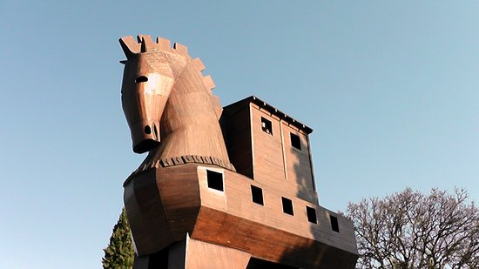
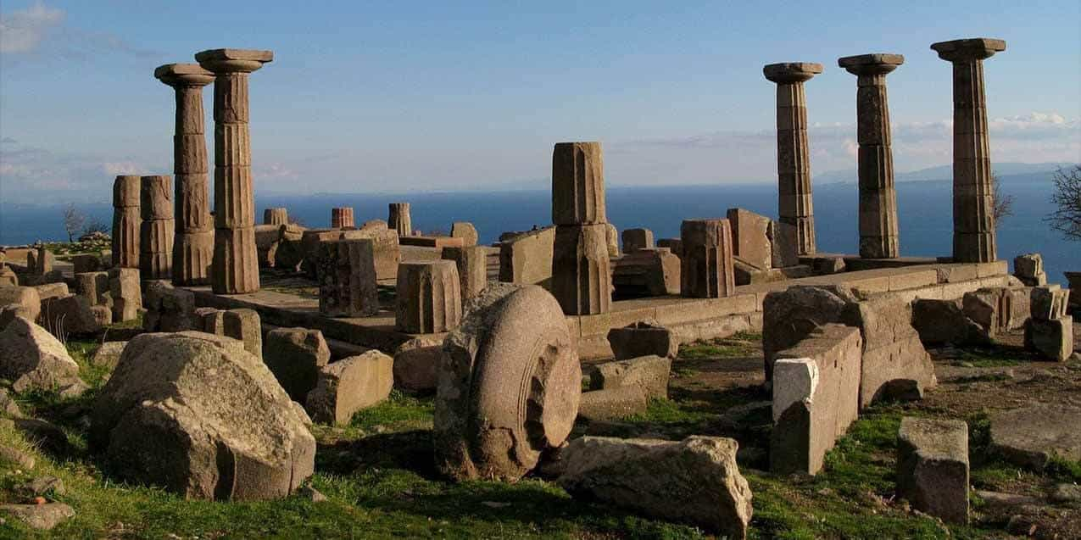
TROYA
The ancient city of Troy, which is called Troy or Troia according to the languages, is a great ancient city that hosted the Trojan War in ancient Greek history, is located within the borders of Çanakkale's Hisarlık district and lived in a prosperous way in its time. The Ancient City of Troy is on the UNESCO World Heritage List.

Slide 7
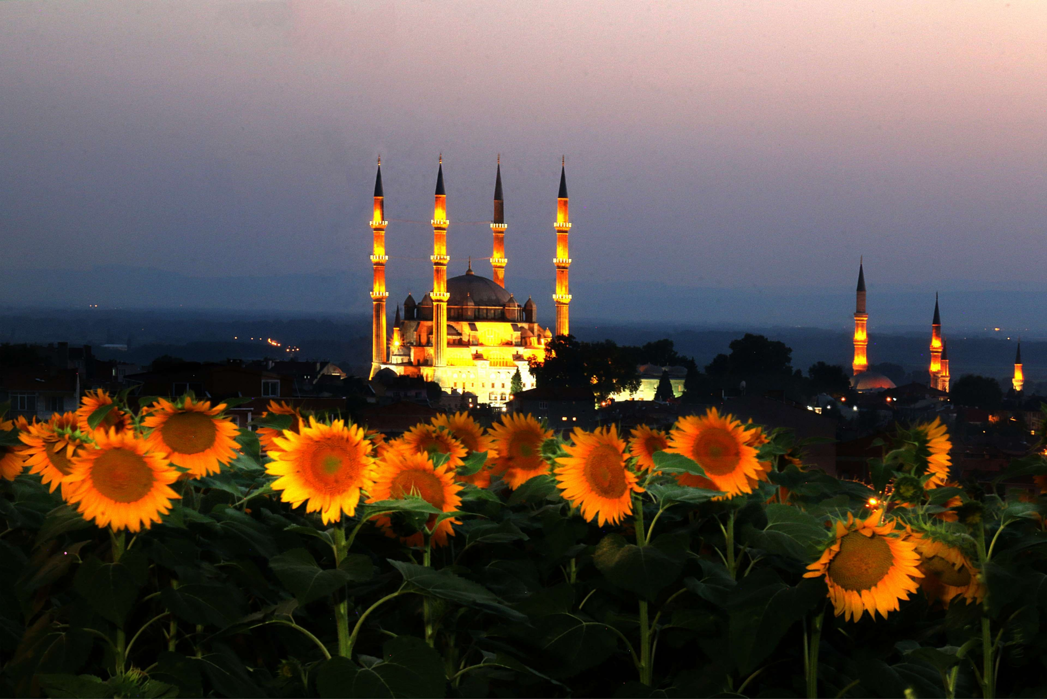
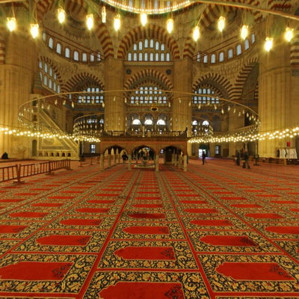
SELIMIYE MOSQUE
Selimiye Mosque is located in Edirne, the Ottoman Sultan II. It is the mosque that Selim built by Mimar Sinan. Selimiye Mosque, built by Sinan at the age of 90 (80 in some books) and called "my masterpiece", is one of the most important works of both Mimar Sinan and Ottoman architecture.

Slide 8
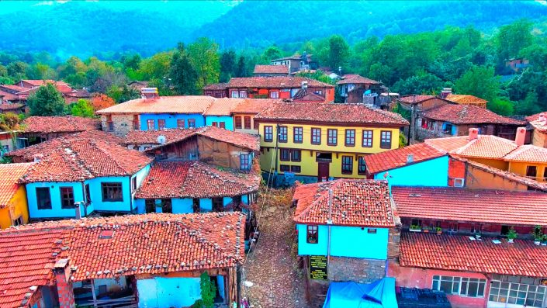
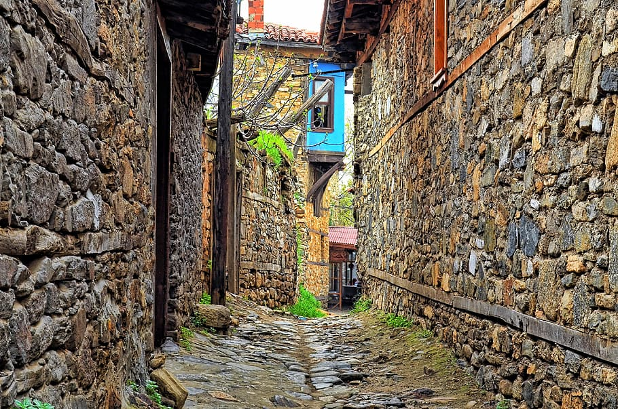
CUMALIKIZIK
It is rich in natural assets as well as cultural assets. History: Cumalıkızık, which was one of the first settlements of the Ottomans in Bursa, brings the Ottoman period housing texture to the present day with a total of 270 houses, 180 of which are still in use and some of them are preserved and restored.

Slide 9
THANKS FOR WATCHING MY SLIDE
HÜSEYİN AKINCI 10/A 220

