Slide 1
Mountain legend: Saint Lucy
Brindisi, Italy

Slide 2
Santa Lucia..the saint of light

Slide 3
Lucy from latin LUX (light)
Santa Lucia (Saint Lucy) is a Catholic saint who was born in Syracuse, Sicily, in 283 AD and was martyred at the age of 20. She is still celebrated in different parts of the world almost two thousand years later.

Slide 4
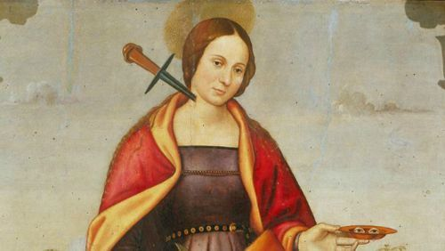
Lucia’s mother arranged marriage for her daughter to a pagan man.
She refused, the angry suitor reported her to Roman authorities, and Lucia was sentenced to life.
They tried to burn her but she survived.
Then she was stubbed.

Slide 5
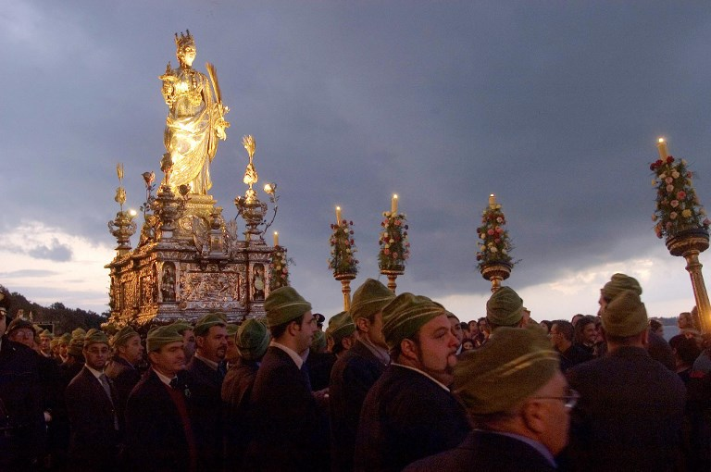
The Saint Lucia's Day parade in Syracuse, Sicily
In the north of Italy, parts of Veneto and Lombardy, especially Verona, Crema, Cremona and Bergamo, the saint has become a sort of Father Christmas figure, visiting in the night to bring children gifts.

Slide 6
Goodbye from
Brindisi, Italy

