Slide 1
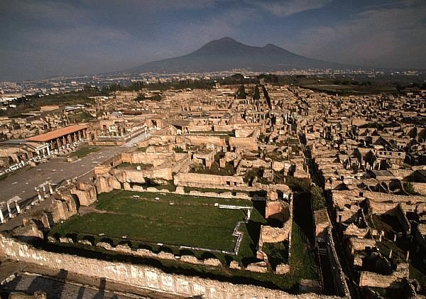
POMPEI
The ROMAN living city

Slide 2
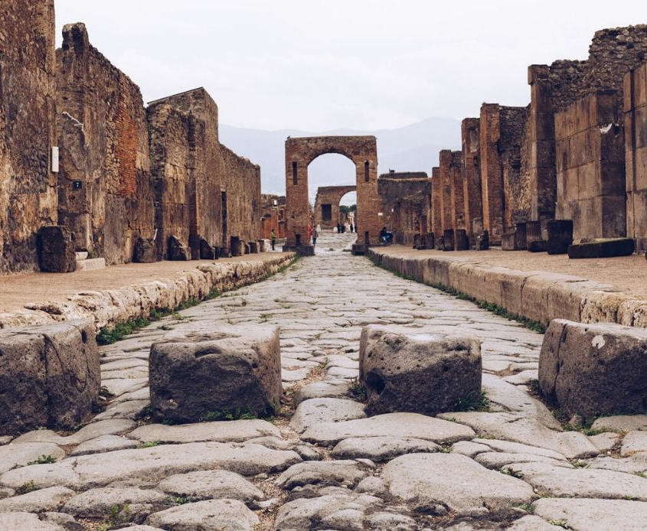
Pompei was a city near Naples, in the south of Italy.

Slide 3
August 24th 79AD, Vesuvius eruption destroys it…

Slide 4
Human figures of clay found in Pompei

Slide 5
Rich houses in Pompei
You can walk and see many houses…still today new excavations give new houses, shops…

