Slide 1
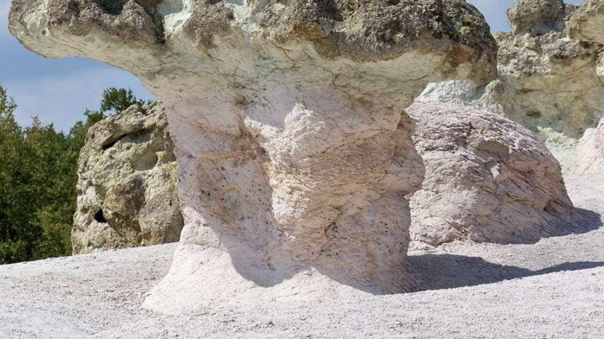
15 stunning rock formations that you will find only in Bulgaria
Anka Petrova 11b class

Slide 2
background
Imagine driving on a simple mountain road and suddenly you come across a group of giant stone mushrooms. Or stand in front of a field of giant vertical stones, still keeping the secret of their origin from scientists. Bulgaria is a land of rock wonders and has something to show you. Here is the guide of Culture Trip for some of the best rock phenomena in Bulgaria.

Slide 3
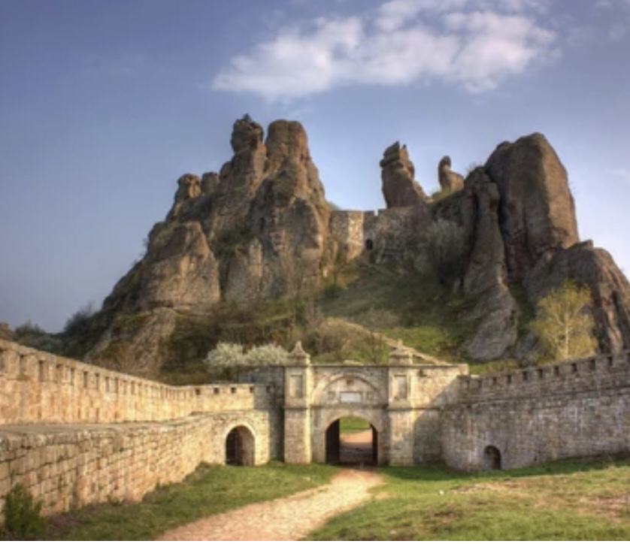
Belogradchik Rocks
The Belogradchik Rocks have caught the imagination of Bulgarians for centuries and most of the strangely shaped rocks have their own names - the Schoolgirl, the Priest, the Couple, etc. One of the best places to admire them is the Belogradchik fortress, which is partly built in the rocks. Be there for the sunset to sow the rocks changing their nuances of red and orange. st. "Dedo Bozhin" 15, 3900 Belogradchik, Bulgaria

Slide 4
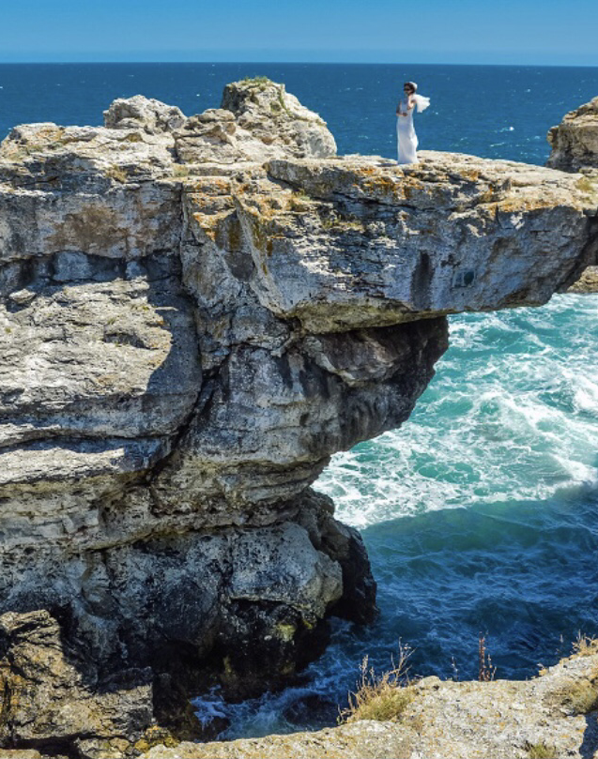
Tyulenovo Rocks
While the southern part of the Bulgarian Black Sea is sandy and touristy, the northern part is wilder and rocky. A favorite place of climbers and lovers of wild campsites, the rocky beach near the village of Tyulenovo will amaze you with its arches and shapes. Be there for the sunrise, as it is probably the most beautiful on the Bulgarian coast.

Slide 5
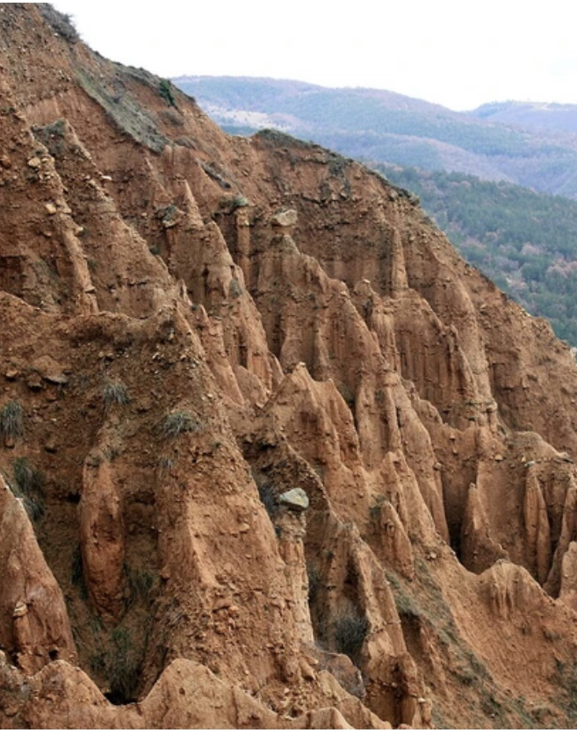
Stob Pyramids
These natural pyramids are famous for their interesting shares but also for the amazing legends of love that go along with them. The Stob Pyramids are located just 40 km from the biggest Bulgarian monastery - the Rila Monastery, so you can visit both in a day trip.

Slide 6
Melnik Pyramids
Another pyramid-shape formation has created other-worldly landscapes near the smallest Bulgarian town, Melnik. The Melnik Pyramids spread for miles all the way from Melnik town to Rozhen Monastery. The area is famous for its typical wines too, so don’t miss the chance to taste them. Melnik pyramids

Slide 7
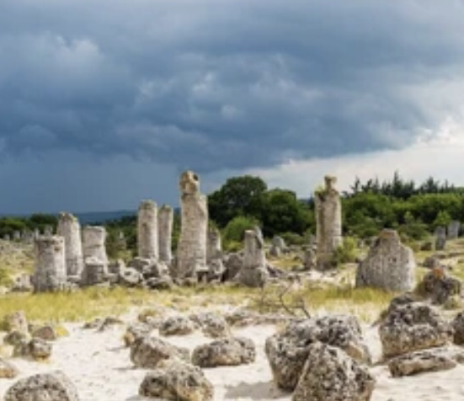
Pobitite Kamani (the Stone Desert)
Pobitite Kamani, also known as the Stone Desert, is situated a short drive away from the seaside city of Varna. This is a huge field of stones vertically set in the ground, which as the legend goes, was created by a giant. When it comes to science, though, there is no agreement among the researchers and their origin is still unknown. The sight of the stones only becomes more special because of the surrounding uncertainty and mystery. 2, 9144, Bulgaria

Slide 8
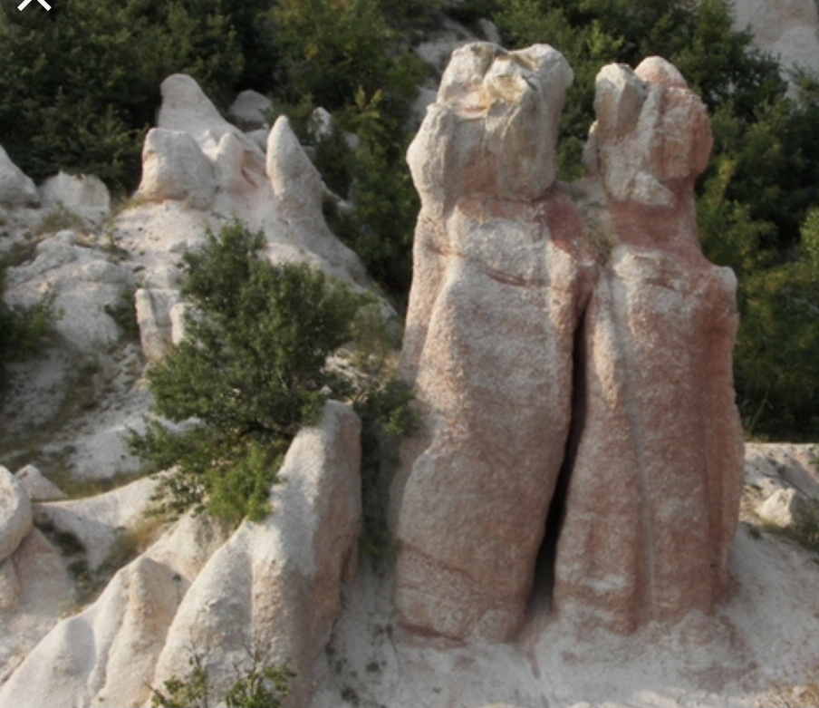
The Stone Wedding
The legend says that a girl and a boy fell in love and wanted to get married but their parents did not agree. The young couple kept on insisting and finally the wedding was organized. At the moment when they were about to say "yes", however, the mother of the groom threw a curse and everyone turned to the stone. You can still see the Stone Wedding today near the city of Karzhali, Southern Bulgaria. The Stone wedding, 6627, Bulgaria

Slide 9
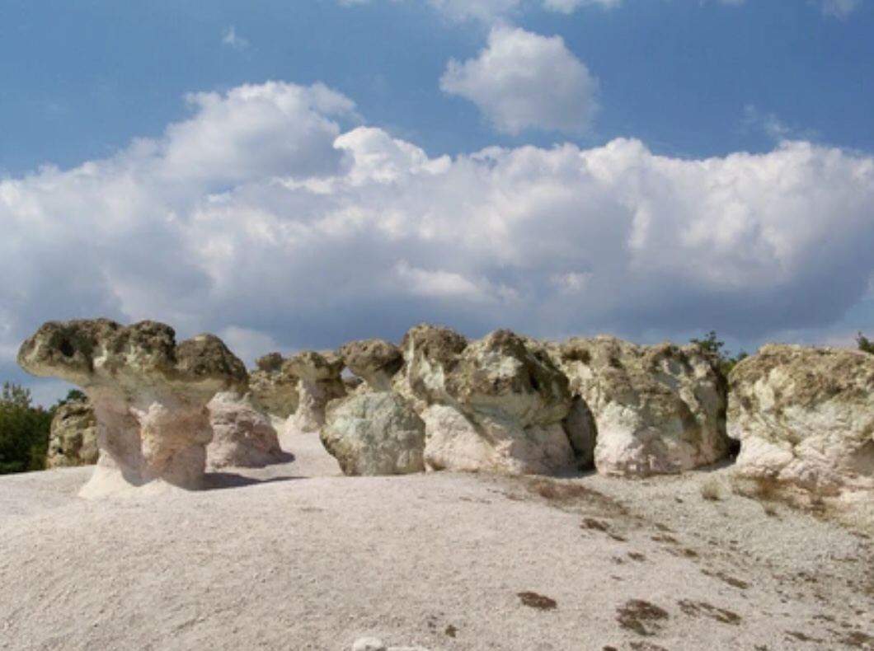
The Stone Mushrooms
The sun and the wind worked for years and years to create these funny giant stone mushrooms near the village of Beli Plast, Southern Bulgaria. They are located by the road and you can't miss them. The Stone Mushrooms, 6689, Bulgaria

Slide 10
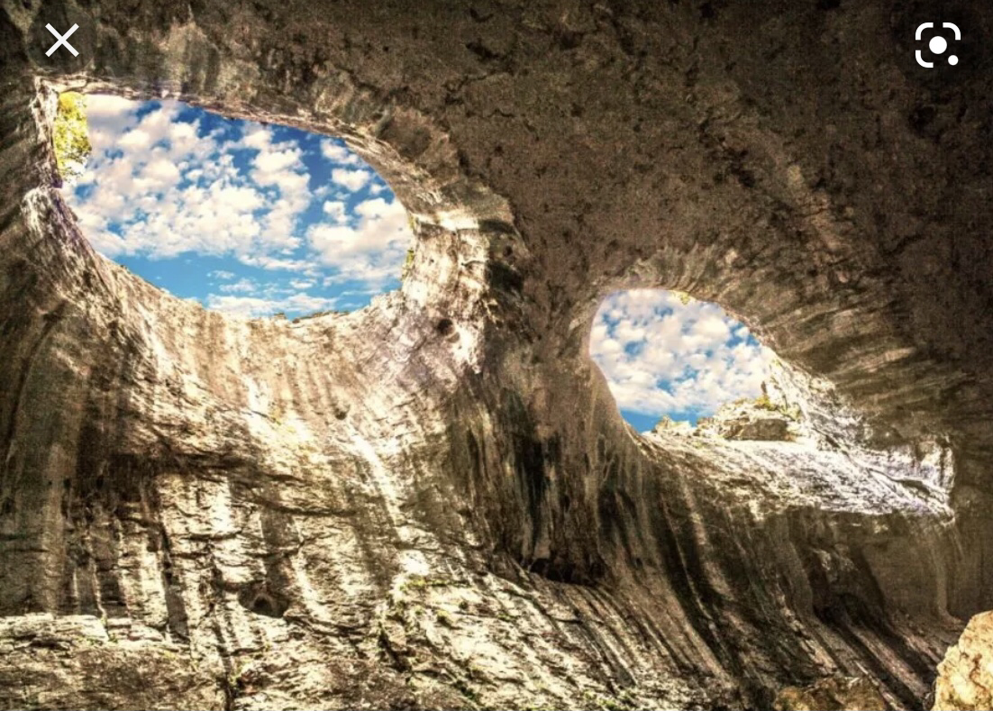
Prohodna Cave
This cave is a favorite of Bulgarians because of the two big openings in its ceiling, which create the feeling that someone is watching you from above. When it rains, it looks like the "eyes" are crying. Prohodna Cave is free and always open for visits by tourists and by climbers who enjoy the climbing routes. Проходна, 5782, Bulgaria

Slide 11
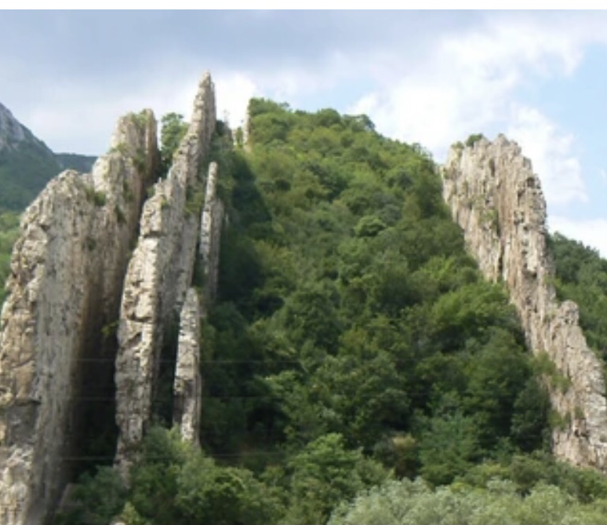
Ritlite
If you explore the Iskar River Gorge, you might be surprised to see four almost vertical flat rocks towering on the river bank. These are called Ritlite and are a local attraction. For fact lovers, some of them reach 260 feet (80 m) in height and were formed some 120 million years ago. Vratsa Balkan, 3159, Bulgaria

Slide 12
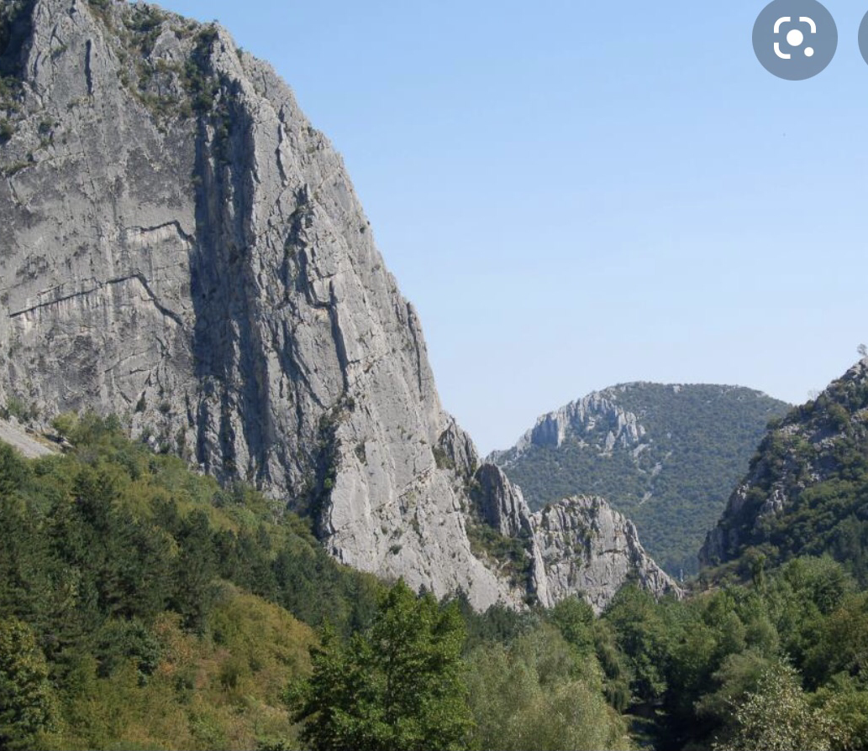
Vratsata
Vratsata is a two mile (three km) gorge in Stara Planina (Balkan Mountains) where you can admire the highest vertical rocks on the Balkan peninsula (more than 1300 feet / 400 m high) and the tiny spots of the rock climbbers enjoying their day somewhere in the middle.

Slide 13
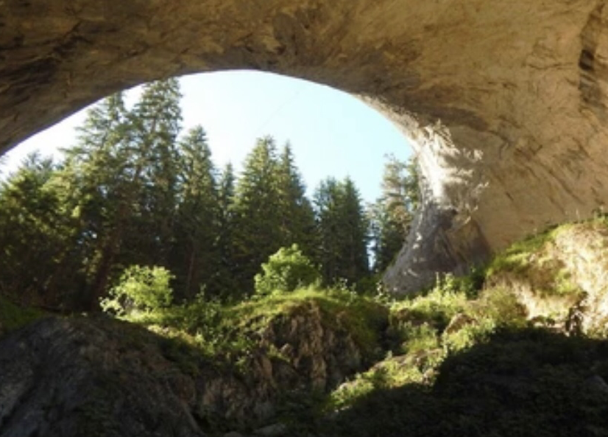
The Wonderful Bridges (Wonderful Bridges)
Chudnite Mostove are exactly what their names suggest - a wonderful rock formation resembling giant bridges. Created by the river flowing through the rocks and making a bigger and bigger crevice. This rock wonder is situated in the Rhodope Mountains. 4877, Bulgaria

Slide 14
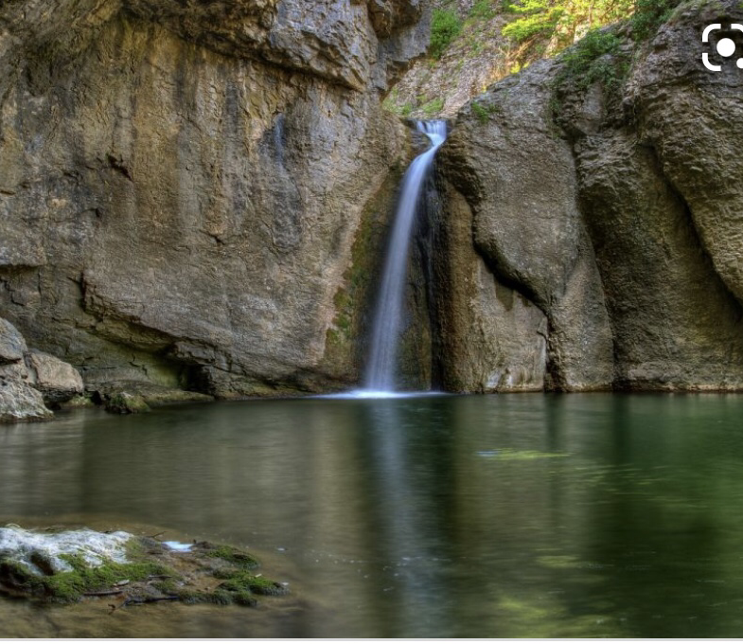
Emen Canyon
Along the bank of Negovanka River near Veliko Tarnovo, the canyon is three miles / five km long witha cave and a spectacular waterfall along the way. Emen, 5065, Bulgaria,

Slide 15
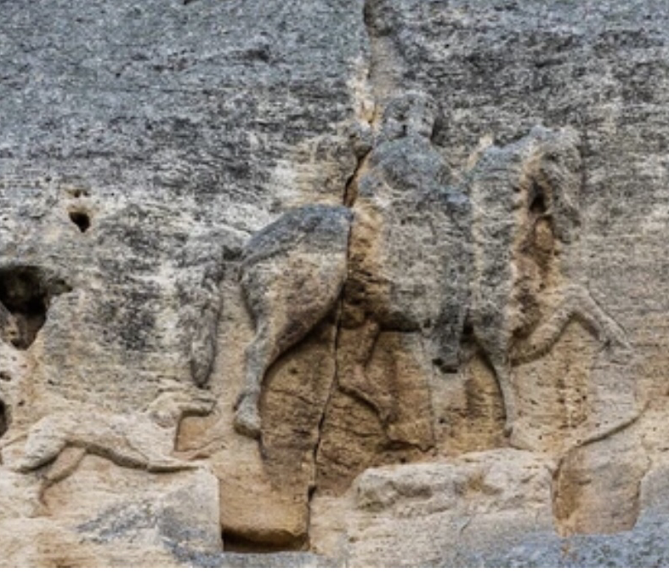
Madara Rider
The Madara Rider (Madarski Konnik) is a rock relief created in the early Middle Ages and enlisted in the World Heritage List of UNESCO. You will see a 320 foot (100 meter) rock with a huge figure of a horseman, nearly human in size. The meaning of the image and its origins are still uncertain. The Horseman is located in Northeastern Bulgaria, not far from the city of Shumen. 9971, Bulgaria

Slide 16
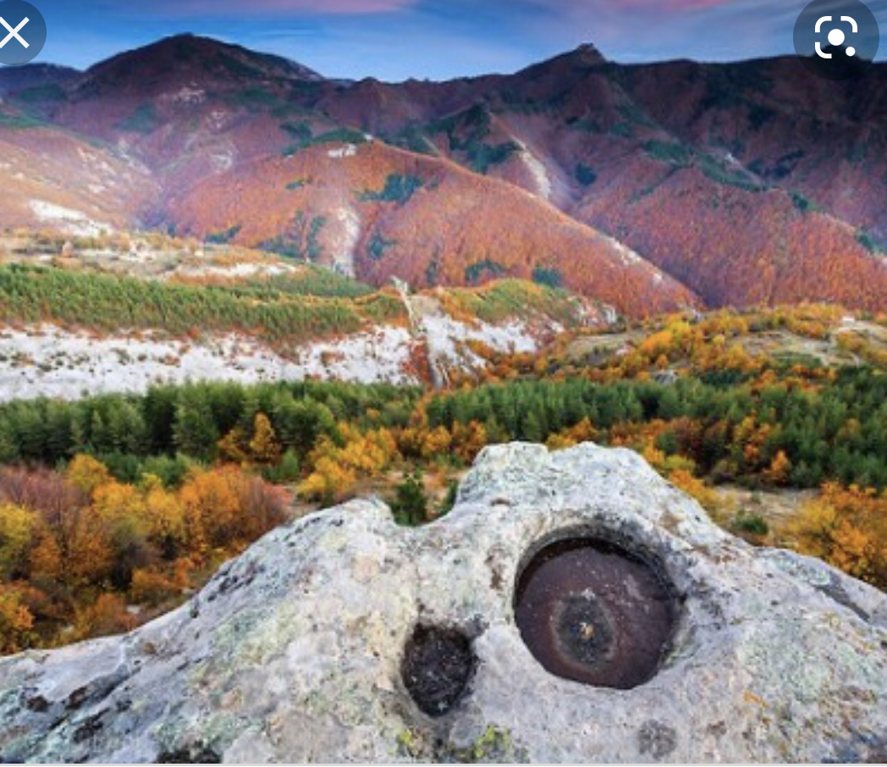
Belintash
Belintash is a mystical place in the Rhodope mountains that will impress you with its story and legends rather than with its spectacular shapes. It is believed that it was a sacred place for the ancient Thracians but stories about hidden treasures and UFOS surround it. You will find yourself on a huge plateau with a few ancient carvings and a gorgeous view to the nearby ridges. 4236 Assenovgrad, Bulgaria

Slide 17
Thank you for your attention

