Slide 1
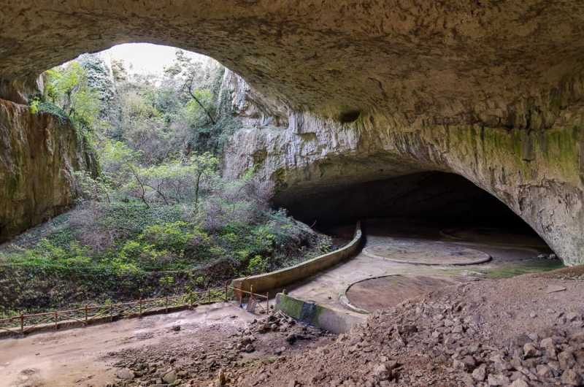
caves in Bulgaria and their inhabitants

Slide 2
The devil's throat
The Devil's Throat is an abyssal cave, which was formed as a result of the collapse of the earth's layers. Its main part is occupied by a large hall, which houses the highest underground waterfall on the Balkan Peninsula. The cave was formed by a river falling underground from a height of 42 m, forming a huge hall called the "Roaring Hall". It is 110 m long, 40 m wide and 35 m high. The devil's throat gives shelter to 4 species of bats that inhabit the cave during different seasons. Large horseshoe ,Small horseshoe , Long-fingered nightgown ,Long-winged bat. The devil's throat gives rise to various legends from the time of the Thracians. One of them says that it was here that Orpheus descended into the underworld of Hades to save his beloved Eurydice.

Slide 3
Devetashka Cave
Devetashka Cave, located near the village of Devetaki, Lovech municipality, is one of the largest caves in Bulgaria. It is located about 7 km from Letnitsa and 15 km northeast of Lovech, near the village of Devetaki, on the east bank of the river Osam. Devetashka Cave is one of the three most important shelters for bat hibernation in Europe. There winters a colony of over 35,000 specimens of the species Cave Long-winged, Long-toed Nightingale, Large Horseshoe Bat and Rusty Nightingale.
Large horseshoe, Small horseshoe, Southern horseshoe, Horseshoe of Mecheli , Rusty nightgown, Nightingale of Naterer , Mustache nightgown, Big nightgown , Tricolor nightgown, Water nightgown , Long-fingered nightgown , Sharp nightingale , Long-winged cave, Savi's bat.

Slide 4
Yagodinska cave
This fabulous cave is the jewel of the cave world in Bulgaria. We find it in the Rhodopes, near Trigrad. Its length is 10 km. It has three floors. The temperature in the Yagodinska Cave is 6 degrees. The entrance and exit are artificial tunnels. Inside it was found an ancient home of master potters. Unfortunately, due to the collapse caused by the earthquake, they had to leave it. Jagodina Cave is the only one of its kind with its countless stalactites, stalagmites, leopard skins (differently colored rock layers). As many as 103 weddings took place in the cave. Bitter!

Slide 5
Bacho Kiro
Bacho Kiro is one of the most interesting for visitors. It bears its name from 1940, and is named after one of the heroes of the April Uprising - Bacho Kiro, who hid in its mysterious labyrinths. We find it near the Dryanovo Monastery, a few kilometers from Dryanovo. It is equipped with modern lighting, which reveals unsuspected beauties. If you haven't gotten lost somewhere before, be careful - the cave is a 4-storey labyrinth of galleries and branches. But there is no room for panic still has an experienced guide who will accompany you with joy on the road. There, time flew by imperceptibly. On departure you could stop at the Dryanovo Monastery and light a candle for health.

Slide 6
Magura
Magura Cave is located in northwestern Bulgaria, about 18 km from Belogradchik. She has amassed a huge fortune, she is the owner of the largest deposit of rock paintings. It is proud of the production of the only champagne wine in Bulgaria, which matures for 3 years under natural conditions. It is like a magic museum with its halls and unique limestone forms. In the corridor of glory you can see the original cave paintings, and shortly after the exit is the seventh largest lake in the country - Rabishkoto Lake.

Slide 7
Ledenika
Ledenika is the name of a cave in Stara Planina, Vratsa municipality, Bulgaria. It is considered one of the oldest in Bulgaria, with an age of nearly 2 million years. Ledenika Cave is located 16 km from the town of Vratsa, on the territory of Vrachanski Balkan Nature Park. It is located at 840 m above sea level in the Stresher part of the Vratsa mountain, in the area of ​​Ledenishki uval. It was formed in Malm limestones (caprote-orbitolin limestones - Lower Cretaceous) during the Quaternary, when most Bulgarian caves were formed.

Slide 8
Prohodna
Prohodna is one of the most famous caves in Bulgaria, located near the village of Karlukovo (0.5 km), an emblem of the Karlukovo karst region. In 1962 it was declared a natural landmark. According to archaeologists in ancient times, the cave was an important occult site for the locals, where various rituals were performed. On March 21, the vernal equinox, a fertility ritual was performed. On this day, a ray of sunlight passes through the interior of the cave, illuminating it at a specific angle. During the bombings during World War II, locals hid in the cave. Passable is one of the few caves in which cave bungee jumping is practiced.

Slide 9
The womb
The womb is an ancient cave sanctuary dating from the 11th to the 10th century BC. The site is located near the village of Ilinitsa, in the area of ​​Tangardak Kaya, about 12 kilometers northwest of Kardzhali. It is a natural horizontal slit in a rock that has been further cut and shaped by a human hand, resembling a uterus. From Turkish "tangardak kaya" means "thundering" or "noisy" rock. In the middle of the cave is carved a hemispherical dome, which gives the acoustics of the room a special sound, which, however, resonates only in low male voices - throughout the cavity is a sound similar to thunder. This is how the local Turkish-speaking population gave the cave its name.

Slide 10
I hope you enjoyed it and found it interesting
prepared by Dilek from 11th grade!

