Slide 1
Rocks in Moldova
IP LT “B.P.-Hasdeu”, Drochia
Teacher Rata Natalia
Done by Livia

Slide 2
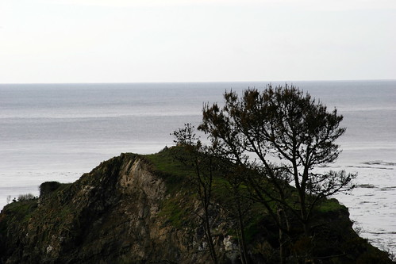
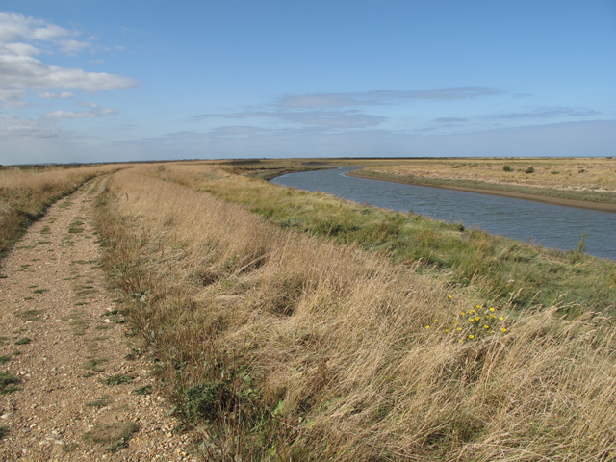
Moldovan rocks

Slide 3
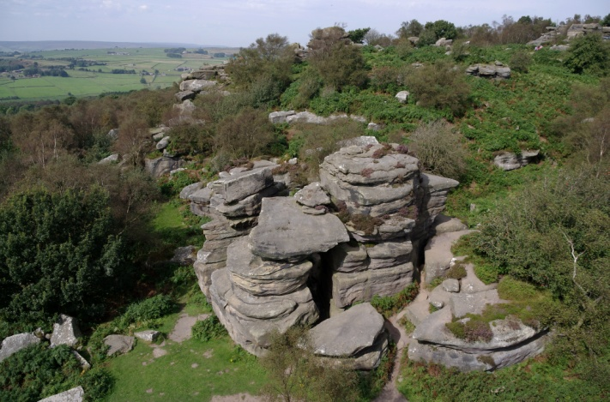
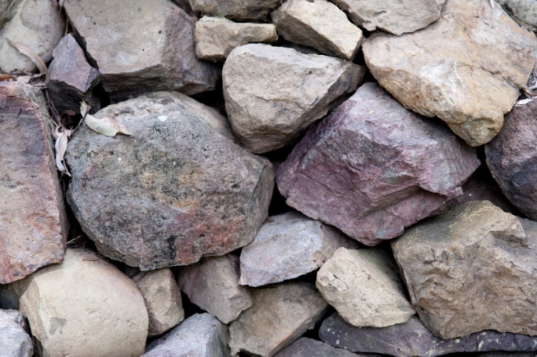
Mineral resources
The mineral resources of the Republic of Moldova are mainly represented by sedimentary rocks, such as limestone, chalk, gypsum, sand, sandstone, bentonite, tripoli, and diatomite, which can be used in construction, cement and glass production, food processing, chemical and metallurgical industries etc.

Slide 4
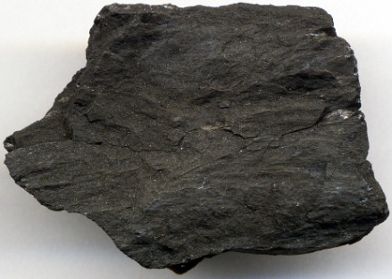
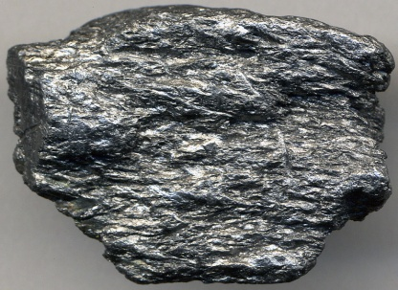
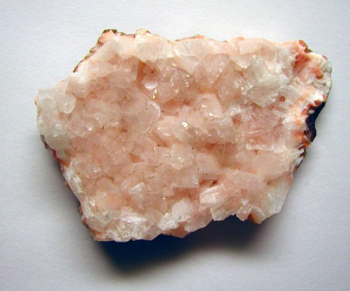
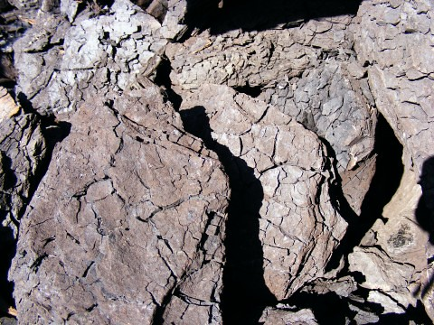
Minerals
Among other nonmetallic minerals that have been identified on the territory of the Republic of Moldova are graphite, phosphorite, zeolite, fluorite, barite, iodine and bromine as well as several industrial metals such as iron, lead, zinc and copper. Moldova has small deposits of lignite, crude oil and natural gas

