Slide 1
Historical Beauties of Antalya
Saint Nicolas Church, Demre
Myra Ancient City, Demre
Termessos Ancient City, Döşemealtı
Historical Clock Tower, Antalya
Olympos Ancient City, Kumluca
Temple of Apollo, Side
Perge Ancient City, Aksu
Aspendos Theater, Serik

Slide 2
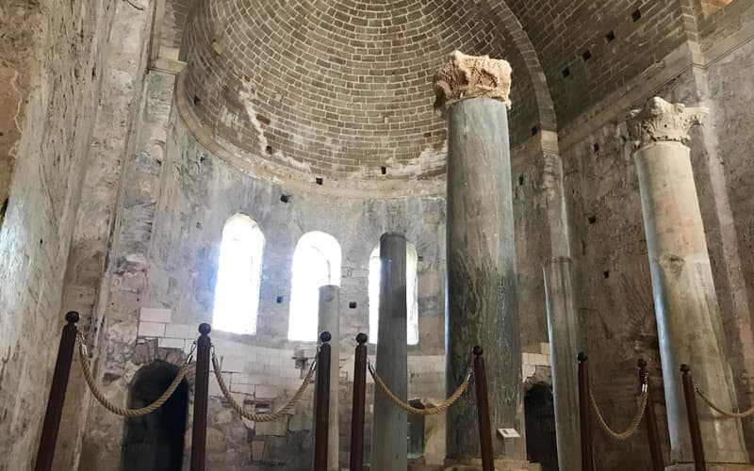
Saint Nicolas Church, Demre
Located between Kaş and Finike, in Antalya's Demre district, Santa Claus Church is a mystical historical building built after the death of St. Nicholas, who is thought to be Santa Claus. In the church, which is considered holy for Christians, a ritual is held every year with careful leave.

Slide 3
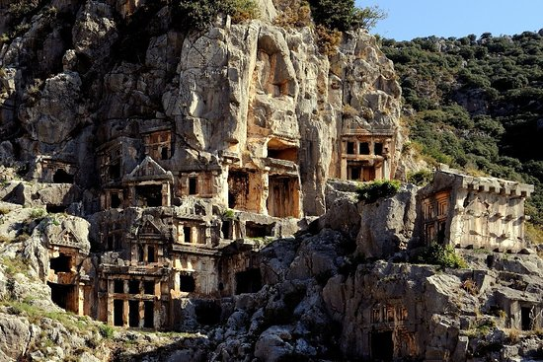
Myra Ancient City, Demre
Myra Ancient City is the most important historical point in Demre along with the Church of St. Nicholas. It is worth seeing the rock tombs in the Ancient City of Myra, whose history dates back to the 5th century BC, the amphitheater from the Roman Period, and Lycian inscriptions.

Slide 4
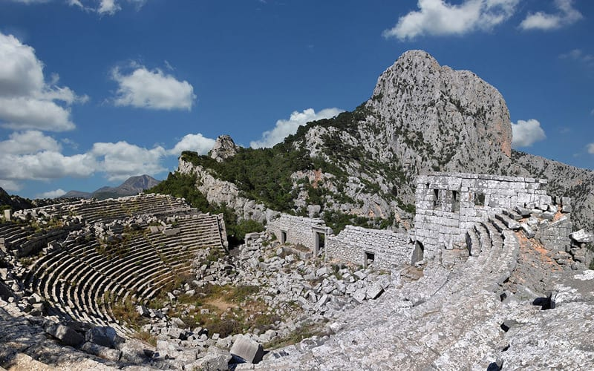
Termessos Ancient City, Döşemealtı
Termessos, one of the most magnificent ancient cities of Antalya, is located at an altitude of 1,150 meters, at the foot of Güllük Mountain. The ancient theater of Termessos, which can be reached by walking up a pathway, is quite magnificent.

Slide 5
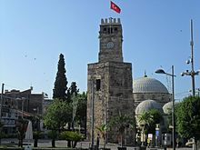
Historical Clock Tower, Center
The Historical Clock Tower, located in the city center of Antalya, was built in 1901 in the name of Abdulhamit II, just like the clock towers of Izmir and Yozgat. Located in the Kaleiçi district, on the outer walls of the Kale Gate, the clock tower is 14 meters high.

Slide 6
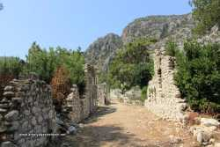
Olympos Ancient City, Kumluca
Olympos is one of the best known holiday resorts around Antalya. Olympos, which is mostly attracted by backpackers and holiday lovers, has a magnificent beach and an ancient city next to the beach. Hostels consisting of tree houses provide half-board accommodation services.

Slide 7
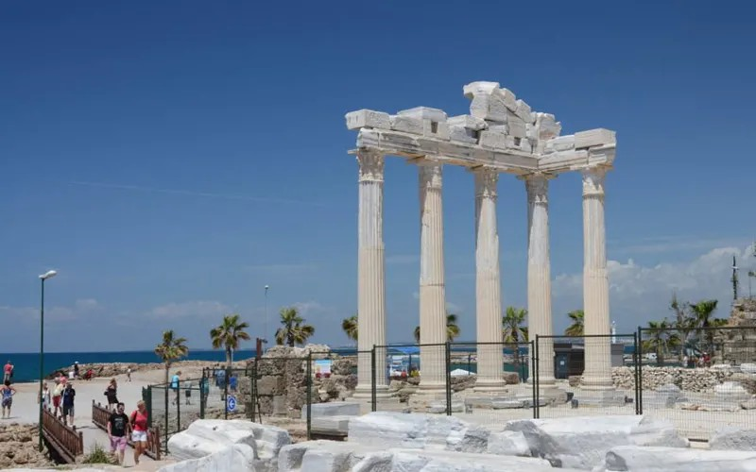
Temple of Apollo, Side
The Temple of Apollo in Side is dedicated to Apollo, known as the son of the sun. The temple, which is the most known historical structure of Side, has a wonderful view on the sea shore, especially at sunset.

Slide 8
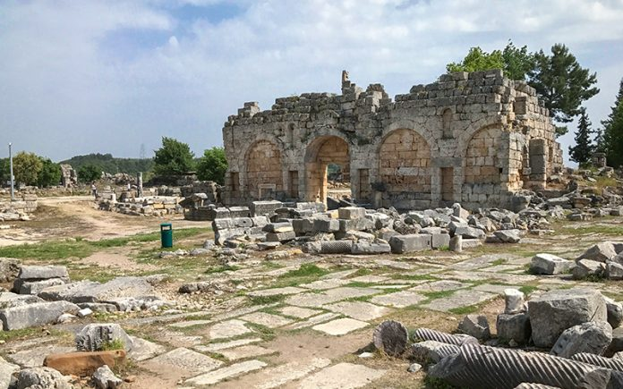
Perge Ancient City, Aksu
Perge Ancient City, which is on the UNESCO World Heritage Temporary List, is located in Aksu district of Antalya. Ancient theaters and city structures are still standing in Perge, one of the most magnificent ancient cities of the Hellenistic Period.

Slide 9
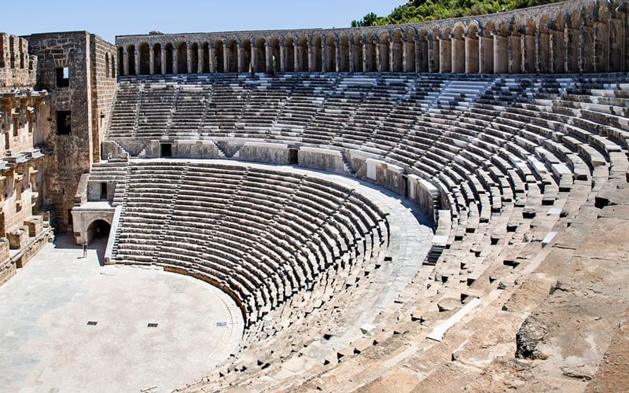
Aspendos Theater, Serik
Aspendos Theater, one of the best preserved ancient theaters and one of the rare examples of Roman theaters in Anatolia, is a unique building with a capacity of 17 thousand people.

Slide 10
Thanks for your interest. Davut Cebeci 10/A 251

