Slide 1
Historical beauties of Aegean Region

Slide 2
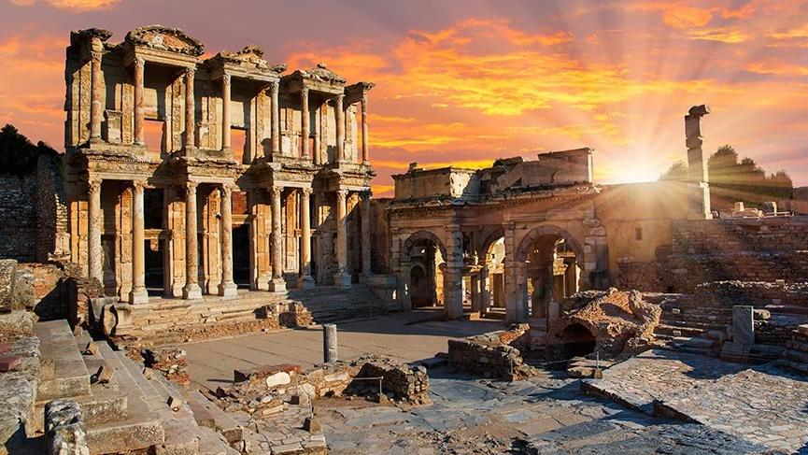
Ephesus Ancient City
The first foundation of the ancient city of Ephesus within the borders of Selçuk district was BC. It goes back to 6000 years. In recent research and excavations, settlements belonging to the Bronze Age and the Hittites were identified on Ephesus, the mounds around it and the Ayasuluk Hill, where the castle is located.

Slide 3
Kemeraltı Bazaar
It was created by filling the seashore and opening new residential areas and businesses from 1650–1670. Anafartalar Avenue constitutes the current line of the old seashore, which started from the location of Hisar Mosque built in 1592.

Slide 4
Pergamon
Pergamon is the name of the ancient city that was established in the center of Bergama district of İzmir province today. Pergamon was one of the important centers of the Misya region in ancient times. It was the capital of the Kingdom of Pergamon between 282-133 BC. The name Pergamon comes from Pergamos, a mythical hero. It is believed that Pergamos took over the city after killing the king of Teuthrania and gave his name.

Slide 5
Pamukkale
Pamukkale, it is a natural site in Denizli in southwest Turkey. Carbonate minerals from the city spas and flowing waters cover terraces and travertines.

Slide 6
Caunos Ancient City
Caunos is an ancient city located in the ancient Caria region of Anatolia. A few kilometers west is Dalyan district of Muğla's Ortaca district. It is on the edge of the river known as Calbys in ancient times, now called Dalyan. This river was the border between Caria and Lycia.

Slide 7
Artemis Temple
Temple of Artemis is also known as the Temple of Diana. The temple dedicated to the goddess Artemis was completed in Ephesus around 550 BC. The temple was built entirely of marble. Only one or two pieces of marble remain from the temple [1] [nb 1], which is considered one of the seven wonders of the world. Turkey is located in the ancient city of Selcuk in Izmir.

Slide 8
Şeytan Sofrası
Şeytan Sofrası is located on the dominant rocky hills 8 km south of Ayvalık district center. The view of all Ayvalık Islands and Lesbos Island can be seen from the area. It is an ancient lava deposit that is believed to have the footprint of Satan on it, and the people wish by throwing coins.

Slide 9
THANKS FOR WATCHING MY SLİDE
DAVUT CEBECİ
10/A 251

