Slide 1
Kırıkkale/ İgneada Forests
Bursa/ Karacabey Forests
Bolu/ Abant Forests
Karabük/ Yenice Forests
Isparta/ Gölcük Forests
Antalya/ Sorgun Forests
İstanbul/ Aydos Forest
Kars/ Sarıkamış Forests
Thrace Region/ Istranca Forests
Kastamonu/ Abana Forests
TURKEY’S MOST BEAUTİFUL FORESTS

Slide 2
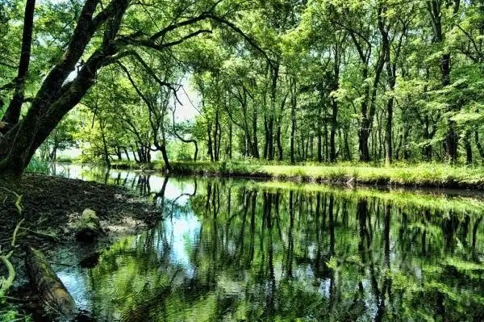
İğneada Forests/ Kırıkkale
İğneada Forests located in Demirköy district of Kırklareli are also Europe's largest longoz forest. Igneada Forest is quite big and beautiful. İğneada Forests on the coast of the Black Sea reveal the unique harmony of green and blue. Wherever you look, you see the forest. It is impossible not to admire İğneada, which has visually beautiful roads, trees and sea. While walking through the forest, you come across puddles. Since the ground water level is high, it is extremely rich in organic matter. It is similar to tropical forests in this respect. This unique beauty found only three in Turkey should see definitely.

Slide 3
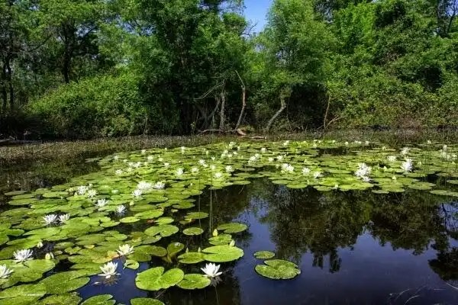
Karacabey Forests/ Bursa
Karacabey Forests in Bursa contain many living species. Another of the swamp forest is also located in Karacabey in Turkey. Longoz are forests formed in water accumulated by streams that cannot reach the sea. Only certain trees grow in this environment. However, water lilies, mountain violets and lake bulbs that form on puddles add an incredible magic to the forest. Every year, thousands of migratory birds migrate to the Karacabey Forest. In addition to the forest landscape, you can also observe birds such as heron and black stork. Karacabey Forest is lush just like rain forests. You will spend a wonderful time in this forest, which you can not get enough of both watching and touring.

Slide 4
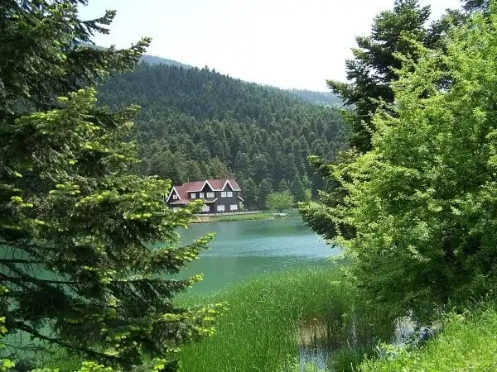
Abant Forests/ Bolu
Abant in Bolu; It is among the most visited resorts of the Black Sea in summer and winter, with both its lake and forests covered with dense trees. While watching this forest that covers Lake Abant, your eyes will shine and your heart will be relieved. While walking by the lake, the forest view also accompanies you. Abant Forests give people a calmness. Sitting by the lake, on the lake, the trees are dancing. While watching the Abant Forest, the rustling of leaves of many kinds of trees leaves a harmony in your ears. If you happen to be in Bolu, even if you do not fall, visit Abant Forests especially to see this beauty.

Slide 5
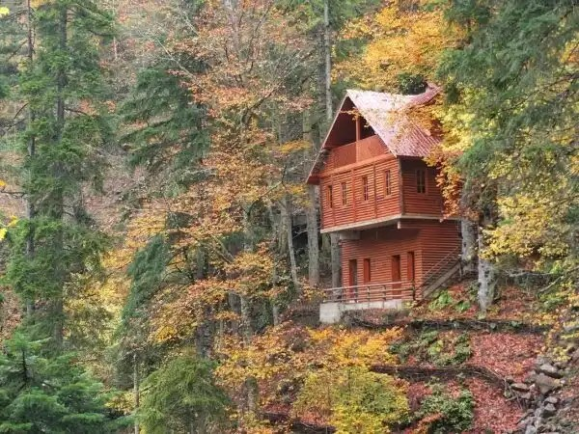
Yenice Forests/ Karabük
Yenice district in Karabük is surrounded by wonderful forests. Its lush forests have tree species in sizes and sizes that can be seen in rare regions of the world. Yenice Forests, which have a mysterious air, are candidates for being a tourism region. The canyon and nature beauties of this forest, which is an oxygen reservoir, will enchant you. It is one of the must-visit places for outdoor sports and taking pictures.

Slide 6
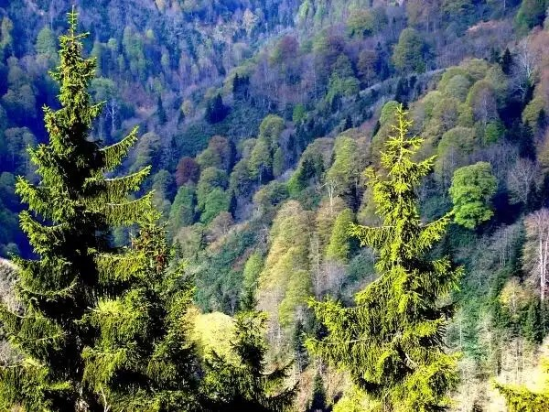
Gölcük Forests/ Isparta
Located in Isparta, Gölcük is home to a crater lake and an incredibly beautiful forest with many kinds of trees around the lake. Gölcük Lake was formed by the accumulation of water in the crater pit of the extinct volcano. Although the water is bitter and salty, the forest surrounding it is extremely green and uniquely beautiful. Gölcük National Park is a recreational area. Nature lovers often visit this area to walk by the lake and explore the forest. In addition, the promenade area where you can have a picnic is overlooking the lake. When viewed from above, it is fascinating that a blue area is completely surrounded by greenery.

Slide 7
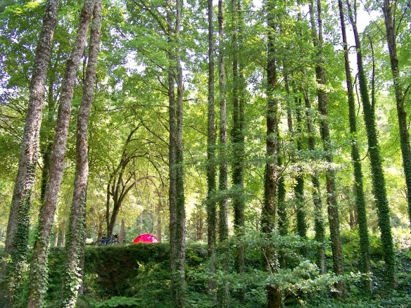
Sorgun Forests/ Antalya
Sorgun, which hosts the enormous flora of the Mediterranean; It is located in Manavgat district of Antalya. It is in such a beautiful place that the Sorgun forests have a unique beautiful Mediterranean in front and Manavgat River in the back. Not only that, but between the Sorgun Forests there is Titreyen Lake. You will find peace among the trees while wandering around the Shaking Lake. Sorgun, which is a complete tourism destination, accompanies every shade of blue, and includes every shade of green with its forests. Bird sounds and frog sounds are mixed. Those who want to relax, swim, wander, and find peace should definitely spend time in Sorgun Forests.

Slide 8
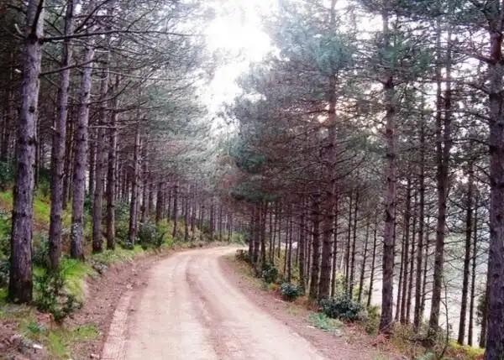
Aydos Forest/ Istanbul
Aydos Forest, located on the Anatolian side of Istanbul, is both a recreation area and an oxygen store away from the noise of the city. Aydos Lake and Aydos Forest are among the details that add beauty to the unique beauty of Istanbul. While you are wandering among the trees and resting, you can sip peace while drinking your tea by the lake.

Slide 9
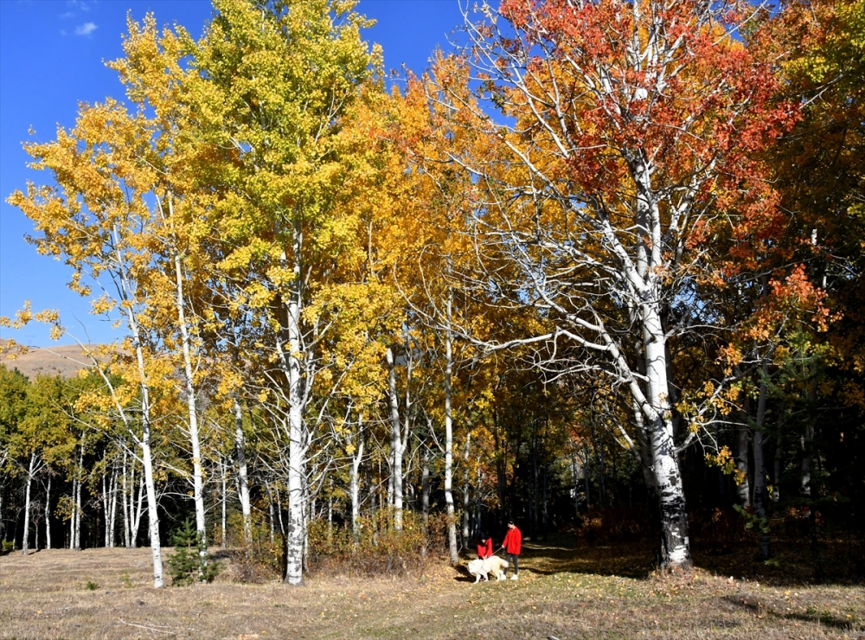
Sarıkamış Forests/ Kars
Sarıkamış, located in Kars and one of the most beautiful places in the east; As the name suggests, it is home to yellow trees. Sarıkamış Forests in Turkey, which is home to pine trees, human and bliss, and gives a slight sadness. You experience both spring and winter together in these forests where yellow and green colors are mixed. Sarıkamış Forests will absorb you. You will not be able to get enough of this beauty.

Slide 10
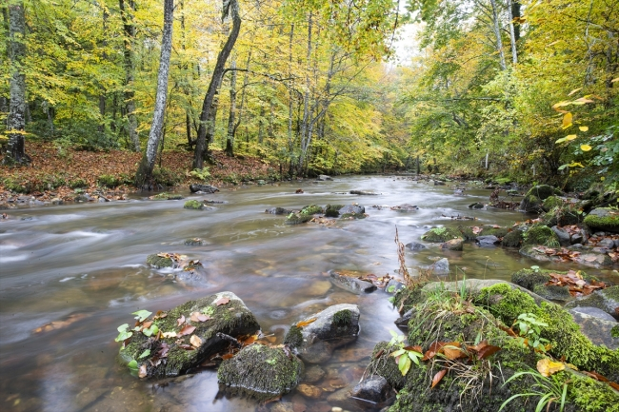
Istranca Forests/ Thrace Region
Strandja Forests, owned by the Yıldız Mountains in the Thrace region, have both an imposing and fabulous appearance. There are many natural water sources from the slopes of Yıldız Mountains. As such, many streams flow through the Strandja Forests. Those who love forest scenery admire the view of the streams flowing through the trees. You can either drive through the forests or sit on the edge and have a long cruise. An incredible peace will fill you up.

Slide 11
Thank you for listening prepared by Davut Cebeci

