Slide 1
ANTALYA'S MOST INTERESTING FORESTS
URBAN FOREST
ADVENTURE FOREST
PARK FOREST

Slide 2
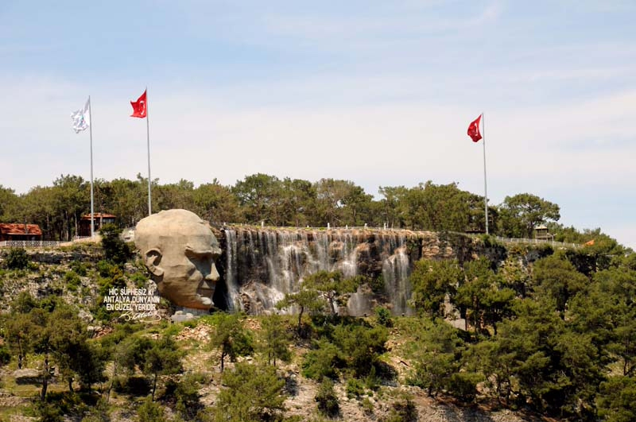
URBAN FOREST/döşemealtı
There is also the Antalya City Forest; It offers all the beauty of Antalya with a wonderful view from the top. The view from Kepez region to Rat Peninsula can also be your muse. The Atatürk statue and artificial waterfall, especially at the entrance of the Antalya Urban Forest, attract attention. Immerse yourself in this beautiful view of Antalya. You will feel your soul.

Slide 3
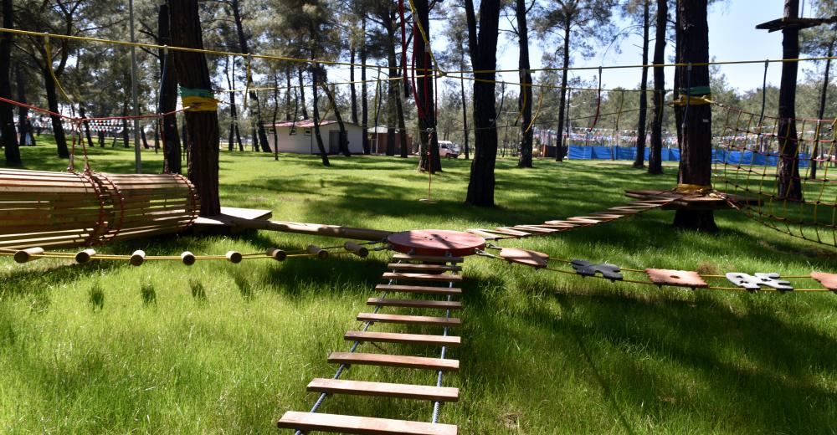
ADVENTURE FOREST/kepez
ANTALYA, (DHA) - KEPEZ Municipality brings together those who are bored of the monotony of the city with a lush green nature in pine trees with the Urban Forest and Adventure Forest park areas.

Slide 4
PARK FOREST
A place where you can have breakfast and run a horse and get away from the monotonous city life and spend peaceful times with your family and friends.

Slide 5
THANK YOU FOR LİSTENİNG
prepared by Taha Atmaca

