Slide 1
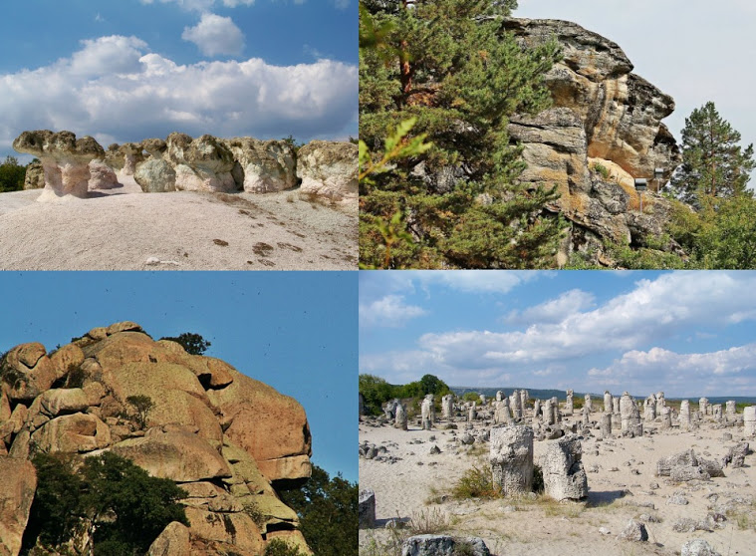
rock landmarks in bulgaria
Presentation by Spasimira Slavcheva

Slide 2
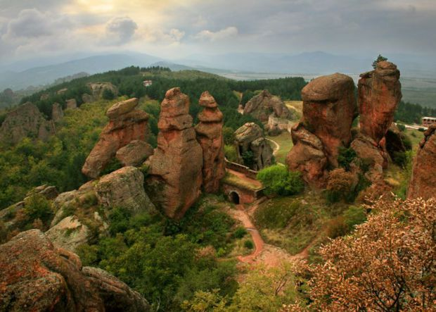
The Belogradchik rocks
Today Belogradchik rocks stretch to approximately 30 km long, 3 to 5 km wide and up to 200 m high. The most majestic rocks: the Madonna, the Horseman, the Monks, the Schoolgirl, the Lion, the Bear, Adam and Eve, the Castle are located in the Western Fore-Balkans, near the town of Belogradchik. These amazing rock formations are probably the most popular in our country. It is no coincidence that a few years ago they were chosen to participate in the world competition for the new seven wonders of the world. Fantastic forms are due to erosion and other natural factors that have affected them for millions of years.

Slide 3
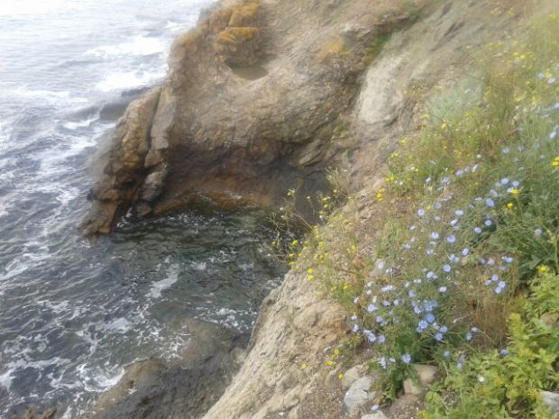
The rock formations on the island of St. Anastasiya
St. Anastasia is an island of legends, mysticism and charm. The island is very small - with an area of ​​only 9 acres. But that doesn't stop it from being extremely beautiful and interesting. There are three rock phenomena located in different places, known as the Mushroom, the Dragon and the Petrified Pirate Ship. Particularly intriguing is the appearance resembling the head of a Dragon drinking from the sea.

Slide 4
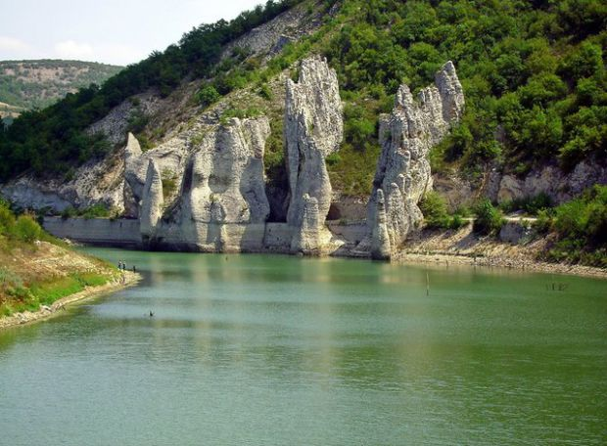
The wonderful rocks near Dalgopol
The rocks near Dulgopol are located 4 km from the village of Asparuhovo, on the shores above the dam "Tsonevo". They are an impressive rock structure formed by the influence of water and wind, including about ten rock hills with a height of 50 - 60 meters. When you stand in front of them, you are left with the impression that the ruins of a huge ancient castle are in front of you.

Slide 5
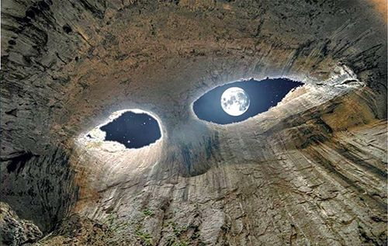
Prohodna Cave, Karlukovo village
This cave is also known as the Eyes of God. As a result of erosion of the ceiling of the cave, two almost the same size holes in the shape of eyes were formed. The place is easily accessible as it is located just below the road from Lukovit to Karlukovo (2 km from the village).

Slide 6
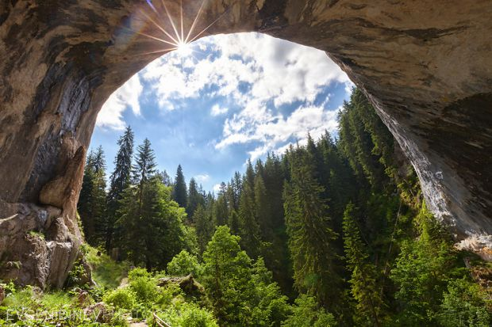
The wonderful bridges
They are located in the Western Rhodopes, 35 km northwest of Chepelare and 8 km from the village of Zabardo. Interestingly, in the past a flooded river passed through this place, whose waters penetrated deep into the cracks of the marbles and over time formed an underground water cave. As a result of the long-term erosion, parts of the cave collapsed and thus the Wonderful Bridges were formed.

Slide 7
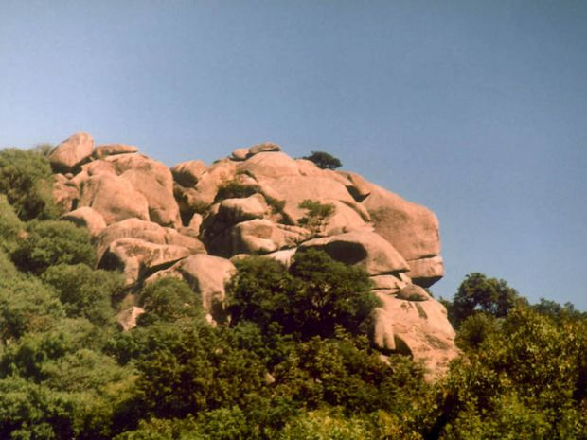
6. The lion's head
The lion's head
This majestic creation of nature is located in the highest parts of the Ropotamo Reserve. It can be easily seen on the road Sozopol - Primorsko, as well as on a boat trip on the river Ropotamo.
tamo Reserve. It can be easily seen on the road Sozopol - Primorsko, as well as on a boat trip on the river Ropotamo.

Slide 8
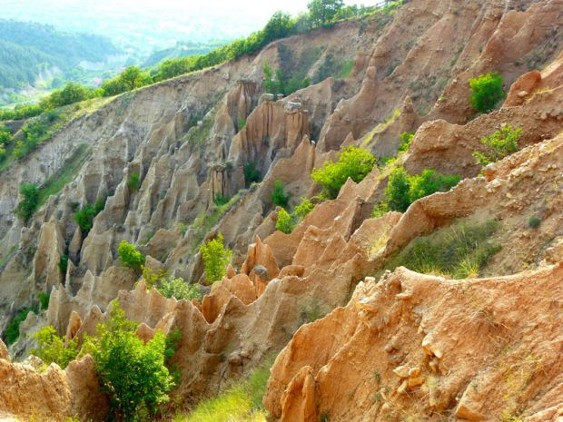
The Stob pyramids
These unique rock compositions in the western foothills of the Rila Mountains, sculpted as if by human hands, are in fact a creation of nature itself. Most of them are conical and end with a stone hat. Their height varies between 7 and 12 meters. The pyramids have different names - the Towers, the Hammers, the Samodiv Chimneys, the Gathers, the Brothers, the Matchmakers and others. One of their impressive qualities lies in their colors, which range from light yellow to dark brown and red. They are most beautiful and spectacular at sunset and in the moonlight.

Slide 9
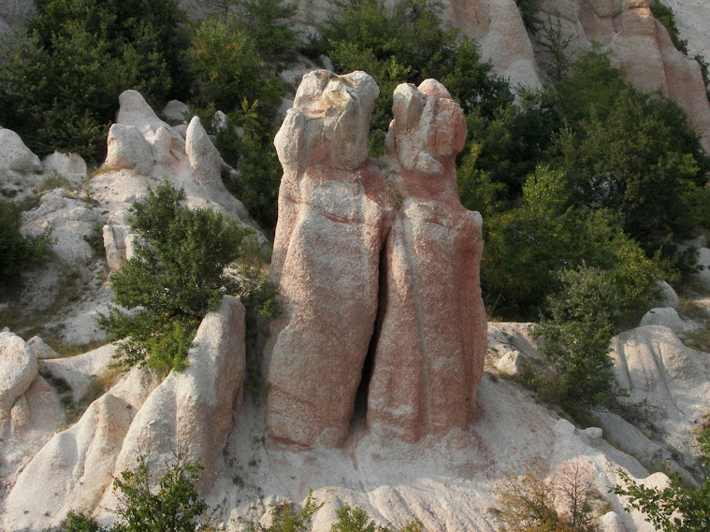
The petrified wedding near the village of Zimzelen.
This unique rock phenomenon is located about 5 km east of the town of Kardzhali. Rock formations are very similar to a group of people. Most impressive are two 10-meter cliffs, resembling embraced newlyweds. According to legend, wedding guests were traveling to a neighboring village when the wind blew and blew the veil of the bride. At the sight of her beauty, the father-in-law envied his son and wished for his daughter-in-law. Nature was outraged and petrified all the wedding guests.

Slide 10
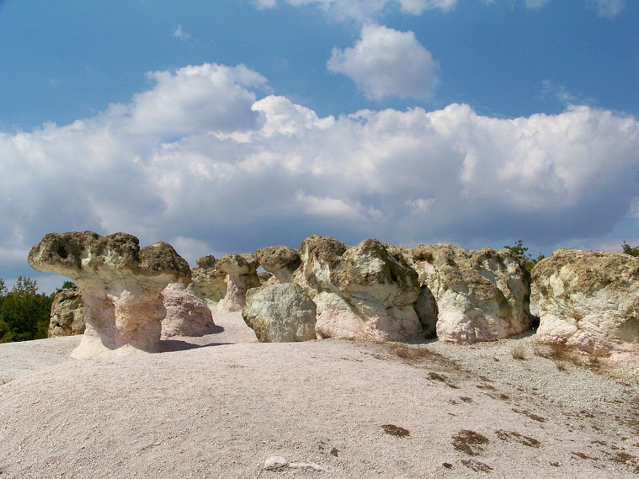
The stone mushrooms
near the village of Beli Plast, Kardzhali municipality. The impressive rock phenomenon is located on the road that connects Haskovo and Kardzhali, almost to the road, about a kilometer from the village of Beli Plast. These are impressive rocks resembling giant mushrooms - with pink stumps and greenish caps. Wind, water and erosion have sculpted the bizarre shapes of these formations, which are thought to be the result of volcanic eruptions on the seabed that existed on these lands 40,000,000 years ago.

Slide 11
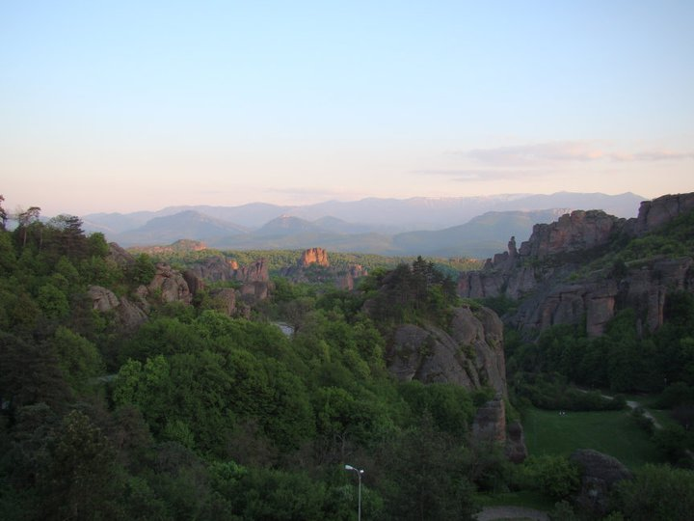
The Belogradchik rocks.
These are probably the most popular rock formations in our country. They also took part in the race for the new seven wonders of the world. They are located in the Western Fore-Balkans, near the town of Belogradchik. The rocks vary in colors from pure red to yellow. Many of the rocks have fantastic shapes and are included in interesting legends. They are often called people or objects that they resemble or resemble. The majestic rock figures formed over hundreds of millions of years as a result of erosion, denudation, growth of mosses and lichens and other

Slide 12
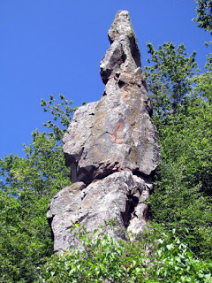
Rock phenomenon “The girl.
The beautiful rock, resembling in the distance a girl with a hurka in her hand, is located about a kilometer from the village of Shiroka Laka in the Western Rhodopes. Its formation is associated with rock erosion and the impact of external natural forces. Legend has it that in this place a beautiful girl from Shiroka Laka prayed to be stoned to save her honor and faith from the persecuting Turks.

Slide 13
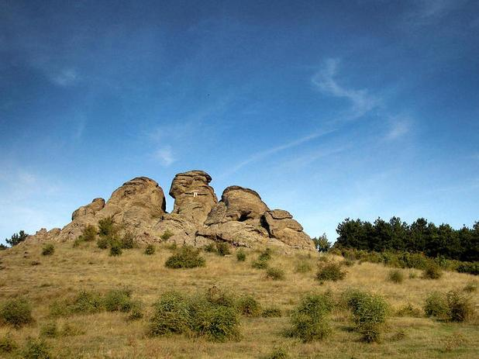
The three brothers.
The rock phenomenon is located at 200 m above sea level in the area "Kazanite" and is one of the symbols of the city of Aytos. They are located north of the city, in the forest park "Slaveeva Reka". According to legend, three giant brothers defended the local population. They fought all day, and in the evening they returned to rest. To hide from the attackers, they turned into three rocks.

