Slide 1
The forests in Bulgaria and their inhabitants

Slide 2
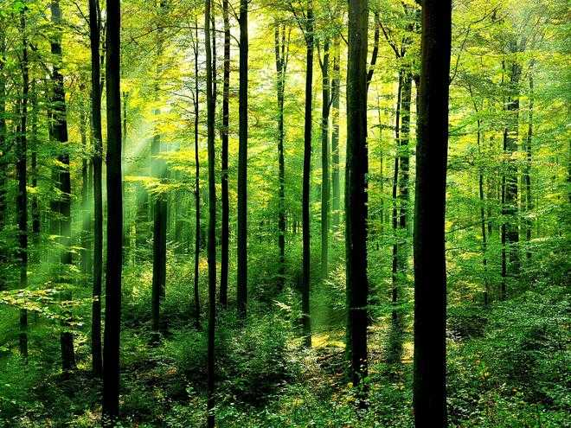
Half of Bulgaria's centuries-old forests are threatened by deforestation

Slide 3
More than 50% of the country's residual forests have not been in protected areas, WWF told a news conference today. That is, they are not completely confident with a high degree of indoor and at any moment can be destroyed.
Large forests are located over 150,000 hectares, or about 4% of all forests in other countries. WWF Bulgaria identifies and maps the most valuable centuries-old forests from protected areas in the Western and Eastern Stara Planina, Western Rhodopes and Sredna Gora. It was found that only 1/5 (approx. 21,000 ha) is used by the fuel to have more centuries-old characteristics. The basic salary for this is the most important thing for logging. With the delineation of the centuries-old forests, they disappeared and are inhabited - a large number of preserved species that cannot be assessed in managed forests, such as the white-backed woodpecker, the owl, the alpine rosal beetle, the broad-eared bat, the barbel and many others. Algae are lost and used in water and counteract these forests. At the initiative of WWF for the first time a comprehensive study of ancient forests is conducted, based on a precise and modern scientific methodology, developed for this purpose after preliminary studies of virgin forests in 12 Bulgarian reserves. The field researches were carried out by specialists from the Forest Institute at the Bulgarian Academy of Sciences, and for all studied forests dossiers with scientific data have been created, which will be provided to the state.

Slide 4
Stages of development of old forests

Slide 5
Birth, development and death are part of the natural rhythm of our world. Following the natural cycle, a forest goes through different stages of development, which are similar in sequence to all living organisms and communities, but differ in duration. IN the first 20 years a new community of trees is created andf ormed. Over the next 60 years, in a competitive environment, the strongest and most adaptable individuals increase in size, and the weak drop out of the race. Between the 80s and 120s, the trees reach their climax in development, after which their growth slows down. Individual large specimens gradually they die and thus conditions are created for the new generation of trees. Given the lifespan of our main tree species (over 300 years for beech, fir, spruce and over 500 years for oaks), the existence of an old forest can lasted for centuries.

Slide 6
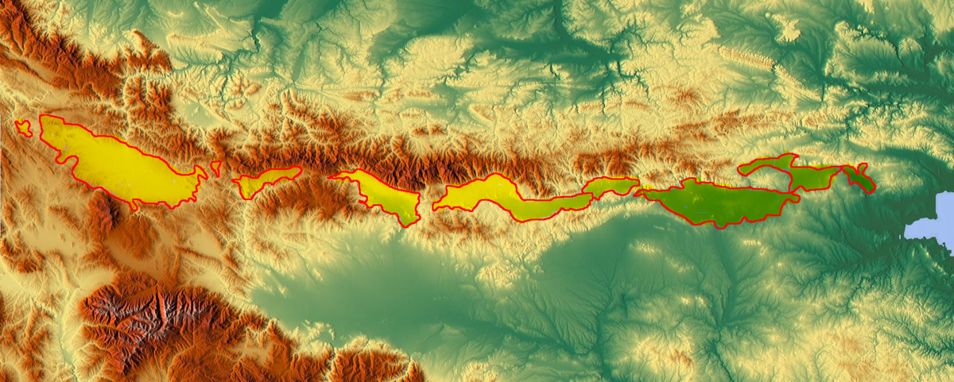
Which forest is old?

Slide 7
Between Stara Planina in the north and Srednogorieto in the south along the parallel stretches the region of the Trans-Balkan valleys. In the direction from west to east, the Burel, Sofia, Saransk, Kamar, Zlatishko-Pirdop, Karlovo, Kazanlak, Tvardishka, Sliven, Karnobat and Aytos valleys alternate here. Apart from the southern slopes of the Stara Planina region and the northern slopes of Srednogorie, which in their lower belt represent enclosing parts of the Trans-Balkan valleys, the transverse ridges between these two mountain systems and the presence of low watershed saddles and gorge valleys complement the orographic closure and separate valleys.
To the west of the watershed of the rivers Slivnishka and Gaberska - Zabelski rid stretches the Burel valley, and to the east of it and from the Aldomirov heights the elliptical contours of the Sofia valley are found. Its spacious valley bottom is drained by the Iskar River and its tributaries. The emphasized flatness of the Sofia field is disturbed by the inner hollows Lozenets, Reduta and Baba. In the eastern periphery of the Sofia valley, the low Negushevski rid separates it from the small Saranska valley. The high Oporski ridge is an orographic border between the Saransk and Kamarska valleys, which is separated from the Zlatitsa-Pirdop valley by the Galabets ridge. The smaller western part of this valley in the range of the Bunovo valley extension is locked between Galabets and the Mirkovo threshold. To the east of the Mirkovo threshold to the high ridge of the Koznitsa ridge stretches the wider and flatter part of the Zlatitsa-Pirdop valley bottom.
The Karlovo valley stretches between the meridional transverse hills Koznitsa and Strazhata. Its flat hollow bottom has the character of a typical field. It is drained by the river Stryama, and the wide range of its flat surface is disturbed by the secluded inner hollows of Momini Gurdi, Konyat and others. To the east between the Strazhata transverse ridge and the western branches of Mezhdenik, the Yamurdzha upland stretches the Kazanlak valley, which has a significant longitudinal extension and is drained by the Tundzha river. Between the complex orographic configuration of the southern Stara Planina slope and the northern branches of Mezhdenik, the Tvardishka valley with its eastern lower part, the Shivachev valley, stands out. To the east of the Mezhdenishki gorge of the Tundzha river, the Sliven valley stretches along a considerable parallel. The flat surface of its valley bottom is disturbed by several well-defined inner valley hills, among which is the hill near the town of Sliven Hamambair. East of the Sliven valley between the valley narrowing of the Mochuritsa river and the watershed of its basin with the Aytoska river stretches the Karnobat valley with its slightly higher western part - Sungurlar field. In the easternmost part of the district stretches the lowest of all Trans-Balkan valleys - Aytos valley

Slide 8
A short story

Slide 9
The southern white-backed woodpecker is rare, endangered
from an endangered species listed in the Red Book
of Bulgaria and in the red lists of the International Union for Conservation of Nature (IUCN) n our country the species is found in old oak, beech and
beech-coniferous forests up to 1700 m above sea level
height. It was found that a couple needs 100-150 ha of old forest.

Slide 10
I HOPE YOU LIKED IT! Prepared by: Serkan Nihat from 10 class

