Slide 1
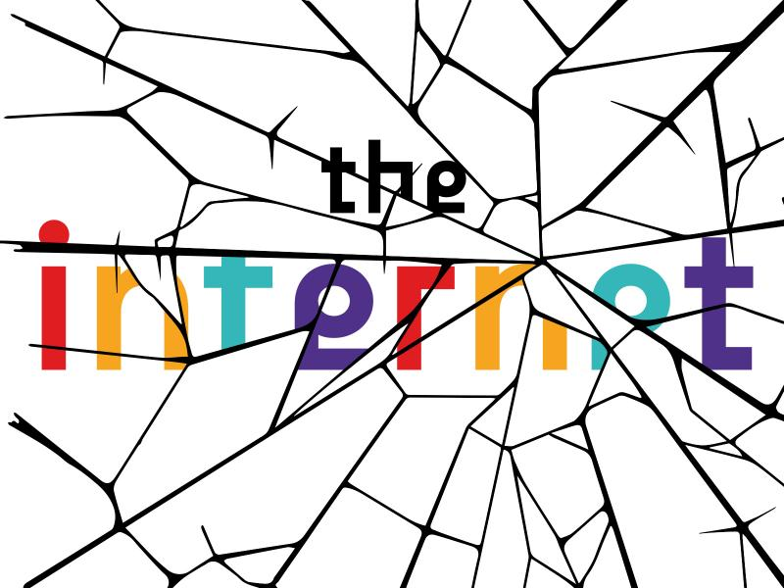

Slide 2
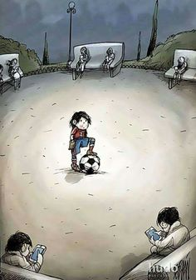

Slide 3
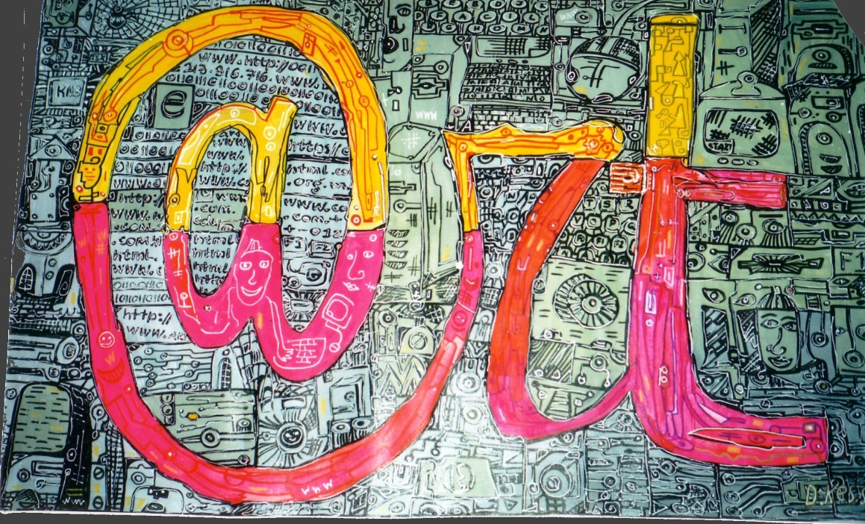

Slide 4
Internet security and hackers by Leon Zernitsky

Slide 5
Cooperation by Leon Zernitsky

Slide 6
network by Leon Zernitsky

Slide 7
Digital age by Leon Zernitsky

Slide 8
e-business by Leon Zernitsky

Slide 9
Business World by Leon Zernitsky

Slide 10
Communication by Leon Zernitsky

Slide 11
Digital Age by Leon Zernitsky

Slide 12
Credit Card by Leon Zernitsky

Slide 13
technology by Leon Zernitsky

Slide 14
HEALTH CARE TECHNOLOGY by Leon Zernitsky

Slide 15
Information age by Leon Zernitsky

Slide 16
Common Ground by Charles Luna

Slide 17
Image Untitled by Gerd Altmann

Slide 18
Take a Shot by HanDraw Lukas P

Slide 19
Modern world caricature illustrations by Steve Cutts

Slide 21
Fazzino U0399 original mixed media art –Brain Technology global

Slide 24
Street graffiti – unknown artist

Slide 25
Street Art – Unkown Artist

Slide 26
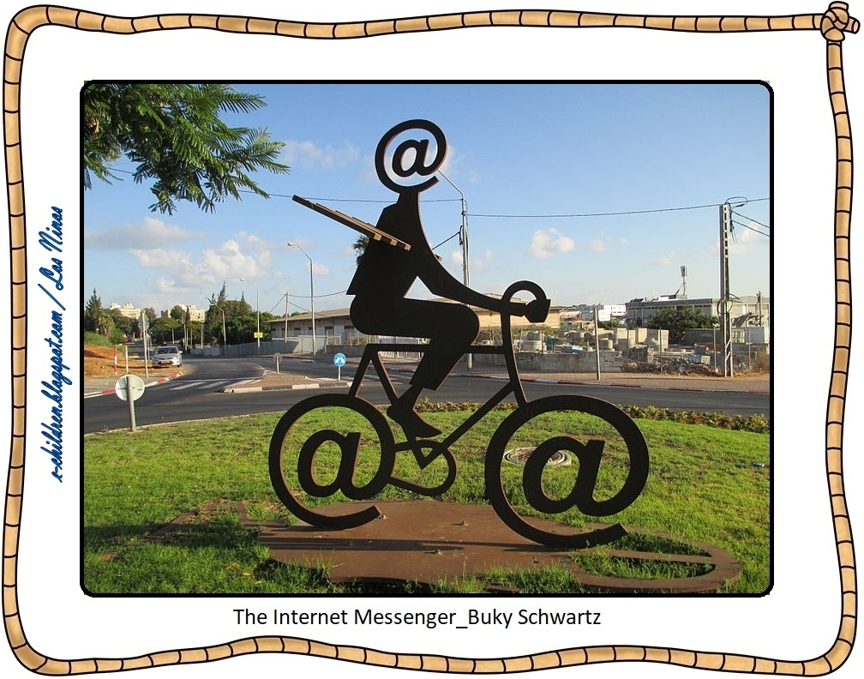
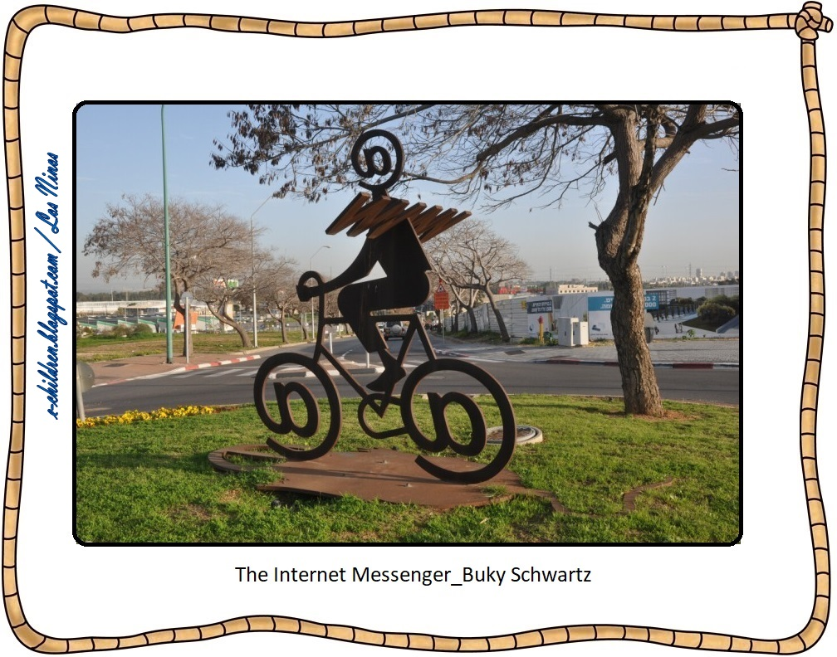

Slide 40
soft bubbles - by Pawel Kuczynski

Slide 41
good morning - by Pawel Kuczynski

Slide 42
Freedom - satirical illustration by Pawel Kuczynski

Slide 43
"Lunch atop a skyscraper“ by Pawel Kuczynski

Slide 44
fREE by Pawel Kuczynski

Slide 45
ISLANDS - by Pawel Kuczynski

Slide 46
Unkown

Slide 47
Unkown

Slide 48
Unkown

Slide 49
Unkown

Slide 50
Unknown

Slide 51
Unknown

Slide 52
Unknown

Slide 53
Unknown

Slide 54
Unknown

Slide 55
Unknown

Slide 56
Unknown

Slide 57
Unknown

Slide 58
Unknown

Slide 59
Unknown

Slide 60
Unknown

Slide 61
Unknown

Slide 62
Unknown

Slide 63
Unknown

Slide 64
Internet Safety project Viv Owen

Slide 65
Internet Safety project Viv Owen

Slide 66
Ευχαριστούμε

