Slide 1
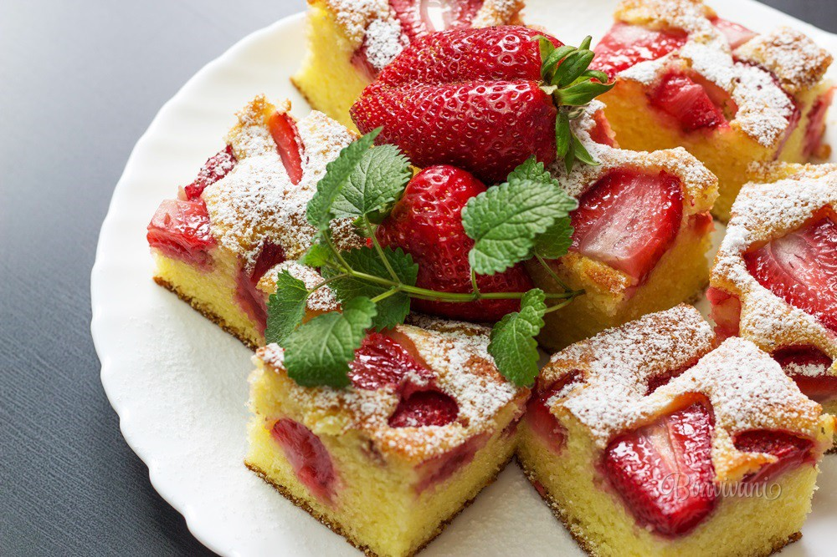
BUBLANINA
Lesana Hrnčárová Príma A

Slide 2
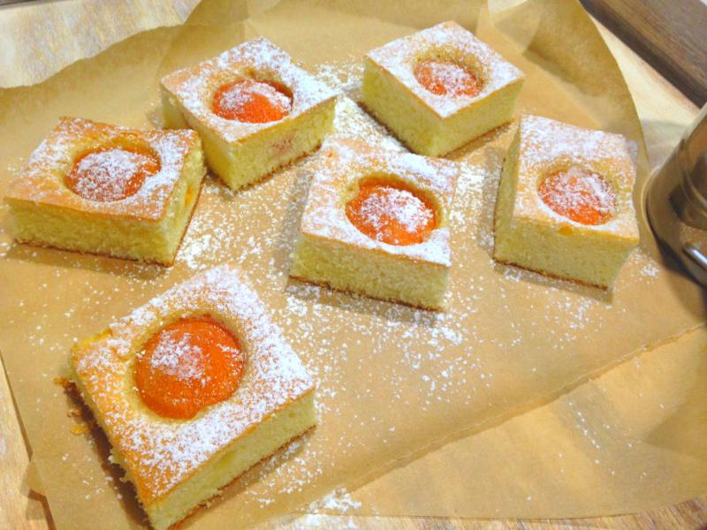
YOU CAN CHOOSE:
STRAWBERRY
CHERRY
BLUEBERRY
CURRANT
APRICOT

Slide 3
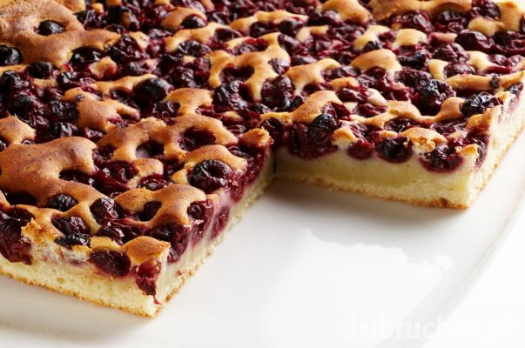
INGREDIENTS:
300g semi-thick flour
200g powder sugar
3 eggs
1 baking soda
1 vanilla sugar
1dl oil
2dl milk
1 cup of fruit

Slide 4
steps:
We whip sugar with eggs
We add oil, milk, flour with baking soda and vanilla sugar
We pour out to a baking tray (greased or on baking paper)
We lay out fruit and put into the preheated oven
We bake at 180 degrees
When it is baked, let it cool and then sprinkle powder sugar on it

Slide 5
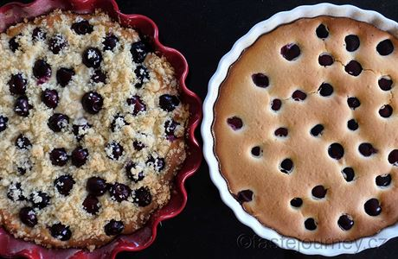
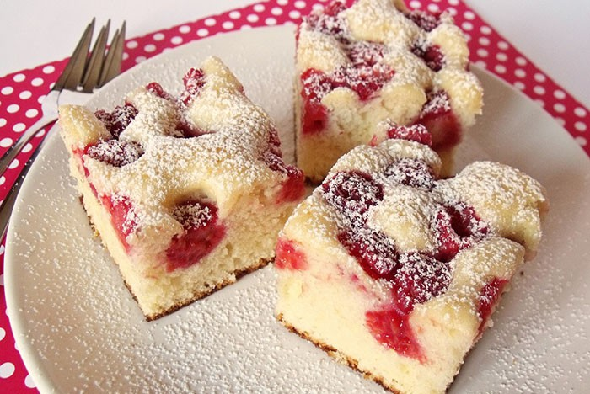
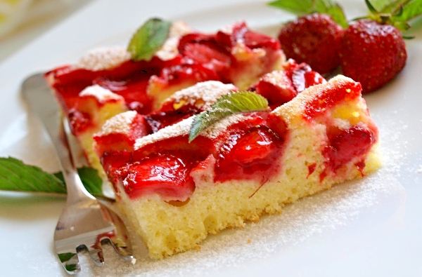
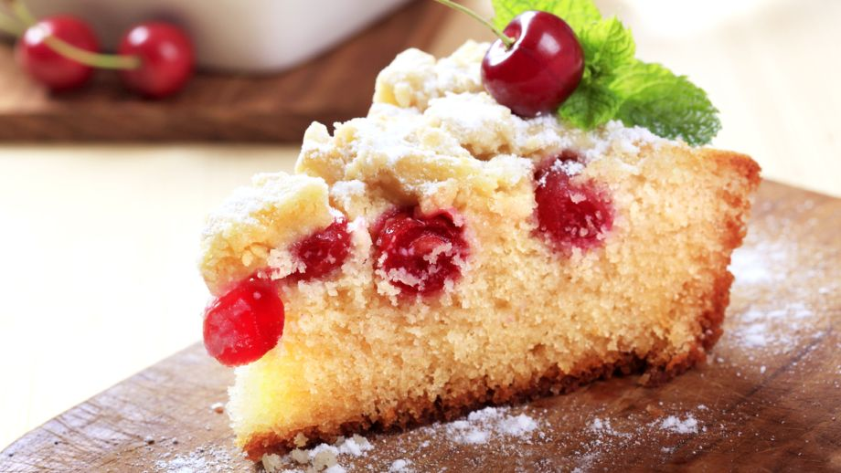

Slide 6
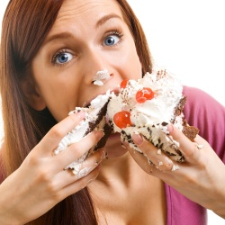
AND NOW WE EAT!!!!!

Slide 7
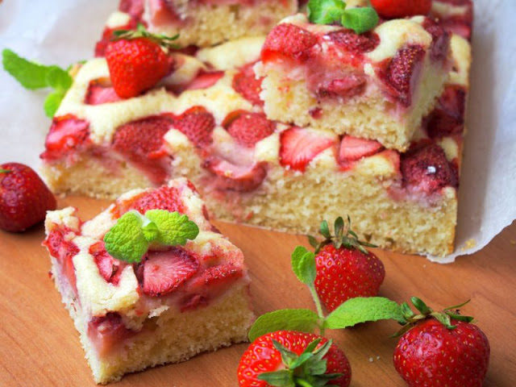
Thank’s for watching

