Slide 1
Babovka Cake
Sebastian Vaško
Da Silva

Slide 2
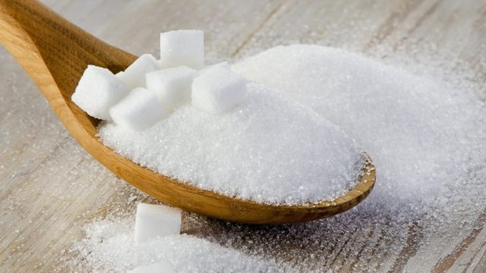
Ingredients
250 g self-riasing flour
4 eggs (separated eggs , 130 ml milk)
130 ml oil (sunflower or vegetable)
a handful of sultanas or raisins
1 tea spoon cocoa powder
a little vanilla extract or some grated lemon peel
butter and semolina for tin preparation
180 g caster sugar

Slide 3
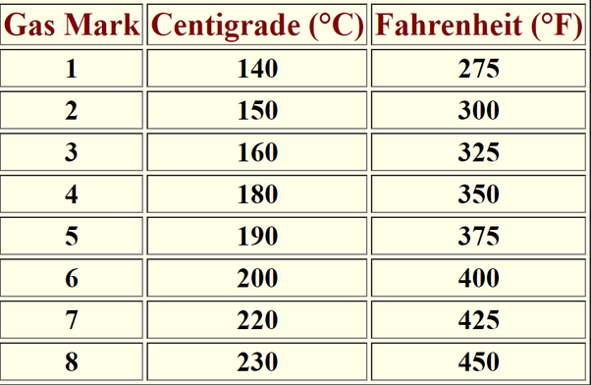
1. step
Grease the inside of the babovka tin and dust with semolina. Preheat your oven to 180 ºC, gas mark 4

Slide 4
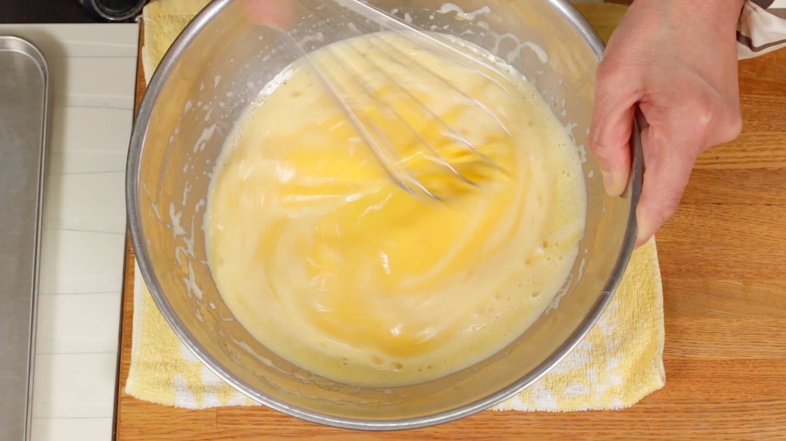
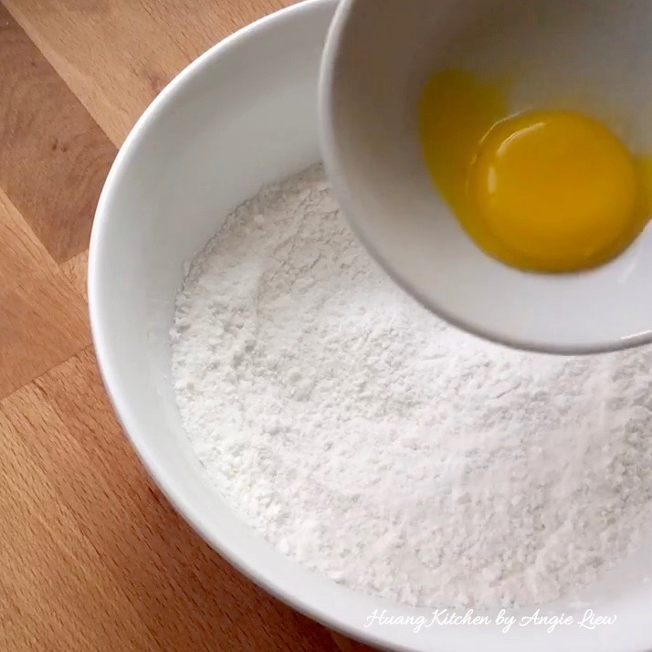
2.step
Mix the flour, sugar, egg yolks, oil and milk in a mixing bowl. Add the vanilla extract and/or grated lemon peel. Add as many sultanas as you like.

Slide 5
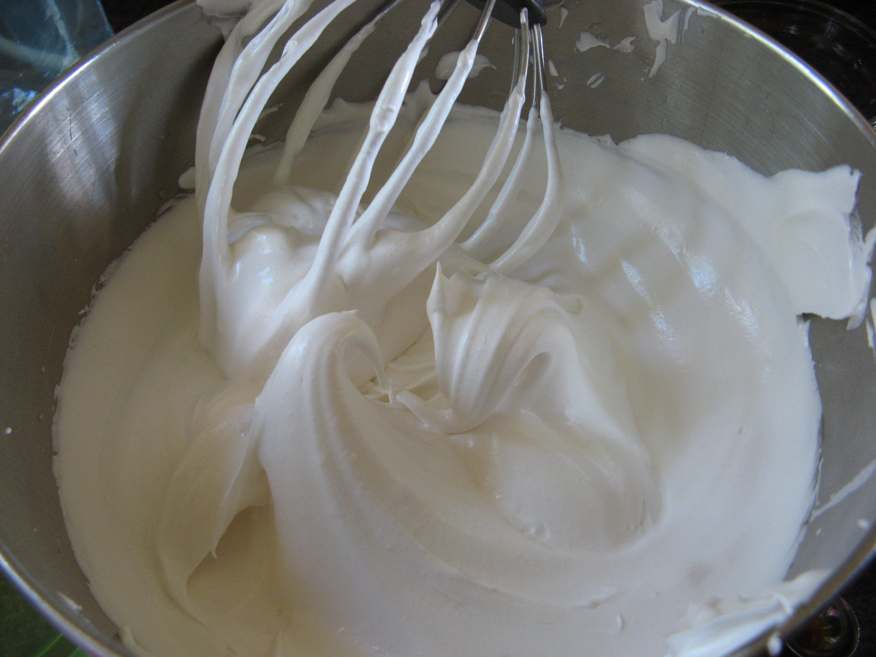
3 step
Beat the egg whites with a pinch of salt until they hold stiff peaks and add to the mixture.

Slide 6
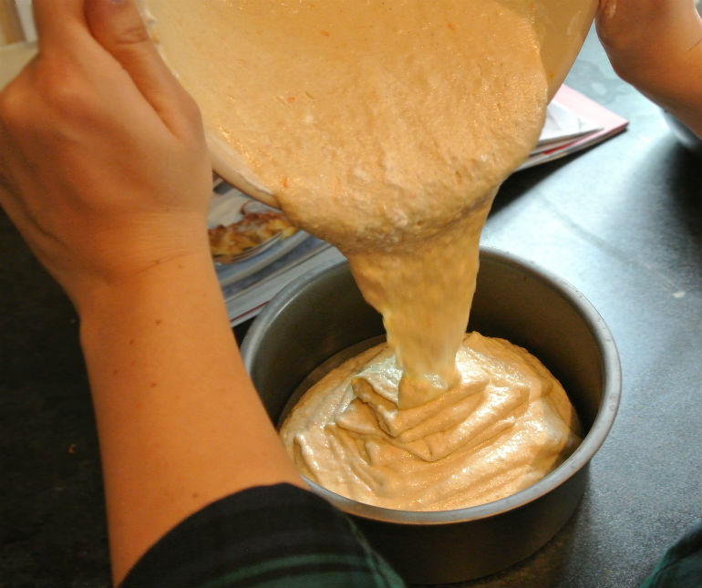
4. Step
Pour about 2/3 of the mixture into the prepared tin.

Slide 7
5 step
Mix the cocoa with a little warm water to a smooth paste.
Cool and add to the remaining mixture.
Pour the cocoa mixture into the tin.

Slide 8
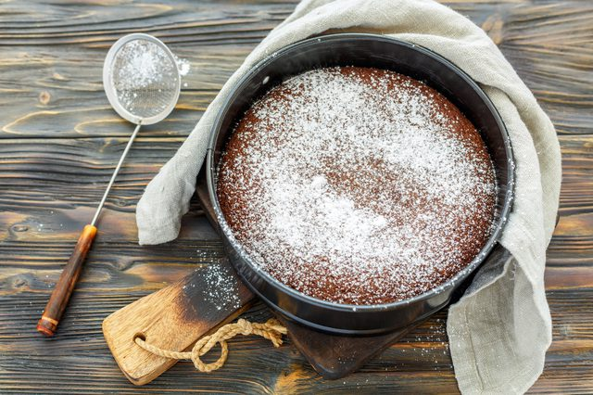
Last step
Bake in the middle of the oven for 35 - 40 minutes.
Take out, let cool down for 10 minutes and turn out onto a plate or tray.
Dust with icing sugar.

Slide 9
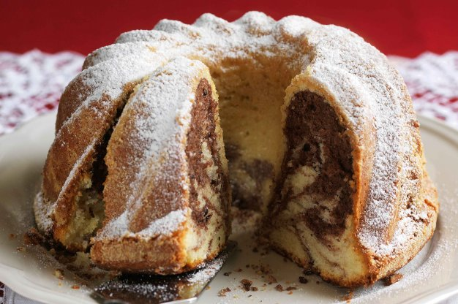
This is completed babovka

Slide 10
Thank you for attention

