Slide 1
Travel Itinary Tallinn 23-27 September 2019

Slide 2
Departure from Hamburg airport to tallinn via Copenhagen
Getting on the plane at 9:15h.

Slide 3
Everybody is excited on the plane

Slide 4
Happy arrival at Copenhagen – first leg!

Slide 5
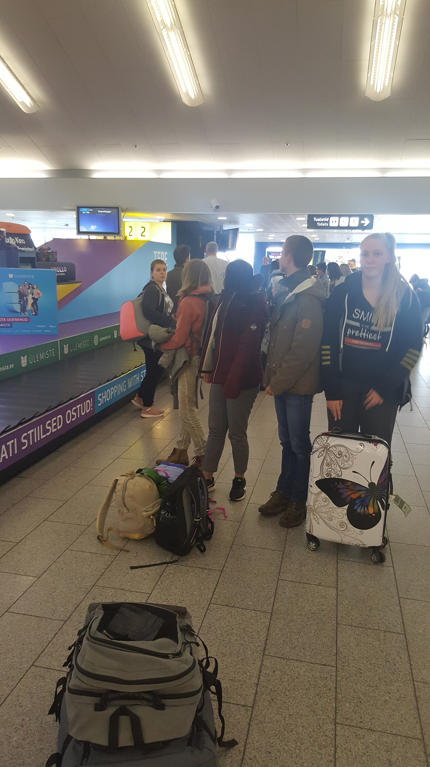
Finally we reach Tallinn at 4:30 p.m. – together with the French team!

Slide 6
Warm welcome by our Estonian hosts!

Slide 7
A very (too) early departure from Tallinn at 6:30 a.m. We will be back at home in Neumuenster 11:30 a.m. with lots of happy memories from an exciting exchange week in Estonia!

