Slide 1
Estonia
Erasmus+

Slide 2
Travelguide
Per person: 3282 DKK

Slide 3
Research - good to know - known for
Estonia capital is Tallinn ( formerly known as Reval )
There live about 434.563 in Tallinn and in Estonia is there about 1,316 milion
Tallinn means “danskernes by” - “the city of Danish”
Public transport is free, for the the citizen in Tallinn, but as a visitor you will need a guest card

Slide 4
Attractions
Alexander Nevsky Cathedral.
Vanalinn (Oldest part of town)
Kadriorg Palace - Art museum

Slide 5
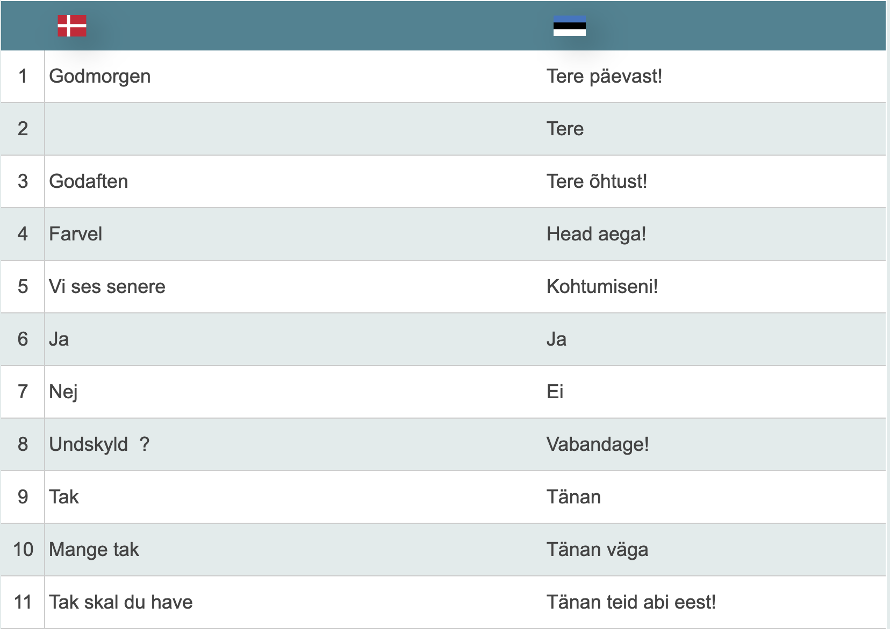
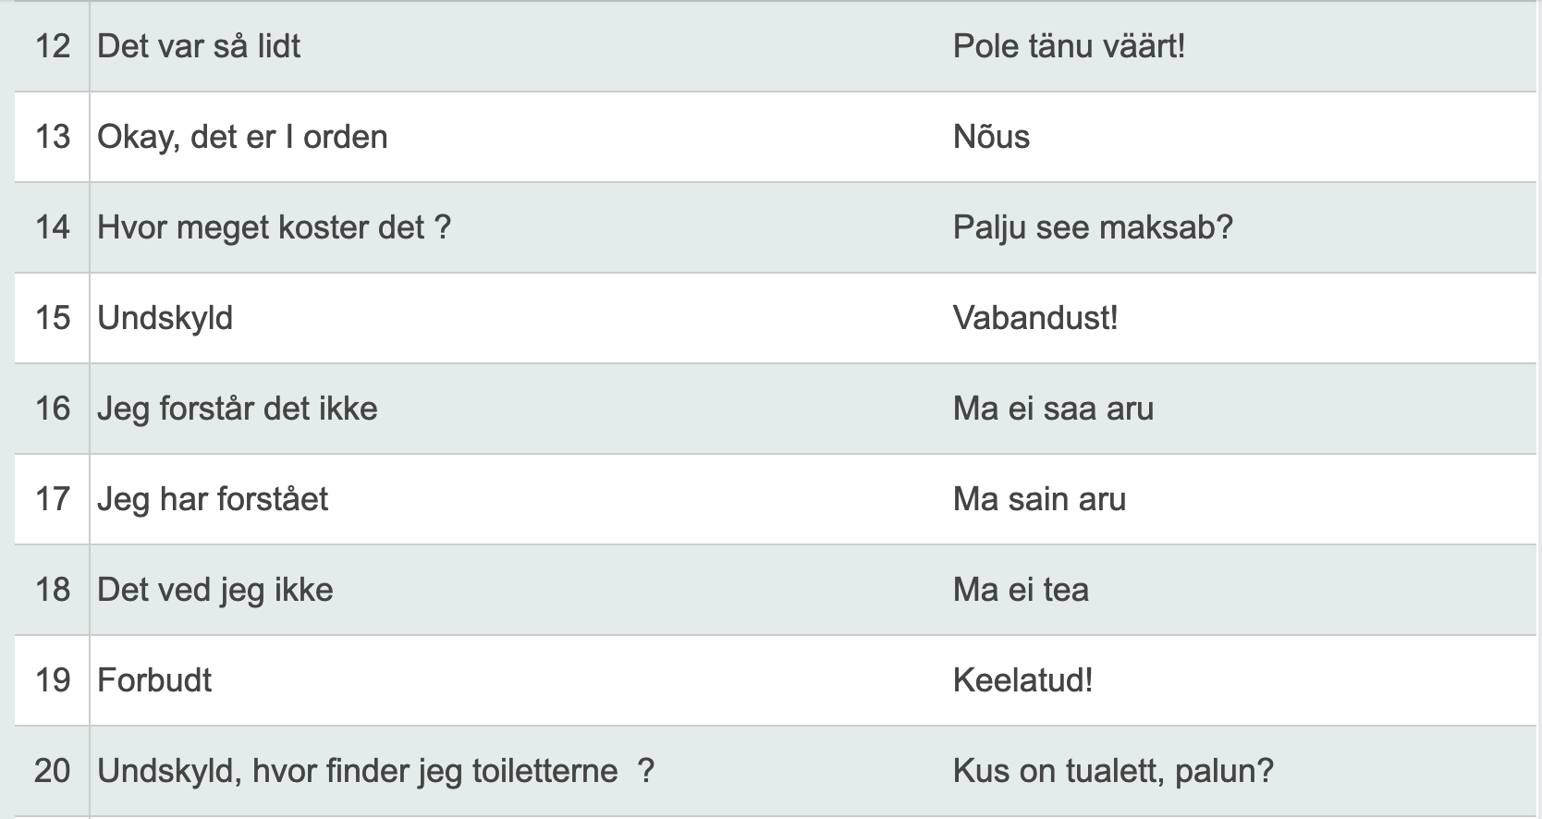
Useful phrases - https://www.loecsen.com/da/ordforrad-estisk

Slide 6
Movie
https://youtu.be/J-v5i-UVcds

