Slide 1
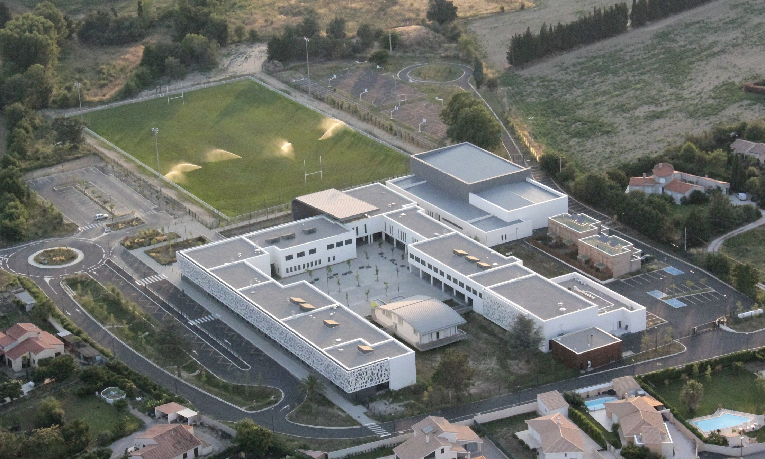
Welcome to
our celebration for
the Erasmus days
Our school is proud to be European

Slide 2
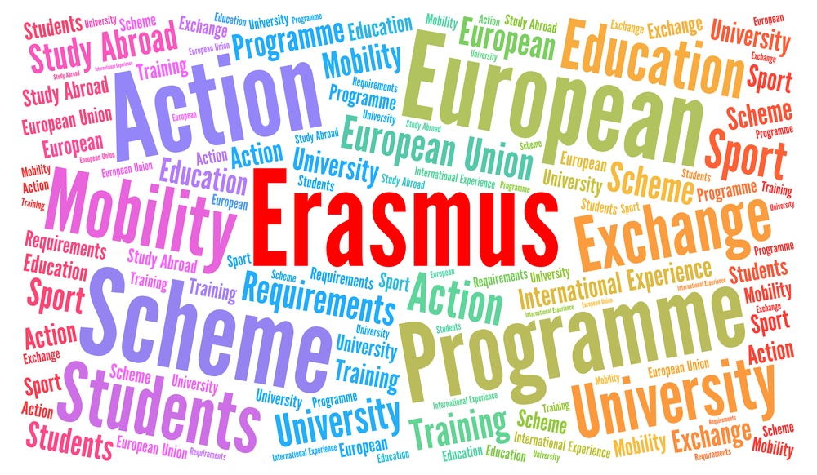
What is « Erasmus »?
It’s a European program that brings together different schools from different European countries and makes them work together on a project.
And in our school?
The « cinquième » classes are going to work with 5 countries in Europe to show how Europe is beautiful and important.

Slide 3
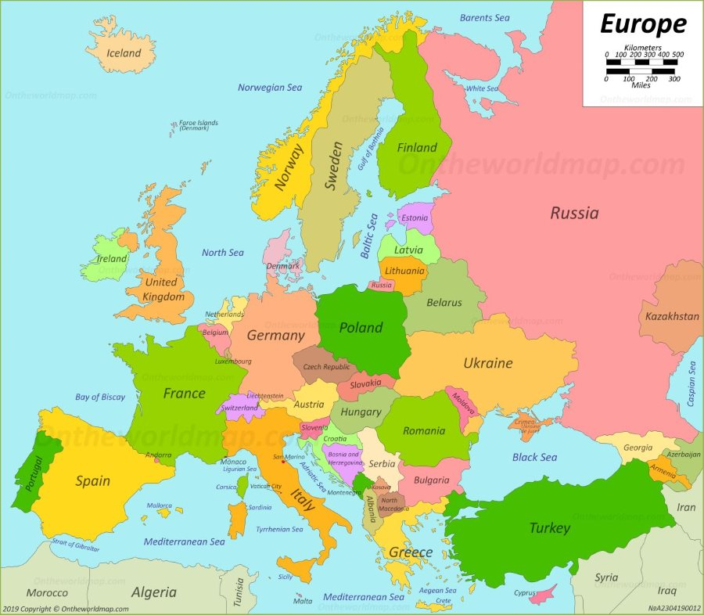
Germany
Poland
What countries?
Latvia
Italy
Portugal

Slide 4
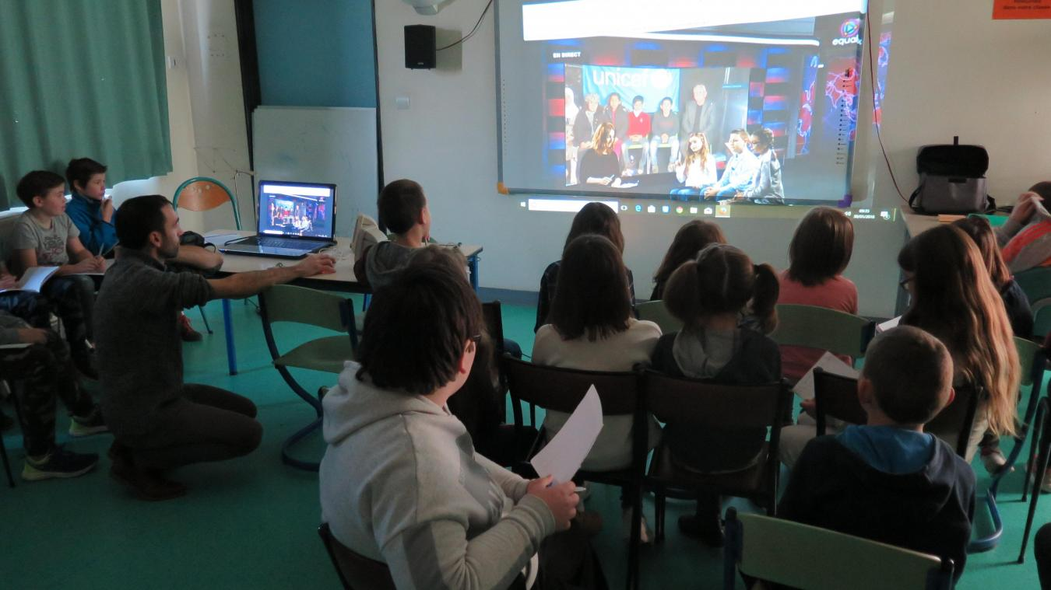
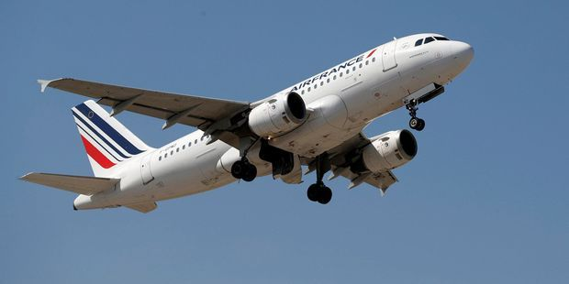
Are the « 5èmes » going to meet their partners?
Yes :
we are going to organise videoconferences with them
Some students will be able to travel to these countries : they will be our school ambassadors, and they will be hosted by families.

Slide 5
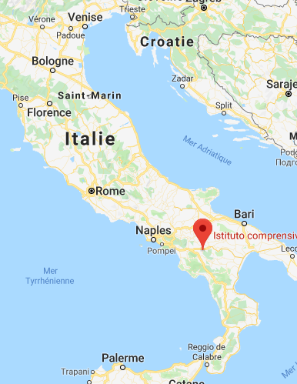
When are they going to travel?
First, some students will go to the Instituto Comprensivo Statale in
Satriano di Lucania
in March 2020

Slide 6
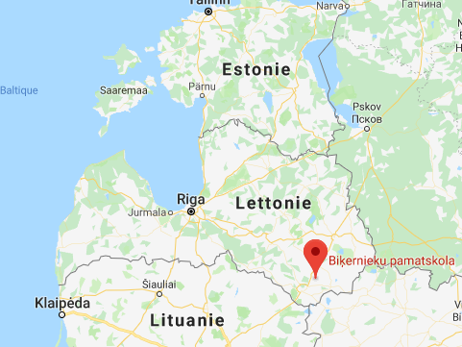
Then others will go to Bikernieku Pamatskola, in Bikernieki …
…in May 2020

Slide 7
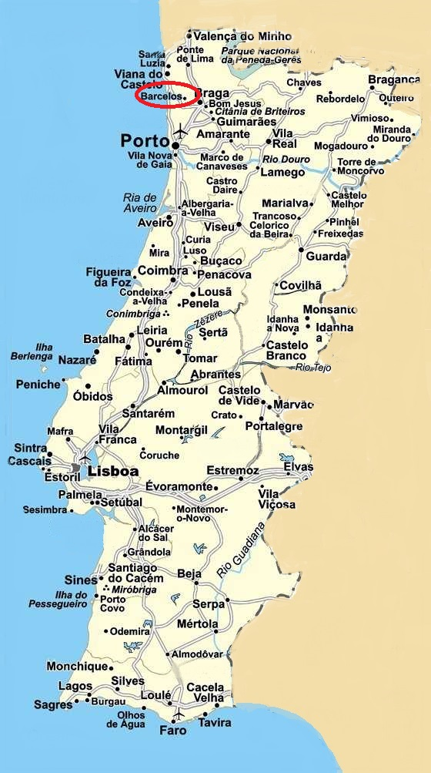
Then next year, when the students are in « 4ème »…
…they will to to the Agrupamento de escolas Rosa Ramalho in Barcelos
in October 2020

Slide 8
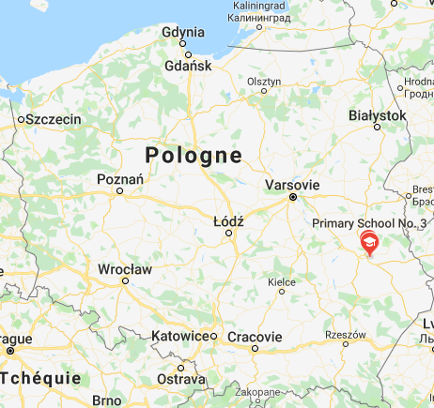
Then they will go to the
Skola Podstawowa
in Swidnik
in December
2020

Slide 9
Finally, the last ambassadors will go to the Oberschule Papenteich
Gross in Schwülper
in March 2021

Slide 10
Will the European partners come to Millas?
Yes, they will, and as we are the coordinators of the project, when they come it will be the end of the project!
They will all come in May 2021 for a week : it’ll be a very special week for everybody in the school.

Slide 11
The « 4èmes » classes will show you their work :
A film which will show how Europe has a rich culture
An exhibition that will relate all the experiences lived bay the ambassadors
And other works shared with our partners!
And they will tell you how much…
…they are proud to be European!

Slide 12
The « 4èmes » classes will show you their work :
A film which will show how Europe has a rich culture
An exhibition that will relate all the experiences lived bay the ambassadors
And other works shared with our partners!
And they will tell you how much…
…they are proud to be European!

